Slide 1


SARVAJANIK COLLEGE OF ENGINEERING AND TECHNOLOGY
Topic: Generalized Effects of Social Networking
Subject: Communication Skills (2110002)
Department: Computer Engineering (2110007)
Guided by: Prof. Shivani Joshi, Prof. Chintan Shinde
Prepared by: (Roll no.)
47. Ms. Shreya Gamit
48. Mr. Amul Luniya
51. Mr. Abhishek Chavda
52. Mr. Jainam Shah
53. Mr. Shyam Khokhariya
54. Mr. Deep Gandhi

Slide 2

GENERALIZED EFFECTS OF SOCIAL NETWORKING

Slide 3
INDEX
Introduction to social media & networking 04
Types of Social Networking 06
On whom does it effect? 07
Positive effects 08
Negative effects 13
Conclusion 19

Slide 4
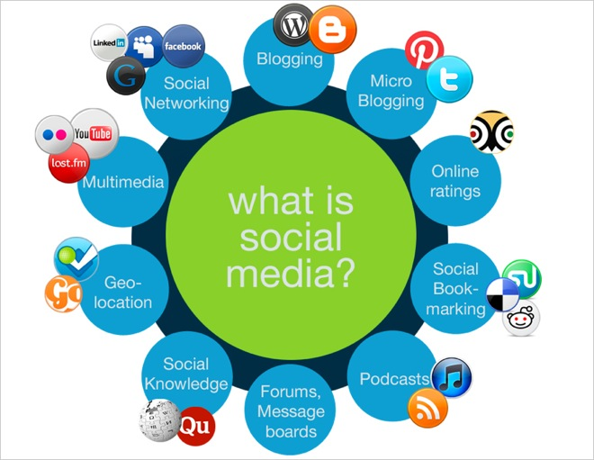

Slide 5


INTRODUCTION- What is it?
Used to build social networks or
social relations with other people
who share similar personal or
career interests, activities, backgrounds
or real-life connections through many
sites.

Slide 6
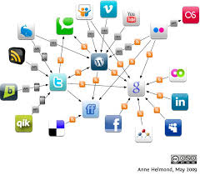
Types Of Social Networking
Social connections
Multimedia sharing
Professional
Informational
Educational
For hobbies and academics

Slide 7
On Whom Does It Effect?
Youth (Adolescents)
Children
Media
Entrepreneurs and Bachelors
Business
Professions
Studies
Society as whole

Slide 8
Positive Effects
Widening business and marketing and collaboration
Reduces communication barrier for many people who are introvert
Unite people on a huge platform for achievement of some specific objective
Gaining knowledge, news and event updates, even if you are in a remote area
Broadcasting and information transfer on large scale
Enhances and promotes creativity
Reduces boredom

Slide 9

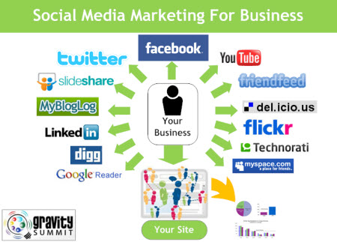
Marketing
Helps in beginning a start-up
Helps in broadcasting the business
to a big crowd easily
Creates a suitable and larger
environment space for customers with
the shopping point of view

Slide 10

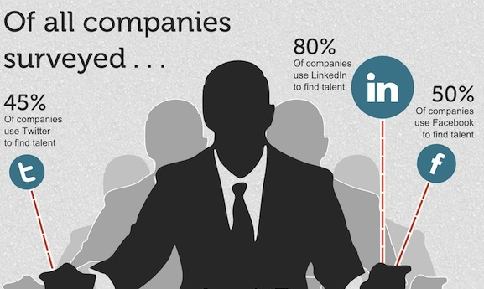
Job hunting
Social networking sites help the unemployed persons to find jobs
on various sites available which
offer different posts in their
companies.

Slide 11

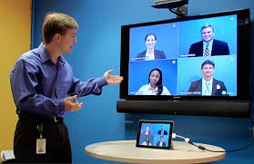
Video conferencing
Another benefit is this.
People can have discussions, teachings, addressings, etc.
While being at anywhere else away from the first spot.

Slide 12
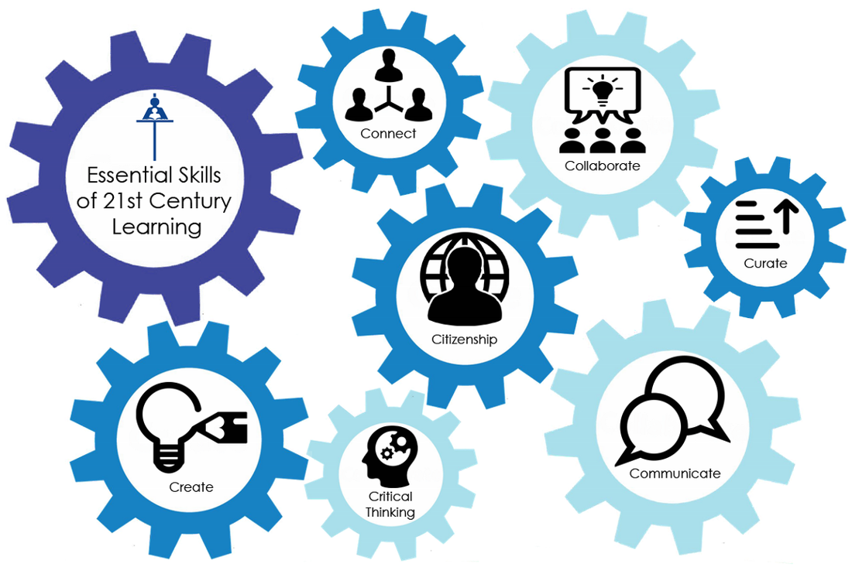

Slide 13
Negative Effects
Waste of time
Harassment
Reduction in physical activities
Illegal acts, crimes, viral attacks
Kids and teenagers are also involved in crime
Increased comparison resulting into de-motivation and depression sometimes

Slide 14

Cyber-bullying
Act of harming or harassing
via IT networks in a repeated
and deliberate manner seeking to control, manipulate, put down, falsely discredit, or humiliate the recipient.

Slide 15

Addiction
Internet Shopping, online gaming, online chatting can be addictive.
Social media addiction can be stronger than addiction to cigarettes
and booze.

Slide 16
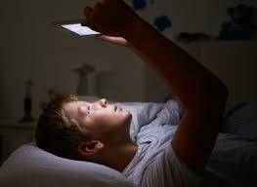

Effect on Health
Damage to eyes and insomnia
Attention deficit
Reduced concentration
Schizoaffective disorders
Body dysmorphia
Narcissistic personality disorder

Slide 17
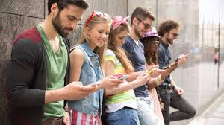

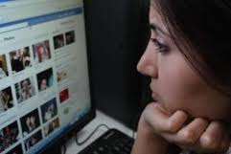
Engrossing
The social networking sites are
too engrossing as they highly involve people.
It makes them access for
longer time making them lose themselves into that huge world.

Slide 18
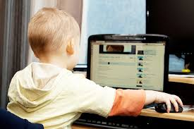


It captivates children
Talking about the effect on children,
Social networking is on a
high rise amongst the innocents
who fall prey to it.
Children give it priority over
other things like studies, sports, etc.

Slide 19
CONCLUSION

Slide 20
THANK YOU

