Slide 1


SARVAJANIK COLLEGE OF ENGINEERING AND TECHNOLOGY
Topic: Money
Subject: Engineering Economics & Management
Department: Computer Engineering (2110007)
Guided by: Prof. Mahesh Trivedi
Prepared by: Amul Luniya

Slide 2
Contents
Money – Introduction
Functions of Money
Types of Money
Monetary Policy
Fiscal Policy

Slide 3
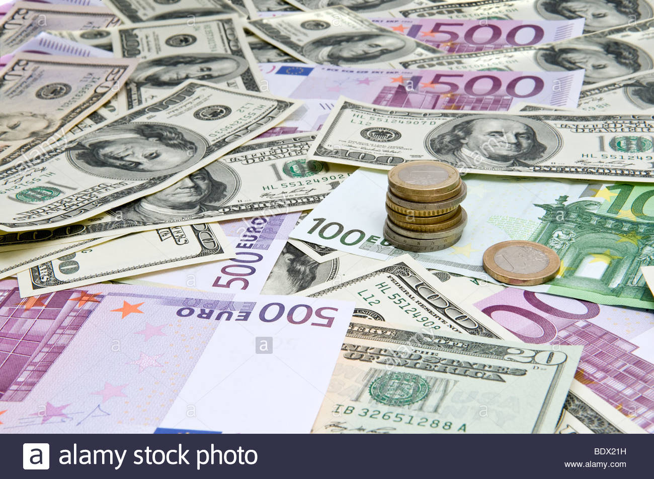
MONEY

Slide 4
Money – Introduction
Money is a medium of exchange developed to pay or accept any goods or services.
Since money is standard, it avoids the inefficiencies of a barter system.
It is either in the form of coins or cash. Amount of money with a person or institution determines its wealth.
Each country has its own currency

Slide 5
In economics, money is define it as something that serves as a medium of exchange, a unit of accounting, and a store of value. Money, as a medium of exchange, is accepted for making transactions all over. As a unit of accounting, money provides a simple device for identifying and communicating value.

