Slide 1


SARVAJANIK COLLEGE OF ENGINEERING AND TECHNOLOGY
ACTIVE LEARNING ASSIGNMENT – EME (210006)
TOPIC: ROTARY PUMPS
DEPARTMENT: COMPUTER (M)
SUBMITTED BY: AMUL LUNIYA (48)
SHREYA GAMIT (47)
SUBMITTED TO: PROF. UMANG GAJJAR

Slide 2
Contents
Introduction to rotary pump– a category of positive displacement pump
Types of P.D. Pumps
Rotary Pump
Working principles and features
Types of rotary pumps
External Gear Pump
Internal Gear Pump
Lobe Pump
Vane Pump
Screw Pump

Slide 3
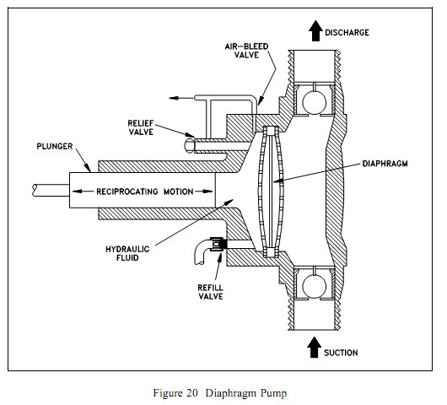
Introduction – a category of positive displacement pump
Positive displacements pumps apply pressure directly to the liquid by a reciprocating piston or rotating members.
Uses –
Can handle shear sensitive liquid
Use for high pressure application
Use for variable velocity applications

Slide 4
Types of P.D. Pumps
On the basis of mechanism used for the movement of fluid, positive displacement pumps are classified into:
1. Rotary type P.D. pumps –
e.g. Gear pump, screw pump, etc.
2. Reciprocating type P.D. pumps –
e.g. Plunger pump, piston pump, etc.
3. Linear type P.D. pumps –
e.g. Rope pumps, chain pumps, etc.

Slide 5
Rotary Pump
In rotary pumps, the chamber moves from inlet to discharge and back to the inlet. A wide variety of rotary pumps are available like –
Gear pumps
Lobe pumps
Screw pumps
Vane pumps
Cam pumps

Slide 6
What it does?
Makes a fluid move by trapping a fixed amount and forcing (displacing) that trapped volume into the discharge pipe.
The fluid can be transported horizontally as well as vertically (upwards).
A rotary pump does so by using different mechanisms, i.e. by using pistons, rotating devices, etc.

Slide 7
Working principles and features
Fluid is trapped in the fixed volume cavity through an inlet
Cavity closes, fluid squeezed through an outlet
A direct force is applied to the confined liquid
Flow rate is related to the speed of the moving parts of the pump and is controlled by the drive speed of the pump
In each cycle (pulsating or periodic) the fluid pumped equals the volume of the cavity
Allows transport of highly viscous fluids
Performance almost independent of fluid viscosity

Slide 8
Types of rotary pumps
Single rotor
Multiple rotors
Sliding vane pump
Flexible tube or lining
Screw pump
Radial pump
Gear pump
2 Lobe pump
3 Lobe pump

Slide 9
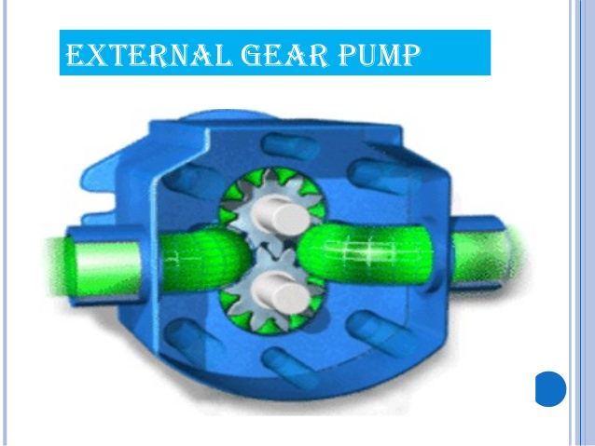
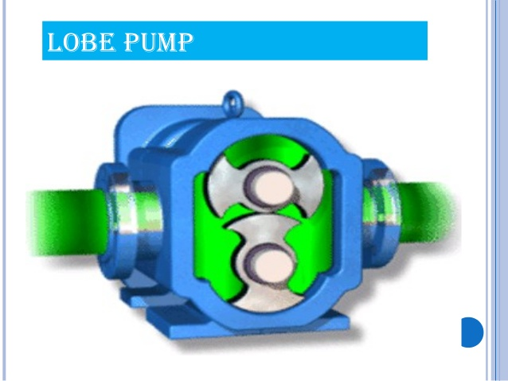
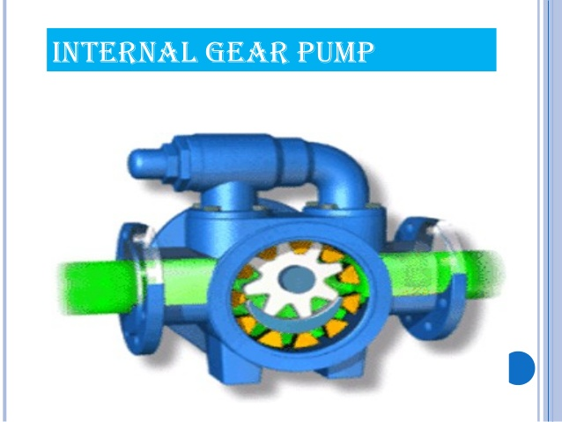
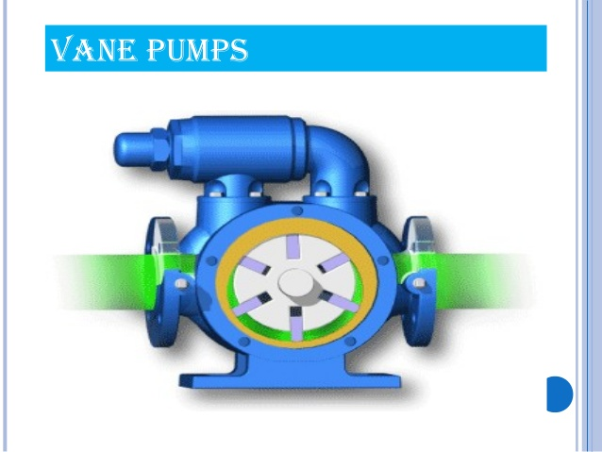

Slide 10
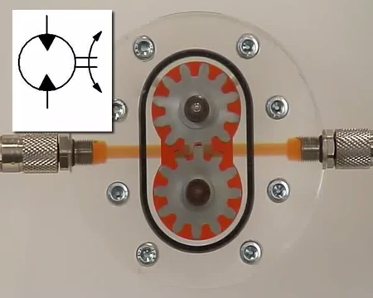
External Gear pump

Slide 11
Applications
Common external gear pump applications include:
Various fuel oils and lube oils
Chemical additive and polymer metering
Chemical mixing and blending (double pump)
Industrial and mobile hydraulic applications (log splitters, lifts, etc.)
Acids and caustic (stainless steel or composite construction)
Low volume transfer

Slide 12
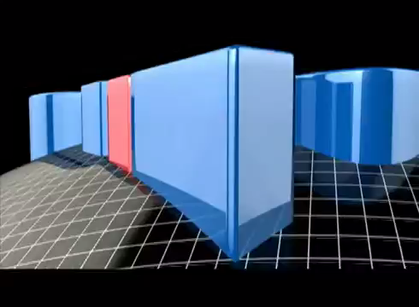
Internal Gear Pump

Slide 13
Applications
Common internal gear pump applications include:
All varieties of fuel oil and lube oil
Resins and polymers
Alcohols and solvents
Asphalt, Bitumen and Tar
Polyurethane foam (Isocyanate and polyol)
Paints, inks and pigments
Soaps and surfactants
Glycol
Food products such as corn syrup, peanut butter and chocolate

Slide 14
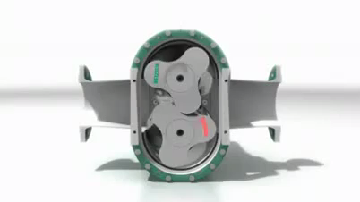
Lobe Pump

Slide 15
Applications
Applications of rotary lobe pump include:
Polymers
Paper coatings
Soaps and surfactants
Paints and dyes
Rubber and adhesives
Pharmaceuticals
Food applications

Slide 16
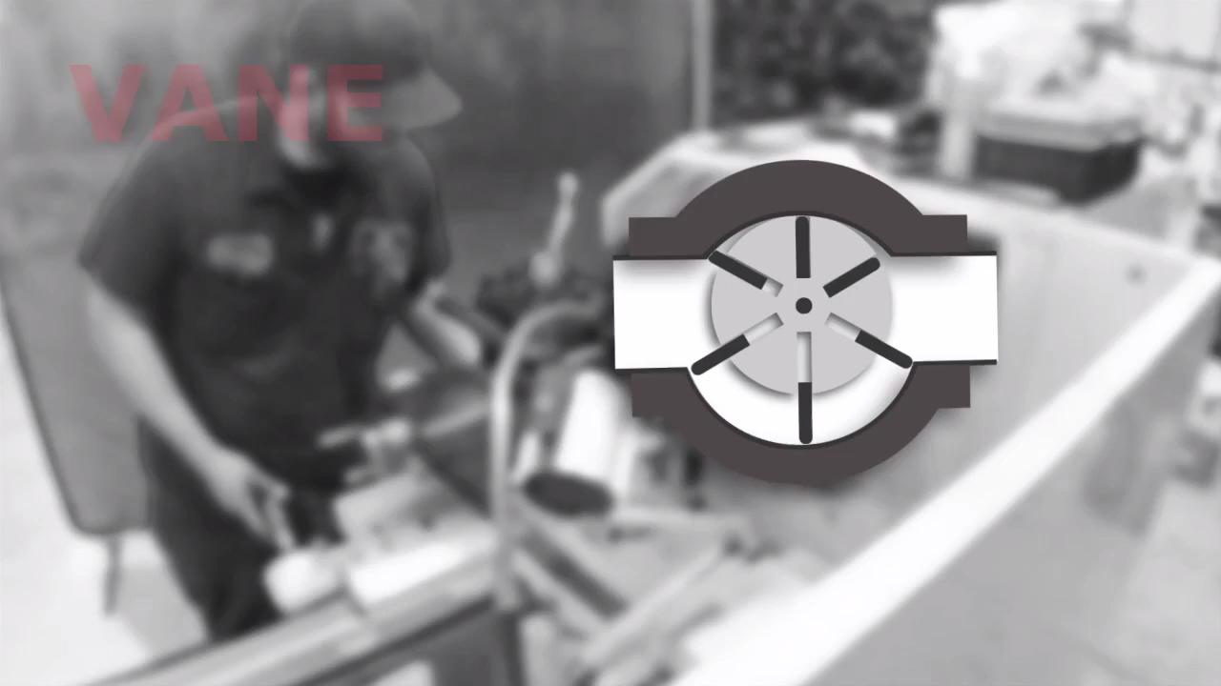
Vane Pump

Slide 17
Applications
Vane pumps find following applications:
Aerosol and propellants
Aviation service – Fuel transfer, Deicing
Auto industry – Fuels, lubes
Refrigeration coolants, Freon, Ammonia
Bulk transfer of LPG and NH₃ .
LPG cylinder filling
Alcohols and solvents
Aqueous solutions

Slide 18
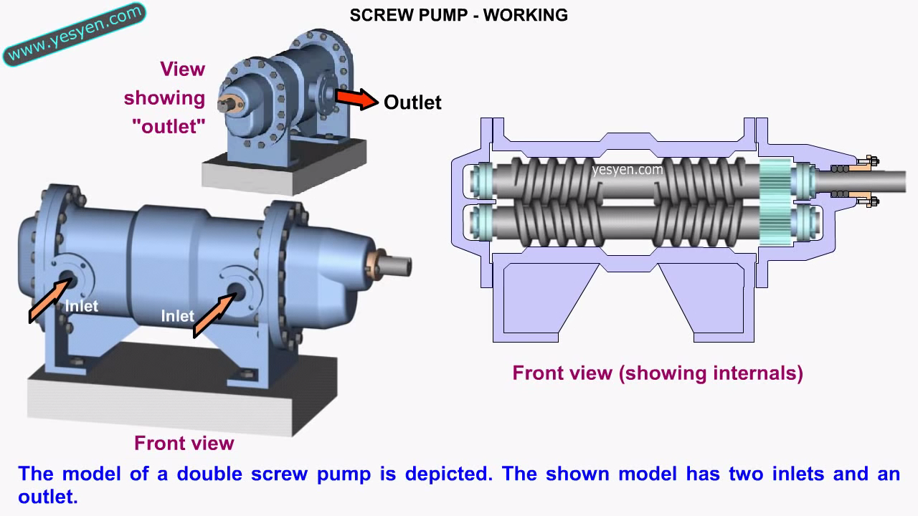
Screw Pump

Slide 19
Applications
Screw pumps find following applications:
Multiphase applications
Crude oil/Water emulsion
Transporting and refining more unconventional, heavier grades of crude oil.
Irrigation systems
Agricultural machinery for transporting grain
Fuel-injection
Oil burners
Hydraulics
Lubrication and circulation

Slide 20
Thank You
For your cooperation

