Slide 1


SARVAJANIK COLLEGE OF ENGINEERING AND TECHNOLOGY
Topic : Graphs
Subject : Data Structures
Department : Computer Engineering (2110007)
Guided by : Prof. Urmi Desai
Prepared by :
Name | Enrollment number
Amul Luniya | 160420107003
Deep Gandhi | 160420107018
Dharmesh Lad | 160420107027
Nikhil Mulchandani | 160420107030

Slide 2
Contents
Introduction to Graph
Matrix Representation of graph
Graph Traversal
Types of Traversal
Spanning Trees
Minimal Spanning Tree
Shortest Path in Graph

Slide 3
What is a graph?
A data structure that consists of a set of nodes (vertices) and a set of edges that relate the nodes to each other
In simple way,
A graph G is defined as follows:
G=(V,E)
V(G): a finite, nonempty set of vertices
E(G): a set of edges (pairs of vertices)

Slide 4
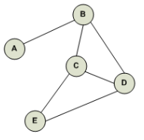
Undirected graphs
When the edges in a graph have no direction, the graph is called undirected
Example
Fig a.

Slide 5
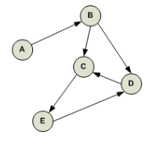
Directed Graphs
When the edges in a graph have a direction, the graph is called directed (or digraph)
Example
Fig b.

Slide 6
Matrix Representation of Graph
Matrix is a 2D array of size V x V where V is the number of vertices in a graph. Let the 2D array be adj[][], a slot adj[i][j] = 1 indicates that there is an edge from vertex i to vertex j.
Matrix is also used to represent weighted graphs. If adj[i][j] = w, then there is an edge from vertex i to vertex j with weight w.

Slide 7
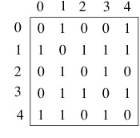
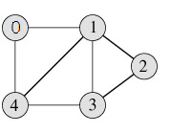
Example
Fig 1.
Matrix representation of Fig 1.

Slide 8
Graph Traversal
It’s the process of visiting (checking and/or updating) each vertex in a graph. Such traversals are classified by the order in which the vertices are visited.
There are two basic methods of traversing a graph –
1. Breadth-first Search
2. Depth-first Search

Slide 9
Breadth-first Search
Example –
Using QUEUE.
Sibling vertices visited before child vertices.
A
B
E
F
C
D
BfS Output – A, B, E, F, C, D
Often used to find the shortest path.
Notes:
A breadth-first search (BFS) is another technique for traversing a finite graph. BFS visits the neighbor vertices before visiting the child vertices, and a queue is used in the search process. This algorithm is often used to find the shortest path from one vertex to another.

Slide 10
Algorithm for ‘B-f S’
Insert (root)
While all nodes not visited
node = delete ()
print node, visit=true
insert all children of node into queue
End while

Slide 11
Depth-first Search
Using STACK.
Child vertices visited before sibling vertices.
Example –
A
B
E
F
C
D
DfS Output – A, B, C, D, E, F

Slide 12
Algorithm for ‘D-f S’
Push (root)
While all nodes not visited
node = pop()
print node, visit=true
push all children of node into stack
End while

Slide 13
Spanning Tree
A spanning tree is a subset of Graph G, which has all the vertices covered with
minimum possible number of edges. Hence, a spanning tree does not have cycles and it cannot be disconnected..
By this definition, we can draw a conclusion that every connected and undirected Graph G has at least one spanning tree. A disconnected graph does not have any spanning tree, as it cannot be spanned to all its vertices.

Slide 14
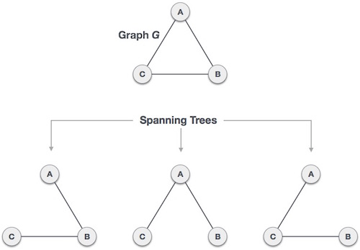
Spanning Tree

Slide 15
Number of Spanning Trees in a Graph
We found three spanning trees off one complete graph. A complete undirected graph can have maximum n^{n}-2 number of spanning trees, where n is the number of nodes. In the above addressed example, 3³−2 = 3 spanning trees are possible.

Slide 16
Properties of Spanning Tree
A connected graph G can have more than one spanning tree.
All possible spanning trees of graph G, have the same number of edges and vertices.
The spanning tree does not have any cycle (loops).
Removing one edge from the spanning tree will make the graph disconnected, i.e. the spanning tree is minimally connected.
Adding one edge to the spanning tree will create a circuit or loop, i.e. the spanning tree is maximally acyclic.

Slide 17
Minimum Spanning Tree
In a weighted graph, a minimum spanning tree is a spanning tree that has minimum weight than all other spanning trees of the same graph. In real-world situations, this weight can be measured as distance, congestion, traffic load or any arbitrary value denoted to the edges.

Slide 18
Applications Of MST
Design of Networks
Telecommunication Networks
Finding road networks in satellite
Cancer imaging
Electrical board circuit design
And many more…

Slide 19
Floyd Warshal’s Algorithm
To find the shortest path between any 2 points in a weighted graph
A dynamic programming approach
Optimal substructure property
Solving subproblems for optimal answer

Slide 20
Algorithm
Initialize the solution matrix as the input graph matrix
Then we update the solution matrix by considering all vertices as an intermediate vertex. The idea is to one by one pick all vertices and update all shortest paths which include the picked vertex as an intermediate vertex in the shortest path.
When we pick vertex number k as an intermediate vertex, we already have considered vertices {0, 1, 2, .. k-1} as intermediate vertices.

Slide 21
Algorithm (contd..)
For every pair (i, j) of source and destination vertices respectively, there are two possible cases.
1) k is not an intermediate vertex in shortest path from i to j. We keep the value of dist[i][j] as it is. 2) k is an intermediate vertex in shortest path from i to j. We update the value of dist[i][j] as dist[i][k] + dist[k][j].

Slide 22
Algorithm (contd..)
Suppose there are m nodes in the weighted graph
Repeat for i,j in 1 to m
If W(i,j)=0 then Q(i,j)=infinite
else Q(i,j)=W(i,j)
Repeat step 3 & 4 for k in 1 to m
Repeat step 4 for i in 1 to m
Repeat for j in 1 to m
Q(i,j) = min(Q(i,j),Q(I,k) + Q(k,j))
End repeat.
Time complexity- O(m^3) ,where m:number of nodes

Slide 23
IMPLEMENTING FLOYD WARSHAL’S ALGORITHM
#include<stdio.h>
#define N 4
#define for(i,a,b) for(i=a;i<b;i++)
#define INF 99999
void floydWarshal(int [][N]);
int min(int a,int b);
int main()
{
int i,j;
int initial[N][N]={{7,5,INF,INF},{7,INF,INF,2},{INF,3,INF,INF},{4,INF,1,INF}}; //initial matrix representation of graph
floydWarshal(initial); //FUNCTION CALL
return 0;
}
int min(int a,int b)
{ return (a<b?a:b);}

Slide 24
void floydWarshal(int q[N][N])
{
int i,j,k;
for(k,0,N)
{
for(i,0,N)
{
for(j,0,N)
{
if(q[i][k]==INF || q[k][j]==INF)continue;
q[i][j]=min(q[i][j],q[i][k]+q[k][j]); //considering k vertex as intermediate
}
}
}
for(i,0,N)
{
for(j,0,N)
{
printf("%d ",q[i][j] );
}
printf("\n" );
}}

Slide 25
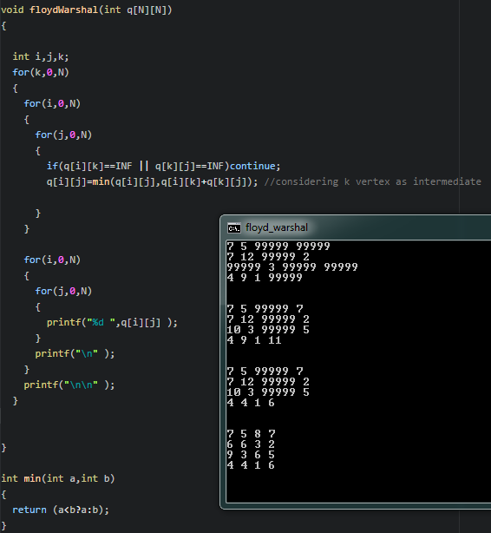
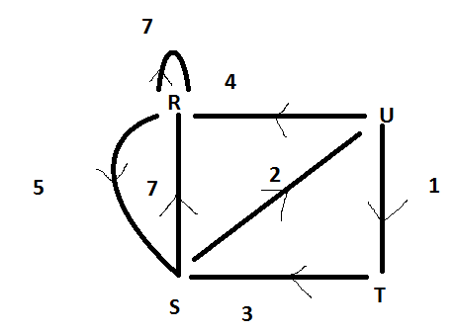
EXAMPLE
The step-by-step matrix output

Slide 26

THANK YOU

