Slide 1

Dataset Name: HR Attrition Data
Description :There are around 35 Variables out of which 3 variables are quantitative rest of them are categorical.
And Attrition is our depended variable and rest of them are independent.
Objective: Main causes of attrition in an organization department wise and there predictions.

Slide 2

Divided the datasets based on the three departments available .
Removed most of the feature’s using IV value function which tells whither the feature’s are strong or weak in predictions ,it is used mainly for reduction of dimensionality from the dataset.
Technical graduates have high attrition rate in all the departments as can be seen from the next graph.

Slide 3

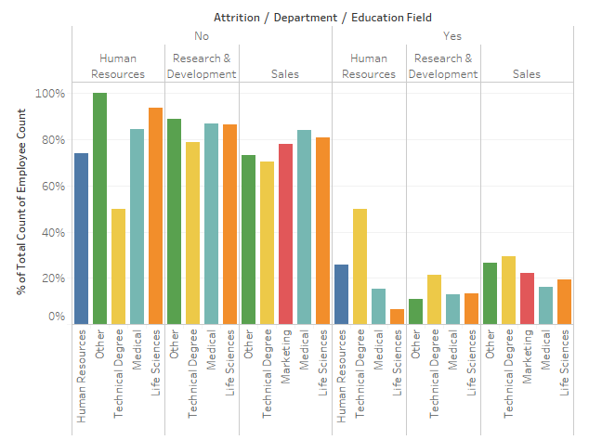

Slide 4


Main code which gives the Significance levels of the features for each of the Departments.
Almost same for all the departments.

Slide 5

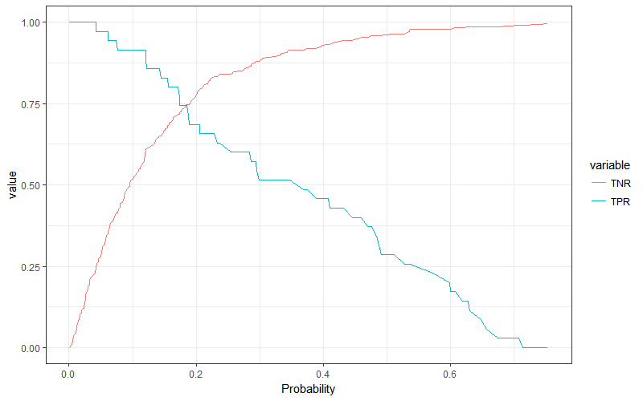

Slide 6
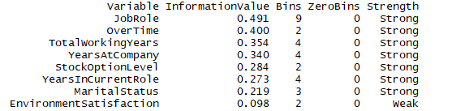

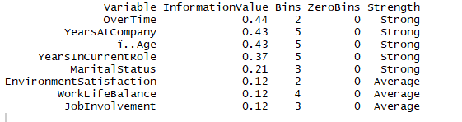
Strong predictors for research dept
Strong predictors for HR dept
Strong predictors for Sales dept

Slide 7
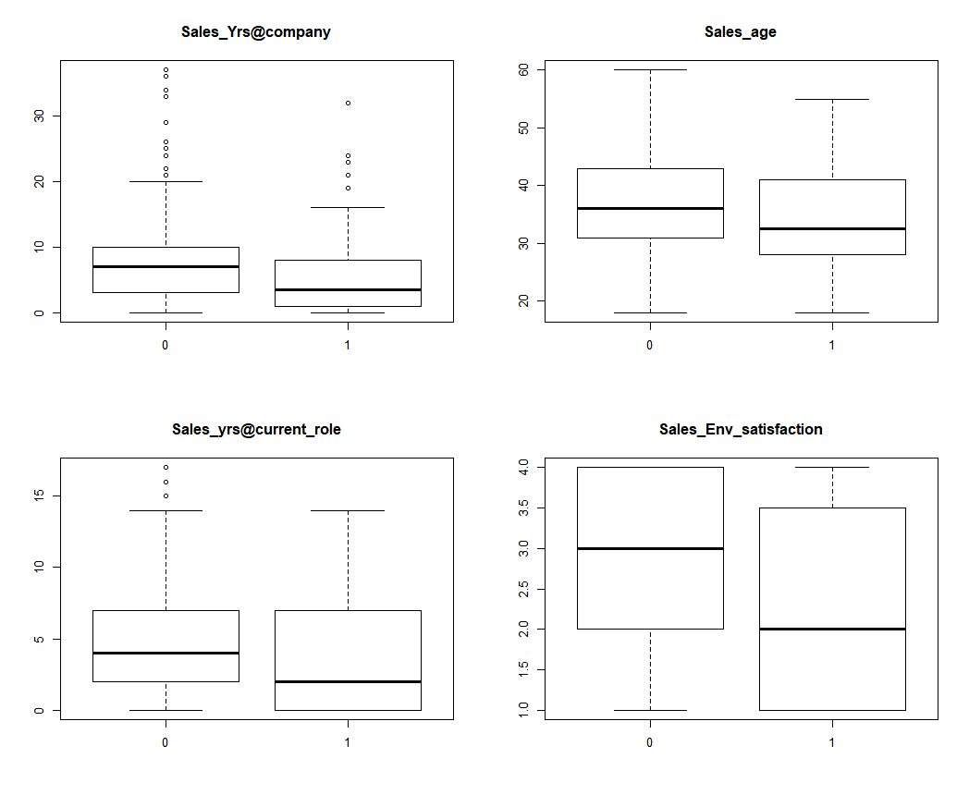

Slide 8
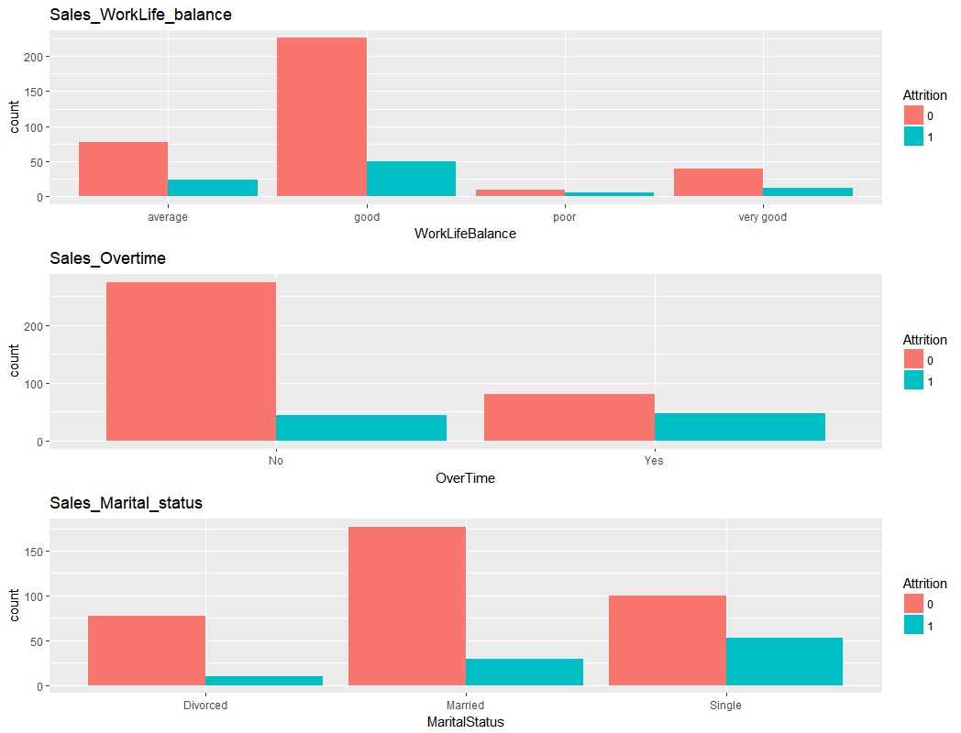

Slide 9
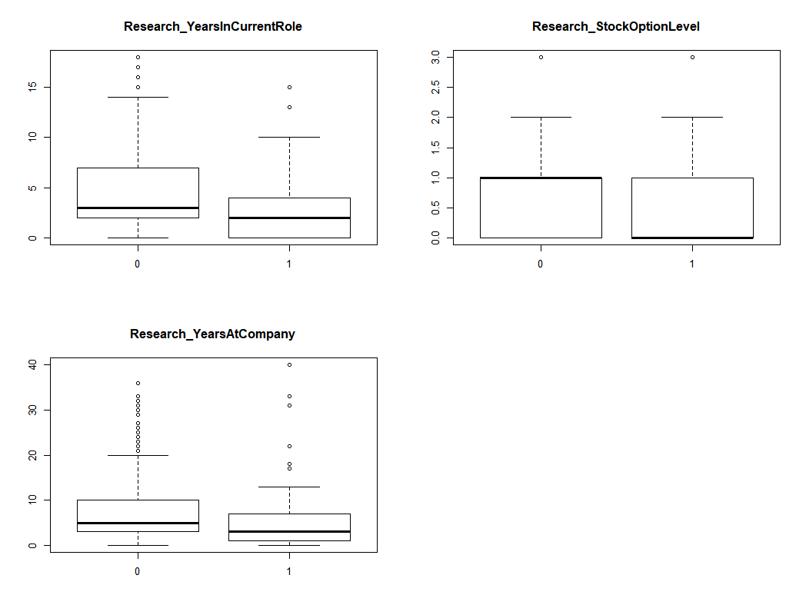

Slide 10
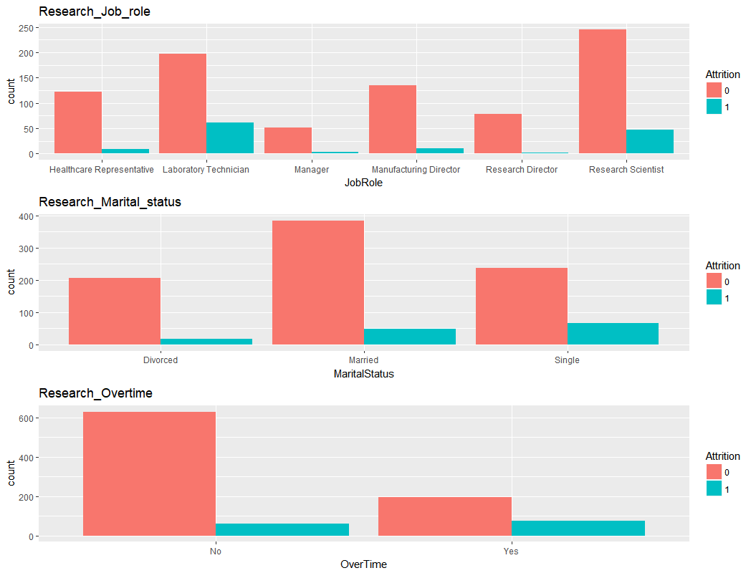

Slide 11

Interpretation & Conclusion:
  There is Huge Attrition rate in “Sales dept” next is “HR” and the least in “Research dept”.
  Technical guys have high attrition rate compared to other discipline in all the departments.
  For sales & Research department they were not happy about working environment, job role , they were working after hrs and they were not satisfied with there job.

