Slide 1
Iterator Design Patterns
Vinutha Muthyala(36),
Amulya Pindi (46),
Naresh Pogakula(47),
Meghasai Reddy Bodamani(6),

Slide 2
ITERATOR
Iterator is a behavioral pattern and it is used to way the access of the elements in a collection object in a sequential manner without any need to know its underlying representation.
We would start with creating an Iterator interface to narrate navigation method.
Container interface would return a iterator.

Slide 3
Problem: Accessing all members of the collection, it requires a specialized traversal for each data structure to perform. (dependences and not generalized)
Solution: Providing the standard iterator object that to be supplied to all data structures.
The implementation would then performs traversals.
Results can be shared to clients through a standard interface.

Slide 4
ADVANTAGES
This supports variations in traversal of an aggregate. Complex aggregates are traversed in many ways. For instance, generating code and checking semantics involves traversing the parse trees. The code generation might traverse in parse tree in-order or pre-order. Iterators would make this easy to change traversal algorithm: that is replacing iterator instance with another. Iterator subclasses can also be defined to support new traversals.
Iterators would greatly simplify Aggregate interface. It’s traversal interface removes a need for its similar interface in Aggregate, thus simplifying.
Many traversal can be in pending on an aggregate. As the iterator keeps a track of its own traversal state, we can have more than one traversal progress.

Slide 5
DISADVANTAGES
Iteration order is fixed by the implementation, not the client.
Missing various potentially useful operations (add, set, etc.).

Slide 6
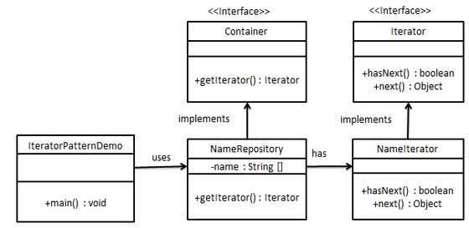
Class diagram

Slide 7
EXAMPLE CODE
SongInfo.java
SongsOfThe70s.java
SongsOfThe80s.java
SongsOfThe90s.java
DiscJockey.java
RadioStation.java
SongIterator.java

Slide 8
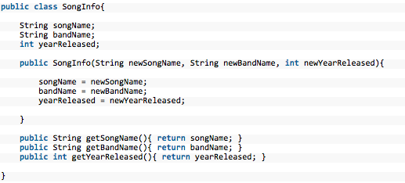
EXAMPLE CODE
SongInfo.java

Slide 9
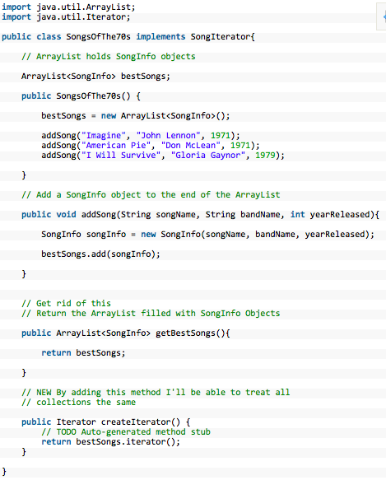
EXAMPLE CODE
SongsOfThe70s.java

Slide 10
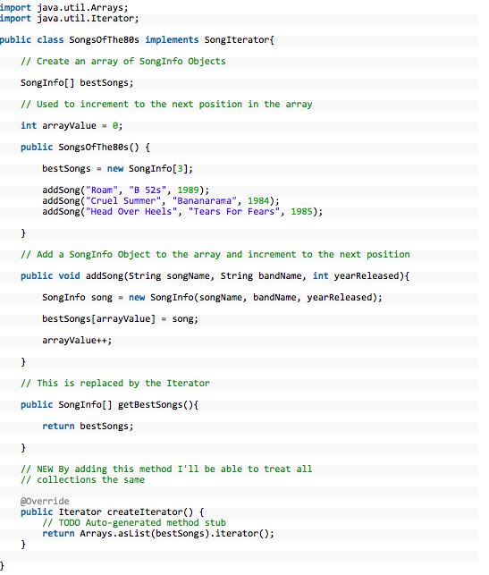
EXAMPLE CODE
SongsOfThe80s.java

Slide 11
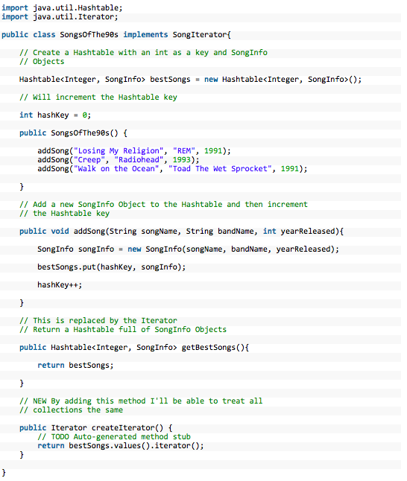
EXAMPLE CODE
SongsOfThe90s.java

Slide 12
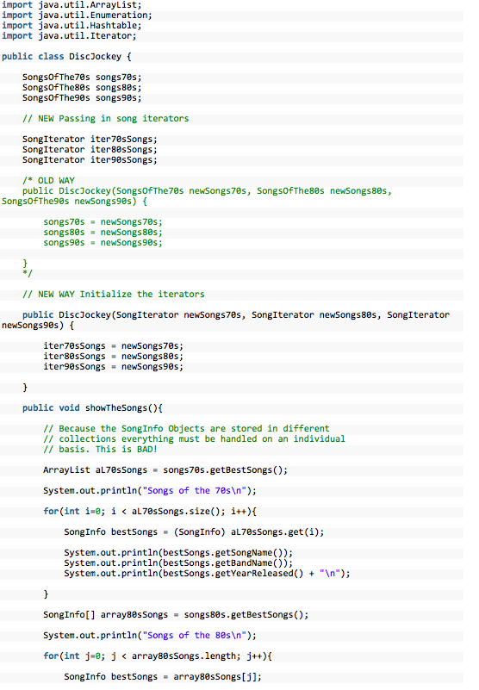
EXAMPLE CODE
DiscJockey.java

Slide 13
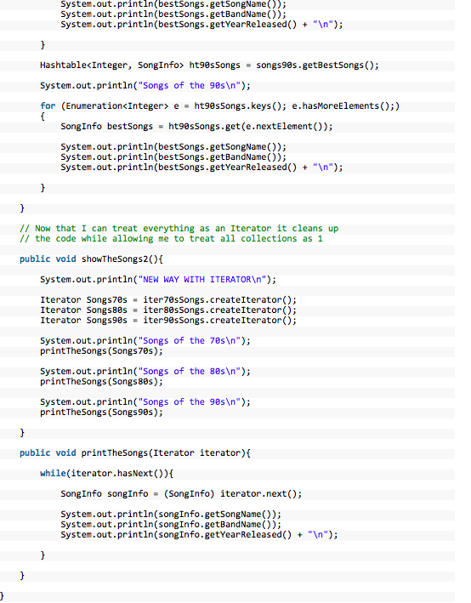
EXAMPLE CODE
DiscJockey.java

Slide 14
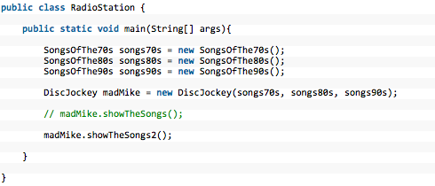
EXAMPLE CODE
RadioStation.java

Slide 15

EXAMPLE CODE
SongIterator.java

Slide 16
THANK YOU

