Slide 1
Headless Browser Testing Using Selenium
By : Tripura Amulya Biyyapu
Batch code: 2023-11124
Enrollment Number -EBGNTR0224135036

Slide 2

SELENIUM
Selenium is one of the powerful web automation test suites to automate the testing of web applications against browsers such as Chrome, Firefox, IE, Edge, etc. It is one of the popular browser automation tools to verify website functioning, check website navigation flow, verify page titles, and fetch huge amounts of data by Web scraping.
Along with all these, it offers one more fantastic feature: Headless Browser testing. Headless browser testing is nothing but running the Selenium tests on headless browsers. A headless browser is just like a real browser with no User Interface.

Slide 3

What is Headless Browser Testing?
A web browser that doesn't have a graphical user interface (GUI) is known as a headless browser.
Headless browser Selenium operates in the background without rendering a graphical user interface, enabling developers and testers to automate web testing and lessen the need for manual testing.
These scripts can test for various things, including a website's functionality, user interface elements, and more. Developers and testers can ensure that their web applications function properly across various environments and platforms by using headless browser testing.

Slide 4
Relevance in Java
Java is widely used in enterprise web application development. Selenium's seamless integration with Java allows for efficient testing of web forms in Java-based applications. Leveraging Java's object-oriented approach, test scripts can be organized and maintained, enhancing the scalability and maintainability of web form testing projects.
TestNG
TestNG is an automation testing framework where NG stands for “Next Generation”.
TestNG is inspired by JUnit which uses the annotations (@).
TestNG overcomes the limitations of JUnit and is designed to make end to end testing easy.
Using TestNG, you can generate a proper report, and you can easily come to know how many test cases are passed, failed, and skipped.
You can execute the failed test cases separately.

Slide 5

How to Run Selenium Tests in Headless Mode?
There are several ways to run Selenium tests in headless mode. In this section, we will discuss three methods for running Selenium tests in headless mode: using the HTMLUnitDriver, using Headless Chrome, and using Headless Firefox.

Slide 6
Running Selenium Headless Browser Tests Using The HTML UnitDriver
Step 1: Download the Selenium WebDriver for Java from the Selenium website.
Step 2: Download the HTMLUnitDriver from the HtmlUnit website.
Step 3: Add the Selenium WebDriver and HTMLUnitDriver JAR files to your project's classpath.
Step 4: Create a new instance of the HTMLUnitDriver in your Selenium code:
WebDriver driver = new HtmlUnitDriver();
Step 5: Write your Selenium test code and run it using the HTMLUnitDriver.

Slide 7
Running Selenium Tests for Headless Chrome
Headless Chrome is a headless browser that can be used for running Selenium tests in headless mode. Here's how to use Selenium Headless Browser Chrome to run Selenium tests:
Step 1: Download and install the latest version of ChromeDriver.
Step 2: Add the path to ChromeDriver to your system's PATH environment variable.
Step 3: Create a new instance of ChromeDriver in your Selenium code:
ChromeOptions options = new ChromeOptions();
options.setHeadless(true);
WebDriver driver = new ChromeDriver(options);
Step 4: Set option.setHeadless() to true as shown in the code above
Step 5: Write your Selenium test code and run it using the ChromeDriver.

Slide 8
Running Selenium Tests for Headless Firefox
Headless Firefox is a headless browser that can be used for running Selenium tests in headless mode. Here's how to use Headless Firefox to run Selenium tests:
Step 1:
Download and install the latest version of geckodriver.
Step 2:
Add the path to geckodriver to your system's PATH environment variable.
Step 3:
Create a new instance of FirefoxDriver in your Selenium code:
FirefoxOptions options = new FirefoxOptions();
options.setHeadless(true);
WebDriver driver = new FirefoxDriver(options);
Step 4:
Set option.setHeadless() to true as shown in the code above
Step 5:
Write your Selenium test code and run it using the FirefoxDriver.

Slide 9
Running Selenium Tests for Headless Edge
Headless Edge is a Selenium headless browser that can be used for running Selenium tests in headless mode. Here's how to use Headless Edge to run Selenium tests:
Step 1: Download and install the latest version of Microsoft Edge Driver.
Step 2: Add the path to Microsoft Edge Driver to your system's PATH environment variable.
Step 3: Create a new instance of EdgeDriver in your Selenium code:
EdgeOptions options = new EdgeOptions();
options.setCapability("ms:edgeOptions", "{\"headless\":true}");
WebDriver driver = new EdgeDriver(options);
Step 4: Set the headless flag in option.setCapability() to true as shown in the code above
Step 5: Write your Selenium test code and run it using the EdgeDriver.

Slide 10
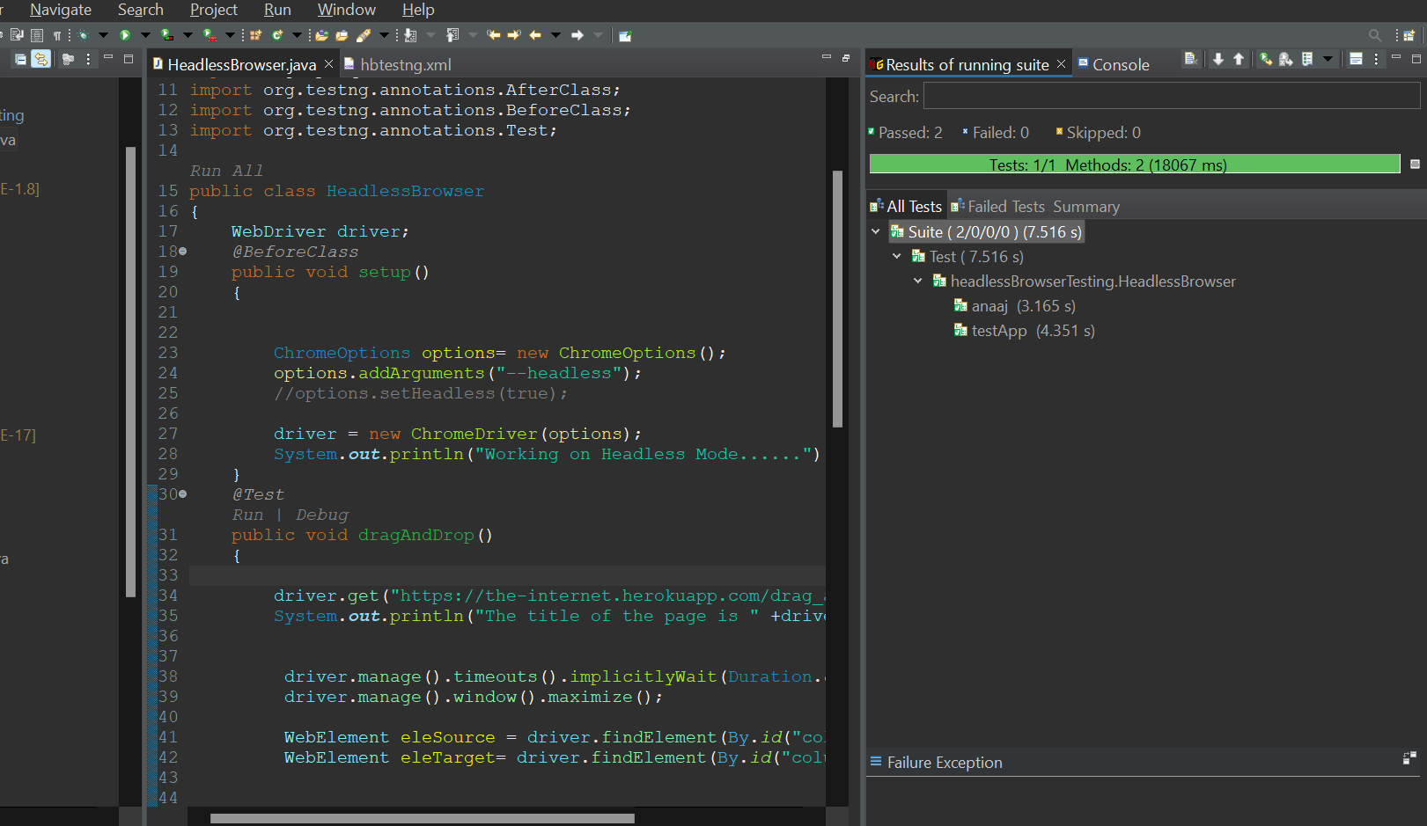
Code & Implementation
DragAndDrop, Login Functionality using Headless Browser.

Slide 11
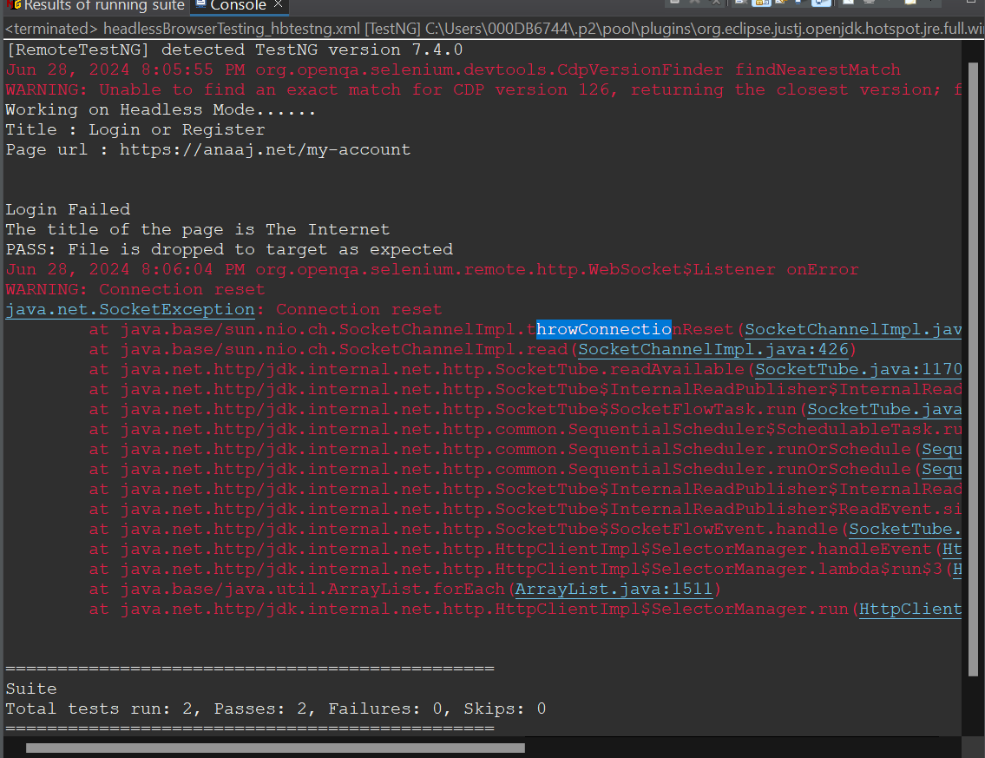
Output

Slide 12

Benefits of Selenium Headless Testing

Slide 13
Limitations of Selenium Headless Testing
In addition to the several benefits discussed in the previous section, here are a couple of drawbacks of Selenium Headless Testing:
Live Debugging is impossible, as you cannot visualize what happens when a test runs in headless mode.
If there is a need to observe the tests visually and report to the developer about the issue with the help of Web page UI, using headless mode for such testing is a bad choice.

Slide 14
Conclusion
Opting for headless or non-headless depends on the web application to be tested, the system on which testing would be performed, and the testing results expected from the execution. If your application demands user interaction visualization, then headless testing is a big NO. And if it requires faster execution and performance and system resources are a concern, then you should try headless browser testing. Headless Browser testing plays a major role when performance and time are crucial.

Slide 15

THANK YOU

