Slide 1
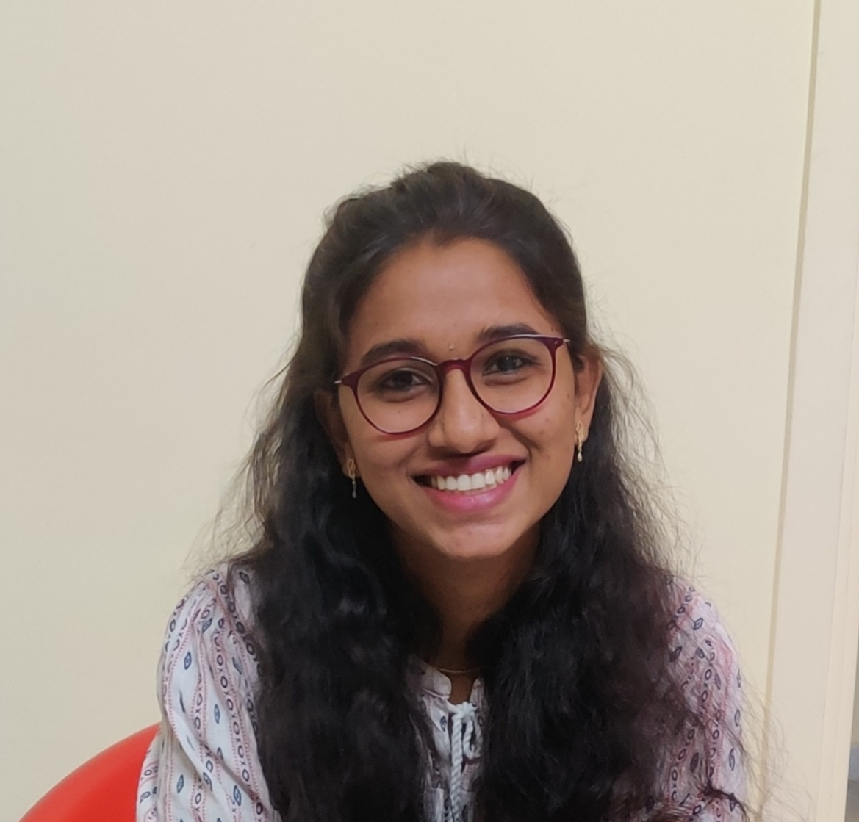
APPANI AMULYA
Analyst/Software Engineer
Bachelor of Computer Science Engineering:2017-2021
Skills
Bangalore
C | C Basics , Arrays, Stacks ,Queues , Data Structures , Sorting.
JAVA Core | Declarations and Access Control , Basic OOPS concept , Collections , Exceptions , multi-threading
JAVA Advanced | JDBC , JPA with Hibernate.
Spring | Spring core , Rest Data JPA, Data JPA , Data Rest
Angular | Essentials of angular , Templates , Styles& Directives , Dependency Injection and services , Reactive and Temporary Forms , Routing.
Database | Postgres , MySQL.
UI Tech | HTML 5 & CSS 3, Bootstrap , JavaScript, TypeScript Optimized UI Designed
Tools | Visual Studio 2019, Visual Studio code, Swagger, Postman, Postgres , Spring STS.
Add On skills | Communications, Team management. Peer learning
appani.amulya@capgemini.com
+91 7995706263
A4
Proficient in C and JAVA.
Hands on experience in creating Web Application with Spring Boot , Rest Controller , JPA with Hibernate and Angular.
Practical Understanding of Query Language Like Postgres SQL, My SQL.
Hands on experience in developing web pages using HTML5, CSS3, Angular. Good understanding of Document Object Model (DOM) and DOM Functions.
Proficient Full Stack developer with working knowledge on Angular.
Implemented Web API and Angular in case study and up skilling this knowledge continuously.
Covid Vaccination Application
Working on end-to-end case study of Covid Vaccination Application along with Validations, Swagger and Angular used for user interface with Postgres as Database.
JEE Full Stack with Angular
Successfully completed the above course with good percentage and Knowledge.
Consideration to Achieve Pulsatality Using BLDC
Description: It is a process of detecting and identifying the people who are not wearing the mask in the public.
My contribution: Worked in data processing stages and analyzing of algorithms.

