Slide 1

SIDDAGANGA INSTITUTE OF TECHNOLOGY, Tumakuru- 3
(An Autonomous institution affiliated to Visvesvaraya Technological University- Belagavi, Approved by AICTE,
Accredited by NAAC with ‘A++’ Grade, Awarded Diamond College Rating by QS I-GAUGE & ISO 9001:2015 certified )
Department of Computer Science & Engineering
MINI PROJECT PRESENTATION
ON
“Symptoms based disease prediction powered by Django and Machine Learning.”
By
Amulya K C 1SI22CS017
Akshatha R Gowda 1SI22CS013
Chinmayee D 1SI22CS048
Batch ID: A12
Under the guidance of
Dr. Srinivasa K
M.Tech,Phd
Professor

Slide 2
Contents
Introduction
Motivation
Literature Survey
Problem Statement
Objectives
System Architecture
Tools and Platforms
Implementation and Methodology
Conclusion
References

Slide 3
Introduction
Overview: The Symptoms-Based Disease Prediction System using Django and machine learning provides a web-based tool to predict diseases based on user-reported symptoms. It uses trained models to deliver real-time predictions and probability scores for potential conditions.
Importance: This system helps users gain preliminary insights into their health, promoting early detection and encouraging timely medical consultation, especially in areas with limited healthcare access.
Key Focus: The main focus is accurate symptom-disease mapping through machine learning, combined with a user-friendly interface for easy input and instant feedback.
Challenges: It include managing ambiguous symptom overlaps, ensuring model accuracy, and effectively integrating machine learning with the Django backend for real-time performance.
Innovation:The system innovatively combines machine learning and Django, offering a scalable solution for disease prediction, with the potential for further enhancement using multimodal inputs like X-rays.

Slide 4
Motivation
Timely Medical Intervention: With the rising prevalence of various diseases, especially in the wake of global health crises, there's a critical need for tools that enable early detection and intervention. This project can help individuals recognize potential health issues based on symptoms, leading to timely medical consultations.
Increased Health Literacy: Many individuals lack adequate understanding of health symptoms and their implications. This project can bridge the knowledge gap by providing clear, accessible information, empowering users to make informed health decisions and reducing anxiety about unknown symptoms.
Strain on Healthcare Systems: As healthcare systems worldwide face increasing pressure due to patient volume, tools that can assist in preliminary assessments can help alleviate this strain. By filtering cases based on symptom analysis, the project can guide users on when to seek professional help, optimizing resource allocation in healthcare facilities.

Slide 5
Literature Survey
Author(s) | Title | Publication Year | Remarks
Manikanta Sirigineedi, Matta Eswar SuryaKumar, Rali Surya prakash,Poojitha Tirunagari, Velagala Pavan Kumar Reddy | Symptom-Based Disease Prediction: A Machine Learning Approach | 2024 | This project concentrates on leveraging machine learning algorithms for disease prediction based on symptoms. The aim is to develop a robust prdictive model capable of accurately diagnosing diseases given a set of symptoms. The process involves several key steps. Initially, the dataset is preprocessed to handle missing values, encode categorical variables, and normalize the data.
Md Manjurul Ahsan,Shahana Akter Luna, Zahed Siddique | Machine-Learning-Based Disease Diagnosis: A Comprehensive Review | 2022 | This review explains how machine learning (ML) is being used to help in the early identification of numerous diseases. The review then summarizes the most recent trends and approaches in machine-learning-based disease diagnosis (MLBDD), considering the following factors: algorithm, disease types, data type, application, and evaluation metrics.

Slide 6
Author(s) | Title | Publication Year | Remarks
Yash Tambe, Shubham Awhad, Medha Kulkarni, Akash Keny, Sonali Pakhmode | Disease Prediction Using Machine Learning and Django and Online Consultation | 2022 | In this paper a system that enables users to obtain timely advice on their health problems via an intelligent health care system online. Numerous symptoms, as well as diseases/illnesses associated with various systems, are input into the system. The system may be used by users to convey their symptoms and difficulties.
Hamsagayathri, S.Vigneshwaran | Symptoms Based Disease Prediction Using Machine Learning Techniques | 2019 | This shows the relative study of various ML algorithm for the detection of various disease such as heart disease, diabetes disease is given in this survey paper. It calls focus on the collection of algorithms and techniques for ML used for disease detection and decision making processes.
Mayur Gadekar, Soyeb Jamadar, Prajak Pachpute, Sanket Shinde, Swati Bhosale | Symptoms based disease prediction | 2022 | A recommendation system are often made for doctors and medicine while using review mining will save plenty of time. In a system like this, the user faces many problems in understanding the core medical vocabulary because the users are laymen. The user is confused because an outsized amount of medical information on different mediums is out there.

Slide 7
Author(s) | Title | Publication Year | Remarks
Stepheny Lucas, Mitali Desai, Amisha Khot, Sincee Harriet, Nilambari Narkar | SmartCare: A Symptoms Based Disease Prediction Model Using Machine Learning Approach | 2022 | Machine Learning technology has been proven beneficial in giving an immeasurable platform in the medical field so that health care issues can be resolved effortlessly and expeditiously. The existing systems either made use of only one algorithm or prediction system were capable for predicting only one disease.
Sayali Kulkarni, Isha Sawant, Megha Shinde, Vishal Sonar | Django Website for Disease Prediction using Machine Learning | 2021 | This makes easier for people to predict the right disease, the development of a machine learning-based system has become important. The system collects the symptoms from the user and predicts the correct disease. This will help people to recognize the disease at an earlier stage and take further decisions based on it.
Mohammad Ali Moni,Md Ekramul Hossain,Shahadat Uddin,Arif Khan | Comparing different supervised machine learning algorithms for disease prediction | 2019 | This study aims to identify the key trends among different types of supervised machine learning algorithms, performance.Extensive research efforts were made to identify those studies that applied more than one supervised machine learning algorithm on single disease prediction

Slide 8
Author(s) | Title | Publication Year | Remarks
Deepti Sisodia, Dilip Singh Sisodia | Prediction of Diabetes using Classification Algorithms | 2018 | The motive of this study is to design a model which can prognosticate the likelihood of diabetes in patients with maximum accuracy therefore 3 machine learning classification algorithm namely decision tree ,SVM and naive bayes are used in this experiment to detect diabetes at an early stage
Marouane Ferjani | Disease Prediction Using Machine Learning | 2020 | This showcased significant potential in surpassing standard systems for disease diagnosis and aiding medical experts in the early detection of high-risk diseases. In this literature, the aim is to recognize trends across various types of supervised ML models in disease detection through the examination of performance metrics. The most prominently discussed supervised ML algorithms were Naïve Bayes (NB), Decision Trees (DT), K-Nearest Neighbor (KNN). As per findings, Support Vector Machine (SVM) is the most adequate at detecting kidney diseases and Parkinson's disease.

Slide 9
Problem Statement
In recent years, the integration of big data analytics in the biomedical and healthcare sectors has transformed disease prediction methodologies. This project aims to develop an innovative disease prediction system using machine learning algorithms that leverage both structured and unstructured medical data sourced from hospitals. The increasing complexity and volume of healthcare data necessitate advanced analytical approaches to facilitate early disease recognition, improve patient care, and enhance community health services.
Key Challenges: The project introduces several innovative solutions to enhance disease prediction and healthcare outcomes. It integrates structured and unstructured medical data for a comprehensive analysis, providing a more accurate predictive model. A user-friendly interface allows healthcare professionals to easily access insights, while advanced machine learning algorithms, including decision trees, Naive Bayes, and random
forests, enable real-time predictions.

Slide 10
Objectives
Primary Objective:
Provide Early Disease Predictions: To offer users a tool for predicting potential diseases based on their reported symptoms, enabling early detection and intervention.
Sub-Objectives:
Enhance Healthcare Accessibility: To make preliminary health insights accessible to individuals, especially in regions with limited medical resources, encouraging them to seek professional advice when necessary.
Utilize Machine Learning for Accuracy: To leverage machine learning algorithms trained on medical data to accurately predict diseases, increasing the reliability of predictions.
Support Multimodal Integration: To extend the system's capability by integrating additional data types like X-rays in the future, enhancing diagnostic accuracy.

Slide 11
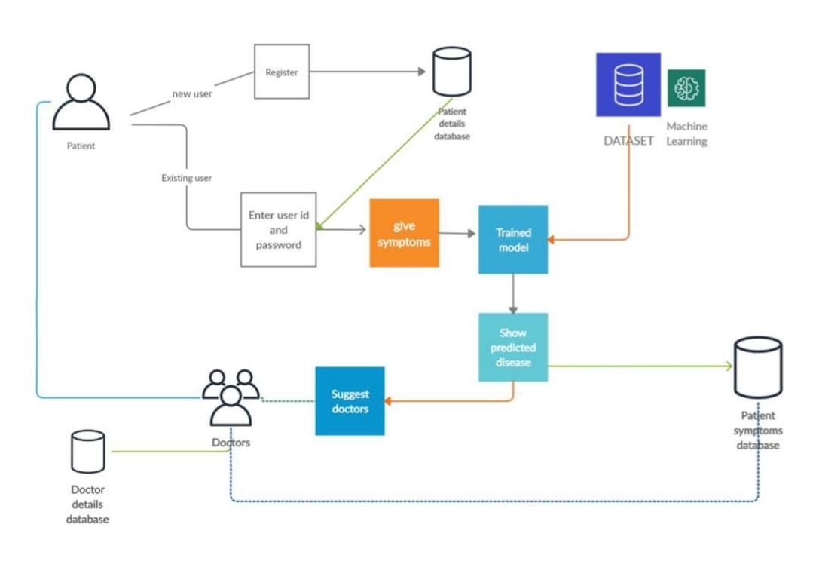
Flow chart

Slide 12
Tools and Platform
Programming Languages: Python is used for implementing the machine learning models and processing medical data.
Libraries:
Scikit learn:For traditional machine learning algorithms.
Tensor flow : For deep learning models.
Pandas: For data manipulation and analysis.
Numpy: For numerical computing.
Django : For authentication, database management and routing.
OpenCv:For realtime image and video processing.

Slide 13
Implementation and Methodology
Data Collection and Preprocessing:
- Symptom Data: Collect a dataset containing symptoms and corresponding diseases from publicly available medical databases or sources like Kaggle. The dataset is cleaned, normalized, and encoded as needed for machine learning.
- X-ray Data (Integration): For future multimodal integration, X-ray datasets are preprocessed by resizing, normalizing, and converting the images into a format suitable for the machine learning model.
Model Selection and Training:
- Machine Learning Model: A classification model (such as Logistic Regression, Random Forest, or Neural Networks) is selected for symptom-based prediction. The model is trained using the preprocessed data, mapping symptoms to diseases.
- Deep Learning for X-rays: If using X-ray data, a CNN model is trained to predict diseases based on images. Both models (symptom and X-ray) can be combined for a multimodal prediction approach.

Slide 14
Implementation and Methodology
Feature Extraction: For symptoms, text-based features are extracted using techniques like TF-IDF or bag-of-words. For X-rays, features are extracted using Convolutional Neural Networks (CNNs).
Integration with Django:
- Model Loading: The trained machine learning model is saved (using formats like .pkl, .h5, or .pth) and loaded into the Django app during server initialization.
- Prediction API: A Django view is created to handle form submissions from users. The symptoms and (optionally) X-ray files are collected through the form, processed, and fed into the model for prediction.
- Preprocessing in Backend: In the backend, the symptoms are vectorized, and the X-ray images are resized and normalized before making predictions.

Slide 15
Conclusion
In conclusion, this project showcases a pioneering approach to disease prediction by integrating machine learning algorithms with comprehensive medical data. By leveraging both structured and unstructured data, the system enhances the accuracy and reliability of disease recognition, empowering healthcare professionals to make timely and informed decisions. The user-friendly interface and advanced analytical features facilitate real-time insights, ultimately improving patient care and community health outcomes.
Moreover, the utilization of a robust technology stack ensures the system's efficiency and scalability, making it suitable for handling large datasets. With the incorporation of data preprocessing techniques and collaboration tools, this project not only addresses current challenges in healthcare analytics but also promotes a more connected and informed healthcare ecosystem. Overall, the innovative solutions presented here lay a strong foundation for future advancements in predictive healthcare technologies, with the potential to transform disease management practices significantly.

Slide 16
References
For journals:
Shahadat Uddin , Arif Khan, Md Ekramul Hossain and Mohammad Ali Moni. Comparing different supervised machine learning algorithms for disease prediction. BMC Medical Informatics and Decision Making.
For conference papers:
Mr Chintan Shah,Dr. Anjali Jivani, “Comparison Of Data Mining Classification Algorithms for Breast Cancer Prediction”, IEEE-31661.
Chinmayi Chitnis and Roger Lee. Improving Health-Care Systems by Disease Prediction. 2018 International Conference on Computational Science and Computational Intelligence (CSCI).
For Textbooks:
P. Groves, B. Kayyali, D. Knott, and S. V. Kuiken, “The ’big data’ revolution in healthcare: Accelerating value and innovation,” 2016

