Slide 1

SIDDAGANGA INSTITUTE OF TECHNOLOGY, Tumakuru- 3
(An Autonomous institution affiliated to Visvesvaraya Technological University- Belagavi, Approved by AICTE,
Accredited by NAAC with ‘A++’ Grade, Awarded Diamond College Rating by QS I-GAUGE & ISO 9001:2015 certified )
Department of Computer Science & Engineering
MINI PROJECT PRESENTATION
ON
“Pneumonia detection using
multimodal learning approach”
By
Amulya K C 1SI22CS017
Akshatha R Gowda 1SI22CS013
Chinmayee D 1SI22CS048
Batch ID: A12
Under the guidance of
_{Dr. Srinivasa K}
_{M.Tech,Phd}
_{Professor}

Slide 2
Contents
Introduction
Motivation
Problem Statement
Literature Survey
Objectives
Flow chart
Demonstration of the project
Tools and Platforms
Implementation and Methodology
Conclusion

Slide 3
Introduction
Overview:
The Pneumonia Detection System using CNN and symptoms-based analysis leverages machine learning models to predict pneumonia based on chest X-rays and patient-reported symptoms. It combines both image and symptom analysis to offer a comprehensive and accurate diagnosis of pneumonia.
Importance:
This system aids in early detection and diagnosis of pneumonia, reducing the reliance on expert radiologists, especially in resource-limited settings. It enhances the accuracy of detection and helps healthcare providers make quicker, more reliable decisions.
Key Focus:
The primary focus is on integrating image-based pneumonia detection with symptom analysis for a more holistic approach to diagnosis. The system aims for high accuracy by combining deep learning models for image processing and NLP for symptom evaluation.
Challenges:
Key challenges include ensuring the accuracy of both the CNN model for X-ray interpretation and the symptom analysis model, as well as managing the integration of two distinct models (image and text) into a single seamless workflow for real-time diagnosis.

Slide 4
Motivation
Timely Medical Intervention: With the rising prevalence of various diseases, especially in the wake of global health crises, there's a critical need for tools that enable early detection and intervention. This project can help individuals recognize potential health issues based on symptoms, leading to timely medical consultations.
Increased Health Literacy: Many individuals lack adequate understanding of health symptoms and their implications. This project can bridge the knowledge gap by providing clear, accessible information, empowering users to make informed health decisions and reducing anxiety about unknown symptoms.
Strain on Healthcare Systems: As healthcare systems worldwide face increasing pressure due to patient volume, tools that can assist in preliminary assessments can help alleviate this strain. By filtering cases based on symptom analysis, the project can guide users on when to seek professional help, optimizing resource allocation in healthcare facilities.

Slide 5
Literature Survey
Author(s) | Title | Publication Year | Remarks
Tafisur Rahnman, Muhammad E.H Chowdary, Amith Khandakar, Saad bin Adbul Kashem. | Transfer Learning with Deep Convolutional Neural Network (CNN) for Pneumonia Detection using Chest X-ray | 2020 | This study uses four pre-trained deep learning models to diagnose pneumonia from chest X-rays, distinguishing between normal, bacterial, and viral types, aiding early detection and supporting radiologists, especially in resource-limited settings.
Pranav Rajpurkar | Deep learning for chest radiograph diagnosis: A retrospective comparison of the CheXNeXt algorithm to practicing radiologists | 2018 | CheXNeXt, a deep learning algorithm, effectively detects multiple pathologies in chest radiographs, matching radiologist performance on most conditions. Its faster interpretation time highlights its potential to improve diagnostics, especially in areas with limited radiologist access.

Slide 6
Author(s) | Title | Publication Year | Remarks
Ilyas Sirazitdinov , Maksym Kholiavchenko , Tamerlan Mustafaev , Yuan Yixuan , Ramil Kuleev , Bulat Ibragimov . | Deep neural network ensemble for pneumonia localization from a large-scale chest x-ray database | 2019 | This research explores the application of deep neural network ensembles for the automated detection and localization of pneumonia from chest X-ray images using a large-scale database.
Abhishek bhadra, Shub Gupta, Naman Garg, Sonali Dhangar | Survey on Pneumonia Disease Detection (Using Deep Learning) | 2023 | This survey aimed to evaluate the effectiveness of chest x-rays in detecting pneumonia by collecting data from 300 healthcare profesional, including radiologists, pulmonologists, and general practitioners. Department.The survey included 10 questions related to the use of X-rays to detect pneumonia, including questions about accuracy, misdiagnosis, and the use of other diagnostic tools.

Slide 7
Author(s) | Title | Publication Year | Remarks
Amith Kumar, Prayag | Identifying pneumonia in chest X-rays: A deep learning approach | 2019 | The rich collection of annotated datasets piloted the robustness of deep learning techniques to effectuate.

Slide 8
Problem Statement
Pneumonia, a leading cause of morbidity and mortality worldwide, poses significant challenges for timely and accurate diagnosis. Traditional diagnostic methods, such as chest X-rays and symptom analysis, often rely on subjective interpretations, leading to misdiagnoses or delayed treatment. In resource-limited settings, the unavailability of expert radiologists further exacerbates the problem, limiting access to quality healthcare.
Key Challenges
Subjectivity in Diagnosis: Reliance on manual interpretation of X-rays increases the risk of errors and inconsistent diagnoses.
Limited Resources: Inadequate availability of skilled radiologists in remote or underserved areas hampers timely detection.
Data Integration: Combining visual data from X-rays with patient-reported symptoms for a holistic diagnosis is complex.
False Negatives and Positives: High rates of diagnostic inaccuracies can lead to under-treatment or overtreatment of patients.
Computational Efficiency: Ensuring the models are lightweight and efficient for real-time deployment in diverse environments.

Slide 9
Objectives
The objectives of this project focus on improving pneumonia diagnosis by integrating image analysis and symptom evaluation. This approach aims to enhance accuracy, reduce subjective errors, and ensure accessibility in resource-limited settings.
1.Build a Custom Convolutional Neural Network (CNN) for Pneumonia Detection
•Design and implement a CNN model specifically for the classification of chest X-ray images into pneumonia-positive and pneumonia-negative categories.
•Include essential CNN layers such as Conv2D for feature extraction, MaxPooling2D for dimensionality reduction, BatchNormalization for stable training, and Dropout to prevent overfitting.
2.Optimize Model Training for Improved Accuracy
•Use the Adam optimizer to efficiently minimize binary cross-entropy loss, ensuring faster convergence and improved model accuracy.
•Employ data augmentation techniques such as rotation, zoom, shear, and horizontal flipping to increase model generalization and reduce overfitting.

Slide 10
3.Integrate Early Stopping and Model Checkpointing
•Implement early stopping to monitor validation loss and automatically halt training when performance plateaus, preventing overfitting and unnecessary computational costs.
•Use model checkpointing to save the best model (based on validation loss) during training, ensuring that the optimal model is retained for deployment.
4.Evaluate Model Performance and Visualize Results
•Assess the trained model's performance on the test dataset to evaluate accuracy and loss, ensuring its generalization ability on unseen data.
•Visualize the model’s training and validation accuracy and loss over epochs to provide insights into model performance, convergence, and potential overfitting.

Slide 11
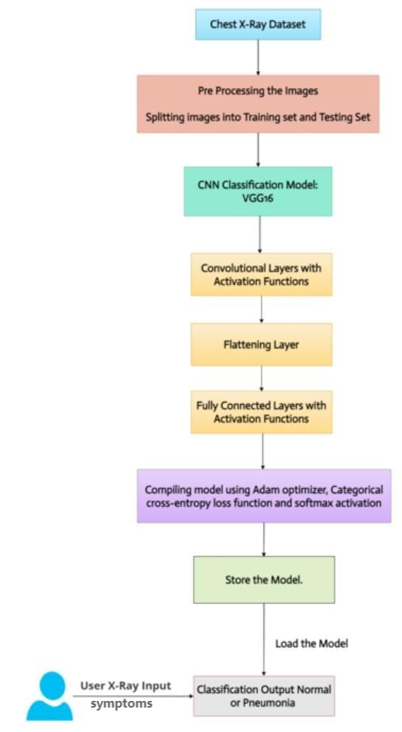
HIGH LEVEL ARCHITECTURE WORKFLOW

Slide 12
The workflow for our pneumonia detection system outlines the steps from processing chest X-ray images to classifying them as normal or pneumonia. It begins with data preparation, followed by training a custom CNN model, and concludes with deploying the model for user input and diagnosis
Chest X-Ray Dataset
A collection of labeled chest X-ray images, categorized as normal or pneumonia, serves as the input data for the model.
Pre-Processing the Images
Rescaling and augmenting the images to ensure uniformity and enhance the model's generalization capability.
Splitting Images into Training and Testing Set.Dividing the dataset into training, validation, and testing subsets to train and evaluate the model effectively.
CNN Classification Model: Custom CNN Model
A custom convolutional neural network designed to classify chest X-ray images into normal or pneumonia categories.
Convolutional Layers with Activation Functions
Layers that extract features from the X-ray images using filters, with activation functions like ReLU to introduce non-linearity.

Slide 13
Flattening Layer
Converts the multidimensional feature maps into a single-dimensional vector for input into fully connected layers.
Fully Connected Layers with Activation Functions
Dense layers that perform classification, culminating in a sigmoid activation function for binary classification.
Compiling Model Using Adam Optimizer, Categorical Cross-Entropy Loss Function, and Softmax Activation
The model is compiled with an Adam optimizer to minimize loss, cross-entropy for binary classification, and softmax for output probabilities.
Store the Model
Saves the trained model for future use without the need for re-training.
User X-Ray Input
Accepts a chest X-ray image uploaded by the user for classification.
Classification Output: Normal or Pneumonia
Outputs a classification result indicating whether the input X-ray image is normal or shows signs of pneumonia.

Slide 14
Tools and Technologies
1. Programming Language:
•Python: The primary language used for developing the machine learning model and deploying the application.
2. Deep Learning Frameworks:
• TensorFlow: An open-source deep learning framework used for building and training the custom CNN model.
• Keras: A high-level neural network API built on top of TensorFlow, used for model construction and training.
3. Libraries and Tools:
• OpenCV: Used for image processing tasks such as resizing, augmentations (e.g., rotation, zoom), and other preprocessing operations.
• Matplotlib: A plotting library for visualizing training and validation accuracy, loss curves, and other model metrics.
• Pandas & NumPy: Used for data manipulation and numerical computations.
• scikit-learn: For evaluating model performance with metrics like accuracy, precision, and recall.

Slide 15
4. Model Deployment:
• Streamlit: A framework used to create the interactive, user-friendly web application for model deployment. It allows users to upload chest X-ray images and get predictions of pneumonia or normal conditions.
5. Image Augmentation:
• ImageDataGenerator (from Keras): Used for data augmentation to artificially expand the dataset by applying random transformations such as rotation, shift, and zoom.
6. Model Checkpointing and Optimization:
• Adam Optimizer: Used for training the model, optimizing weights during the backpropagation phase.
• EarlyStopping: A callback used to halt training when the model’s validation loss does not improve after a specified number of epochs.
• ModelCheckpoint: Saves the best-performing model during training based on validation loss.
7. Cloud/Storage Technologies:
• Google Drive / AWS S3 / Local Storage: Used for storing and accessing datasets and trained models, ensuring easy retrieval and sharing.
8. Data Management:
• Image Dataset: Labeled chest X-ray images, such as the "Chest X-Ray Images (Pneumonia)" dataset, for training and testing the model.

Slide 16
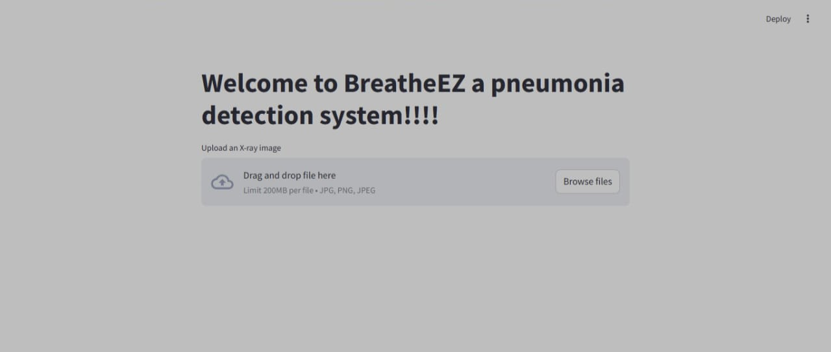
DEMONSTRATION OF THE PROJECT
The project involves two models: one for image processing using CNN to analyze chest X-rays for pneumonia detection, and another for symptom analysis using NLP to assess patient-reported symptoms. Combining these models offers a comprehensive diagnostic approach, enhancing accuracy and reliability in pneumonia detection.
IMPLEMENTATION OF THE IMAGE PROCCESING MODEL:
The home page welcomes users to "BreatheEZ" and prompts them to upload a chest X-ray image in PNG, or JPEG format (max 200MB). Users can drag and drop or browse files to upload the image.

Slide 17
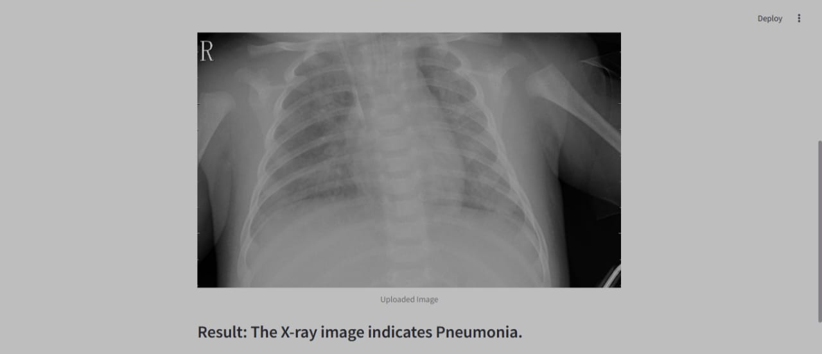
The result page displays the pneumonia detection outcome (normal or pneumonia).

Slide 18
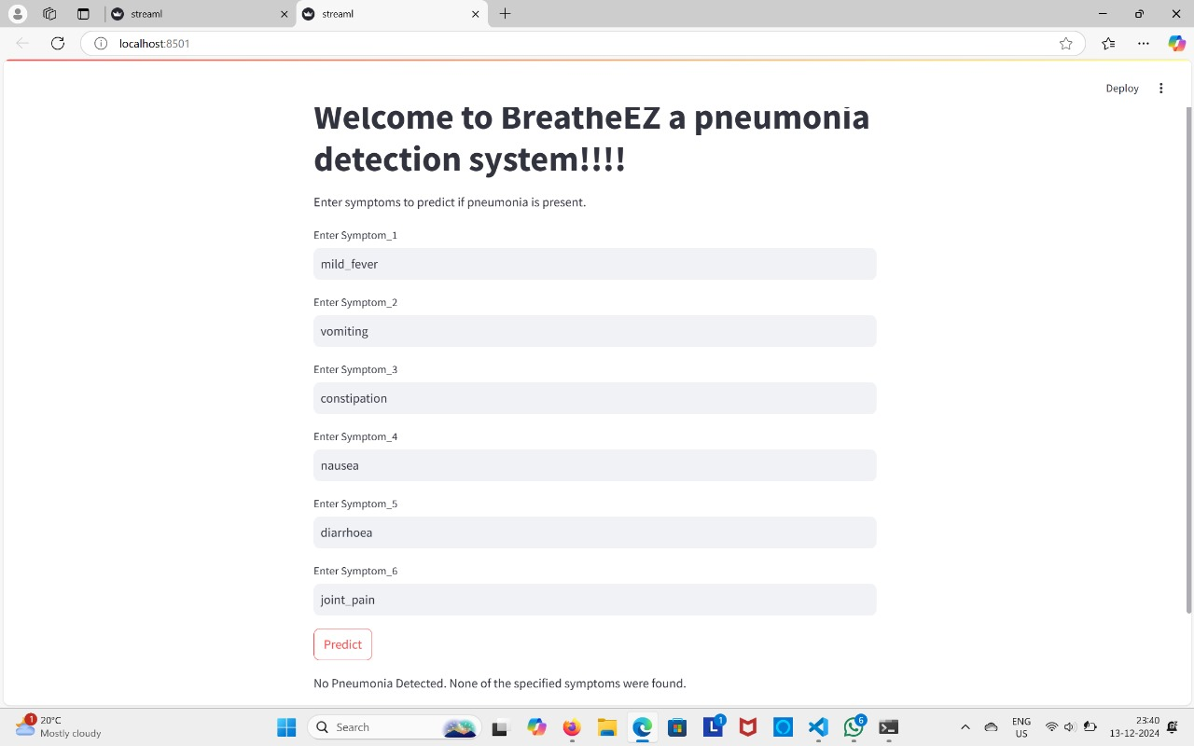
IMPLEMENTATION OF THE SYMPTOMS ANALYSIS MODEL:
The symptom analysis model uses natural language processing (NLP) techniques to evaluate patient-reported symptoms, such as cough, fever, and shortness of breath. It processes these inputs to assess the likelihood of pneumonia, enhancing the diagnostic accuracy by combining symptomatic data with X-ray analysis.

Slide 19
Implementation and Methodology
Data Collection and Preprocessing:
X-ray Data: Utilize a publicly available chest X-ray dataset for pneumonia detection. The dataset is preprocessed by resizing images to 224x224 pixels, normalizing pixel values to the range [0, 1], and organizing data into training, validation, and test sets.
Symptom Data (Optional for Future Scope): For future multimodal integration, collect and preprocess symptom datasets by cleaning, encoding, and normalizing textual or numerical symptom information for compatibility with machine learning models.
Model Selection and Training:
Custom CNN Model: Build a custom convolutional neural network (CNN) for image-based pneumonia detection. The model architecture includes convolutional layers, max-pooling, batch normalization, and fully connected layers, optimized using the Adam optimizer with a binary cross-entropy loss function.
Symptom Analysis Model : A machine learning or natural language processing (NLP) model may be developed to analyze patient-reported symptoms, enabling multimodal integration for comprehensive diagnostics.

Slide 20
Implementation and Methodology
Feature Extraction:
Symptom Data: Text-based features are extracted using techniques like TF-IDF (Term Frequency-Inverse Document Frequency) or bag-of-words to convert patient-reported symptoms into numerical vectors that can be used for machine learning models.
X-ray Data: Features are automatically extracted from chest X-ray images using a Convolutional Neural Network (CNN), which identifies visual patterns and structures such as lung opacity or consolidation to detect pneumonia.
Integration with Streamlit :
Model Loading: The trained CNN model for pneumonia detection (saved in formats like .h5) is loaded into the Streamlit app during the initialization to make real-time predictions.
Prediction API: Streamlit handles user interactions by collecting symptoms and X-ray images via a form interface. The data is then processed and passed to the model for prediction.
Preprocessing in Backend: In the backend, the symptoms are processed (vectorized) and the X-ray images are resized and normalized before being fed into the model for making predictions.

Slide 21
Conclusion
In conclusion, this project showcases a pioneering approach to disease prediction by integrating machine learning algorithms with comprehensive medical data. By leveraging both structured and unstructured data, the system enhances the accuracy and reliability of disease recognition, empowering healthcare professionals to make timely and informed decisions. The user-friendly interface and advanced analytical features facilitate real-time insights, ultimately improving patient care and community health outcomes.
Moreover, the utilization of a robust technology stack ensures the system's efficiency and scalability, making it suitable for handling large datasets. With the incorporation of data preprocessing techniques and collaboration tools, this project not only addresses current challenges in healthcare analytics but also promotes a more connected and informed healthcare ecosystem. Overall, the innovative solutions presented here lay a strong foundation for future advancements in predictive healthcare technologies, with the potential to transform disease management practices significantly.

