Slide 1
Configuration Management Tools

Slide 2
System Configuration Management
Whenever software is built, there is always scope for improvement and those improvements bring changes.
Changes may be required to modify or update any existing solution or to create a new solution for a problem. Requirements keep on changing daily so we need to keep on upgrading our systems based on the current requirements and needs to meet desired outputs.
Changes should be analyzed before they are made to the existing system, recorded before they are implemented, reported to have details of before and after, and controlled in a manner that will improve quality and reduce error. This is where the need for System Configuration Management comes.

Slide 3
System Configuration Management
System Configuration Management (SCM) is an arrangement of exercises that controls change by recognizing the items for change, setting up connections between those things, making/characterizing instruments for overseeing diverse variants, controlling the changes being executed in the current framework, inspecting and revealing/reporting on the changes made.
It is essential to control the changes because if the changes are not checked legitimately then they may wind up undermining a well-run programming. In this way, SCM is a fundamental piece of all project management activities.

Slide 4
Processes involved in SCM
Identification and Establishment – Identifying the configuration items from products that compose baselines at given points in time (a baseline is a set of mutually consistent Configuration Items, which has been formally reviewed and agreed upon, and serves as the basis of further development).
Version control – Creating versions/specifications of the existing product to build new products with the help of the SCM system.
Change control – Controlling changes to Configuration items (CI).

Slide 5
Processes involved in SCM
Configuration auditing – A software configuration audit complements the formal technical review of the process and product. It focuses on the technical correctness of the configuration object that has been modified.
Reporting – Providing accurate status and current configuration data to developers, testers, end users, customers, and stakeholders through admin guides, user guides, FAQs, Release notes, Memos, Installation Guide, Configuration guides, etc.

Slide 6
Advantages of SCM
Improved productivity and efficiency by reducing the time and effort required to manage software changes.
Reduced risk of errors and defects by ensuring that all changes were properly tested and validated.
Increased collaboration and communication among team members by providing a central repository for software artifacts.
Improved quality and stability of software systems by ensuring that all changes are properly controlled and managed.

Slide 7
Disadvantages of SCM
Increased complexity and overhead, particularly in large software systems.
Difficulty in managing dependencies and ensuring that all changes are properly integrated.
Potential for conflicts and delays, particularly in large development teams with multiple contributors.

Slide 8
Ansible
Ansible is an open-source IT engine that automates application deployment, cloud provisioning, intra-service orchestration, and other IT tools. It is an automation and orchestration tool popular for the following reasons:
Simple to Install.
Free and open source.
Lightweight and consistent.
Security features make it very secure.

Slide 9
Ansible
Ansible Architecture
Control node: Commands and list of tasks(playbook) can run by invoking from any control node. You can use any computer that has Python installed on it as a control node.
Managed nodes: Also sometimes called “hosts”, Managed nodes are the network devices you manage with Ansible.
Inventory: Also sometimes called “hostfile”, Inventory is the list of Managed nodes use to organize them. It is also used for creating and nesting groups for easier scaling.

Slide 10
Ansible
Ansible Architecture
Modules: These are the units of code executed by Ansible. Each module can be used for a specific purpose. One can invoke a single module with a task, or invoke several different modules in a playbook.
Tasks: The units of action in Ansible. One can execute a single task once with an ad-hoc command.

Slide 11
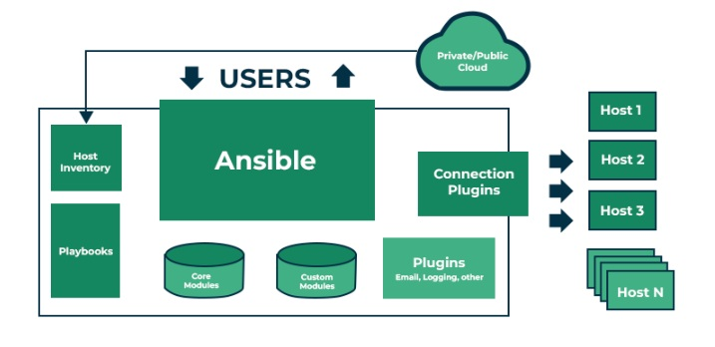
Ansible
Ansible Architecture

Slide 12
Ansible Playbook
These are the ordered list of tasks that are saved so you can run those tasks in that order repeatedly. Playbooks are written in Yet Another Markup Language(YAML) and are easy to read, write, share and understand. Ansible playbooks can perform wide variety of tasks such as:
Deploying and configuring applications
Managing system configurations
Orchestrating complex workflows

Slide 13
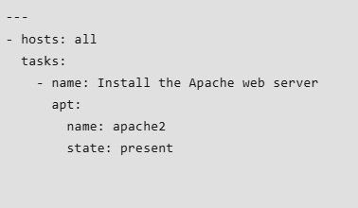
Ansible Playbook
YAML File Example : Playbook

Slide 14
Ansible Tower
Ansible tower provides web-based user interface to manage the playbooks which are used for configuring the software. Ansible tower will acts as an medium to manage and execute the task like playbooks and adding the new host to the ansible. following are some features available in the ansible tower.
Security: Ansible tower provides the Role-based access control (RBAC) which can be used to manage the access of users and can assign permissions to the playbooks and other resources.
Job scheduling: Ansible tower provide the option for scheduling the jobs to execute which will execute automatically in the interval’s of time. This can help to automate tasks such as daily backups or weekly system updates.

Slide 15
Ansible Modules
Ansible modules are scripts which can be reused and performs the tasks which are mentioned in the host servers on behalf of you. Instead of performing the installation of software manually on each server ansible will automate the process.
The tasks which you want to perform can be done on multiple OS also as mentioned following.
Linux
Windows
macOS

Slide 16
Ansible Modules
Types of Ansible Modules
Following are the some modules which are frequently used in the ansible.
System modules
Application modules
Cloud modules
Networking modules
Command modules

Slide 17
Ansible Installation
In order to install ansible, the system must have python preinstalled.
Open up Terminal:
Add the Ansible Repository.
Update the system repository listings.
Install the ansible packages.

Slide 18
Puppet
Puppet is an open-source configuration management automation tool. Puppet permits system administrators to type in infrastructure as code(IaC), using the Puppet Descriptive Language(PDL) rather than utilizing any customized and individual scripts to do so.
A conventional approach would require the system administrator to login to each machine to perform framework organization assignments but that does not scale well.

Slide 19
Puppet Architecture
Puppet uses the client/server model. The server is called a puppet master.
The puppet master stores the recipes or manifests( code containing resources and desired states) for clients.
The clients are called Puppet nodes and runs the puppet agent software. The node runs a puppet daemon(agent) to connect to the puppet master.
These nodes will download the manifest assigned to the node from the puppet master and apply the configuration if needed.

Slide 20
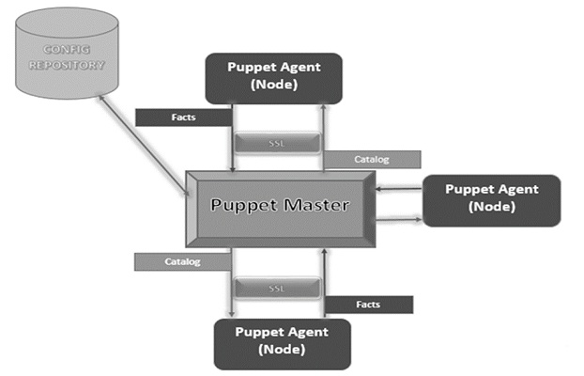
Puppet Architecture

Slide 21
Puppet
Advantages-
It is easy to install.
It has Command Line Interface and Graphical User Interface.
It has a support for all major Operating Systems.
Disadvantages-
Quite slow to respond.
It does not have lifecycle management.
Tough for beginners to learn.

Slide 22
Puppet Installation
Puppet works on the client server architecture, wherein we call the server as the Puppet master and the client as the Puppet node. This setup is achieved by installing Puppet on both the client as well as on all the server machines.
For most of the platforms, Puppet can be installed via the package manager of choice.eg tarball.

Slide 23
Ansible Vs Puppet
S.No. | Ansible | Puppet
1. | Introduced in 2012 by Michael DeHaan. | Introduced in early 2005 by Puppet Labs.
2. | It is built using python. | It is built using Ruby, C++, Clojure.
3. | Ansible follows the concept of procedural programming | Puppet follows the concept of declarative programming.
4. | It follows the push model. | it follows the pull model.
5. | It is more scalable than Puppet. | It is less scalable than Ansible.
6. | It is not much efficient than Puppet. | It is more efficient in completing tasks as compared to Ansible.
7. | There is no role of any agents. | There is the role of the puppet agent.
8. | Its installation process is quite complex. | It can be installed easily and conveniently.
9. | It is less secure than that of Puppet. | It is more secure than Ansible.
10. | It does not offer high availability. | It offers high availability.
11. | Repository of Ansible is Ansible Galaxy. | Repository of Puppet is Puppet Forge.
12. | It primarily has Command Line Interface. | It has Command Line Interface and Graphical User Interface.

Slide 24
End of Slides

