Slide 1
Infrastructure Provisioning

Slide 2
Infrastructure Provisioning
Infrastructure provisioning, as it pertains to IT, involves the preparation, specification, and activation of IT infrastructure components in a way that enables the availability of necessary computing resources when needed. Such resources can include:
Servers
Networks
Storage

Slide 3
Infrastructure Provisioning
Provisioning is generally done before configuring and deploying resources either locally or in the cloud; and while it may sound like it involves these steps, provisioning is different from configuration and deployment.
Provisioning includes the preparatory process needed to get an IT system ready for configuration and can be done in-house or by utilizing Infrastructure as a Service (IaaS).
During configuration that resources can be allocated, dependencies can be set, and components can be enabled to handle necessary workloads.

Slide 4
Benefits of Infrastructure Provisioning
Efficiency: Provisioning significantly reduces the time required to set up resources, streamlining processes and enabling quicker deployment.
Consistency: Ensures consistent configurations and setups, minimizing the chances of human error that can often accompany manual processes.
Productivity: Provisioning reduces the need for extensive intervention by team members, which can increase productivity and enable IT teams to focus more time on revenue-generating initiatives or projects to enhance user experience.
Scalability: With infrastructure provisioning it’s easier to scale operations and deploy resources across various environments efficiently.
Less Downtime: Helps in quick and consistent resource provisioning, reducing downtime and enhancing overall system reliability.

Slide 5
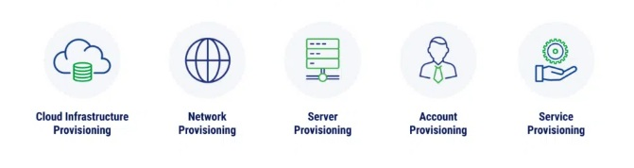
Types of Infrastructure Provisioning

Slide 6
Types of Infrastructure Provisioning
Cloud Infrastructure Provisioning
The goal of cloud infrastructure provisioning is to efficiently establish and manage the resources needed to run applications and services in a cloud environment.
Network Provisioning
Network provisioning involves the configuration of essential components within an enterprise network, such as routers, switches, firewalls, and access points.

Slide 7
Types of Infrastructure Provisioning
Server Provisioning
Server provisioning is the process of setting up and configuring various servers, whether they are physical hardware or virtual machines (VMs). It involves the installation and configuration of necessary software, including operating systems (OS), applications, and middleware.
Account Provisioning
Account provisioning (also referred to as user provisioning) is the management of user accounts across various systems and applications used by an organization and involves setting up initial accounts with the correct credentials, access rights, permissions, user roles.

Slide 8
Types of Infrastructure Provisioning
Service Provisioning
Service provisioning refers to the process of setting up and preparing IT services and applications end users may need to complete their daily tasks. Service provisioning commonly includes tasks like configuration, installation, and activation, ensuring that these services are operational and ready for use by authorized users or systems.

Slide 9
Infrastructure Provisioning Tools
Terraform
Terraform is an open-source infrastructure as code (IaC) software tool which can be used to provision the infrastructure of a cloud platform.
The Hashi Corp Configuration Language(HCL) scripts which have been used to provision infrastructure can be human-readable configuration files that can be versioned, reused, and shared.
One can provision wide range of resources in the cloud by using terraform like compute, storage, networking, and application services, across a variety of cloud providers and on-premises environments.

Slide 10
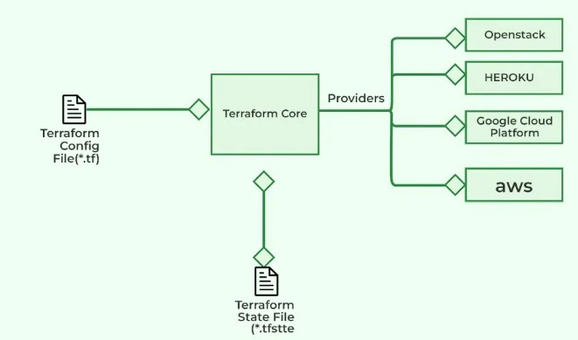
Terraform

Slide 11
Terraform
Application Area of Terraform
Provisioning Cloud Resources: Different types of cloud resources can be provisioned by using terraform like AWS,GCP, and others.
Multi-Cloud Management: You can manage the infrastructure of different cloud platform at a time which will helps you to maintain the multi-cloud or hybrid cloud environments.
Infrastructure Versioning and Collaboration: You can store the scripts which have been written to provision the infrastructure in the version control system like git form where other teams can collaborate on infrastructure changes, track revisions, and roll back to previous states if needed.
Automation and Continuous Integration/Continuous Deployment (CI/CD): You can also integrate the terraform into your CI/CD pipelines wherever the build is triggered if there is any changes the infrastructure will upgrades automatically.

Slide 12
Terraform
Components of Terraform Architecture
1. Terraform Configuration Files(TCF)
These files contain the definition of the infrastructure resources that Terraform will manage, as well as any input and output variables and modules. The configuration files are written in the HashiCorp Configuration Language (HCL), which is a domain-specific language designed specifically for Terraform.

Slide 13
Terraform
2. Terraform State File(TSF)
This file stores the current state of the infrastructure resources managed by Terraform statefile. The state file is used to track the resources that have been created, modified, or destroyed, and it is used to ensure that the infrastructure resources match the desired state defined in the configuration files.
3. Infrastructure as Code(IaC)
Terraform allows you to use code to define and manage your infrastructure, rather than manually configuring resources through a user interface. This makes it easier to version control, review, and collaborate on infrastructure changes.

Slide 14
Terraform
4. Cloud APIs or other Infrastructure Providers
These are the APIs or other interfaces that Terraform uses to create, modify, or destroy infrastructure resources. Terraform supports multiple cloud providers, as well as on-premises and open-source tools.
5. Providers
Terraform integrates with a wide range of cloud and infrastructure providers, including AWS, Azure, GCP, and more. These providers allow Terraform to create and manage resources on those platforms.

Slide 15
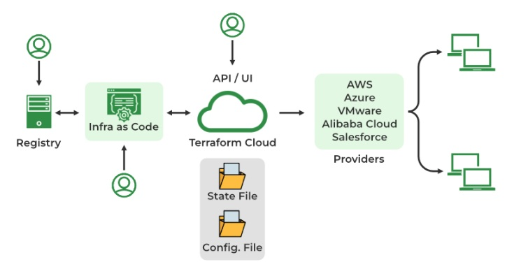
Terraform

Slide 16
Basic Terraform Commands
1. Terraform init
Terraform init command initializes a Terraform working directory by downloading and installing any required plugins and dependencies.
2. Terraform validate
The validate command performs precisely what its name implies. It ensures that the code is internally coherent and examines it for syntax mistakes.

Slide 17
Basic Terraform Commands
3. Terraform apply
Terraform apply command applies the changes defined in the configuration to your infrastructure.
4. Terraform destroy
Terraform destroy command will destroy all the resources created by Terraform in the current working directory.

Slide 18
Basic Terraform Commands
5. Terraform import
Imports an existing resource into the Terraform state, allowing it to be managed by Terraform.
6. Terraform console
Opens an interactive console for evaluating expressions in the Terraform configuration.

Slide 19
Basic Terraform Commands
7. Terraform refresh
This command updates the state of your infrastructure to reflect the actual state of your resources. It is useful when you want to ensure that your Terraform state is in sync with the actual state of your infrastructure.

Slide 20
CloudFormation(AWS)
Amazon Web Services(AWS) offers cloud formation as a service by which you can provision and manage complicated services offered by AWS by using IaC.
CloudFormation is the service offered by the AWS cloud mainly used to provision the service in the AWS like Autoscaling and load balancing and so on.
One can provision all the service automation with the Infrastructure as a code (IAC), instead of managing all of them manually with the help of AWS Cloudformation.

Slide 21
Features Of AWS Cloudformation
No up-front investment
Lowering operating cost
Highly scalable
Easy access
Reducing business risks and maintenance expenses

Slide 22
Benefits of AWS Cloudformation
Automation: AWS CloudFormation helps to automate the process of creating, configuring, and managing AWS resources. This allows for the infrastructure to be deployed quickly, reliably, and repeatedly.
Consistency and standardization: With AWS CloudFormation, it is possible to create standard templates of infrastructure stacks that can be used to create identical copies of the same infrastructure. This ensures consistency in the infrastructure deployment and makes it easier to maintain.
Cost savings: AWS CloudFormation helps to reduce costs by allowing customers to use existing infrastructure templates and reuse them across multiple environments. This reduces the cost of designing and deploying new infrastructure.

Slide 23
Benefits of AWS Cloudformation
Security: AWS CloudFormation helps to ensure that all AWS resources are configured securely by using security policies and rules. This helps to protect the infrastructure from potential security threats.
Scalability: AWS CloudFormation allows for the quick and easy scaling of resources on demand. This means that customers(developers) can quickly and easily add resources to meet their changing needs.

Slide 24
Application Areas Of AWS Cloudformation
Infrastructure Provisioning: AWS Cloudformation is used to provision the infrastructure which means as an infrastructure as a code and it can be performed multiple times to get exact replicas across all the environments.
AutoScaling Environments: The infrastructure provisioned using AWS Cloudformation will always get provisioned with scaling environments which will help you scale up and scale down depending on the incoming load.
Integration With Services: You can integrate the AWS Cloudformation with different services like code pipeline, Jenkins CI/CD pipeline and so on which will help to automate the deployment.
Deployment In Multiple Regions: You can manage the AWS cloud formation to deploy it in multiple regions which will help you in disasters.

Slide 25
CloudFormation (Terms and Concepts)
1.Template
A CloudFormation template is a simply Javascript Object Notation(JSON) or Yet Another Markup Language(YAML) file that defines the AWS resources to be created and configured.
2.Stacks
Stacks are the totality of the resources which are contained within a CloudFormation Template.

Slide 26
CloudFormation (Terms and Concepts)
3.Formatting
JSON and YAML is used in handling templates within CloudFormation. YAML is the more appropriate choice and is very much opted for in terms of usage.
4.Change Sets
Change sets are used to examine what CloudFormation will do, in terms of modification or change , to the deployed resources when an update operation is required on a specific stack.

Slide 27
CloudFormation (Terms and Concepts)
5. Functions
CloudFormation comes with several built-in functions and these functions are aimed at making dynamic configuration easier so that as the resources are being deployed, their properties can be adjusted and modified.
6. Parameters
These offer an opportunity for user interaction during the deployment of the stack thus making it easier to create templates that are flexible and reusable.

Slide 28
CloudFormation (Terms and Concepts)
7. Conditions
Conditions enable or disable the creation of a resource depending on whether certain conditions are true or false.

Slide 29
Deploy a CloudFormation Template
Method 1 : Simply log in, navigate to CloudFormation, and select “Create Stack.” You can then upload your template (in JSON or YAML format), configure parameters, tags, and permissions, and finalize by clicking “Create Stack.”
Method 2: For a more graphical approach, CloudFormation Designer allows users to visually build or modify templates using a drag-and-drop interface within the AWS Console. After creating or adjusting your template, deployment is just a click away by selecting “Create Stack.”
Method 3: After ensuring the AWS CLI is installed and configured, you can deploy your template by running a simple command. This method is particularly useful for developers who want to integrate deployments into CI/CD pipelines or automate infrastructure tasks.

Slide 30
End of Slides

