Slide 1
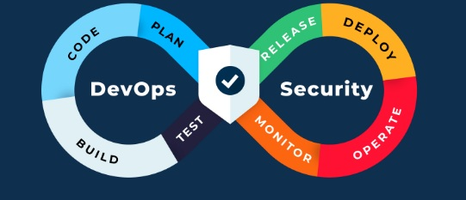
DevOps Security & Compliance
DevOps Security & Compliance refers to the integration of security and regulatory compliance practices into the DevOps lifecycle—from code development and testing to deployment and operations.

Slide 2
What is DevSecOps?
Integration of security into DevOps practices.
Rather than treating security as a final step or separate function, it becomes a shared responsibility across development, operations, and security teams.
Faster releases increase risk. Security must scale with automation.

Slide 3
Key Goals of DevOps Security
Key Goals:
Shift Left: Catch and fix vulnerabilities early in the software development life cycle (SDLC).
Automation: Automate security testing (SAST, DAST), secrets detection, vulnerability scanning, etc.
Continuous Monitoring: Monitor for security threats in real-time across the CI/CD pipeline and production.
Collaboration: Promote a culture of secure coding and operations through shared accountability.

Slide 4
Static Application Security Testing (SAST)
SAST is a security testing method that analyzes source code, bytecode, or binary code for vulnerabilities without executing the program.
It's often called white-box testing and is typically performed early in the CI/CD pipeline—during development or at build time.

Slide 5
How SAST Works ?
Scans the application’s static codebase line-by-line.
Identifies security flaws, such as:
SQL injection
Cross-site scripting (XSS)
Hardcoded secrets
Insecure function usage
Integrates into IDEs, version control systems, or CI pipelines.

Slide 6
Tools for SAST
Open Source:
SonarQube, Bandit (Python) and
Brakeman (Rails)

Slide 7
Benefits of SAST
Early detection of security weakness (shift-left security)
Language-aware analysis for precise findings
No need for a running application (fast and resource-efficient)
Can be automated in the CI pipeline

Slide 8
Limitations
May produce false positives
Doesn’t catch runtime issues (unlike DAST)
Limited in detecting configuration or environment-specific flaws

Slide 9
Dynamic Application Security Testing (DAST)
DAST is a type of black-box security testing that analyzes a running application from the outside in.
It simulates attacks on the application to find vulnerabilities in real-time, without needing access to the source code.

Slide 10
How DAST Works?
Interacts with the deployed application via HTTP/S, mimicking a real attacker.
Sends crafted inputs to identify vulnerabilities like:
SQL Injection
Cross-Site Scripting (XSS)
Authentication flaws
Session management issues
Used mostly in staging or QA environments, and sometimes in production.

Slide 11
Tools for DAST
Open Source:
OWASP ZAP, w3af

Slide 12
Benefits of DAST
Detects runtime issues missed by static analysis
Language-independent — works with any tech stack
No need for access to the source code
Simulates real-world attack scenarios

Slide 13
Limitations
Requires a deployed and running app
Can’t trace issues directly to source code
May have longer scan times
Doesn’t detect issues in hidden paths or dead code

Slide 14
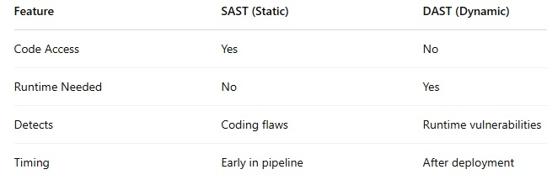
SAST vs. DAST Comparison

Slide 15
DevOps and Compliance
DevOps and Compliance refers to ensuring that software development and delivery processes adhere to industry regulations, legal standards, and internal policies, even as teams move rapidly through continuous integration and delivery cycles.

Slide 16
Compliance Challenges in DevOps
Speed vs. Control: DevOps emphasizes fast iteration; compliance needs documentation, controls, and traceability.
Automation Gaps: Traditional compliance is manual, while DevOps is automated.
Complex Toolchains: Multiple tools across CI/CD pipelines complicate policy enforcement.

Slide 17
Key Compliance Standards
GDPR – Data privacy and protection
HIPAA – Health data security
PCI-DSS – Payment card security
SOC 2 – Trust service principles
ISO/IEC 27001 – Information security management

Slide 18
DevOps Compliance Practices
Compliance as Code:
Use code (e.g., policies, scripts) to automate compliance checks.
Examples: OPA (Open Policy Agent), InSpec, HashiCorp Sentinel
Continuous Compliance Monitoring:
Real-time validation of configurations, access controls, and audit trails.
Automated Auditing & Reporting:
Collect and report on logs, change history, and user activities.
Access Control & Identity Management:
Enforce least privilege, MFA, RBAC across pipelines.

Slide 19
Benefits of DevOps-Driven Compliance
Reduces risk of regulatory fines
Accelerates audits with automated reports
Increases confidence in release quality
Promotes security-by-default culture

Slide 20
Common Compliance Pitfalls
Ignoring security in automation scripts.
Poor secrets management.
Inconsistent configuration across environments.
Lack of traceability in change management.

Slide 21
End of Slides

