Slide 1
SCM and GIT Fundamentals

Slide 2
Introduction to VCS (Git)
Version control systems are a category of software tools that helps in recording changes made to files by keeping a track of modifications done in the code.
A version control system is a kind of software that helps the developer team to efficiently communicate and manage(track) all the changes that have been made to the source code along with the information like who made and what changes have been made.
Basically, Version control system keeps track on changes made on a particular software and take a snapshot of every modification.

Slide 3
Introduction to VCS (Git)
Benefits of the version control system:
Enhances the project development speed by providing efficient collaboration,
Leverages the productivity, expedites product delivery, and skills of the employees through better communication and assistance,
Reduce possibilities of errors and conflicts meanwhile project development through traceability to every small change,
Employees or contributors of the project can contribute from anywhere irrespective of the different geographical locations through this VCS.
For each different contributor to the project, a different working copy is maintained and not merged to the main file unless the working copy is validated.

Slide 4
Introduction to VCS (Git)
Types of Version Control System
Local Version Control Systems: It is one of the simplest forms and has a database that kept all the changes to files under revision control.
Centralized Version Control Systems: Centralized version control systems contain just one repository globally and every user need to commit for reflecting one’s changes in the repository.
Distributed Version Control Systems: Distributed version control systems contain multiple repositories. Each user has their own repository and working copy.

Slide 5
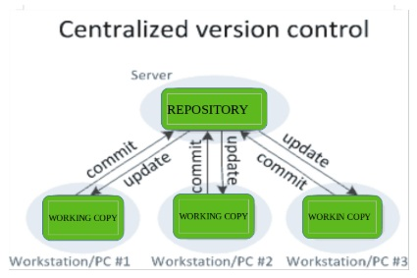
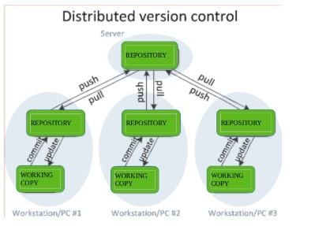
Introduction to VCS (Git)

Slide 6
Introduction to VCS (Git)
Purpose of Version Control:
Multiple people can work simultaneously on a single project.
It also enables one person to use multiple computers to work on a project, so it is valuable even if you are working by yourself.
It integrates the work that is done simultaneously by different members of the team.

Slide 7
Internal Management Mechanisms(GIT)
HEAD :
The current branch in Git is referred to as HEAD. It points to the last commit, which happened in the current checkout branch. It is treated as a pointer for any reference. Once you checkout to another branch, the HEAD also moves to the new branch.
Staging Area :
Staging Area (Index) is where git tracks and saves all the changes in the files. The saved changes are reflected in the .git directory. You use git add “filename” to add the file to the staging area.

Slide 8
Internal Management Mechanisms(GIT)
Working Directory:
The working directory is the place where you are currently working, it is the place where your files are present. Using git status command, you can see what all files/folders are present in the working directory.

Slide 9
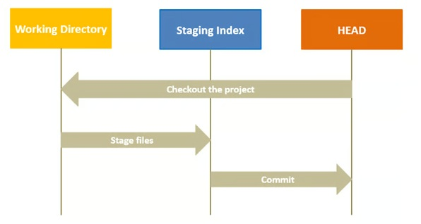
Internal Management Mechanisms(GIT)

Slide 10
Important Note
For second half of unit 4 refer to the experiments conducted in the lab.

Slide 11
Thank You

