Slide 1
Cyber Bullying
A Social Problem of our time
By
Melissa Merry
Allen Road Elementary
mmerry@nscsd.org

Slide 2
Using Public Policy Analysis to solve problems PPA
Define the Problem
Gather the Evidence
Identify the Causes
Evaluate the Existing Policy
Develop Solutions
Select the Best Solution (Feasibility vs. Effectiveness)
This PowerPoint focuses on step one “Defining the Problem” of Cyber Bullying and explaining just what Cyber Bullying is.

Slide 3
Everyone knows what a bully is right?
Think of things that bullies do.
Did you think of these….

Slide 4
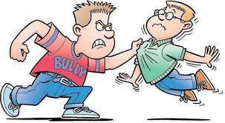
Hurting someone’s body
kicking
hitting
punching

Slide 5
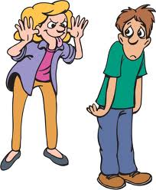
Hurting someone’s feelings
name calling
leaving them out
Making fun of someone

Slide 6
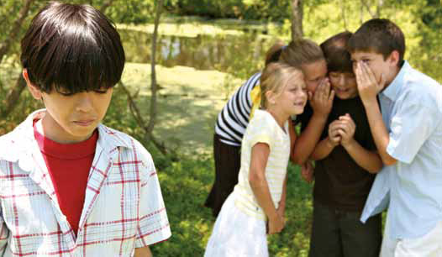
Other types of bullying like…
Spreading rumors about someone
Telling private things about someone
Or threatening to hurt someone

Slide 7
Are these the ONLY examples of bullying there are?
NO!
You are being bullied whenever anyone does something to you in a mean way that makes you feel uncomfortable!

Slide 8
But the title of this PowerPoint is
Cyber Bullying
So…. What is Cyber bullying?

Slide 9


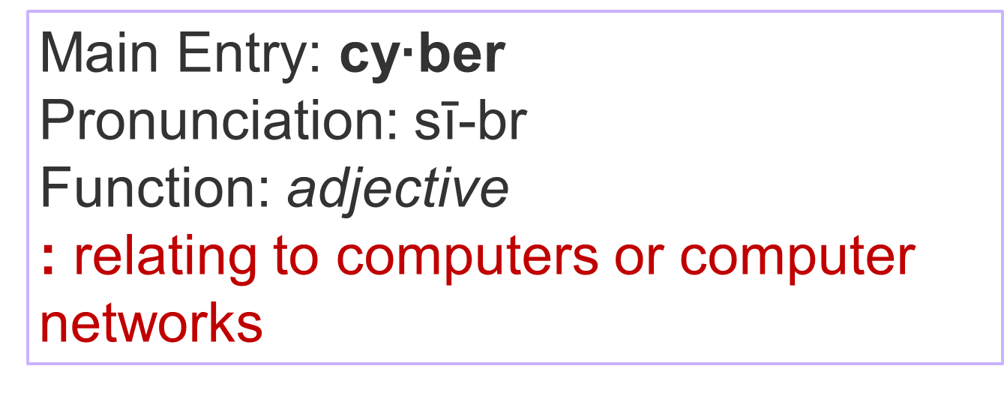
What do you think Cyber Bullying is?

Slide 10
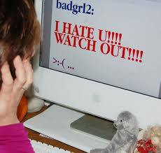
Cyber bullying is when you bully by sending hurtful messages, pictures, or information using computers or cell phones.

Slide 11
Ways children may be Cyber Bullied
Email
Instant messages
Facebook/My Space
Any website or web space that allows posting
Voicemail
Text messages

Slide 12
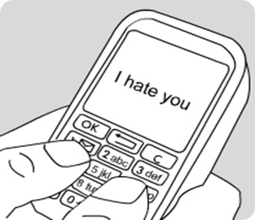
Lets think of some reasons why Cyber Bullying could be even WORSE than bullying someone in person!

Slide 13
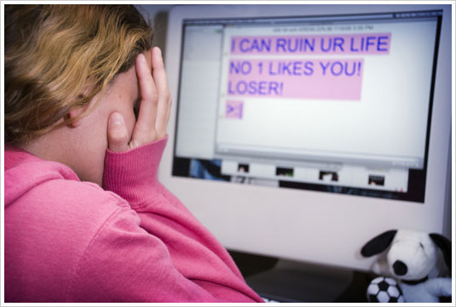
It’s easier to do because you aren’t looking that person in the face. You may not realize how much you are hurting someone.

Slide 14
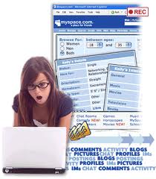
When you post something mean on the internet it can be seen by the world!!! It becomes even MORE hurtful for that person to know that hundreds of people may know that hurtful thing about them.

Slide 15
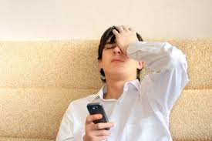
When you send mean text or picture messages to lots of people about a person you can’t take it back and they can send it on and on and it can potentially never get taken back.

Slide 16

When you are thinking of treating others in a certain way….
How would YOU feel if someone treated YOU that way?

Slide 17
Resources
http://library.thinkquest.org/07aug/00117/typesbullying.html#
http://www.stopcyberbullying.org/what_is_cyberbullying_exactly.html
http://www.wordcentral.com/cgi-bin/student
http://www.indezine.com/powerpoint/freebackgrounds/3344.html
Pictures:
azraalibasic.blogspot.com
stopbullyingcanada.wordpress.com
tsa-usa.org
messenger-index.com
events.ucr.edu
ua.edu
dosomething.org
netbus.org

