Slide 1
The Cyber Law Regime in India
Notes:
The Information Technology Act 2000

Slide 2
Disclaimer
This presentation is merely a sketch for the Cyber law provisions in India. It is not to be construed as a verbatim narration of the Law.

Slide 3
“Cyber Law” is a vast study
It is not the IT Act but, It includes, and is comprised of many Acts, legislations like Evidence, IPC & Cr.P.C.
The IT Act in itself, is a challenging study.
Understanding the difference between http & https is beyond the comprehensive capacity for any Lawyer.
Cyber forensic, Cyber security, Cyber law, anatomy of cyber attacks ….ohhh !

Slide 4
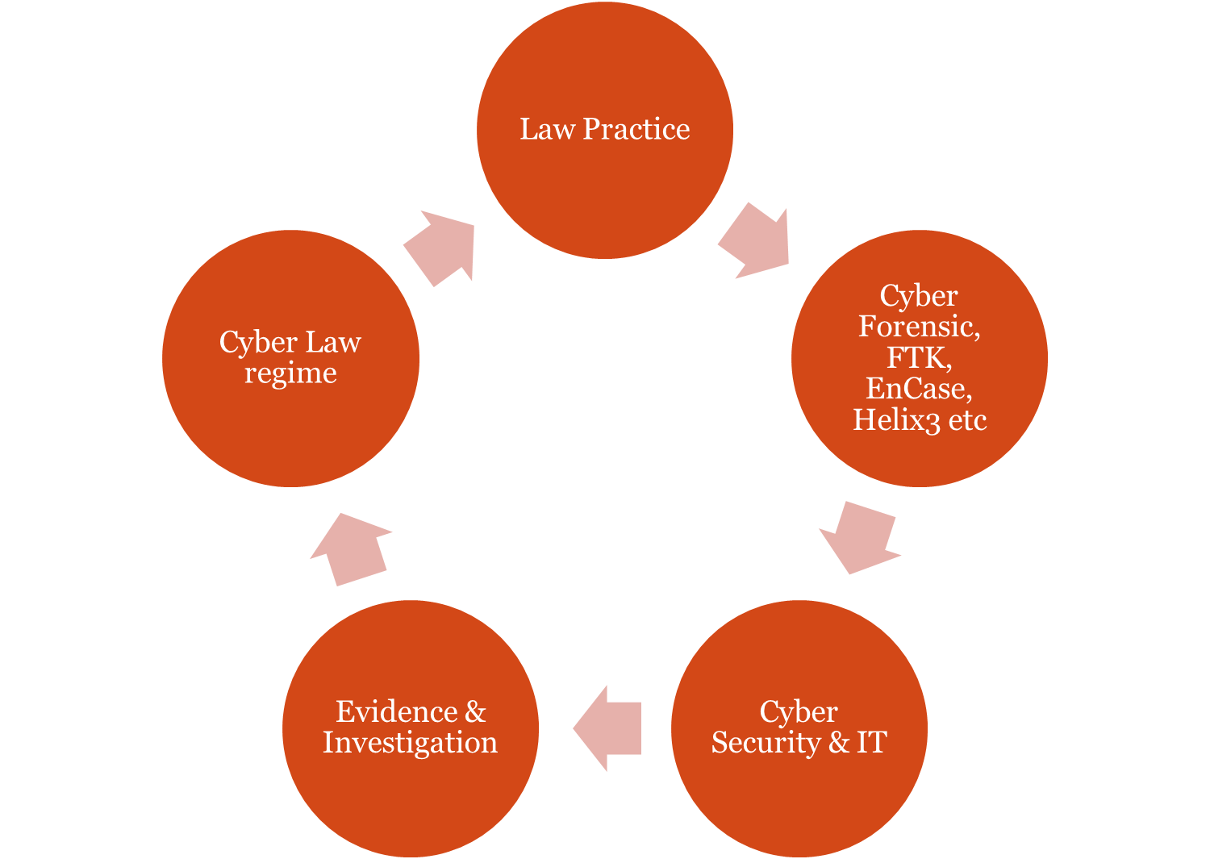


Slide 5
Introduction
The Information Technology Act is the Second Law in India governing the field of Technology.
The First one was in the year 1885.
That was the Indian Telegraph Act 1885

Slide 6

However, The first recorded Cyber crime incident is believed to be recorded in the year 1820 !
Difficult to believe ? Any guesses ?

Slide 7
In the year 1820, Sir Joseph-Marie Jacquard, created an automated loom.
This device was blended with analogical technology in the weaving of special fabrics.
This resulted in a fear amongst Jacquard's employees that their traditional employment and livelihood were being threatened. They committed acts of sabotage to discourage Jacquard from further use of the new technology.
This was the first recorded cyber crime !

Slide 8
But why Cyber Law ?

Slide 9
Because :
Cyber space is a completely different sphere of human existence.
No regards for any Government or territory.
To facilitate international norms.
Cyber Law needs to be specific.
Conventional Laws will muddle up the cyber law structure.

Slide 10
Intention of the IT Act 2000
The Act begins with :
“An Act to provide legal recognition for transactions carried out by means of electronic data interchange and other means of electronic communication, commonly referred to as "electronic commerce", which involve the use of alternatives to paper-based methods of communication and storage of information, to facilitate electronic filing of documents with the Government agencies…”

Slide 11
Evolution of the Act
The General Assembly of the United Nations by its resolution A/RES/51/162, dated the 30th January, 1997 had adopted the Model Law on E - Commerce adopted by the UNCITRAL,
The said resolution recommended that all member States give favourable consideration to the said Model Law when they enact or revise their laws, in view of the need for uniformity of the law applicable to alternatives to paper-based methods of communication and storage of information; i.e. amongst member nations to promote international trade and commerce via electronic means.
Hence, the same was adopted and enforced in India.

Slide 12
Cyber Law in India
Aided by many other Acts and Statutes.
1) The Indian Penal code
2) The Evidence Act
3) the code of Criminal procedure.
& many others

Slide 13
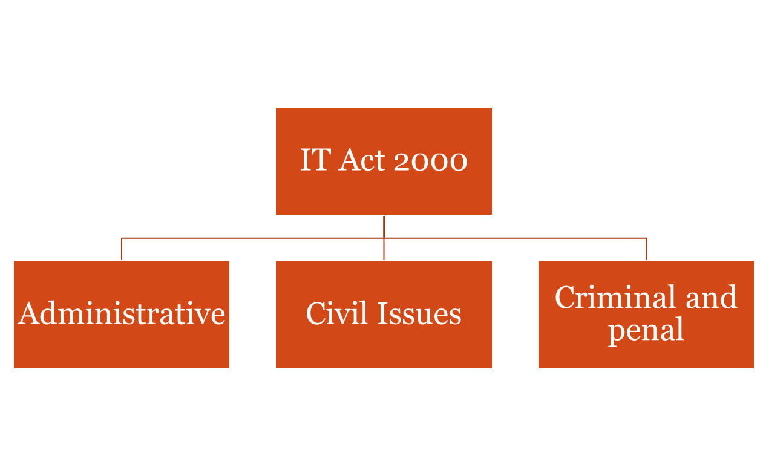
The Information Technology Act
The Act can be broadly classified into 3 aspects :

Slide 14
IT Act of 2000
ADMINISTRATIVE PART :
Recognizing e-commerce
Legal enforceability and authentication of electronic - Documents
Methodology and process.
A special adjudicating officer & Cyber Law Appellate Tribunal
Their role and duties therein.

Slide 15
IT Act 2000
The CIVIL aspect
Runs parallel to Administrative ventures of the IT Act.
Describes what constitutes civil infringement of rights.
Prescribes civil duties

Slide 16
IT Act 2000
CRIMINAL Part
Recognizes and provides for Penal measures against crime in cyber space, digital crimes or crime against computer resource.
Related issues to redress, monitor, restrict, investigate, cyber crime is also provided herein.

Slide 17
IT Act 2000
Recognises the Cardinal Philosophy of Cyber disputes
1 ) Computers can be abused.
2 ) Computers are weapons as well as Victims.
The term “Computer” has a wide amplitude in view of the IT Act.

Slide 18
Definition of a Computer
Section 2 of the Act defines :
(i)"computer" means any electronic magnetic, optical or other high-speed data processing device or system which performs logical, arithmetic, and memory functions by manipulations of electronic, magnetic or optical impulses, and includes all input, output, processing, storage, computer software, or communication facilities which are connected or related to the computer in a computer system or computer network.
(j) "computer network" means the interconnection of one or more computers through—
    (i) the use of satellite, microwave, terrestrial line
    or other communication media; and
    (ii) terminals or a complex consisting of two or more interconnected computers whether or not the interconnection is continuously maintained;
(k) "computer resource" means computer, computer system, computer network, data, computer data base or software;
(l) "computer system" means a device or collection of devices, including input and output support devices and excluding calculators which are not programmable and capable of being used in conjunction with external files, which contain computer programmes, electronic instructions, input data and output data, that performs logic, arithmetic, data storage and retrieval, communication control and other functions;

Slide 19
The new amendment also defines :
Cyber Café (s 2 (na))
Electronic signature (apart from DSC)
Communication devices. (s 2 (ha))
Cyber security (s 2 (nb))
Indian CERT (s 70 B (1))

Slide 20
Section 4- Legal recognition of Electronic Records
If any information is required in printed or written form under any law the Information provided in electronic form, which is accessible so as to be usable for subsequent use, shall be deemed to satisfy the requirement of presenting the document in writing or printed form.
A general provision for recognizing electronic documents

Slide 21
Sections 5, 6, 7, 8, 9 & 10.
5 - Legal recognition of electronic signatures
6 - Use of e-Records & signatures in Government & Its Agencies
7 and 7 (a)- Retention of Electronic Records & audits
8 - Publications of rules and regulations in the e-Gazette.
9 - no right to claim and insist on electronic documents
10 – Central Govt retains the power to make rules w.r.t. e-Signatures (type, manner, format & process)

Slide 22
Sections 11, 12 – Receipt & Ack.
Sec. 11 – discuss about the attributor(sender) of electronic record i.e. sender himself, or by a person authorised by the other, or by an auto response duly programmed on behalf of the other
Sec. 12 – discuss receipt for acknowledgement where nothing has been stipulated
    Any communication from addressee/automated or otherwise.
    Any conduct of the addressee that proves sufficiently.
  However conditions may be imposed by the attributor via e mail footer and statements therein

Slide 23
IT Act –overview of other relevant admin. provisions
Sec. 16 | Central Government to prescribe security procedures !!!
Sec 17-34 | Appointment and Regulation of Controller and certifying authority
Sec 35 to 39 | Obtaining Digital Signature Certificate
Sec 40 to 42 | Duties of Subscriber of DSC- exercise due care to retain the private key

Slide 24
Administrative character
Sec 44 : penalty for failure to furnish information, return etc…
Appointment and functions of Adjudicating officer
Powers and functioning of the Cyber Law Appellate Tribunal
Sec 61 : Civil Court excluded from jurisdiction.
Sec 46 & 2(1)(c) : Adjudicating officer.

Slide 25
Offences in a Gist
Sec 43 : earlier a simple civil provision
Now a Civil, and may amount to a penal offence u/s 66 if a fraudulent or dishonest mens rea is established !
It relates to access to computer without the permission of the computer owner
It penalizes any sort of unauthorized access or assistance

Slide 26
Sec 43 in a nut shell
Whoever without permission of owner of the computer
  Secures/Disrupts access of computer ..resource..network..
  Downloads, copies, extracts any data
  Introduces or causes to be introduced any viruses or contaminant
  Damages or causes to be damaged any computer resource
    Destroy, alter, delete, add, modify or rearrange
    Change the format of a file
  Disrupts or causes disruption of any computer resource
    Preventing normal continuance of computer
Sec 43A : Failure to protect Data

Slide 27
Examples
An employee authorised to access Word files, accesses internet.
A student inadvertently spreads a virus with his USB Drive.
A neighbor mistakenly chops off the internet cable, expecting it to be an electric wire.

Slide 28
Case Study 1
Xgen Networks Pvt Ltd provides Internet services to Robust Software solutions.
Robust Software cleared all its monthly bills.
Xgen had some billing issue and they barred the internet services to Robust Software despite repeated reminders from Robust that their bills were paid.
Robust Software suffered tremendous loss due to the disrupted Internet Services.
What would you suggest Robust Software?

Slide 29
Sec 65 : Tampering with Computer Source documents.
Punishment – Imprisonment upto three years or fine upto Rs 2 Lacs or both.
Sec 66 : Penalises any contravention u/s 43 if carried out with a fraudulent or dishonest motive
Punishment – Imprisonment upto three years or fine upto Rs 5 Lacs or both.
Sec 66 A : Punishment for sending offensive messages through communication service etc…
Requisites : offensive or menacing or false, or for the purpose of annoyance, inconvenience, ill will etc…
Punishment – Imprisonment upto three years and with fine.

Slide 30
Sec 66 B : Punishment for dishonestly receiving stolen computer/resource etc.
Sec 66 C : Punishes identity theft (DSC, passwords, or such unique identification.)
Sec 66 D : Punishes personating, by means of Computer resource.
Sec 66 E : Punishes violation of privacy rights.
Sec 66 F : Punishes Cyber Terrorism

Slide 31
Sec 67A : Punishment for publishing or transmitting of material containing sexually explicit act, etc.. In the electronic form.
Punishment :
1st conviction-Imprisonment upto 5 years and fine upto Rs 10 Lacs.
2nd conviction-Imprisonment upto 7 years and fine upto Rs 10 Lacs.
EXCEPTION
Art, Science, literature or other interests of learning and other cases
Sec 67B : Punishment for publishing or transmitting of material depicting children in sexually explicit act, etc.. In the electronic form. (Readwith other sub rules)
Punishment :
1st conviction-Imprisonment upto 5 years and fine upto Rs 10 Lacs.
2nd conviction-Imprisonment upto 7 years and fine upto Rs 10 Lacs.
Sec 67C : Preservation & retention of information by intermediaries.
Punishment - Imprisonment upto three years and with fine.

Slide 32
Sec 68 : Provision and punishment for violation of orders from the Controller.
Sec 69 : Powers of the Govt. to issue direction for monitoring, intercepting or decrypting any information through any Computer Resource.
(Basically an administrative right of the Govt. and provides for punishment to the violator, usually intermediaries who are incharge of such database or are service providers.)
Sec 69 A powers for blocking of public access
Sec 69 B power to authorize monitor and collect traffic.

Slide 33
Sec 71 : Penalty for Misrepresentation before the Controller or the Certifying Authority
    Punishment - Imprisonment upto 2 years or fine upto Rs. 1 Lac or both.
Sec 72 : Penalty for breach of Confidentiality & privacy, the provision applies to those persons who are empowered under this Act with such a database or records.
    Punishment - Imprisonment upto 2 years or fine upto Rs. 1 Lac or both.
Sec 72A : Penalty for disclosure of information in breach of Lawful Contract –(an amendment to include even the employees of private organisations or such intermediaries working therein)
    Punishment - Imprisonment upto 3 years or fine upto Rs. 5 Lac or both.

Slide 34
Sec 74 : Publication of Signature or signature certificates for fraudulent purpose.
    Punishment - Imprisonment upto 2 years or fine upto Rs. 1 Lac or both.
Sec 76 : provides for confiscation of any related computer accessory, system part etc if the same is believed to be used in any violation of this Act or rules.

Slide 35
Sec 77 B : Offences punishable with imprisonment upto 3 years to be bailable.
Sec 78 : Power to investigate offences now available to Inspector, earlier the onus was on the DSP rank officer or above.

Slide 36
Sec 79 : Exemption of Intermediaries and service providers if they establish that they have exercised due diligence on their part.
An abusive provision for the ISP’s but often helpful !

Slide 37
The 2009 notification makes it an offence to even abet or attempt a cyber crime, earlier unsuccessful criminals always escaped by virtue of this grey area.
Sec 84 B : Punishment for Abetment
    Same punishment as prescribed for the offence
Sec 84 C :Punishment for attempt
    A maximum of one-half of the term of imprisonment provided for the offence, or with fine as prescribed for the offence or with both.
Sec 90: State Govt. has powers to make allied rules.

Slide 38
The Indian Penal Code
Vis-à-vis
The Cyber Crime

Slide 39
Relevant application of IPC etc…
Sending threatening messages by email | Sec 503 IPC
Sending defamatory messages by email | Sec 499, 500 IPC
Forging electronic records | Sec 463, 470, 471 IPC
Bogus websites, cyber frauds | Sec 420 IPC
Email spoofing | Sec 416, 417, 463 IPC
Online sale of Drugs | NDPS Act
Web - Jacking | Sec. 383 IPC
Online sale of Arms | Arms Act

Slide 40
The Evidence Act
Filing an FIR is easy, but not chargesheet.
Digital evidence is extremely volatile & difficult to preserve.
Indian criminal justice system requires guilt to be proved beyond reasonable doubt.

Slide 41
Evidence Act
The major highlight of the Evidence Act in view of the IT Act 2000 is that it recognises electronic evidence.
Sec 65 is the most important provision dealing with specific provision on digital evidence.
Sec 65B provides for a detailed process for the analysis of the digital evidence in question.
Sec 65 B (4) requires a certificate from the examiner of digital evidence.

Slide 42
Evidence Act
The Govt. shall notify who is the gazetted examiner for Digital evidence u/s 79 A of the IT Act.
The same provision is exclusive, it excludes all other Cyber Forensic experts from entering this field u/s 45 of the Evidence Act.

Slide 43
Is digital evidence binding upon courts ?
Is EnCase/FTK approved by Central govt. for this purpose?
Is e-mail/sms admissible as evidence?
Is data retrieved from remote servers acceptable?

Slide 44
Is EnCase/FTK approved by Central govt. for this purpose?
Answer : It is not required, the testimony of such an evidence is viewed as a mere opinion of the expert. Do not be confused for NIST(USA) Policy, although a standard approval should help.

Slide 45
Detrailing tricks !
Keep altering the time clock.
Keep the PC infected with viruses and Trojans.
Use (Kernel)modified forms of OS.
Use unknown applications.
Keep the PC in defective mode.
Use hardware that is difficult to find.
Never try any trick which directly co-relates with an attempt to destroy evidence.

Slide 46
Need of the hour ?
To strengthen investigation mechanism by making it a quick response cell.
Educate the IO’s, about handling & processing, search & seizure.
Advanced Lab with skilled personnel.
YOU HAVE TO join hands with IT Professionals.
Keep upgrading.
Remember, It’s a white collar crime.

