Slide 1
Computer Security: Principles and Practice
Chapter 14 – IT Security Management and Risk Assessment
First Edition
by William Stallings and Lawrie Brown
Lecture slides by Lawrie Brown
Notes:
Lecture slides prepared by Dr Lawrie Brown (UNSW@ADFA) for “Computer Security: Principles and Practice”, 1/e, by William Stallings and Lawrie Brown, Chapter 16 “IT Security Management and Risk Assessment”.

Slide 2
Overview
security requirements means asking
  what assets do we need to protect?
  how are those assets threatened?
  what can we do to counter those threats?
IT security management answers these
  determining security objectives and risk profile
  perform security risk assessment of assets
  select, implement, monitor controls
Notes:
Now look at the process of how to best select and implement measures to effectively address an organization’s security requirements. This involves examining three fundamental questions:
What assets do we need to protect?
How are those assets threatened?
What can we do to counter those threats?
IT security management is the formal process of answering these questions, ensuring that critical assets are sufficiently protected in a cost effective manner. More specifically, IT security management consists of firstly determining a clear view of an organization’s IT security objectives and general risk profile. Next an IT security risk assessment is needed for each asset in the organization that requires protection to answer the three key questions listed above. This provides the information necessary to decide what management, operational and technical controls are needed to reduce the risks identified to an acceptable level, eliminate them, or to provide mitigating controls. The process continues by selecting suitable controls, and then writing plans and procedures to ensure these necessary controls are effectively implemented. The whole process must be iterated, and the plans and procedures kept up-to-date, because of the rapid rate of change in both the technology and the risk environment. We discuss the latter part of this process in the next chapter.

Slide 3
IT Security Management
IT Security Management: a process used to achieve and maintain appropriate levels of confidentiality, integrity, availability, accountability, authenticity and reliability. IT security management functions include:
  • organizational IT security objectives, strategies and policies
  • determining organizational IT security requirements
  • identifying and analyzing security threats to IT assets
  • identifying and analyzing risks
  • specifying appropriate safeguards
  • monitoring the implementation and operation of safeguards
  • developing and implement a security awareness program
  • detecting and reacting to incidents
Notes:
The discipline of IT security management has evolved considerably over the last few decades. [ISO13335] provides a conceptual framework for managing security. It defines IT Security Management as shown on this slide.

Slide 4
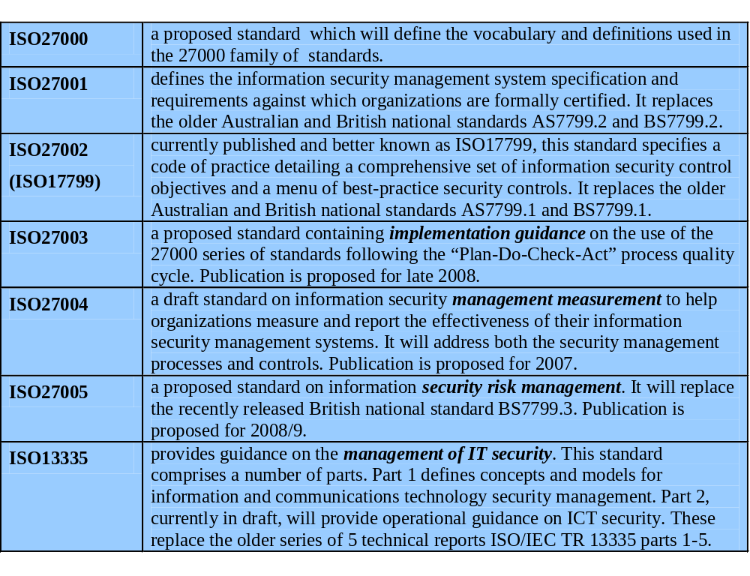
ISO 27000 Security Standards
Notes:
In the last decade a number of national and international standards have been published. These represent a consensus on the “best practice” in the field. The International Standards Organization (ISO) is currently revising and consolidating a number of these standards into the “ISO 27000 series”. Table 16.1 in the text details a number of existing and proposed standards associated with this family. In the US, NIST has produced a number of relevant standards, including [NIST02], [NIST05] and [NIST06]. With the growth of concerns about corporate governance following events such as the Enron collapse, and repeated incidences of the loss of personal information by government organizations, auditors for such organizations increasingly request adherence to formal standards such as these.

Slide 5
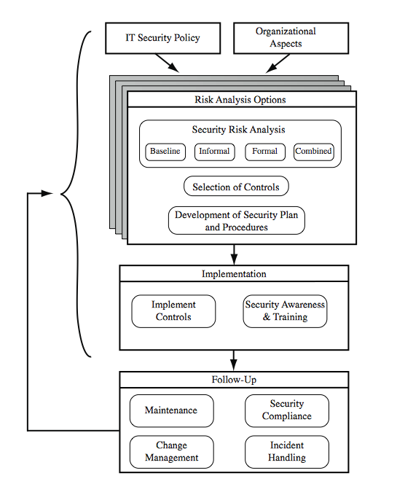
IT Security Management Process
Notes:
The IT security management process is illustrated in Figure 16.1 of the text (based on [ISO13335]), with a particular focus on the internal details relating to the risk assessment process. It is important to emphasize that IT security management needs to be a key part of an organization’s overall management plan. Similarly, the IT security risk assessment process should be incorporated into the wider risk assessment of all the organization’s assets and business processes. Hence, unless senior management in an organization are aware of, and support, this process, it is unlikely that the desired security objectives will be met and contribute appropriately to the organization’s business outcomes. Note also that IT management is not something undertaken just once. Rather it is a cyclic process that must be repeated constantly in order to keep pace with the rapid changes both in IT technology and the risk environment.

Slide 6
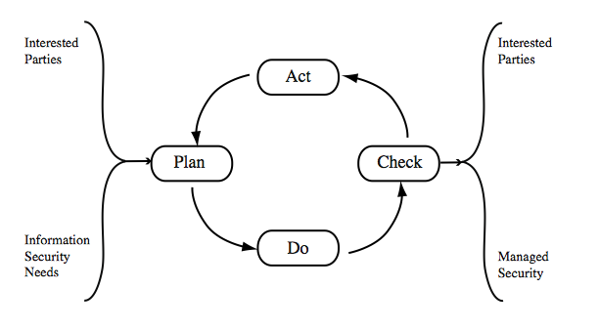
Plan - Do - Check – Act (Deming Cycle)
take corrective and
preventative actions
(based on audits)
establish policy; define
objectives and processes
assess and measure
and report results
implement and operate
policy, controls, processes
Notes:
The iterative nature of this process is a key focus of [ISO27001], and is illustrated in Figure 16.2 (from [ISO27001]) in the text. This standard details a model process for managing information security that comprises the following steps:
Plan - establish security policy, objectives, processes and procedures relevant to managing risk and improving information security to deliver results in accordance with an organization’s overall policies and objectives.
Do - implement and operate the security policy, controls, processes and procedures.
Check - assess and, where applicable, measure process performance against security policy, objectives and practical experience and report the results to management for review.
Act - take corrective and preventive actions, based on the results of the internal security audit and management review or other relevant information, to achieve continual improvement of the security management process.
Compare this figure with that on the previous slide. The development of the organization’s IT security objectives, strategies and policies, the risk assessment, and the development of an IT security plan all clearly constitute the “plan” stage of this process. The implementation aspects constitute the “do” stage. The follow up forms the “check” stage. Lastly, the feedback of details from the follow up aspects to all earlier stages in the process comprises the “act” stage of this model. The outcome of this process should be that the security needs of the interested parties are managed appropriately.

Slide 7
Organizational Context and Security Policy
first examine organization’s IT security:
  objectives - wanted IT security outcomes
  strategies - how to meet objectives
  policies - identify what needs to be done
maintained and updated regularly
  using periodic security reviews
  reflect changing technical/risk environments
Notes:
The initial step in the IT security management process comprises an examination of the organization’s IT security objectives, strategies and policies, in the context of the organization’s general risk profile. Organizational security objectives identify what IT security outcomes should be achieved. They need to address individual rights, legal requirements and standards imposed on the organization, in support of the overall organizational objectives. Organizational security strategies identify how these objectives can be met. Organizational security policies identify what needs to be done. These objectives, strategies and policies need to be maintained and regularly updated based on the results of periodic security reviews, to reflect the constantly changing technological and risk environments. To help identify these organizational security objectives, the role and importance of the IT systems in the organization is examined. The value of these systems in assisting the organization achieve its goals is reviewed, not just the direct costs of these systems.

Slide 8
Security Policy: Topics to Cover
needs to address:
  scope and purpose including relation of objectives to business, legal, regulatory requirements
  IT security requirements
  assignment of responsibilities
  risk management approach
  security awareness and training
  general personnel issues and any legal sanctions
  integration of security into systems development
  information classification scheme
  contingency and business continuity planning
  incident detection and handling processes
  how when policy reviewed, and change control to it
Notes:
The organizational security policy describes what the objectives and strategies are, and the process used to achieve them. The intent of the policy is to provide a clear overview of how an organization’s IT infrastructure supports its overall business objectives in general, and more specifically what security requirements must provided in order to do this most effectively. The organizational or corporate security policy may be either a single large document, or more commonly a set of related documents. This policy typically needs to address at least the following topics:
• the scope and purpose of the policy
• the relationship of the security objectives to the organization’s legal and regulatory obligations, and its business objectives
• IT security requirements in terms of confidentiality, integrity, availability, accountability, authenticity and reliability, with regard to views of asset owners
the assignment of responsibilities relating to the management of IT security
the risk management approach adopted by the organization
• how security awareness and training is to be handled
• general personnel issues, especially for those in positions of trust, and any legal sanctions that may be imposed on staff, and the conditions when apply
• integration of security into systems development and procurement
• definition of the information classification scheme used across the organization
• contingency and business continuity planning, incident detection and handling
• how and when it is reviewed and method for controlling changes to it

Slide 9
Management Support
IT security policy must be supported by senior management
need IT security officer
  to provide consistent overall supervision
  manage process
  handle incidents
large organizations needs IT security officers on major projects/teams
  manage process within their areas
Notes:
It is critical that the IT security policy has full approval and buy-in by senior management. Without this, experience shows that it is unlikely sufficient resources or emphasis will be given to meeting the identified objectives and achieving a suitable security outcome. With the clear, visible support of senior management, it is much more likely that security will be taken seriously by all levels of personnel in the organization. This support is also evidence of concern and due diligence in the management of the organizations systems, and the monitoring of its risk profile. Because the responsibility for IT security is shared across the organization, there is a risk of inconsistent implementation of security, and a loss of central monitoring and control. The various standards strongly recommend that overall responsibility for the organization’s IT security be assigned to a single person, the Organizational IT security officer. This person should ideally have a background in IT security. Larger organizations will need separate IT project security officers associated with major projects and systems. Their role is to develop and maintain security policies for their systems, develop and implement security plans relating to these systems, handling the day-to-day monitoring of the implementation of these plans, and assisting with the investigation of incidents involving their systems.

Slide 10
Security Risk Assessment
critical component of process
  else may have vulnerabilities or waste money
ideally examine every asset vs risk
  not feasible in practice
choose one of possible alternatives based on organization’s resources and risk profile
  baseline
  informal
  formal
  combined
Notes:
The key risk management component of the IT security process is critical, since without it there is a significant chance that resources will not be deployed where most effective. The result will be that some risks are not addressed, leaving the organization vulnerable, whilst other safeguards may be deployed without sufficient justification, wasting time and money. Ideally every single organizational asset is examined, and every conceivable risk to it evaluated. If a risk is judged to be too great, then appropriate remedial controls are deployed to reduce the risk to an acceptable level. In practice this is clearly impossible.
Given the very wide range of organizations there clearly needs to be a range of alternatives available in performing this process. There are a range of formal standards which detail suitable IT security risk assessment processes, including [ISO13335] and [NIST02]. In particular, [ISO13335] recognizes four approaches to identifying and mitigating risks to an organization's IT infrastructure: baseline approach, informal approach, detailed risk analysis, combined approach.
The choice among these will be determined by the resources available to the organization, and from an initial high-level risk analysis that considers how valuable the IT systems are, and how critical to the organization’s business objectives. Legal and regulatory constraints may also require specific approaches. This information should be determined when developing the organization’s IT security objectives, strategies and policies.

Slide 11
Baseline Approach
use “industry best practice”
  easy, cheap, can be replicated
  but gives no special consideration to org
  may give too much or too little security
implement safeguards against most common threats
baseline recommendations and checklist documents available from various bodies
alone only suitable for small organizations
Notes:
The baseline approach to risk assessment aims to implement a basic general level of security controls on systems using baseline documents, codes of practice, and “industry best practice”. The advantages of this approach are that it doesn’t require the expenditure of additional resources in conducting a more formal risk assessment, and that the same measures can be replicated over a range of systems. The major disadvantage is that no special consideration is given to variations in the organization’s risk exposure based on who they are and how their systems are used. As well, there is a chance that the baseline level may be set either too high, leading to expensive or restrictive security measures that may not be warranted. Or it may be set too low, resulting in insufficient security and leaving the organization vulnerable. The goal of the baseline approach is to implement generally agreed safeguards to provide protection against the most common threats. These would include implementing “industry best practice” in configuring and deploying systems. As such, the baseline approach forms a good base from which further security measures can be determined. Suitable baseline recommendations and checklists documents may be obtained from a range of organizations (standards, CERTs, NSA, industry bodies). The use of the baseline approach alone would generally only be recommended for small organizations without the resources to implement more structured approaches. But it will at least ensure that a basic level of security is deployed, which is still not guaranteed by the default configurations of many systems.

Slide 12
Informal Approach
conduct informal, pragmatic risk analysis on organization’s IT systems
exploits knowledge and expertise of analyst
fairly quick and cheap
does address some org specific issues
some risks may be incorrectly assessed
skewed by analysts views, varies over time
suitable for small to medium sized orgs
Notes:
The informal approach involves conducting some form of informal, pragmatic risk analysis for the organization’s IT systems. This analysis does not involve the use of a formal, structured process, but rather exploits the knowledge and expertise of the individuals performing this analysis. These may either be internal experts if available, or alternatively external consultants. A major advantage of this approach is that the individuals performing the analysis require no additional skills. Hence an informal risk assessment can be performed relatively quickly and cheaply. In addition, since the organization’s systems are being examined, judgments can be made about specific vulnerabilities and risks to systems for the organization that the baseline approach would not address. Thus more accurate and targeted controls may be used than would be the case with the baseline approach. There are a number of disadvantages. Since a formal process is not used, there is a chance that some risks may not be considered appropriately, potentially leaving the organization vulnerable. As well, because the approach is informal, the results may be skewed by the views and prejudices of the individuals performing the analysis. It may also result in insufficient justification for suggested controls, leading to questions over whether the proposed expenditure is really justified. Lastly there may be inconsistent results over time as a result of differing expertise in those conducting the analysis. The use of the informal approach would generally be recommended for small to medium sized organizations where the IT systems are not necessarily essential to meeting the organization’s business objectives, and where additional expenditure on risk analysis cannot be justified.

Slide 13
Detailed Risk Analysis
most comprehensive alternative
assess using formal structured process
  with a number of stages
  identify likelihood of risk and consequences
  hence have confidence controls appropriate
costly and slow, requires expert analysts
may be a legal requirement to use
suitable for large organizations with IT systems critical to their business objectives
Notes:
The third and most comprehensive approach is to conduct a detailed risk assessment of the organization’s IT systems, using a formal structured process. This provides the greatest degree of assurance that all significant risks are identified and their implications considered. This process involves a number of stages including identification of assets, identification of threats and vulnerabilities to those assets, determination of the likelihood of the risk occurring and the consequences to the organization should that occur, and hence the risk the organization is exposed to. With that information, appropriate controls can be chosen and implemented to address the risks identified. The advantages of this approach is that it provides the most detailed examination of the security risks of an organization’s IT systems, and produces strong justification for expenditure on the controls proposed. It also provides the best information for continuing to manage the security of these systems as they evolve and change. The major disadvantage is the significant cost in time, resources, and expertise needed to perform such an analysis. The time taken to perform this analysis may also result in delays in providing suitable levels of protection for some systems. The details of this approach are discussed in the next section. The use of a formal, detailed risk analysis is often a legal requirement for some government organizations, and businesses providing key services to them. This may also be the case for organizations providing key national infrastructure. For such organizations, there is no choice but to use this approach. It may also be the approach of choice for large organizations with IT systems critical to their business objectives, and with the resources available to perform this type of analysis.

Slide 14
Combined Approach
combines elements of other approaches
  initial baseline on all systems
  informal analysis to identify critical risks
  formal assessment on these systems
  iterated and extended over time
better use of time and money resources
better security earlier that evolves
may miss some risks early
recommended alternative for most orgs
Notes:
The last approach combines elements of the baseline, informal, and detailed risk analysis approaches. The aim is to provide reasonable levels of protection as quickly as possible, and to then examine and adjust the protection controls deployed on key systems over time. The approach starts with the implementation of suitable baseline security recommendations on all systems. Next systems either exposed to high risk levels, or critical the organization’s business objectives are identified in the high-level risk assessment. A decision can then be made to possibly conduct an immediate informal risk assessment on key systems, with the aim of relatively quickly tailoring controls to more accurately reflect their requirements. Lastly an ordered process of performing detailed risk analyses of these systems can be instituted. Over time this can result in the most appropriate and cost effective security controls being selected and implemented on these systems. This approach has a significant number of advantages. The use of the initial high-level analysis to determine where further resources need to be expended, rather than facing a full detailed risk analysis of all systems, may well be easier to “sell” to management. It also results in the development of a strategic picture of the IT resources and where major risks are likely to occur. This provides a key planning aid in the subsequent management of their security. The use of the baseline and informal analyses ensures that a basic level of security protection is implemented early. And it means that resources are likely to applied where most needed, and that systems most at risk are likely to be further examined reasonable early in the process. However, there are some disadvantages. If the initial high-level analysis is inaccurate, then some systems for which a detailed risk analysis should be performed may remain vulnerable for some time. [ISO13335] considers that for most organizations, in most circumstances, this approach is the most cost effective. Consequently its use is highly recommended.

Slide 15
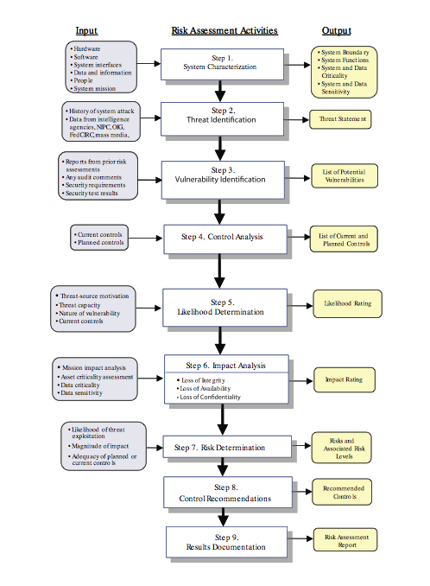
Detailed Risk Analysis Process
Notes:
The formal, detailed security risk analysis approach provides the most accurate evaluation of an organization’s IT system’s security risks, but at the highest cost. This approach has evolved with the development of trusted computer systems, as discussed in chapter 10 of the text. A number of national and international standards document the expected formal risk analysis approach. These include [ISO13335], [ACSI33], [AS4360], [HB231], and [NIST02]. Its use is often mandated by government organizations and associated businesses. These standards all broadly agree on the process used. Figure 16.3 in the text (reproduced from Fig 3-1 in [NIST02]) illustrates a typical process used.

Slide 16
Establish Context
determine broad risk exposure of org
  related to wider political/social environment
  legal and regulatory constraints
specify organization’s risk appetite
set boundaries of risk assessment
  partly on risk assessment approach used
decide on risk assessment criteria used
Notes:
The process starts with the organizational security objectives, and considers the broad risk exposure of the organization. It explores the relationship between a specific organization, and the wider political and social environment in which it operates. Figure 16.4 in the text suggests a possible spectrum of organizational risk. Any relevant legal and regulatory constraints must also be identified. These features provide a baseline for the organization’s risk exposure, and an initial indication of the broad scale of resources it needs to expend to manage this risk in order to successfully conduct business.
Next senior management must define the organization’s risk appetite, the level of risk they view as acceptable. This decision is not just IT specific. Rather it reflects the organization’s broader management approach to how they conduct business.
The boundaries of this risk assessment are then identified. This may range from just a single system or aspect of the organization, up to its entire IT infrastructure. This will depend in part on the risk assessment approach being used.
A decision also needs to be made as to precisely which risk assessment criteria will be used in this process. This decision may be determined by what has been used previously in this, or related, organizations. For government organizations, this decision may be specified by law or regulation. Lastly the knowledge and experience of those performing the analysis may determine the criteria used.

Slide 17
Asset Identification
identify assets
  “anything which needs to be protected”
  of value to organization to meet its objectives
  tangible or intangible
  in practice try to identify significant assets
draw on expertise of people in relevant areas of organization to identify key assets
  identify and interview such personnel
  see checklists in various standards
Notes:
The last component of this first step in the risk assessment is to identify the assets to examine. This directly addresses the first of the three fundamental questions “What assets do we need to protect?”. An asset is “anything which needs to be protected” because it has value to the organization and contributes to the successful attainment of the organization’s objectives, and may be either tangible or intangible. It includes computer and communications hardware infrastructure, software including applications, information/data held on these systems, the documentation on these systems, and the people who manage and maintain these systems. Within the boundaries identified for the risk assessment, these assets need to be identified, and their value to the organization assessed. It is important to emphasize again, that whilst the ideal is to consider every conceivable asset, in practice this is not possible. Rather the goal here is to identify all assets that contribute significantly to attaining the organization’s objectives, and whose compromise or loss would seriously impact on the organizations operation.
Whilst the risk assessment process is most likely being managed by security experts, they will not necessarily have a high degree of familiarity with the organization’s operation and structures. Thus they need to draw on the expertise of the people in the relevant areas of the organization to identify key assets and their value to the organization. A key element of this process step is identifying and interviewing such personnel. Many of the standards listed previously include checklists of types of assets and suggestions for mechanisms for gathering the necessary information. These should be consulted and used. The outcome of this step should be a list of assets, with brief descriptions of their use by, and value to, the organization.

Slide 18
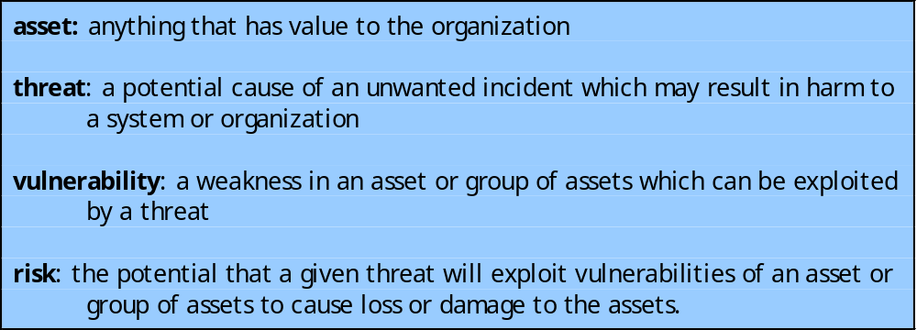
Terminology
Notes:
The next step in the process is to identify the threats or risks the assets are exposed to. It is worth commenting on the terminology used here. The terms “threat” and “risk”, whilst having distinct meanings, are often used interchangeably in this context. There is considerable variation in the definitions of these terms, as seen in the range of definitions provided in the cited standards. [ISO13335] includes the definitions shown here. The relationship between these and other security concepts is illustrated in Figure 1.2 of the text. It shows the central term risk results from a threat exploiting vulnerabilities in assets which causes loss of value to the organization.

Slide 19
Threat Identification
to identify threats or risks to assets asK
  who or what could cause it harm?
  how could this occur?
threats are anything that hinders or prevents an asset providing appropriate levels of the key security services:
  confidentiality, integrity, availability, accountability, authenticity and reliability
assets may have multiple threats
Notes:
Identifying the threats or risks the assets are exposed to directly addresses the second of our three fundamental questions: “How are those assets threatened?”. The goal of this stage is to identify potentially significant risks to the assets listed. This requires answering the following questions for each asset:
1. Who or what could cause it harm? and
2. How could this occur?
Answering the first of these questions involves identifying potential threats to assets. In the broadest sense a threat is anything that might hinder or prevent an asset providing appropriate levels of the key security services: confidentiality, integrity, availability, accountability, authenticity and reliability. Note that one asset may have multiple threats, and a single threat may target multiple assets.

Slide 20
Threat Sources
threats may be
  natural “acts of god”
  man-made and either accidental or deliberate
should consider human attackers
  motivation
  capability
  resources
  probability of attack
  deterrence
any previous history of attack on org
Notes:
A threat may be either natural or man-made, and may be accidental or deliberate. This is known as the threat-source. The classic “natural” threat sources are those often referred to as “acts of god”, and include damage caused by fire, flood, storm, earthquake and other such natural events. It also includes “environmental threats” such as long-term loss of power or natural gas. Or it may be the result of chemical contamination or leakage. Alternatively a threat source may be a human agent acting either directly or indirectly. Examples of the former include an insider retrieving and selling information for personal gain, or a hacker targeting the organizations server over the Internet. An example of the latter includes someone writing and releasing a network worm that infects the organizations systems. These examples all involved a deliberate exploit of a threat. However, a threat may also be a result of an accident, such as an employee incorrectly entering information on a system, which results in it malfunctioning. The possible motivation of deliberate attackers in relation to the organization should be considered as potentially influencing this variation. In addition, any previous experience of attacks seen by the organization needs to be considered, as that is concrete evidence of risks that are known to occur. When evaluating possible human threat sources, it is worth considering their reason and capabilities for attacking this organization, including their:
• motivation: why would they target this organization, how motivated are they?
• capability: what is their level of skill in exploiting the threat?
• resources: how much time, money, and other resources could they deploy?
• probability of attack: how likely and how often would your assets be targeted?
• deterrence: what are the consequences to the attacker of being identified?

Slide 21
Threat Identification
depends on risk assessors experience
uses variety of sources
  natural threat chance from insurance stats
  lists of potential threats in standards, IT security surveys, info from governments
  tailored to organization’s environment
  and any vulnerabilities in its IT systems
Notes:
Identifying possible threats and threat sources requires the use of a variety of sources, along with the experience of the risk assessor. The chance of natural threats occurring in any particular area is usually well known from insurance statistics. Lists of other potential threats may be found in the standards, in the results of IT security surveys, and in information from government security agencies. The annual computer crime surveys, such as those conducted by the CSI/FBI in the US and AusCERT in Australia, provide useful general guidance on the broad IT threat environment and the most common problem areas. However, this general guidance needs to be tailored to the organization and the risk environment it operates in. This involves consideration of vulnerabilities in the organization’s IT systems, which may indicate that some risks are either more or less likely than the general case.

Slide 22
Vulnerability Identification
identify exploitable flaws or weaknesses in organization’s IT systems or processes
hence determine applicability and significance of threat to organization
need combination of threat and vulnerability to create a risk to an asset
again can use lists of potential vulnerabilities in standards etc
Notes:
Answering the second of these questions “How could this occur?” involves identifying flaws or weaknesses in the organization’s IT systems or processes which could be exploited by a threat. This will help determine the applicability of the threat to the organization, and its significance. Note that mere existence of some vulnerability does not mean harm will be caused to an asset. There must also be a threat source for some threat that can exploit the vulnerability for harm to possibly occur. It is the combination of a threat and a vulnerability that creates a risk to an asset. Again, many of the standards listed previously include checklists of threats and vulnerabilities, and suggestions for tools and techniques to list them, and to determine their relevance to the organization. The outcome of this step should be a list of threats and vulnerabilities, with brief descriptions of how and why they might occur.

Slide 23
Analyze Risks
specify likelihood of occurrence of each identified threat to asset given existing controls
  management, operational, technical processes and procedures to reduce exposure of org to some risks
specify consequence should threat occur
hence derive overall risk rating for each threat
  risk = probability threat occurs x cost to organization
in practice very hard to determine exactly
use qualitative not quantitative, ratings for each
aim to order resulting risks in order to treat them
Notes:
The next step is to to identify and categorize the risks to assets that threaten the regular operations of the organization, and to provide information to management to help them evaluate these risks and determine how best to treat them. Risk analysis involves firstly specifying the likelihood of occurrence of each identified threat to an asset, in the context of any existing controls (management, operational and technical processes and procedures that act to reduce the exposure of the organization to some risks, by reducing the ability of a threat source to exploit some vulnerabilities). Next the consequence to the organization is determined, should that threat eventuate. Lastly this information is combined to derive an overall risk rating for each threat. The ideal would be to specify the likelihood as a probability value, and the consequence as a monetary cost to the organization should it occur. The resulting risk is then simply given as:
Risk = Probability threat occurs x Cost to organization
This can be directly equated to the value the threatened asset has for the organization, and hence specify what level of expenditure is reasonable to reduce the probability of its occurrence to an acceptable level. Unfortunately it is often extremely hard to determine accurate probabilities, realistic cost consequences, or both. This is particularly true of intangible assets, like the loss of confidentiality of a trade secret for example. Hence most risk analyses use qualitative, rather than quantitative, ratings for both these items. The goal is then to order the resulting risks to help determine which need to be most urgently treated, rather than give them an absolute value.

Slide 24
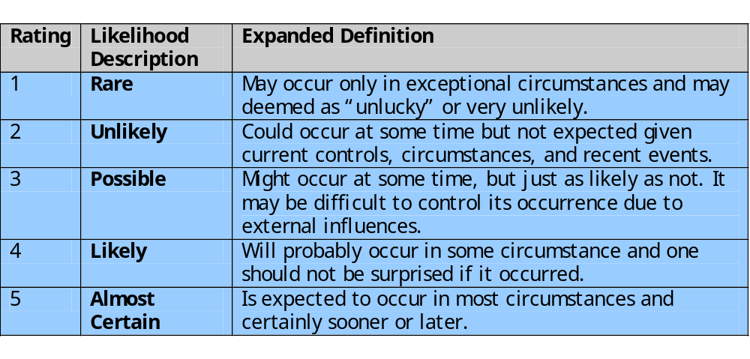
Determine Likelihood
Notes:
Having identified existing controls, the likelihood that each identified threat could occur and cause harm to some asset needs to be specified. The risk analyst takes the descriptive asset and threat/vulnerability details from the preceding steps in this process, and in the light of the organizations overall risk environment and existing controls, decides the appropriate rating. This estimation relates to the likelihood of the specified threat exploiting one or more vulnerabilities to an asset or group of assets, which results in harm being caused to the organization. The likelihood is typically described qualitatively, using values and descriptions such as those shown here from Table 16.2 in the text. Whilst the various risk assessment standards all suggest tables similar to these, there is considerable variation in their detail.
The specified likelihood needs to be realistic. In particular, a rating of Likely or higher suggests that this threat has occurred sometime previously. This means past history provides supporting evidence for its specification. If this is not the case, then specifying such a value would need to be justified on the basis of a significantly changed threat environment, a change in the IT systems which has weakened it’s security, or some other rationale for its anticipated likely occurrence. In contrast, the Unlikely and Rare ratings can be very hard to quantify. They are an indication that the threat is of concern, but knowing whether it could potentially occur is difficult to specify. Typically such threats would only be considered if the consequences to the organization of their occurrence are so severe that they have to be considered, even if extremely improbable.

Slide 25
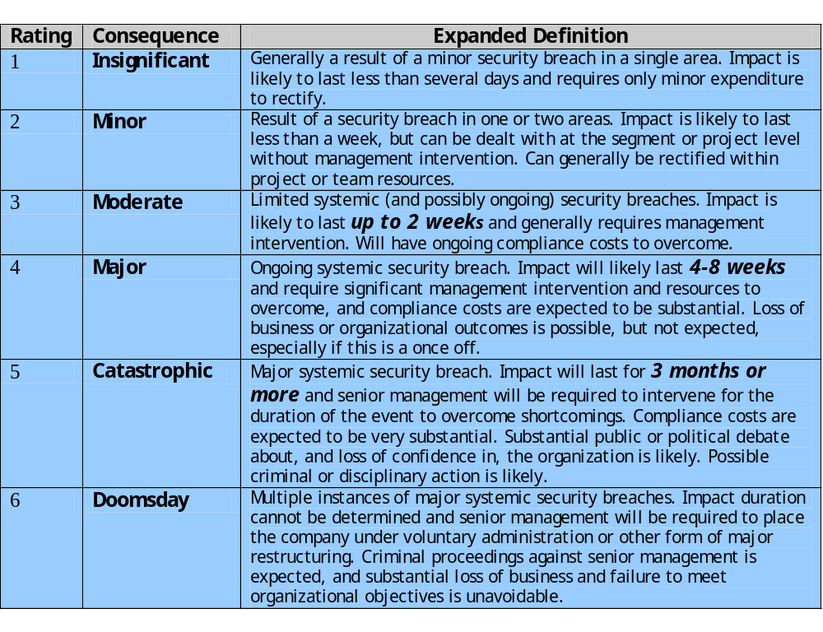
Determine Consequence
Notes:
The analyst must then specify the consequence of a specific threat eventuating, which is distinct from, and not related to, the likelihood of the threat occurring. Rather, consequence specification indicates the impact on the organization should the particular threat in question actually eventuate. Even if a threat is regarded as rare or unlikely, if the organization would suffer severe consequence should it occur, then it clearly poses a risk to the organization. Hence, appropriate responses must be considered. A qualitative descriptive value, such as those shown here from Table 16.3 in the text, is typically used to describe the consequence. As with the likelihood ratings, there is likely to be some uncertainty as to the best rating to use.
This determination should be based upon the judgment of the asset’s owners, and the organization’s management, rather than the opinion of the risk analyst. This is in contrast with the likelihood determination. The specified consequence needs to be realistic. It must relate to the impact on the organization as a whole should this specific threat eventuate. It is not just the impact on the affected system. It is possible that a particular system (a server in one location for example) might be completely destroyed in a fire. However, the impact on the organization could vary from it being a minor inconvenience (the server was in a branch office, and all data was replicated elsewhere), to a major disaster (the server had the sole copy of all customer and financial records for a small business). As with the likelihood ratings, the consequence ratings must be determined knowing the organization’s current practices and arrangements. In particular the organization’s existing backup, disaster recovery, and contingency planning, or lack thereof, will influence the choice of rating.

Slide 26
Determine Resultant Risk
Consequences
Likelihood
Doomsday
Catastrophic
Major
Moderate
Minor
Insignificant
Almost
E
E
E
E
H
H
Certain
Likely
E
E
E
H
H
M
Possible
E
E
E
H
M
L
Unlikely
E
E
H
M
L
L
Rare
E
H
H
M
L
L
Risk Level
Description
Extreme (E)
Will require detailed r
esearch and management planning at an
executive/director level. Ongoing planning and monitoring will be required
with regular reviews. Substantial adjustment of controls to manage the
risk are expected, with costs possibly exceeding original forecasts.
H
igh (H)
Requires management attention, but management and planning can be left
to senior project or team leaders. Ongoing planning and monitoring with
regular reviews are likely, though adjustment of controls are likely to be
met from within existing resources
Medium (M)
Can be managed by existing specific monitoring and response procedures.
Management by employees is suitable with appropriate monitoring and
reviews.
Low (L)
Can be managed through routine procedures.
Notes:
Once the likelihood and consequence of each specific threat have been identified, a final level of risk can be assigned. This is typically determined using a table that maps these values to a risk level, such as those shown in Table 16.4 from the text. This table details the risk level assigned to each combination. Such a table provides the qualitative equivalent of performing the ideal risk calculation using quantitative values. It also indicates the interpretation of these assigned levels.

Slide 27
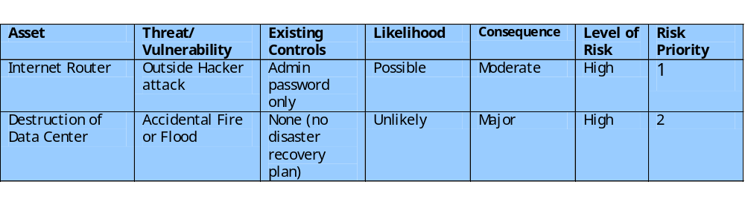
Document in Risk Register and Evaluate Risks
Notes:
The results of the risk analysis process should be documented in a risk register. This should include a summary table such that shown in Table 16.5 from the text. The risks are usually sorted in decreasing order of level. This would be supported by details of how the various items were determined, including the rationale, justification, and supporting evidence used. The aim of this documentation is to provide senior management with the information they need to make appropriate decisions as how to best manage the identified risks. It also provides evidence that a formal risk assessment process has been followed if needed, and a record of decisions taken with their reasons.
Once the details of potentially significant risks are determined, management needs to decide whether it needs to take action in response. This would take into account the risk profile of the organization, and its willingness to accept a certain level of risk, as determined in the initial “Establishing the Context” phase of this process. Those items with risk levels below the acceptable level would usually be accepted with no further action required. Those items with risks above this will need to be considered for treatment. Typically the risks with the higher ratings are those that need most urgently action. However, it is likely that some risks will be easier, faster, and cheaper to action than others. In the example shown, both risks were rated High. Further investigation reveals that a relatively simple and cheap treatment exists for the first risk, by tightening the router configuration to further restrict possible accesses. Treating the second risk requires the development of a full disaster recovery plan, a much slower and more costly process. Hence management would take the simple action first, to improve the organization’s overall risk profile as quickly as possible.

Slide 28
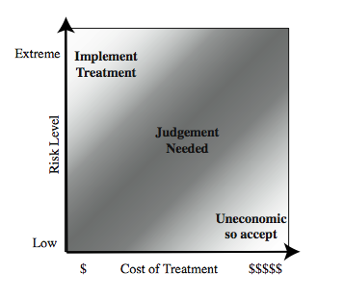
Risk Treatment
Notes:
Management may decide that for business reasons, given an overall view of the organization, some risks with lower levels should be treated ahead of other risks. This is both a reflection of limitations in the risk analysis process in the range of ratings available and their interpretation, and management’s perspective of the organization as a whole. Figure 16.5 from the text shows a range of possibilities for costs verses levels of risk. If the cost of treatment is high, but the risk is low, then it is usually uneconomic to proceed with such treatment. Alternatively, where the risk is high, and the cost comparatively low, then clearly treatment should occur. The most difficult area occurs between these extremes. This is where management must make a business decision about the most effective use of their available resources. This decision usually requires a more detailed investigation of the treatment options.

Slide 29
Risk Treatment Alternatives
risk acceptance: accept risk (perhaps because of excessive cost of risk treatment)
risk avoidance: do not proceed with the activity that causes the risk (loss of convenience)
risk transfer: buy insurance; outsource
reduce consequence: modify the uses of an asset to reduce risk impact (e.g., offsite backup)
reduce likelihood: implement suitable controls
Notes:
There are five broad alternatives available to management for treating identified risks:
risk acceptance: of a risk level greater than normal for business reasons, typically due to excessive cost or time needed to treat the risk. Management must then accept responsibility for the consequences to the organization should the risk eventuate.
risk avoidance: not proceeding with the activity or system which creates this risk, resulting in loss of convenience or ability to perform some function that is useful to the organization, but traded off against the reduced risk profile.
risk transferal: sharing responsibility for the risk with a third-party. This is typically achieved by taking out insurance against the risk occurring, by entering into a contract with another organization, or by using partnership or joint venture structures to share the risks and costs should it eventuate.
reduce the consequence: by modifying the structure or use of the assets at risk to reduce the impact on the organization should the risk occur. This could be achieved by implementing controls to enable the organization to quickly recover should the risk occur. Examples include implementing an offsite backup process, developing a disaster recovery plan, or arranging for data and processing to be replicated
reduce the likelihood: by implementing suitable controls to lower the chance of the vulnerability being exploited. These could include technical or administrative controls such as deploying firewalls and access tokens, or procedures such as password complexity and change policies. Such controls aim to improve the security of the asset, making it harder for an attack to succeed by reducing the vulnerability of the asset.
If either of the last two options is chosen, then possible treatment controls need to be selected, and their cost effectiveness evaluated. We discuss this in the text chapter 17.

Slide 30
Case Study: Silver Star Mines
fictional operation of global mining company
large IT infrastructure
  both common and specific software
  some directly relates to health & safety
  formerly isolated systems now networked
decided on combined approach
mining industry less risky end of spectrum
management accepts moderate or low risk
Notes:
This case study involving the operations of a fictional company “Silver Star Mines”, the local operations of a large global mining company. It has a large IT infrastructure used by numerous business areas. Its network includes a variety of servers, executing a range of application software typical of organizations of its size. It also uses applications that are far less common, some of which directly relates to the health and safety of those working in the mine. Many of these systems used to be isolated, with no network connections between them. In recent years they have been connected together, and connected to the company’s intranet to provide better management capabilities. However, this means they are now potentially accessible from the Internet, which has greatly increased the risks to these systems.
A security analyst was contracted to provide an initial review of the company’s risk profile, and to recommend further action for improvement. Following initial discussion with company management, a decision was made to adopt a “combined approach” to security management. The analyst was then asked to conduct a preliminary formal assessment of their key IT systems to identify those most at risk, which management could then consider for treatment.
The first step was to determine the context for the risk assessment. Being in the mining industry sector places the company at the less risky end of the spectrum, and consequently less likely to be specifically targeted. Silver Star Mines is part of a large organization, and hence is subject to legal requirements for occupational health and safety, and is answerable to its shareholders. Thus management decided that they wished to accept only moderate or lower risks in general.

Slide 31
Assets
reliability and integrity of SCADA nodes and net
integrity of stored file and database information
availability, integrity of financial system
availability, integrity of procurement system
availability, integrity of maintenance/production system
availability, integrity and confidentiality of mail services
Notes:
Next, the key assets had to be identified. The analyst conducted interviews with key IT and engineering managers in the company. A number of the engineering managers emphasized how important the reliability of the SCADA (Supervisory Control and Data Acquisition) network and nodes were to the company. They control and monitor the core mining operations of the company and enable it to operate safely, efficiently, and most crucially to generate revenue. Some of these systems also maintain the records required by law, and which are regularly inspected by the government agencies responsible for the mining industry. Any failure to create, preserve and produce on demand these records would expose the company to fines and other legal sanctions. Hence, these systems were listed as the first key asset. A number of the IT managers indicated that a large amount of critical data was stored on various file servers either in individual files, or in databases. They identified the importance of the integrity of this data to the company. Some of this needed be available for audits by government agencies. There were also data on production and operational results, contracts and tendering, personnel, application backups, operational and capital expenditure, mine survey and planning, and exploratory drilling. Collectively, the integrity of stored data was the second key asset. These managers also indicated that three key systems: the Financial, Procurement, and Maintenance/Production servers, were critical to the effective operation of core business areas. Any compromise in the availability or integrity of these systems would impact on the company’s ability to operate effectively. Lastly, the analyst identified e-mail as a key asset, as a result of interviews with all business areas of the company. E-mail is given greater importance than usual due to the remote location of the company. Hence the collective availability, integrity and confidentiality of mail services was listed as a key asset.

Slide 32
Threats & Vulnerabilities
unauthorized modification of control system
corruption, theft, loss of info
attacks/errors affecting procurement system
attacks/errors affecting financial system
attacks/errors affecting mail system
attacks/errors maintenance/production affecting system
Notes:
Having determined the list of key assets, the analyst needed to identify significant threats to these assets, and to specify the likelihood and consequence values. The major concern with the SCADA asset is unauthorized compromise of nodes by an external source. These systems were originally designed for use on physically isolated and trusted networks, and hence were not hardened against external attack to the degree that modern systems can be. Recognizing that the SCADA nodes are very likely insecure, these connections are isolated from the company intranet by additional firewall and proxy server systems. The second asset concerned the integrity of stored information. These assets could be compromised by both internal and external sources. All indications are that such database security breaches are increasing, and that access to such data is a primary goal of intruders. These systems are located on the company intranet, and hence are shielded by the company’s outer firewall from much external access. However, should that firewall be compromised, or an attacker gain indirect access using infected internal systems, compromise of the data was possible. The availability or integrity of the key Financial, Procurement, and Maintenance/Production systems could be compromised by any form of attack on the operating system or applications they use. Although their location on the company intranet does provide some protection, due to the nature of the company structure a number of these systems have not been patched or maintained for some time. This means at least some of the systems would be vulnerable to a range of network attacks if accessible. The last asset is the availability, integrity and confidentiality of mail services. Without an effective e-mail system the company will operate with less efficiency.

Slide 33
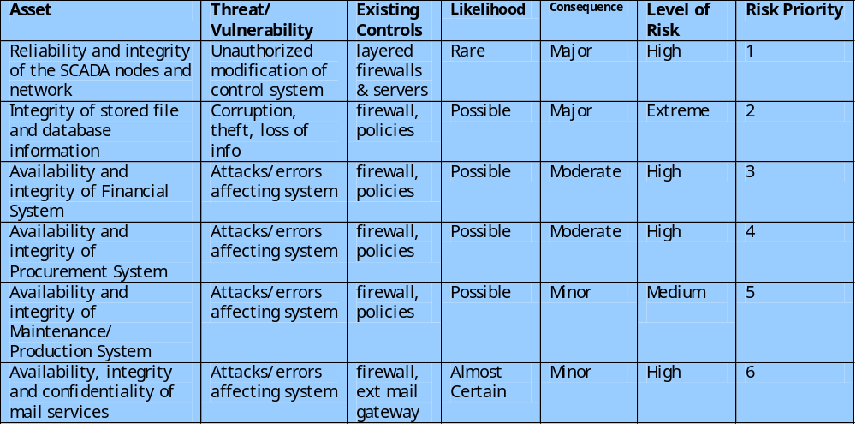
Risk Register
Notes:
Given that externally sourced attacks are increasing, and known cases of attacks on SCADA networks exist, the analyst concluded that whilst an attack was very unlikely, it could still possibly occur. Thus a likelihood rating of Rare was chosen. The consequence of successful attack could have serious consequences as it could affect the safety of personnel in the mine, and the financial impact could be. A consequence rating of Major was selected. This results in a risk level of High. For integrity of stored information, a likelihood rating of Possible was chosen. Discussions with IT managers revealed that some of this information is confidential and may cause financial harm if disclosed to others, as well as the possibility of serious legal consequences if personal information was disclosed, or if the results of statutory tests and process information were lost. Hence a consequence rating of Major was selected. This results in a risk level of Extreme. For availability or integrity of the key Financial, Procurement, and Maintenance/Production systems a likelihood of Possible was specified. Discussions with management indicated that the degree of harm would be proportional to extent and duration of the attack. An attack would have a detrimental impact on the efficiency of operations. Consequence ratings of Moderate and Minor respectively were selected, resulting in risk levels of High or Medium. For availability, integrity and confidentiality of mail services, a likelihood rating of Almost Certain was selected in recognition of the wide range of possible attacks, and the high chance that one will occur sooner rather than later. Discussions with management indicated that whilst other possible modes of communication exist, they do not allow for transmission of electronic documents. Since compromise would not have a large impact, a consequence of Minor was selected. This results in a risk level of High. The information was summarized and presented to management, with the final result of this risk assessment process is shown in this Table 16.6.

Slide 34
Summary
detailed need to perform risk assessment as part of IT security management process
relevant security standards
presented risk assessment alternatives
detailed risk assessment process involves
  context including asset identification
  identify threats, vulnerabilities, risks
  analyse and evaluate risks
Silver Star Mines case study
Notes:
Chapter 16 summary.

