Slide 1

Network Security Devices

Slide 2




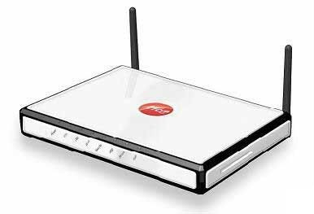

Network Security Devices: Firewalls
Firewall is a software or hardware or combination of both, which is generally used to separate a protected network from an unprotected public network
It monitors and filters the incoming and outgoing traffic of the network and prevents unauthorized access to private networks
It works at the network layer of the OSI model or the IP layer of the TCP/IP
ork layer of the
Local Area Network
Public Network
Firewall
Modem
Internet

Slide 3
Proxy Server
A proxy server is a dedicated computer, or a software system virtually located between a client and the actual server
It is a sentinel between an internal network and the open internet
It serves client requests on behalf of actual servers, thereby preventing the actual servers from exposing themselves to the outside world
It intercepts and filters all the requests going to the real server
It provides an additional layer of defence to the network and can protect against some OS and web server specific attacks
Network administrators should deploy a proxy server to intercept malicious, offensive web content, computer viruses etc. hidden in the client requests

Slide 4





Victim
Proxy Server
Internet

Slide 5

Advantages of using Proxy Servers
Bandwidth Savings & Improve Speed
Control Internet Usage
Proxy Server
Improve Security Mainly in Corporate Networks
Hides IP Address, Location & Other Info

Slide 6
Honeypot
A honeypot is an information system resource that is explicitly setup to attract and trap people who attempt to penetrate an organisations network
It has no authorised activity, does not have any production value, and any traffic to it is likely a probe or an attack
A honeypot can log port access attempts or monitor an attacker’s keystrokes. These could be early warnings of a more concerted attack

Slide 7




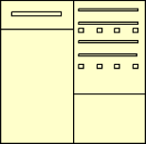

DMZ
Honey pot
Internal Network
Firewall
Packet Filter
Web Server

Slide 8
Advantage of using Honeypots
Honeypots appear to be easy to compromise, so the attackers focus on the honeypots first
The sole purpose of honeypots is to track the attacks, so they can easily identify any newly created viruses and worms
They are easy to deploy, configure and maintain
They can be used to identify zero-day attacks
It is difficult to identify an internal attack attempted within the organisation’s firewall monitoring space. Honeypots can resolve this
They provide high value and limited data compared to firewalls, system logs and IDS
Due to limited data monitoring feature, they rarely face a resource exhaustion problem
They need less equipment, so the investment in them is less
Honeypots confuse attackers and keeps them occupied

Slide 9
Network Security Devices: Intrusion Detection System (IDS)
An intrusion detection system (IDS) is a network security appliance that inspects all inbound and outbound network traffic for suspicious patterns that may indicate a network or system security breach
If found, the IDS will alert the network administrator about the suspicious activities
IDS checks traffic for signatures that match known intrusion patterns, and triggers an alarm when a match is found

Slide 10
Network Security Devices: Intrusion Prevention System (IPS)
IPS is a network security appliance that combines functions of both a firewall and an IDS
It is an extension of an IDS used to monitor network traffic for all malicious activities
Unlike IDS, an IPS is able to actively prevent / block detected intrusions on the network

Slide 11



Server
Untrusted network
IPS
Firewall
IDS

Slide 12

Network Security Devices: Network Protocol Analyzer
Protocol analyzer is the combination of hardware and software that can be installed on the organisation network or systems to enhance security against malicious activity
It is an efficient network sniffer for capturing and logging traffic between an organization's server and its users
Examines packets transmitted across a network segment and decodes the packet’s data if needed and analyses its content
Protocol analyzer often referred to as packet analyzer, network analyzer, sniffer etc.,
Protocol analyzer usually places a NIC in promiscuous mode to see and capture all the packets on the network
It includes a timing chart, which indicates the interaction of the packet flow between organization's server and the user’s browser by time

Slide 13











Advantages of Protocol Analyzer using a Network
Detects network misuse by external and internal users
Analyses network problems Detects network intrusion attempts
Monitors network usage and WAN bandwidth utilization Gather and reports network statistics
Debugs network protocol implementations
Troubleshoots hard to solve problems
Gathers information, such as baseline traffic patterns and network utilization metrics
Identifies unused protocols so that you can remove them from the network
Generates traffic for penetration testing Eavesdrops on traffic and filters suspected traffic from the
network

Slide 14
Network Protocol Analyser Tools
Wireshark | PRTG Network Monitor
CommView | Observer
CAPSA | SoftPerfect
ETHERDETECT | JUSTNIFFER
Microsoft Message Analyser | NetworkProbe

Slide 15
Network Security Devices: Internet Content Filter
Internet content filter is either software or hardware that blocks browsing of harmful websites and undesirable content on world wide web (WWW)
It filters content based on keywords, URLs and Contextual analysis
It prevents the network from malware, phishing and charming attacks
It provides additional protection other than traditional network firewalls and antivirus software

Slide 16

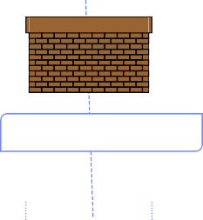





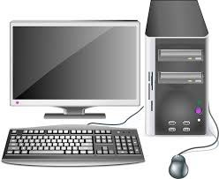



Firewall
Firewall
Firewall
LAN (Ethernet)
LAN (Ethernet)
LAN (Ethernet)
Client Side Internet Filtering
Gateway Level Content Filtering
End to End Content Filtering

Slide 17
Advantages of using Internet Content Filters
Prevents employees from deliberately or inadvertently accessing pornography
Prevents predators from chatting with employees online
Blocks certain categories of sites permanently or for a limited time, greatly reducing cyber slacking and productivity drops
Frees up an organization's internet bandwidth for legitimate, business-related activities

Slide 18


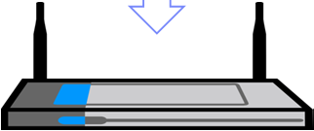

How it works?
How a protocol analyzer monitors network traffic
List of Network Packets
Production Network
Switch SAN
Router
Server farm
Packet Driver
Switch
Analyzer Host
Data Access Network
Consolidated Tool Farm
Packet capturing function
Decoding Engine
Security
P
erforman Protocol e Monitor analyzer
Probe
Forensic Recorder
Packet Analyzed
IDS
c
Packet Displayed
Further Analysis

Slide 19
Network Security Devices: Unified Threat Management (UTM)
Load Balancer
Network Firewall
UTM
Solutions
Anti Virus and Anti Spam
Content Filter
IDS/IPS
VPN
UTM is a network security management solution which allows administrator to monitor and manage the organization's network security through a centralized management console
It provides firewall, intrusion detection, anti malware, spam filter, load balancing, content filtering, data loss prevention and VPN capabilities using a single UTM appliance
Advantages
Reduced complexity
Simplicity
Easy Management
Disadvantages
Single point of failure
Single point of compromise

Slide 20
UTM Appliances
Fortinet
Sophos
WatchGuard
Dell
Barracuda
Paloalto
Intel Security (McAfee)
Cisco

Slide 21

Network Security Devices: Network Access Control (NAC)
Network Access control also known as Network Admission Control (NAC) are appliances or solutions that attempt to protect the network by restricting the connection of an end user to the network based upon a security policy
The preinstalled software agent may inspect several items before admitting the device and may restrict where the device may be connected
What NAC does?
Authentication of users connected to network resources
Defining a connection point of network devices
Identification of devices, platforms and operating systems
Development and application of security policies

Slide 22

NAC Solutions
ForeScout CounterACT
Extreme Networks NAC
Trustwave Network Access Control
Cisco NAC Appliance
Bradford Network’s Network Sentry / NAC
PacketFence NAC
Arubanetworks ClearPass Policy Manager
Portnox Network Access Control

Slide 23
Demilitarized Zone (DMZ)
Computer sub network is placed between the organization's private network, such as LAN and an outside public network such as the Internet and acts as an additional security layer
Contains the servers which need to be accessed from an outside network
Web servers
Email servers
DNS servers
DMZ Configurations
Both internal and external networks can connect to DMZ
Hosts in the DMZ can connect to external networks
But hosts in the DMZ cannot connect to internal networks

Slide 24


DMZ
DMZ
Network
Three-legged Firewall
Internet
Internal Network

Slide 25
Virtual Private Network (VPN)
Private network which uses public networks, like the internet to provide secured connections to the employees working remotely
Uses public networks like telephone lines and assures secure transfer of data between systems over an insecure network
It makes use of encryption techniques and security mechanisms to provide security by the use of tunnelling protocols and encryption methods

Slide 26
RADIUS
Remote Authentication Dial In User Service (RADIUS) is an authentication protocol which provides centralized authentication, authorization and accounting (AAA) for the remote access servers to communicate with the central server
RADIUS authentication steps :
The client initiates the connection by sending Access Request packets to the server
The server receives the access request from the client and compares the credentials with the ones stored in the database. If the provided information matches, then it sends the (Accept-Accept message) along with the (Access-Challenge) to the client for additional authentication else it sends back (Accept Reject message).
Radius Accounting Steps:
Client sends the Accounting request to the server to specify accounting information for a connection that was accepted
The server receives the Account request message and sends back the Accounting Response message which states the successful establishment of network

Slide 27

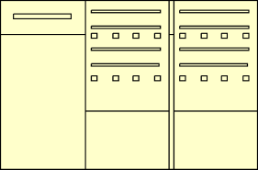

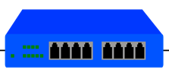

TACACS+
Terminal Access Controller Access Control System Plus is a network security protocol used for authentication, authorization and accounting for network devices like switches, routers, firewalls through one or more centralized servers
TACACS+ encrypts the entire communication between the client and server including the user’s password which protects from sniffing attacks
It is a client server model approach where the client (user or network device) requests for connection to the server, then the server authenticates the user by examining the credentials
TACACS+
Security Server
Remote User
PSTN/ISDN
TACACS+
Client
Router
Corporate Network

Slide 28


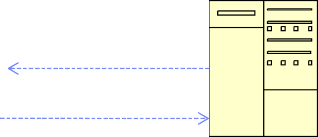

Difference between RADIUS and TACACS+
USER
TACACS+
Authentication
USER
RADIUS
Authentication
1
1
4
2
3
4
1
3
1.Authentication request 2. Authentication reply 3. Accounting 4. Authentication reply, Authorization level

Slide 29

Kerberos
Kerberos is an authenticating method for accessing network
Kerberos authentication protocol (KAP)
User sends the credentials to the authentication server (AS)
AS hashes the password of the user and verifies the credentials in the Active Directory (AD) database. If the credential matches, then AS (consists of Ticket Granting Service(TGS)) sends back the TGS session key and granting ticket to the user to create a session
Once users are authenticated, they send granting ticket to request a service ticket to the server or TGS for accessing services
TGS authenticates the TGT and grants a service ticket to the user. The service ticket consists of the ticket and a session key
The client sends the service ticket to the server. The server uses its key to decrypt the information from the TGS and the client is authenticated to the server

Slide 30
Kerberos
Client
KDC
(Kerberos)
Ticket general and using server secret key
KDC request
Ticket Request
Ticket response
Decrypt the ticket response and forward the ticket to server
Server
Ticket
Decrypt the ticket and confirm the identity of client

