Slide 1




Encryption
Encryption is a way of protecting information by transforming it in such a way that the resulting transferred form is unreadable to an unauthorized party
To encrypt data, an encryption algorithm uses a key to perform a transformation on the data
Types of Encryption
Symmetric Encryption
Asymmetric Encryption
Encryption
………
………
………
………
File
A……
………
………
………
E…ncrypted file
Random Key
A…………
……………
……………
……………
……………
Encry…pted file with user’s public key in Header
User's Public Key
E
ncryption

Slide 2

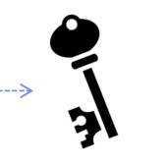
Symmetric Encryption
Symmetric encryption is the oldest cryptographic technique used to encrypt digital data to ensure data confidentiality
It is called symmetric encryption as a single key is used for encrypting and decrypting the data
It is used to encrypt large amounts of data
Encrypted Message
Decrypted Message
Bothe sender and receiver share the same key to encrypt and decrypt data
Sender
Receiver
(Sender Uses the secret key to encrypt the confidential message and sends it to the receiver )
(Receiver decrypts the data using the secret key and reads the confidential message)

Slide 3
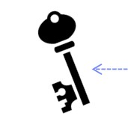

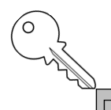
Asymmetric Encryption
Asymmetric Encryption, unlike symmetric encryption, uses two separate keys to carry out encryption and decryption; one key is called the Public Key for encrypting messages, and the second key, Called the Private Key for decrypting messages
It is also called Public Key encryption and is used to encrypt small amounts of data
Confidential Message
Receiver selects a public and private key sends the public key to the sender
Confidential Message
Sender
Receiver
(Sender Uses the secret key to encrypt the confidential message and sends it to the receiver )
(Receiver decrypts the data using the secret key and reads the confidential message)

Slide 4

Hashing: Data Integrity
Hashing is one of the forms of cryptography that transforms the information into a fixed length value or key that represents the original information
Hashing ensures the security of information by checking the integrity of information on both the sender and receiver sides
Checking the integrity of information :
The sender of the message creates a hash code of it and sends the message to the receiver along with its hash code
The receiver again creates a hash code for the same messages at the receiver side and compares both the hash codes; if it is match, then the message has not been tampered with

Slide 5





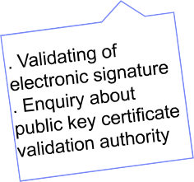
Public Key Infrastructure
Certified authority (CA)
4. Updates information
Validating Authority
2. Request for issuing certificate
Registration Authority (RA)
3. Public Key Certificate
7. Determined Result
6. Public Key Certificate
1. User applies for issuing certificate
Message in public key certificate signed with digital certificate
User

