Slide 1



Secure Data Transmission Protocols

Slide 2




Pretty Good Privacy (PGP)
PGP is an application layer protocol which provides cryptographic privacy and authentication for network communication
It encrypts and decrypts email communication as well as authenticates messages with digital signatures and encrypts stored files
………
………
………
………
File
A……
………
………
………
Encrypted file
Random Key
A…c--
……………
……………
……………
User's Public Key
E
ncryption
File Encryption

Slide 3
S/MIME
S/MIME (Secure/Multipurpose Internet Mail Extensions) is an application layer protocol which is used to send digitally signed and encrypted email messages
It uses the Rivest-Shamir-Adleman encryption (RSA) system for email encryption
Administrators need to enable S/MIME based security for mailboxes in their organizations.
Difference between PGP and S/MIME
Mandatory Features | S/MIME v3 | OpenPGP
Message format | Binary, based on CMS | Application/Pkcs 7-mime
Certificate format | Binary, based on X.509 v3 | Binary, based on previous PGP
Symmetric Encryption Algorithm | Triple DES (DES,EDE3,CBC) | Triple DES (DES,EDE3,Eccentric CFB)
Signature Algorithm | Diffie-Hellman(X9.42) with DSS or RSA | EIGamal with DSS
Hash Algorithm | SHA-1 | SHA-1
MIME Encapsulation of Signed Data | Choice of Multipart/signed or CMS Format | Multipart/signed ASCII Amor
MIME Encapsulation of Encrypted Data | Application/Pkcs 7- mime | Multipart / Encrypted

Slide 4









How it Works
Alice
Bob
Private Key
Signaling
Certificate Alice
OK
Public Key
Encryption( DES)
Digital Signature
Signature Checking
Encryption(^{Secret Key}
Encrypted message
Decryption( DES)
RSA)
Secret Key
Certificate Bob
Decryption( RSA)
OK

Slide 5
Secure HTTP
Secure HTTP is an application layer protocol, used to encrypt the web communications carried over HTTP
It is an alternate for the HTTPS (SSL) protocol
It ensures secure data transmission of individual messages while SSL establishes a secure connection between two entities ensuring security of the entire communication
It is generally used in situations where the server requires the authentication from the user
S-HTTP Application-Level Security
WWW Client Crypto smart
HTTP
WWW Client Crypto smart
Crypto smart
Crypto smart
Unencrypted Channel
Network Layer
Network Layer

Slide 6
Hyper Text Transfer Protocol Secure (HTTPS)
HTTPS ensures secure communication between two computers over HTTP
The connection is encrypted using Transport Layer Protocol Security (TLS) or Secure Sockets Layer (SSL) protocol
It is often used in confidential online transactions
It protects against man in the middle attacks as data is transmitted over encrypted channel

Slide 7
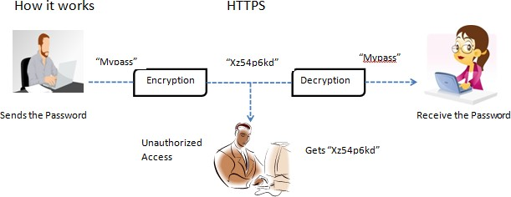

Slide 8
























Transport Layer Security (TLS)
TLS ensures secure communication between client server applications over the internet
It prevents the network communication from being eavesdropped or tampered
Layers of TLS Protocol
TLS Record Protocol
It ensures connection security with encryption
TLS Handshake Protocol
It ensures server and client authentication

Slide 9
Secure Sockets Layer (SSL)
SSL was developed by Netscape for managing the security of message transmission on the internet
It uses RSA asymmetric (Public Key) encryption to encrypt data transferred over SSL connections
Client Hello message (including SSL version , randomly generated data , encryption algorithms, session ID, key exchange algorithms, compression algorithms and MAC algorithm)
Determine the SSL version and encryption algorithms be used for the communication; sends server hello message (session ID)and certificate message
Sends a server hello done message
Verifies the digital certificate ; generates a random premaster secret and sends client key exchange message with the premaster secret.
Sends a change cipher spec message and client key exchange message with the premaster secret
Hash value is calculated for the exchanged hands messages and then compared to the hash value received from the client ; if the two match the key and cipher suite negotiation succeeds. Sends a change cipher spec message and sends finished message(hash of handshake message)

Slide 10
Internet Protocol Security (IPsec)
IPSec is a network layer protocol that ensures secure Internet protocol (IP) level communication
It provides end to end security at the internet layer of the internet protocol suite
It encrypts and authenticates each IP packet in the communication
It supports network level peer authentication, data origin authentication, data integrity, data confidentiality (encryption) and replay protection

Slide 11
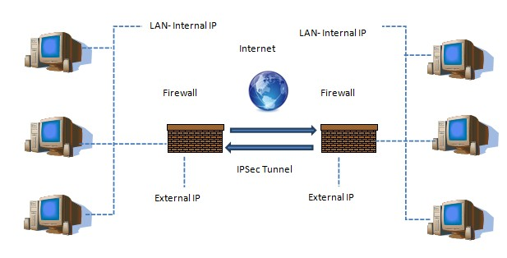
Internet Protocol Security (IPSec)

