Slide 1
COVID-19 DATA ANALYSIS

Slide 2
OBJECTIVE:
To perform data analysis and visualization on Covid-19 data using ETL tools.
To perform data analysis on Covid_19 data and extract the meaningful information from the dataset which will help in taking quick and informed decision.

Slide 3
TECHNOLOGIES USED
AWS Glue
SparkSQL
Redshift
AWS S3
SparkSQL
Crawler
AWS Lambda
PySpark

Slide 4
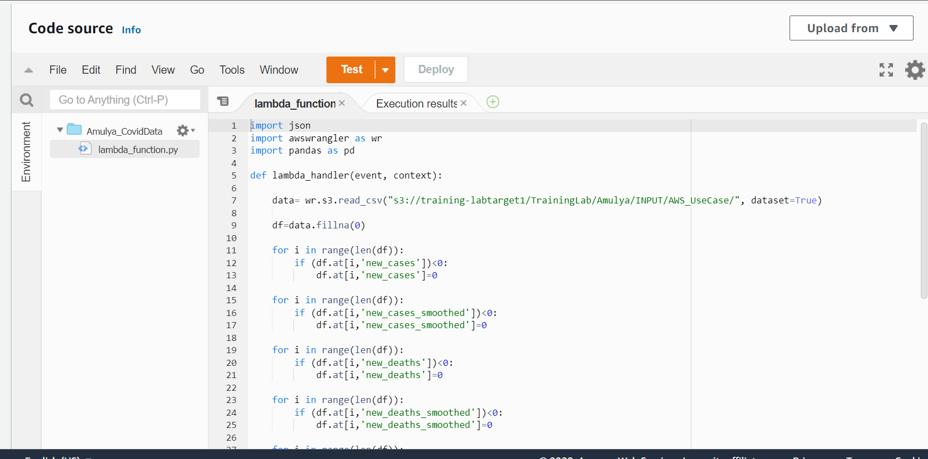
Problem Statements 1.Clean and transform data for processing Job Name: Amulya_CovidData

Slide 5
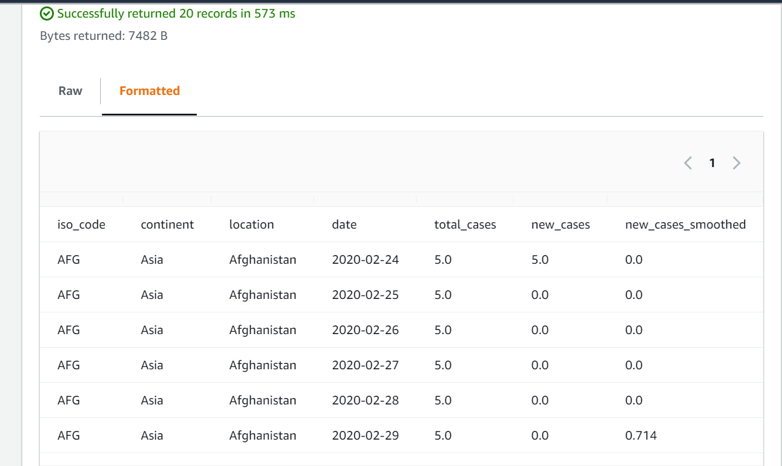
1.OUTPUT:

Slide 6
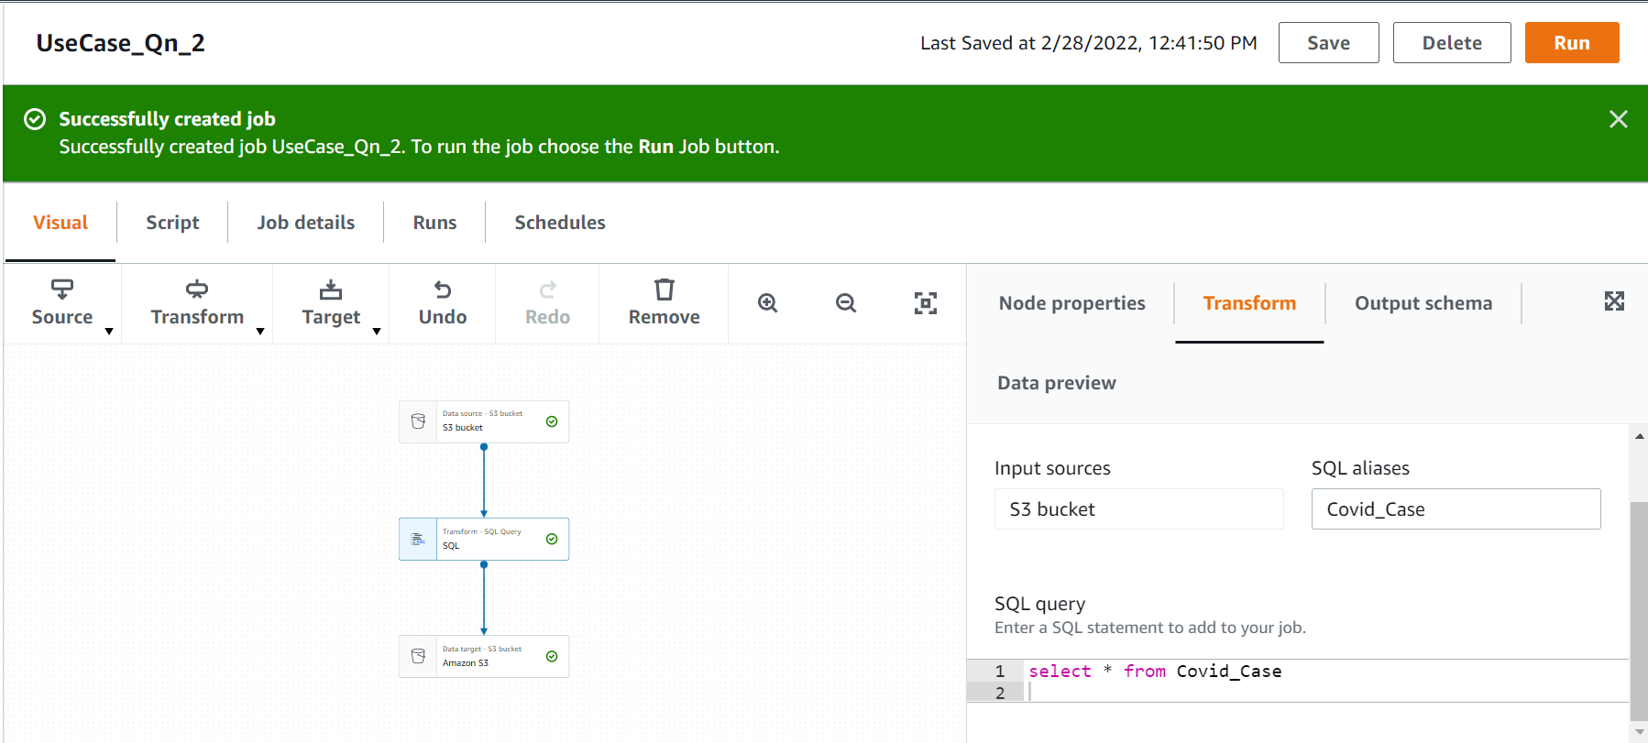
2. ETL operations on dataset. Job Name: UseCase_Qn_2

Slide 7
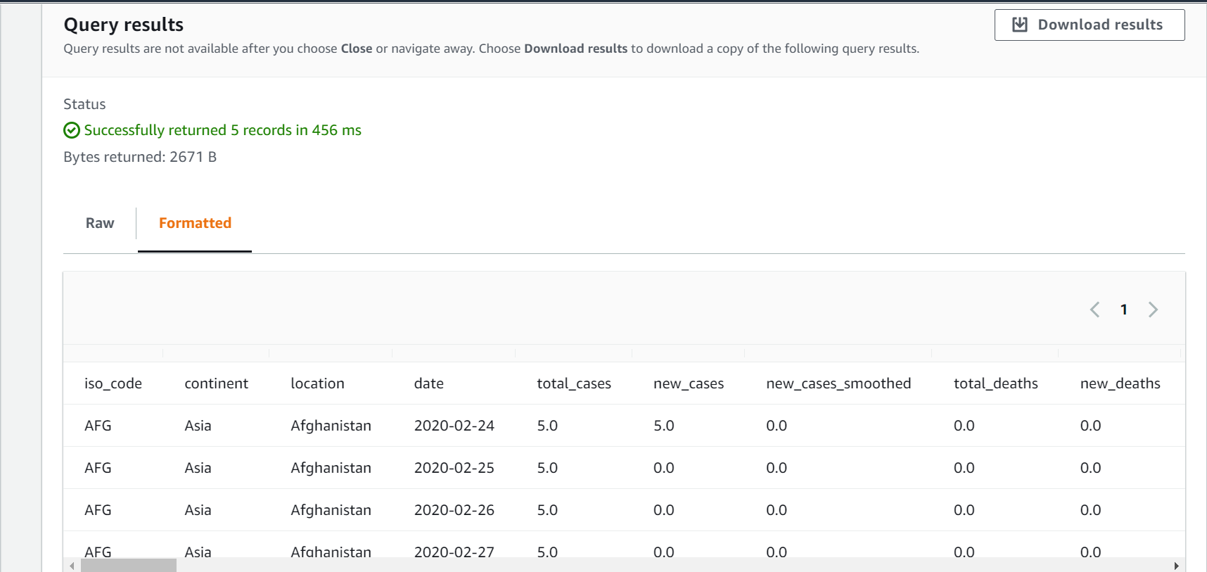
2. OUTPUT:

Slide 8
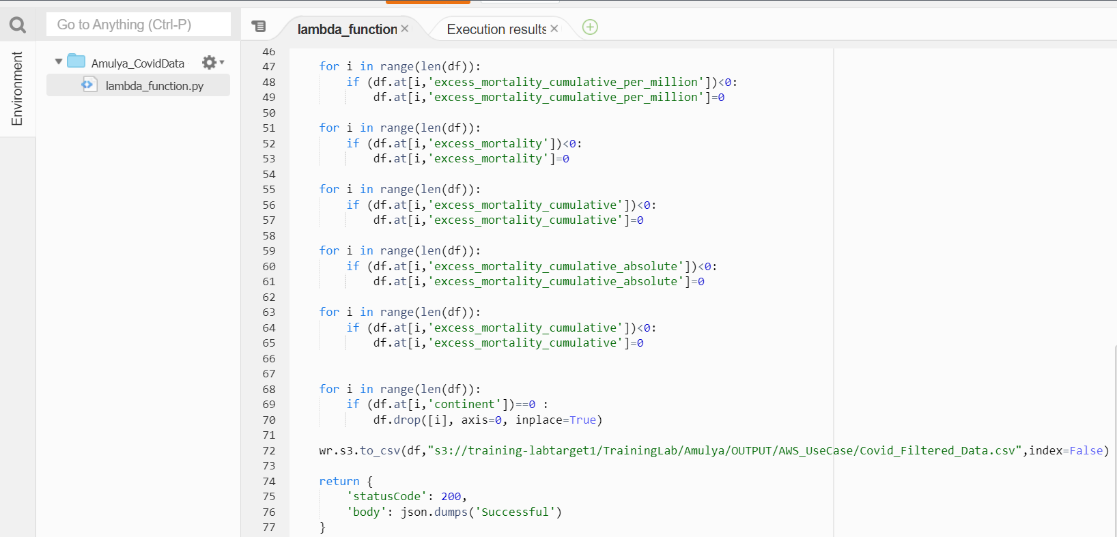
3. Storing the modified data in AWS. Job Name: Amulya_CovidData

Slide 9
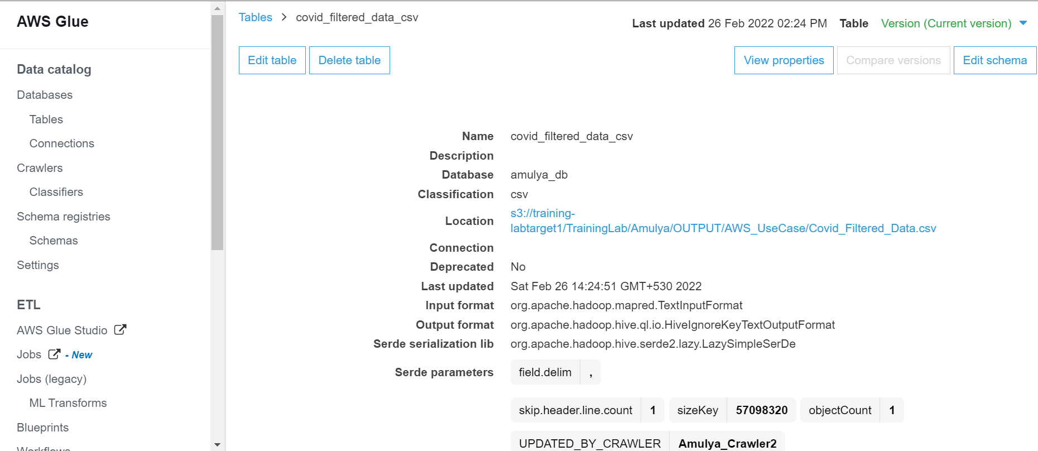
4.Display total cases ,new cases , recovered cases and deaths. CREATING CRAWLER

Slide 10
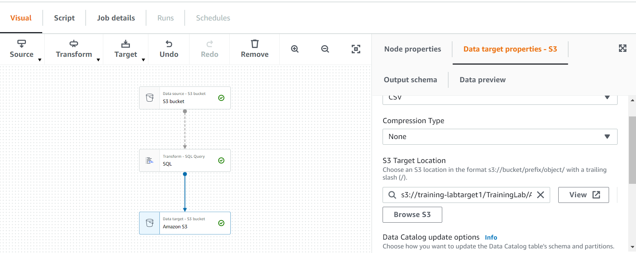
4. Display total cases ,new cases ,recovered cases and deaths. Job name: Amulya_qn4

Slide 11
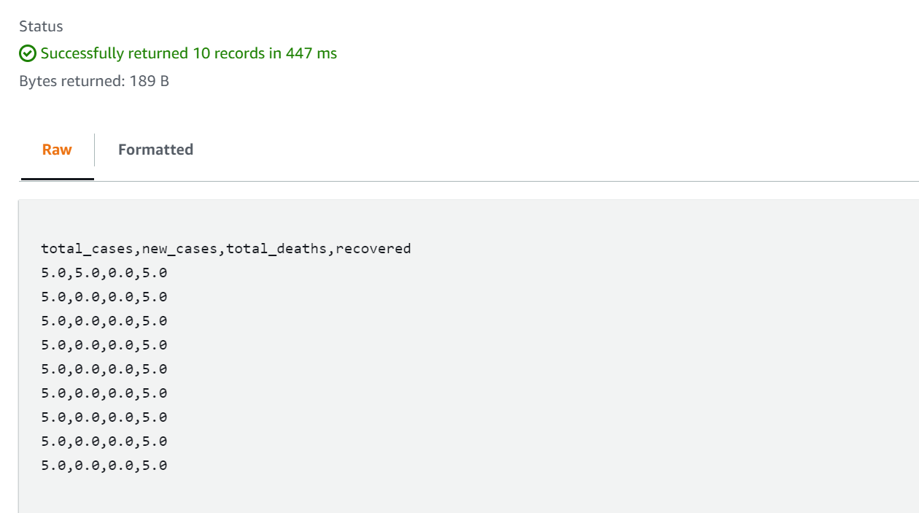
4.OUTPUT

Slide 12
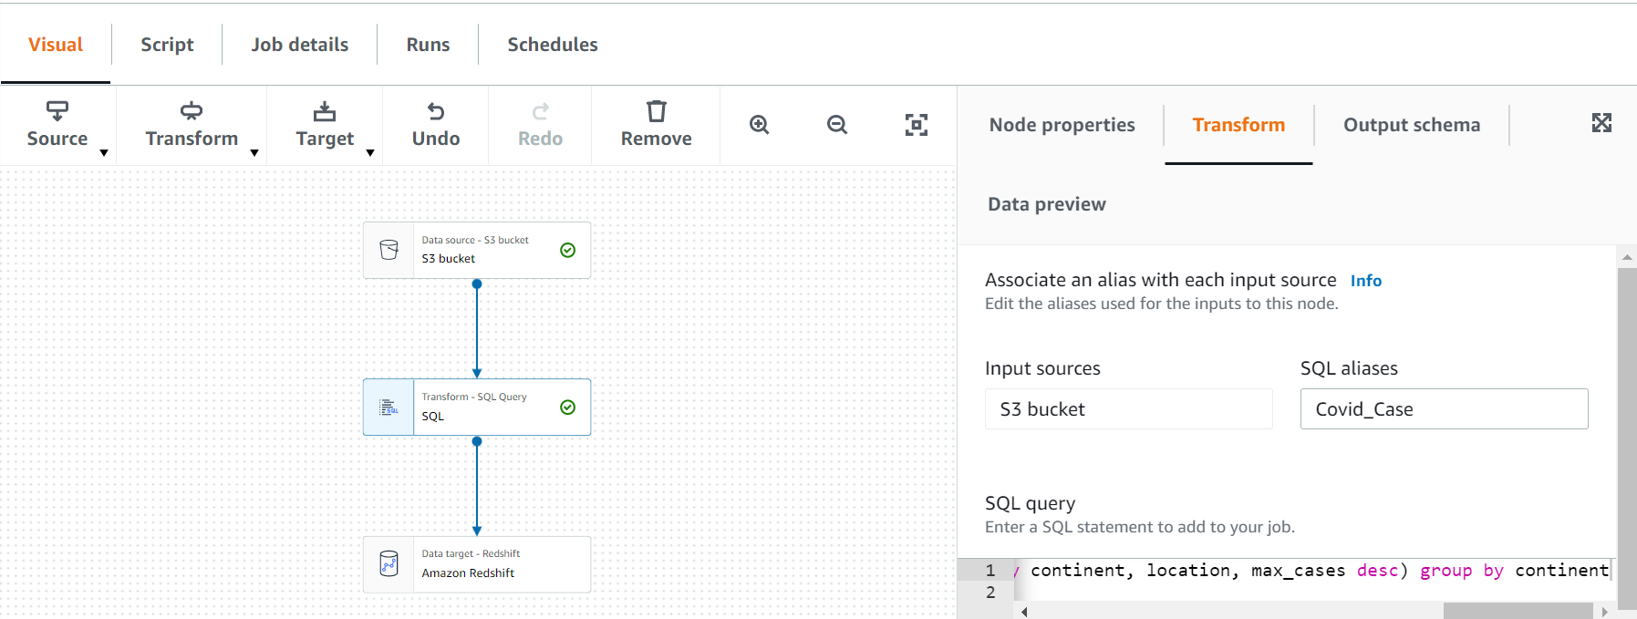
5.Which country in Distinct WHO region highest cases in till date. Job Name: UseCase_Qn_5

Slide 13
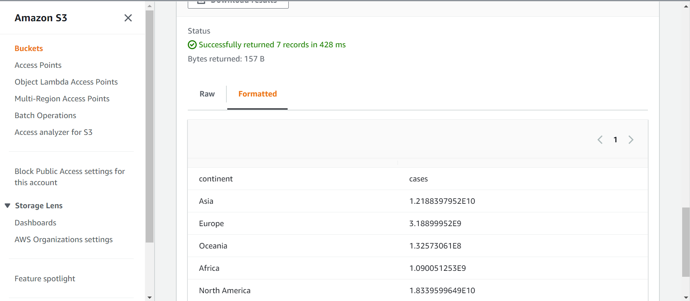
5.OUTPUT

Slide 14
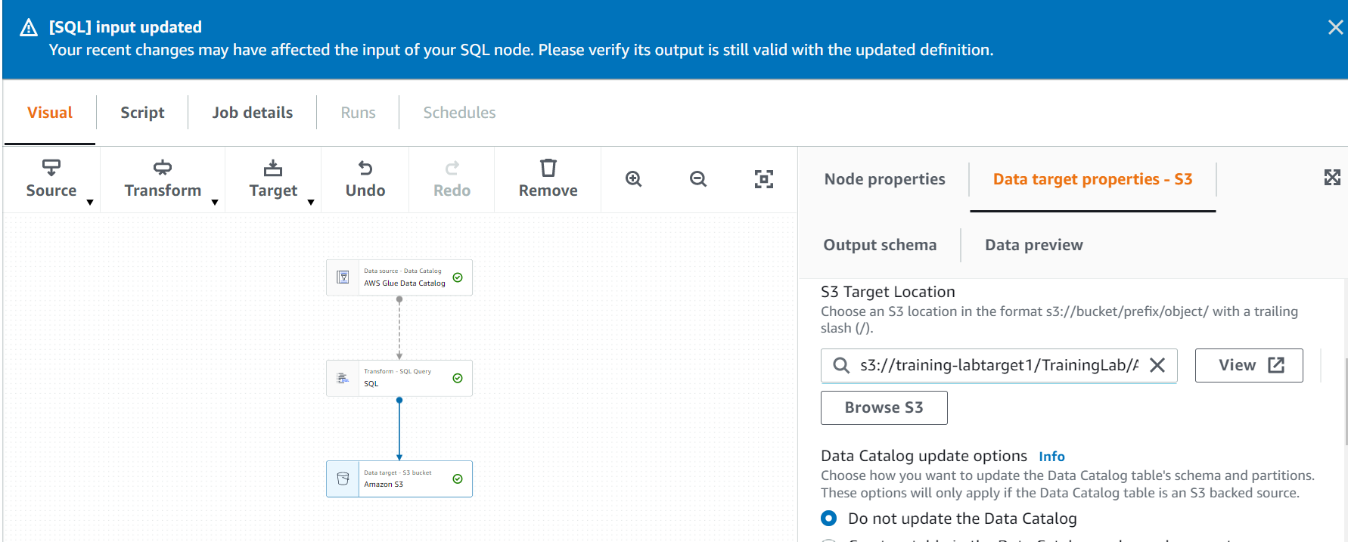
6. Total no of confirmed cases over between a certain date. Job Name: UseCase_Qn_6

Slide 15
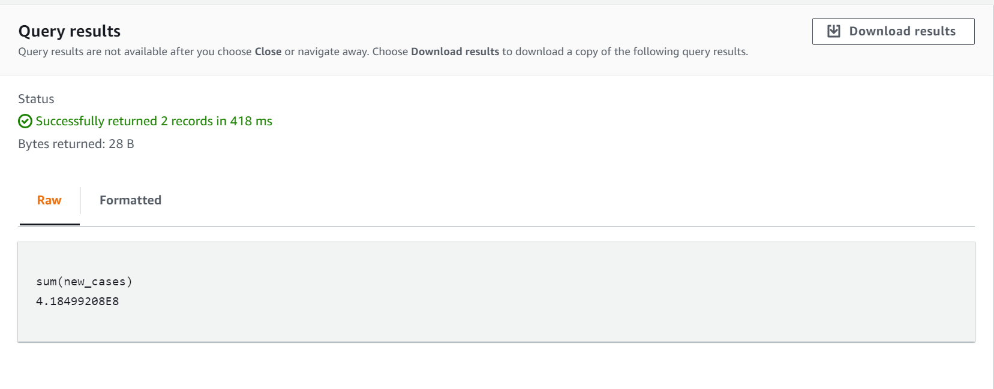
6.OUTPUT:

Slide 16
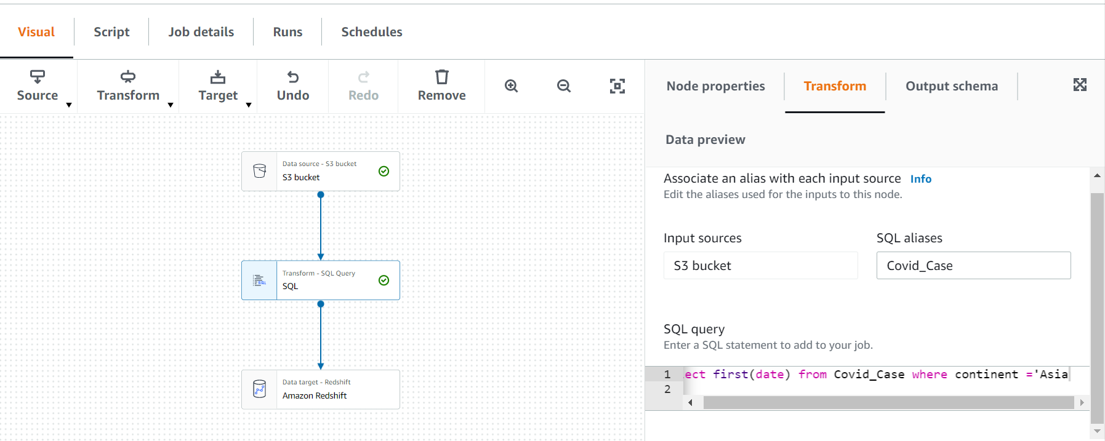
8.Date of first confirmed case in a particular region. Job Name:UseCase_qn_8

Slide 17
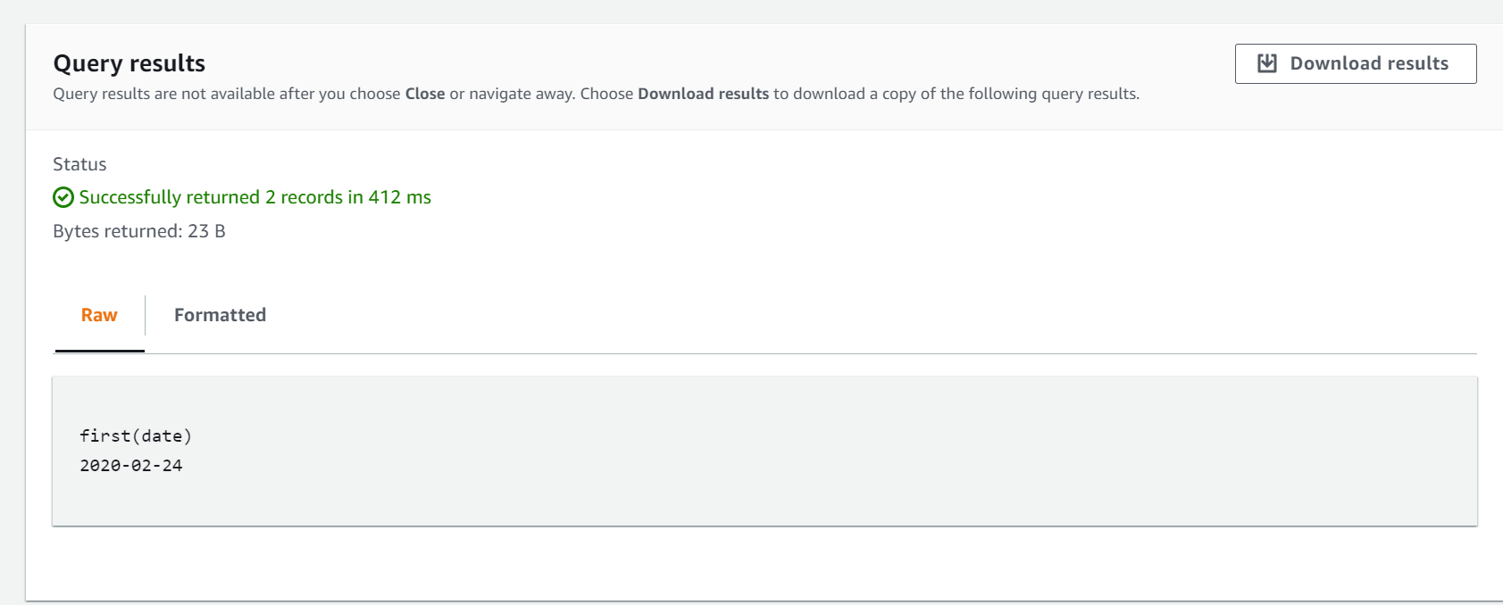
8.OUTPUT:

Slide 18
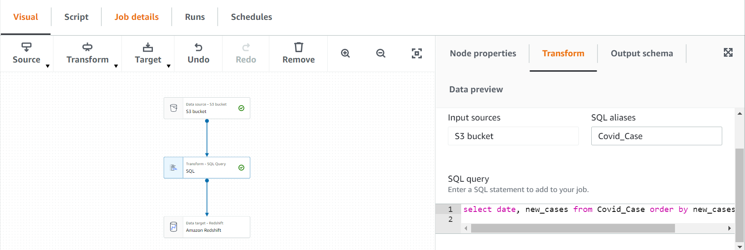
9.Date on which max no. cases were reported in a country. Job Name : UseCase_Qn_9

Slide 19
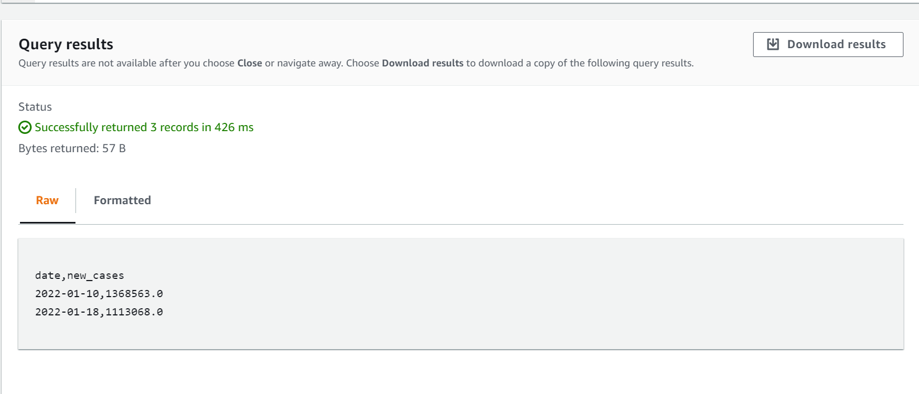
9.OUTPUT:

Slide 20
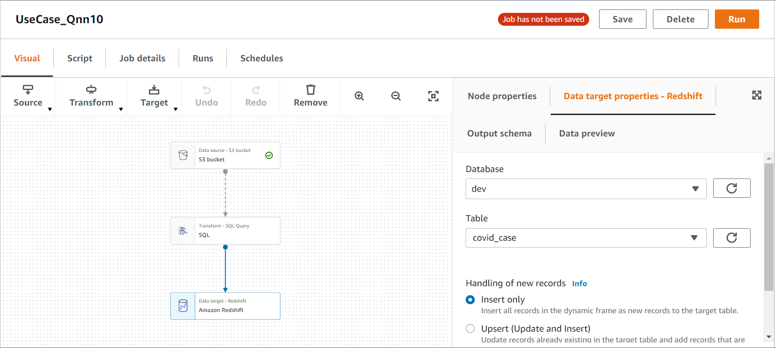
10.Line chart showing total cases, deaths &recoveries of a particular country . Job Name: UseCase_Qnn10

Slide 21
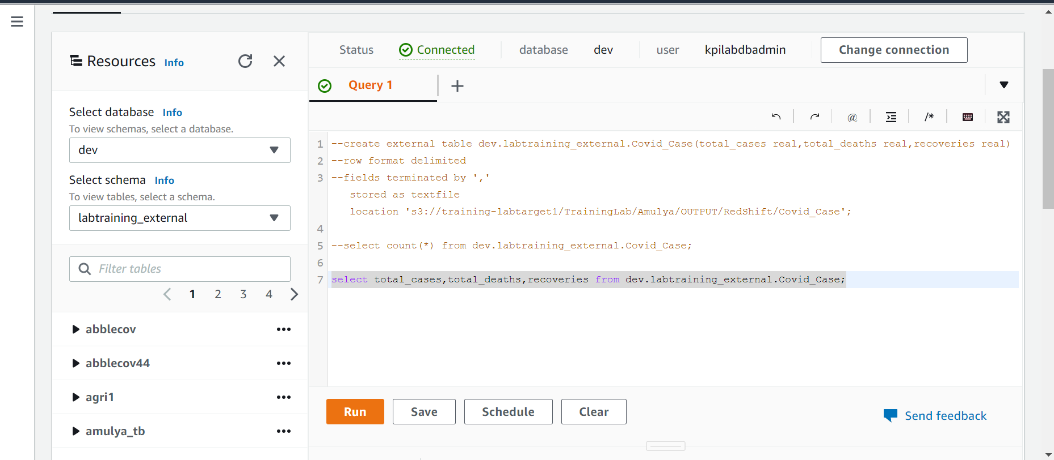
10 . Creating external table

Slide 22
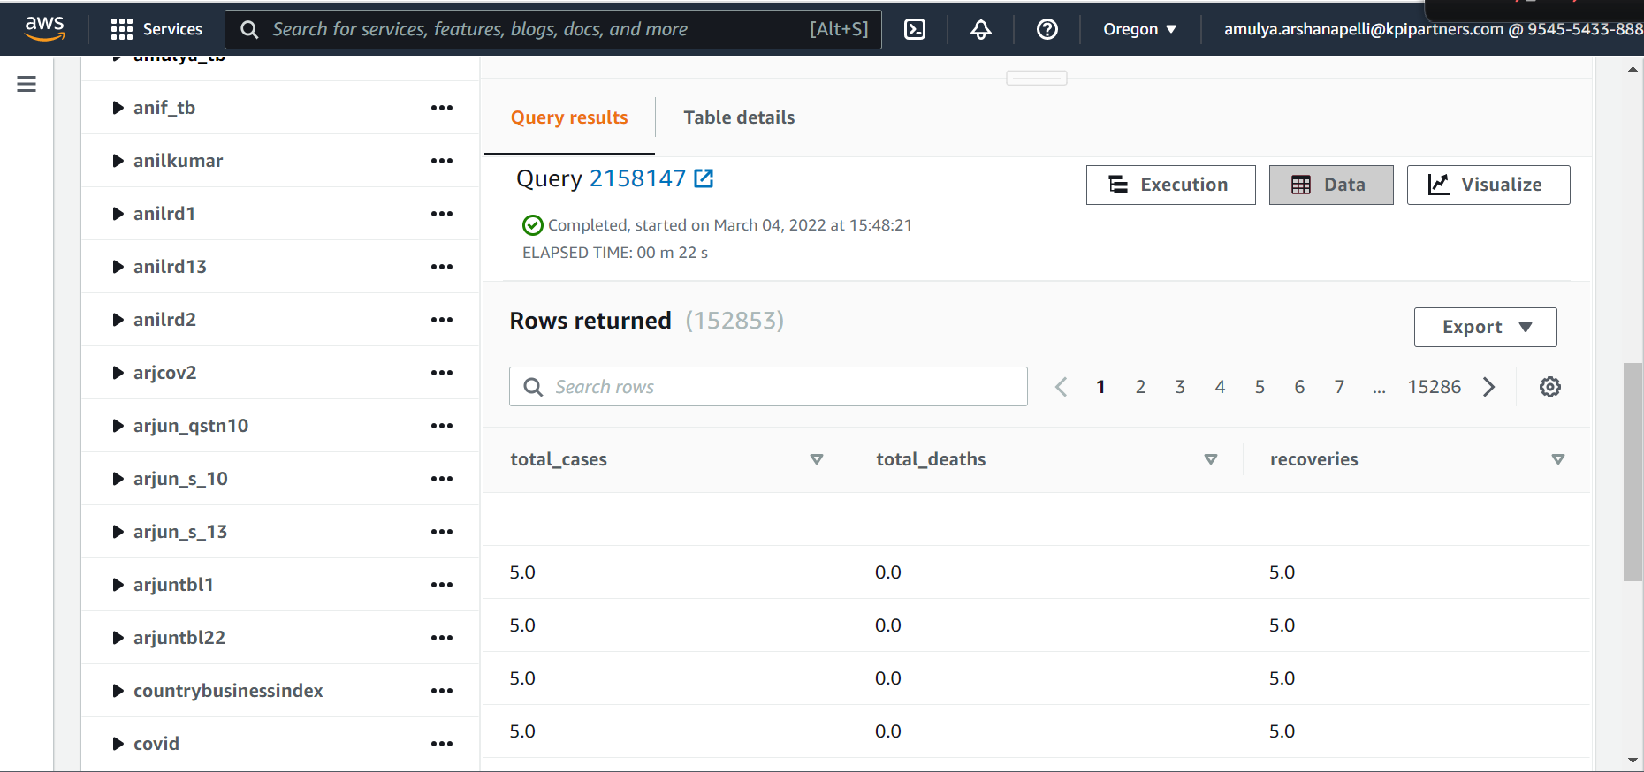
10. OUTPUT:

Slide 23
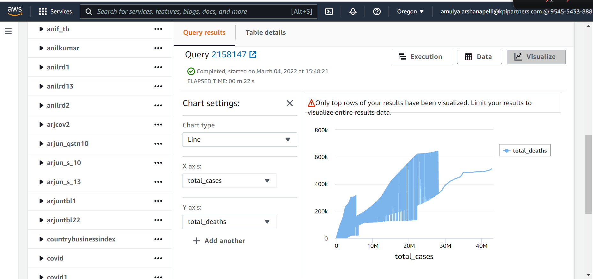
10. Line chart:

Slide 24
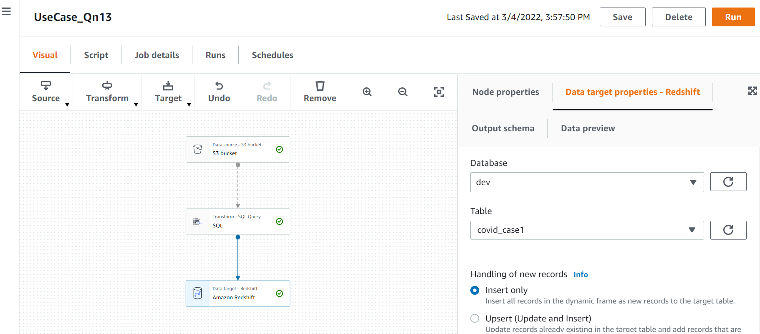
13.No. of active cases vs critical cases of a country. Job Name: UseCase_Qn13

Slide 25
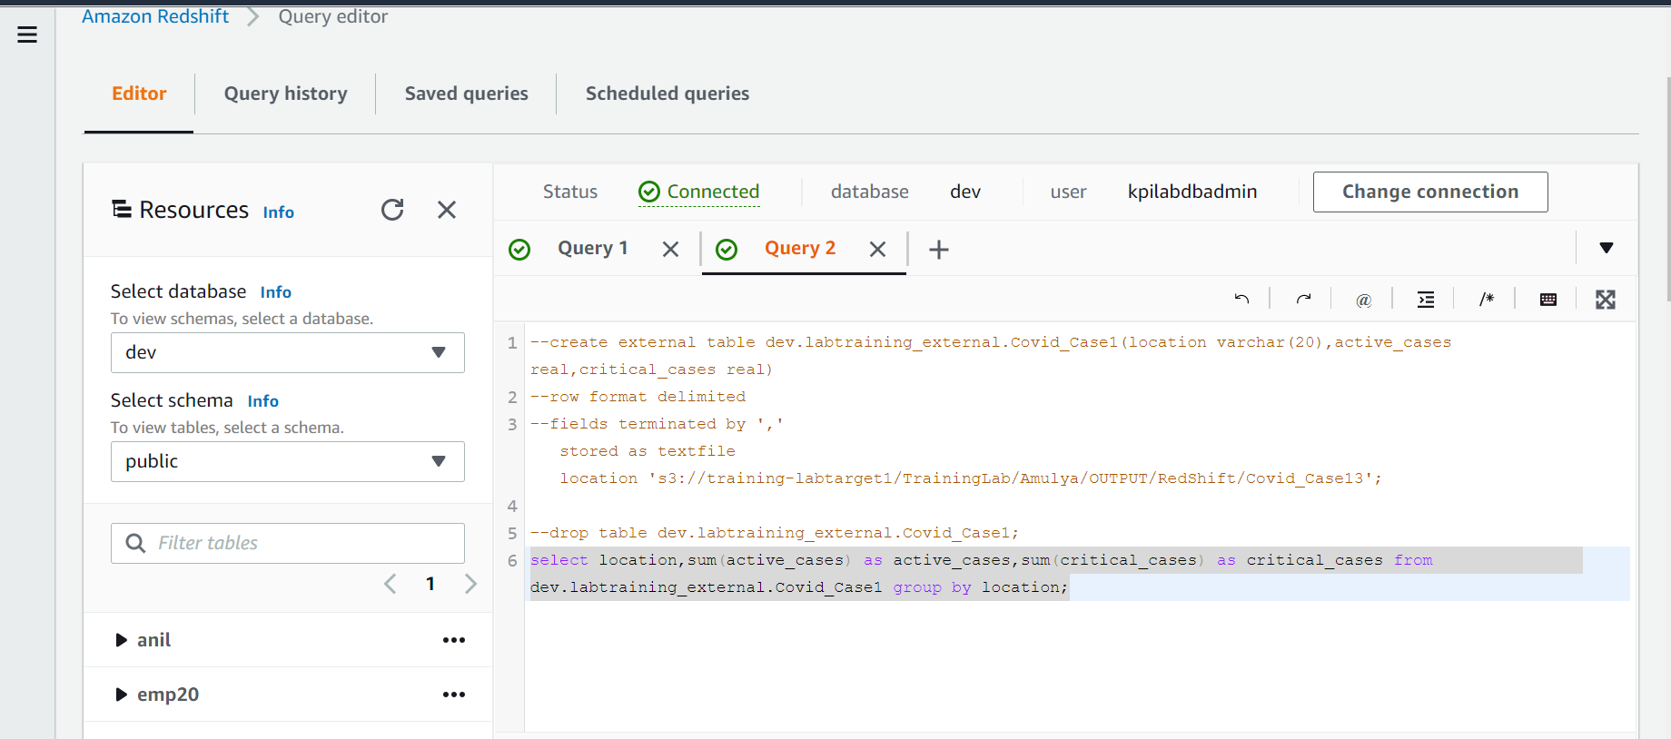
13. Creating external table.

Slide 26
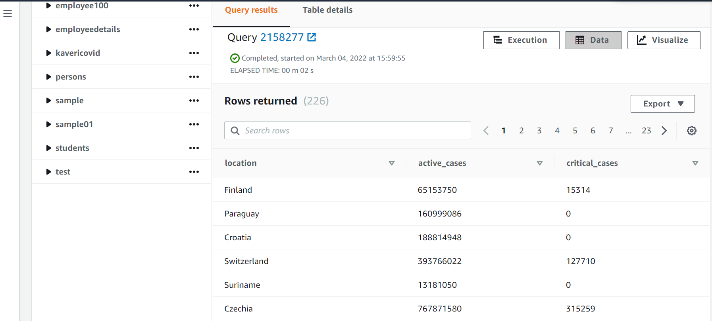
13. OUTPUT:

Slide 27
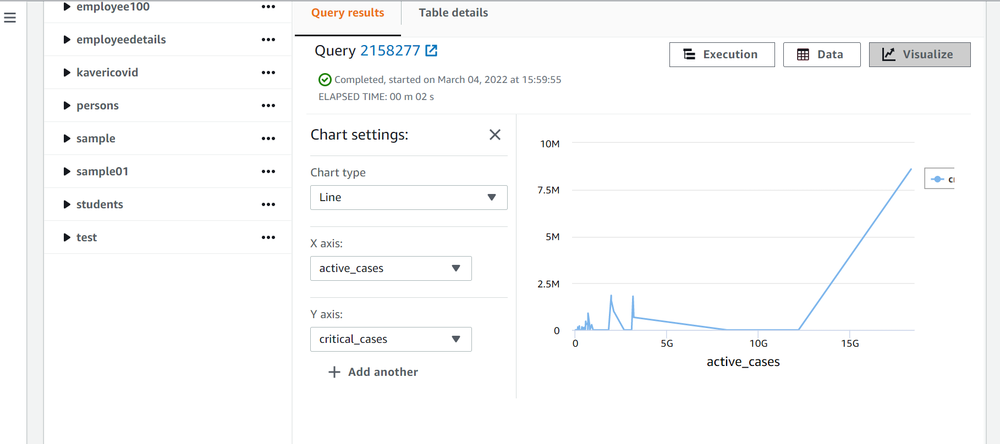
13. active cases vs critical cases.

Slide 28
THANK YOU

