Slide 1

HiveSparkCineSight
Amulya Murududdi

Slide 2
Goals and Objectives
MOTIVATION- Real-world Relevance: Analyzing a movies dataset is relevant to the entertainment industry, providing insights that can be valuable for movie producers, distributors, and streaming platforms. Big Data Processing: Both Hive and PySpark are powerful tools for big data processing. Handling a movies dataset, which can be extensive with information on various movies, actors, genres, and user ratings, allows you to leverage the capabilities of these technologies for efficient and scalable data processing.
Data Exploration and Analysis: A movies dataset is rich in diverse data types, including information about movies, genres, actors, directors, release dates, and user ratings. This variety allows you to perform interesting exploratory data analysis (EDA) and gain insights into trends, preferences, and correlations within the dataset. Visualization and Reporting: Analyzing a movies dataset allows you to create visualizations and reports that can effectively communicate your findings. You can use tools like Matplotlib, Seaborn, or even integrate with business intelligence tools to present your insights in a visually appealing and understandable manner.

Slide 3
Significance
Industry Relevance: Analyzing a movies dataset is relevant to the entertainment industry, offering insights that can inform business decisions. The ability to extract valuable information from vast datasets is crucial for stakeholders in the movie industry, including producers, distributors, and streaming platforms.
Data-Driven Decision Making: The project allows you to demonstrate the power of data-driven decision-making. By leveraging big data technologies like Hive and PySpark, you can showcase how insights gained from the analysis can guide strategic decisions, such as content creation, marketing, and audience targeting.
Revenue Optimization: The insights gained from the project can contribute to revenue optimization. For instance, understanding which genres or types of movies are more likely to attract a particular demographic can help in optimizing advertising strategies and partnerships.
Competitive Advantage: Companies that can effectively analyze and leverage their data gain a competitive advantage. This project allows you to showcase your ability to extract meaningful insights from large datasets, giving organizations a competitive edge in a data-driven business landscape. The significance of the project lies in its potential to transform raw data into actionable insights that have real-world implications for the entertainment industry,

Slide 4
Objectives-
Data Exploration:
Objective: Explore the movies dataset to understand its structure, features, and data quality.
Data Preprocessing:
Objective: Preprocess the dataset to handle missing values, outliers, and any other data quality issues.
Hive SQL Queries:
Objective: Apply Hive SQL queries to perform data manipulation and filtering.
Data Visualization:
Objective: Create visualizations to represent key findings and trends in the dataset.

Slide 5
Features-
Data Ingestion: Importing and loading the movies dataset into HDFS for further processing.
Data Exploration and Profiling: Exploring the dataset to understand its structure, schema, and basic statistics.
Data Preprocessing: Cleaning and transforming the data to handle missing values, outliers, and ensure data quality.
Hive SQL Queries: Applying Hive SQL queries for data manipulation, filtering, and exploration.
PySpark for Big Data Processing: Leveraging PySpark for distributed computing and processing large-scale data efficiently.
User Behavior Analysis: Analyzing user ratings, viewing patterns, and preferences to understand viewer behavior. Data Visualization: Creating visualizations (charts, graphs) to represent key findings and trends in the dataset.
Business Insights and Recommendations: Deriving actionable business insights and providing strategic recommendations based on the analysis.
Documentation and Reporting: Documenting the entire project, including methodologies, preprocessing steps, and findings.

Slide 6
Background
with linked reference
Related work to the topic- We went through many articles and websites related to movies dataset related to data science topics. We have come to the conclusion that most of the features would require us to implement machine learning to get the best out of the data set However, we are obligated to use what we have learned so far. So we implemented our project with Hive, Hadoop and Spark. The most challenging part was to set up the environment where all three would work perfectly without running into any issues.
This had been quite a challenge for us.
linked reference Exploratory Data Analysis With Movies | by Jeremy Lee | Towards Data Science
The Role of Data Science and Analytics in Movie & Film Making - The Smart Cube

Slide 7
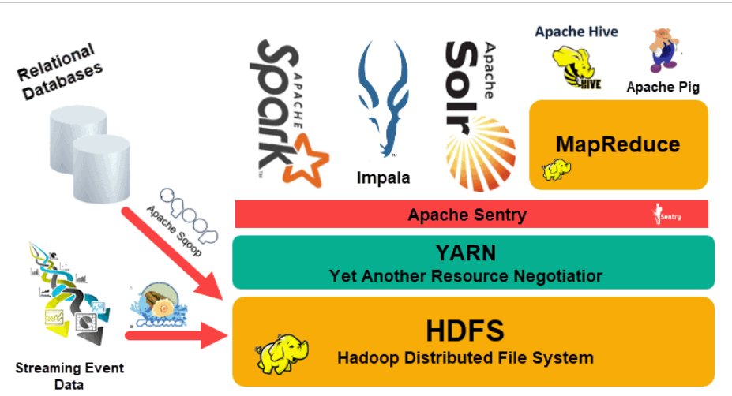
Model
Architecture
1-HDFS HDFS is a distributed file system that allows for high-speed access to application data.
Large files are divided into blocks (usually 128 MB or 256 MB) and distributed across numerous nodes in the Hadoop cluster.By replicating data across several nodes, HDFS ensures fault tolerance.
.

Slide 8
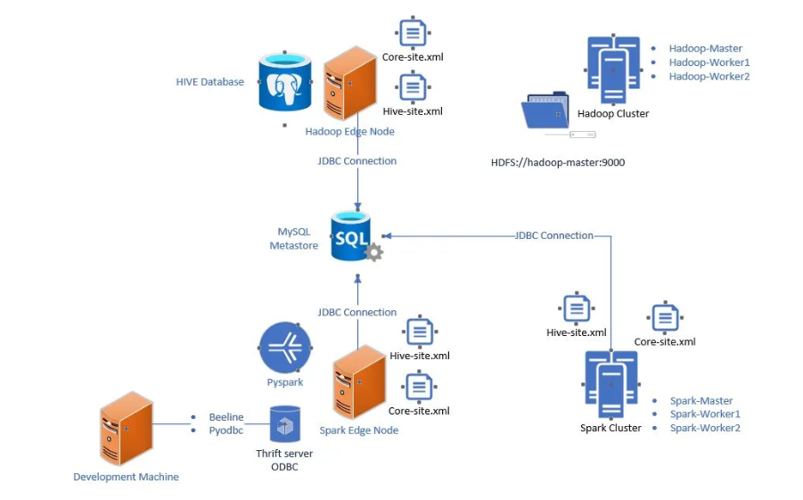
2. Mapreduce: MapReduce is a distributed data processing programming methodology and processing engine
It is divided into two phases: the Map phase, during which data is processed in parallel among nodes, and the Reduce phase, during which results are merged.
3. YARN (Yet Another Resource Negotiator): YARN is Hadoop's resource manager, which manages resources and schedules tasks.It enables multiple applications in a Hadoop cluster to share resources.
.

Slide 9
Integration with Hive:
Hive:
Hive is a Hadoop-based data warehouse and SQL-like query language solution. It provides a higher-level abstraction for accessing and managing Hadoop data, making it accessible to SQL users. Hive transforms SQL-like queries into MapReduce jobs that can be run on a Hadoop cluster
Integration with Spark:
Spark:
Apache Spark is a general-purpose distributed computing system that can swiftly handle big datasets. Spark can perform batch processing (similar to Hadoop MapReduce) as well as real-time processing (streaming).Unlike MapReduce, Spark processes data in memory, eliminating the requirement for intermediate storage and enhancing performance.

Slide 10
How Spark Works with Hadoop:
Data Storage: Park can read data directly from HDFS or other Hadoop-compatible storage systems.
It may also process data in memory, eliminating the need for repetitive disk reads.
Cluster Manager: Spark can run on the same resource management as Hadoop, YARN. It can also be operated standalone or on other cluster managers such as Apache Mesos.
Resilient Distributed Datasets (RDDs):RDDs, which are fault-tolerant distributed collections of objects, are used to handle data in Spark.RDDs enable Spark to do parallel processing across a cluster in an effective manner.
Spark SQL: Spark SQL is a structured data processing module provided by Spark. Similar to Hive, Spark SQL allows you to query structured data using SQL queries.
Integration with Hive:Spark may be integrated with Hive, allowing users to run SQL queries in Spark using Hive's SQL syntax. It connects to Hive via the Hive Context.
Performance- When compared to traditional MapReduce, Spark's in-memory processing and caching capabilities frequently result in faster data processing.

Slide 11
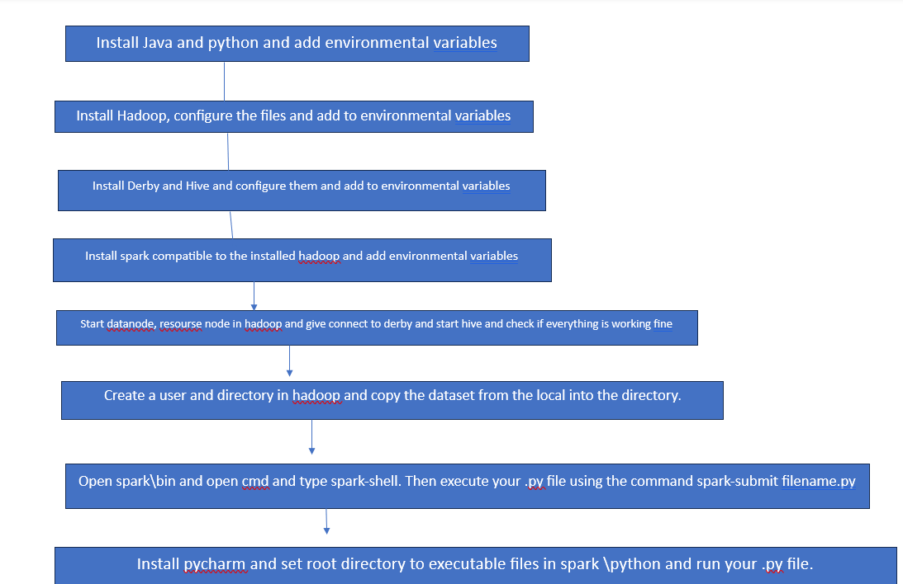
Work Flow
Setting up the environment for the project is the hardest path. Step 1- Install java and python and set env variables
Step-2Install Hadoop and set environmental variable
-Hadoop conf is tricky as you need to add few lines of code. Add the configurations and create a new folder called datanode and create 2 more namenode and datanode and add inside it
-start name node, start yarn demons and check them using jps command

Slide 12
Step 3 – Install Derby and hive and add env variables
- Add derby libraries in hive and check for guvava file compatibility in Hadoop and hive
-Add hive.xml file in the hive and replace the bin folder with windows executable bin
-Start Hadoop and derby and hive metastore and execute hive and you will go to hive shell
Step 4 – Install spark and set env variables and go to spark/bin and open cmd and type spark-shell and spark will open
-Execute your .py file giving the command spark-submit textfile.py
Step5-create a directory in Hadoop and copy dataset file from local to the directory
Step 6- Try to read it from spark giving hdfs command
Step 7- Start sparksession with hivecontext to execute hivecommands
Step 8 – create a dataframe and load the data into it then create a table and load that into the tables
Step 9- Perform data cleaning, scaling, analysis and finally data visualization on the dataset

Slide 13
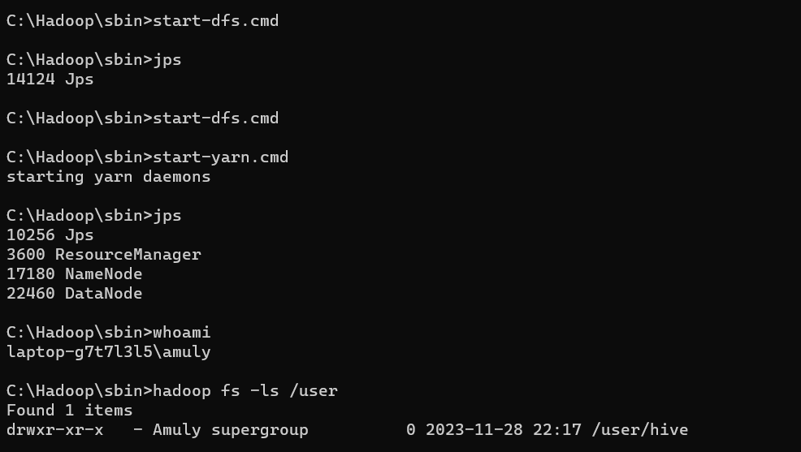
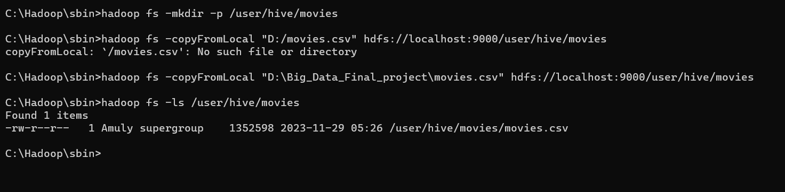
Start Hadoop and copy the file into hdfs View the file in hdfs run spark and execute .py file

Slide 14
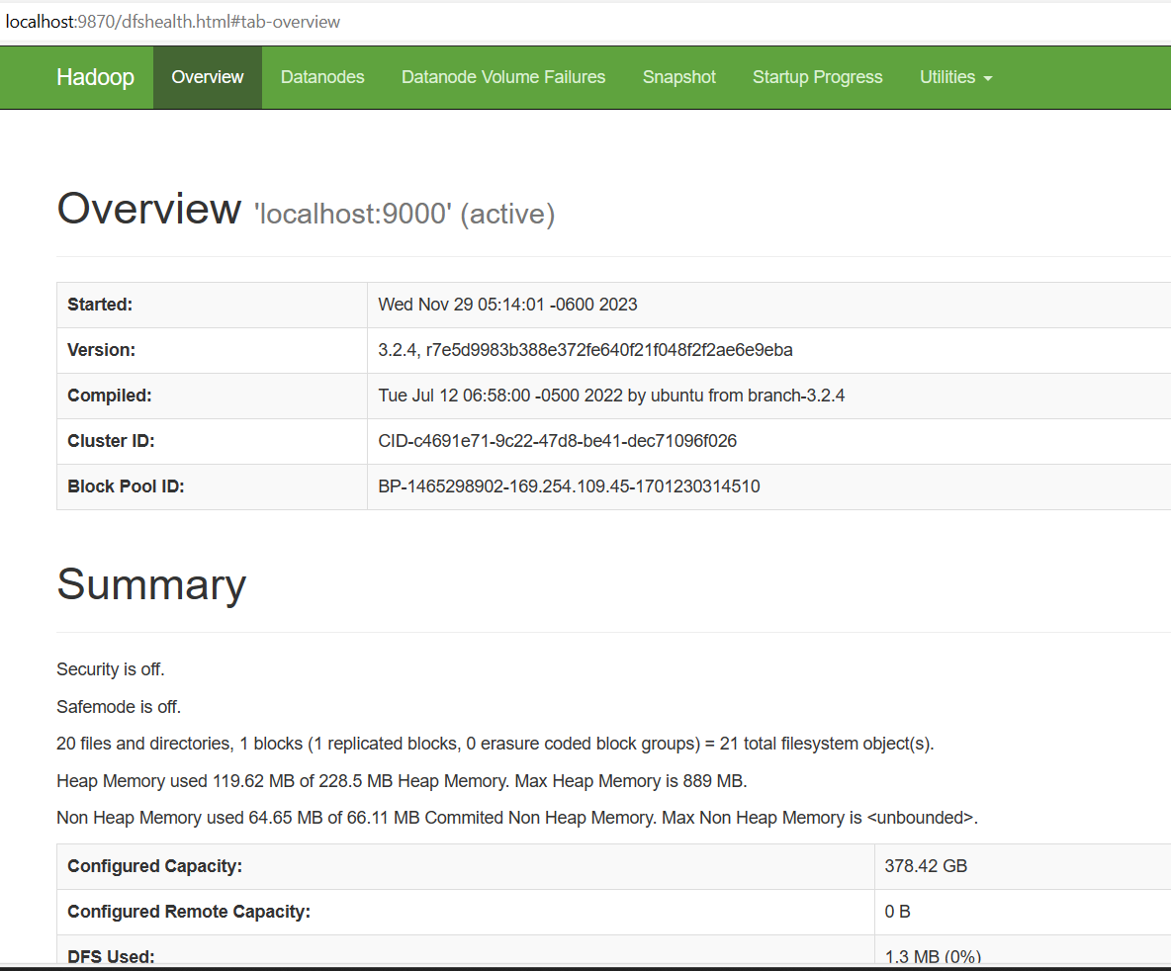
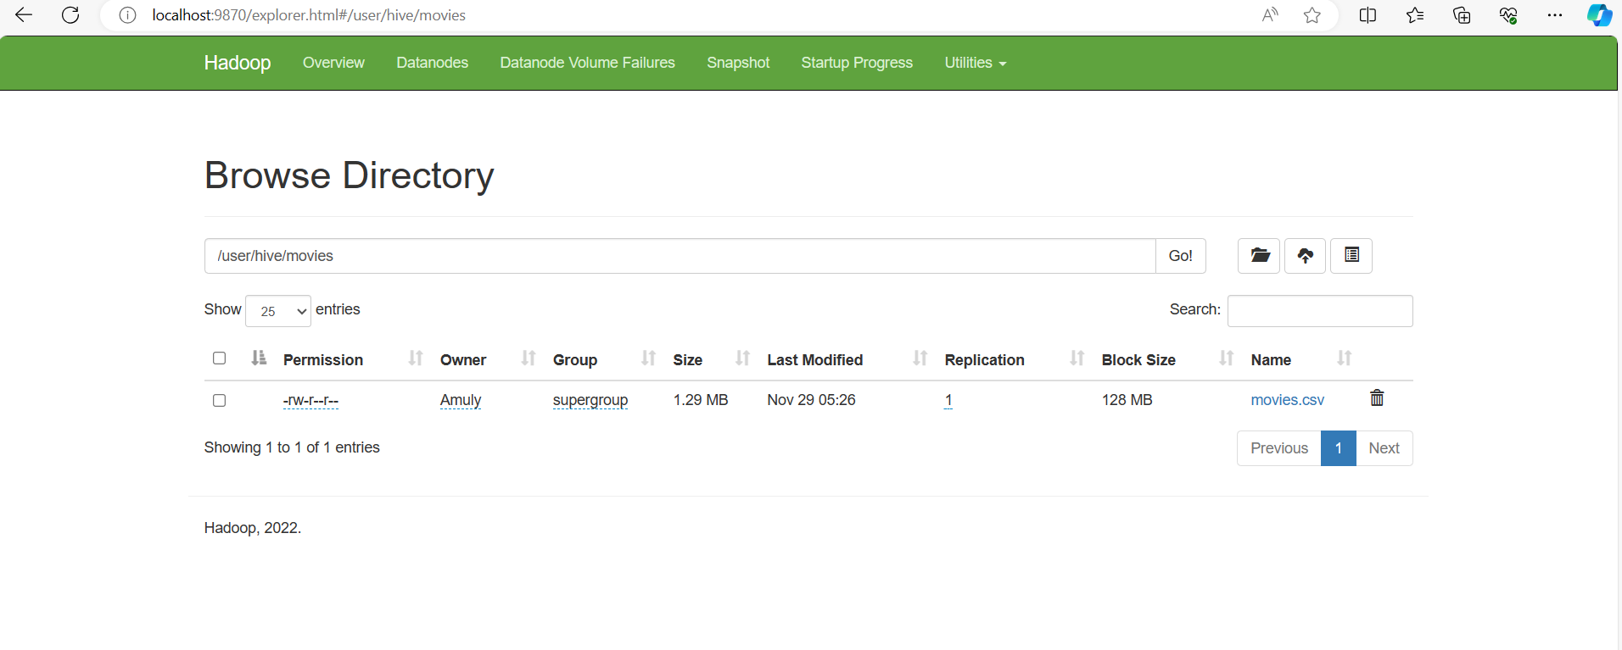

Slide 15
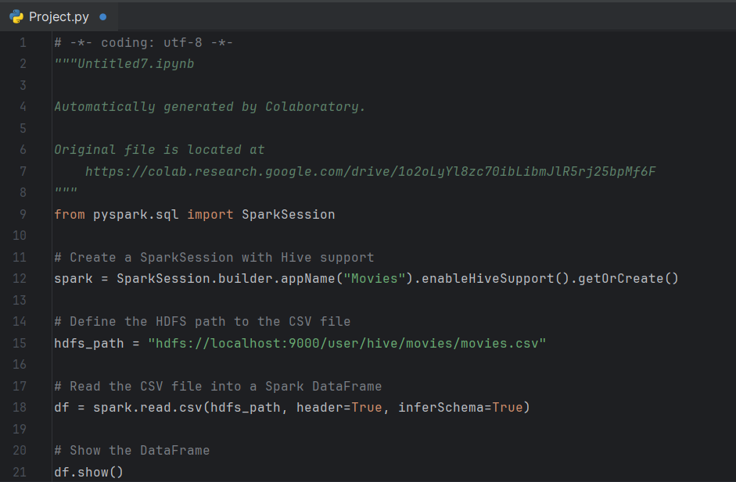

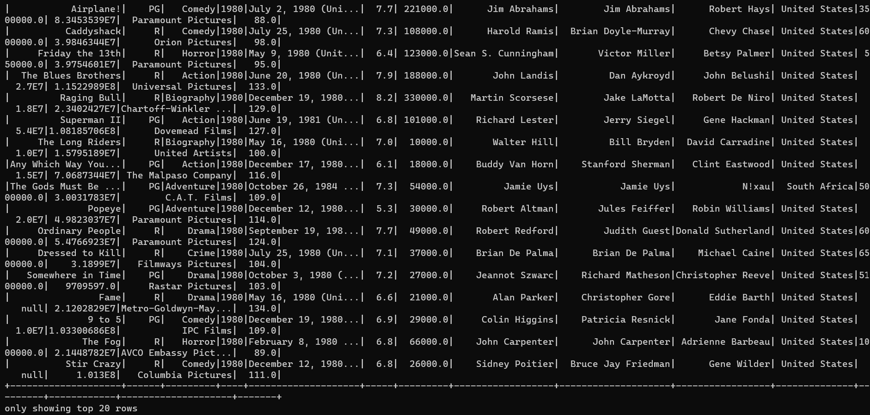

Slide 16
Dataset
Detailed description of Dataset
For our project we took a dataset of movies which have 7600 recods of the details related to a movies over a span of 40 years . The records are Name, rating, genre, year, released, score, votes, director, writer, star,country,budget,gross,company,runtime
The data gives us the details of each record over a span of time
All this data is stored in a CSV file. However, there are lot of null values in the data set while will be handled in data cleaning.

Slide 17
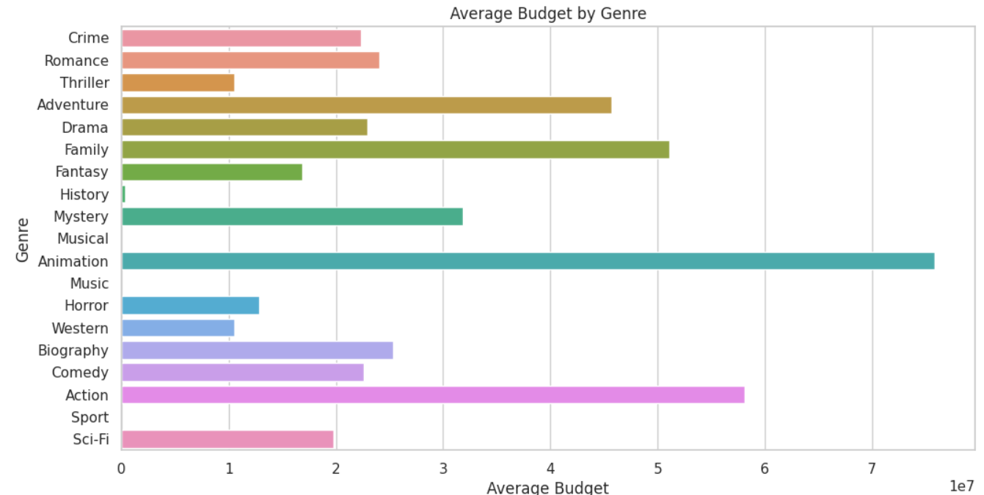
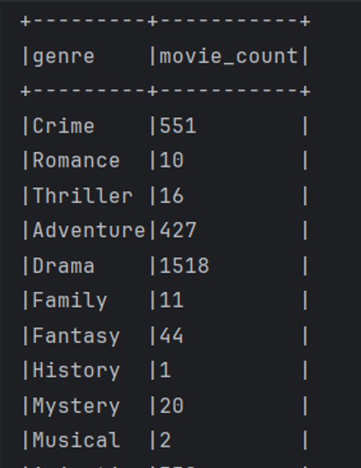
Dataset Features:
As this data set have 7 plus thousand details of the movies over 40 years, this helps us understanding and recognizing the parents when data is visualized.
1) Data Vizualization- From the data
and the graph we can easily determine which type of movies and encouranged in the industry
2)Data Analysis-Similarly the data can also be alalysed
3) Data Integration- As we have done in the project we can integrate in multiple platforms for better analysis

Slide 18
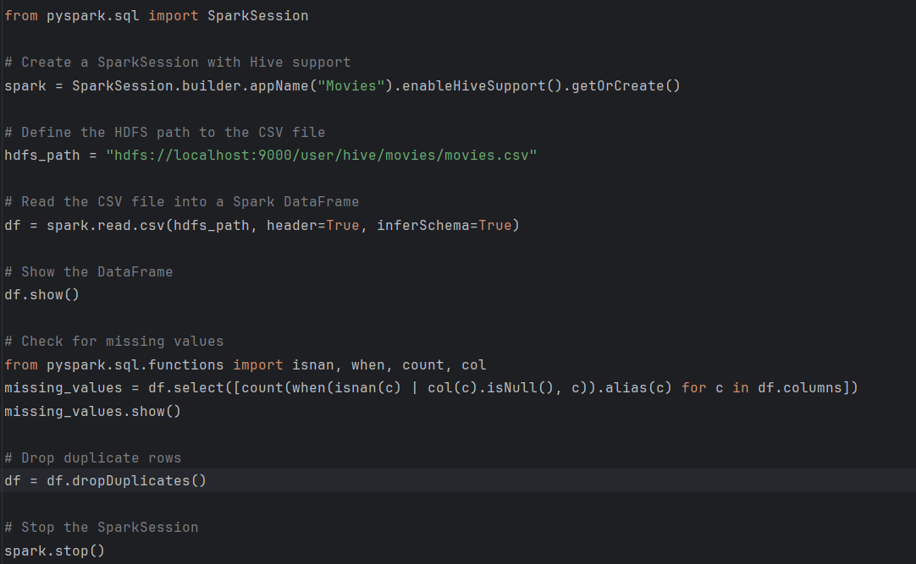
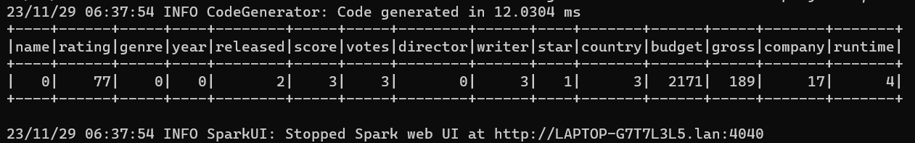
Analysis of data
Data Pre-processing
Drop duplicate records and view empty records
output
Data Pre-processing
Initially the file is copied into HDFS and then loaded into Spark.
In .py file we are supposed to clean the data as there might be duplicate values as it is a large dataset.
Now, we need to handle the records which are empty. This is very important as it will give you very wrong results if it is not implemented.

Slide 19
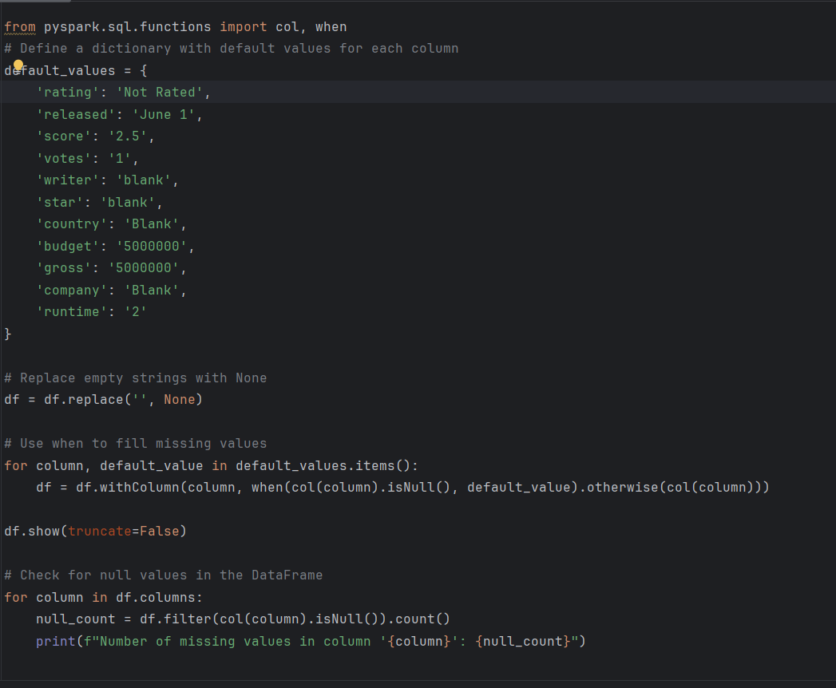
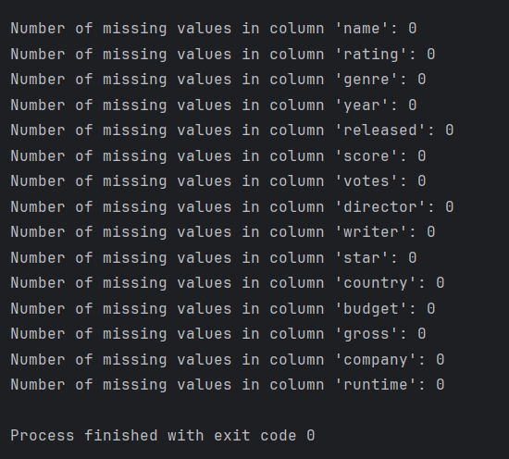
Handling Missing Values

Slide 20
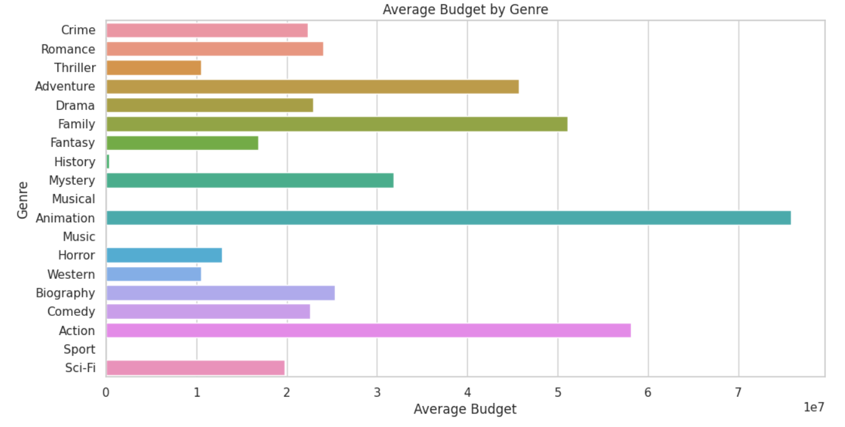
Graph model with explanation
Description
Graph
This graph tells us that over the past few decades. The budget for animation is so high while history, spots and musicals are very less or negligible. Action movies come right next to Animation even then, it is no way close.
Use Case- For a small producer this graph tells in which movie he had to invest it so that he won’t end up paying a lump.

Slide 21
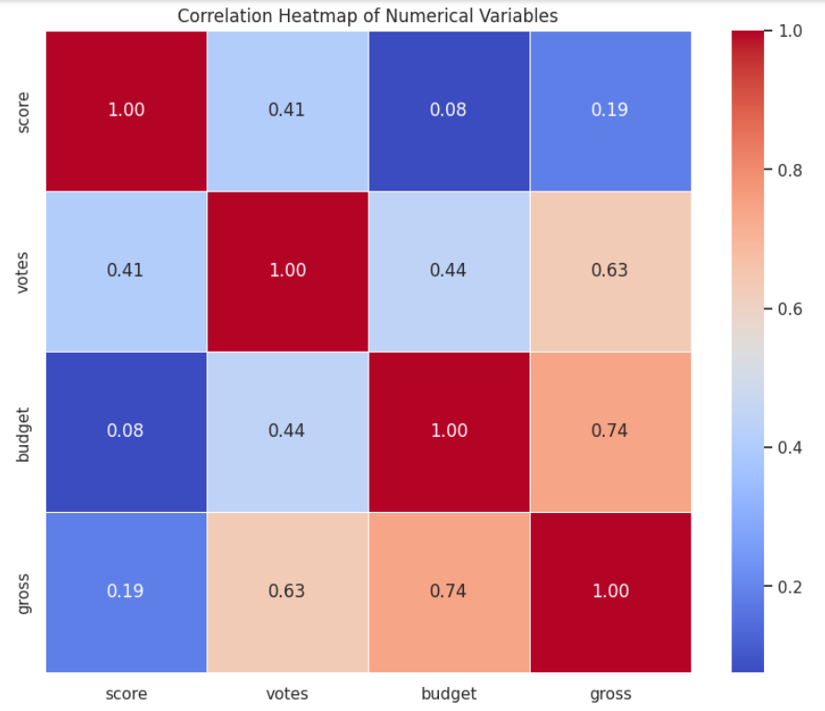
Graph model with explanation
Description
Graph
.This is a correlation heatmap which compares one value with other.
It help us to understand relation between two records.
In this graph, The gross and budget relationship is 0.74 which is high. It means most of the producers money is being returned

Slide 22
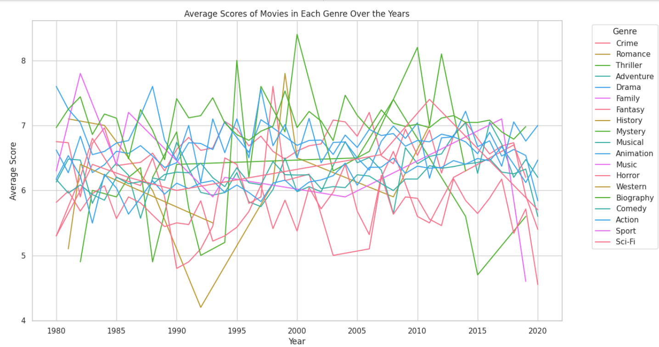
Graph model with explanation
Description
Graph
. In this graph, we can observe the scores of a particular genre over a specific time
In the year 2000, romance ratings are very high and then again it reached that high in the year 2010. It took 10 years to reach that.
Similarly, the western movies score fell down in between 90 and 95.
These help us to identify the patterns which can be further implemented using ML

Slide 23
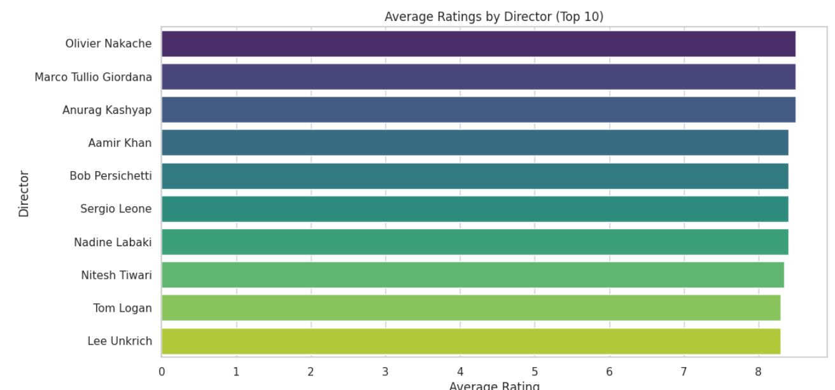
Graph model with explanation
Description
Graph
This graph gives us the average rating of top 10 directors which tell us that all of them are the best as there is no bigger change in the graph and their score
All of them are above 8, for a producer this gives confidence to invest in that directors movies.

Slide 24
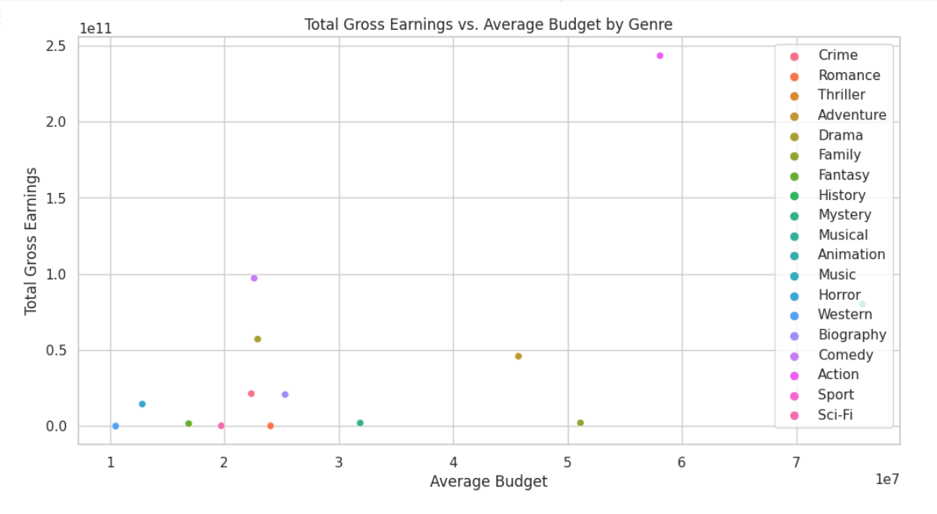
Graph model with explanation
Description
Graph
This graph gives us the scatter plot of ration between budget and gross
This tells us the higher rate od returns for action movies are so much more than the rest
This helps the movie makers to choose which movie they should invest in to get the profits .

Slide 25
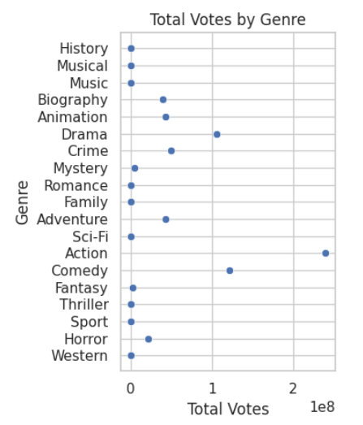
Graph model with explanation
Description
Graph
This graph gives us the scatter plot of total votes per genre .
People prefer to give higher votes to actin movies, from the previous graphs we also know that they are high budgeted. To some extent we can say that high budget movies might be well liked by viewers

Slide 26
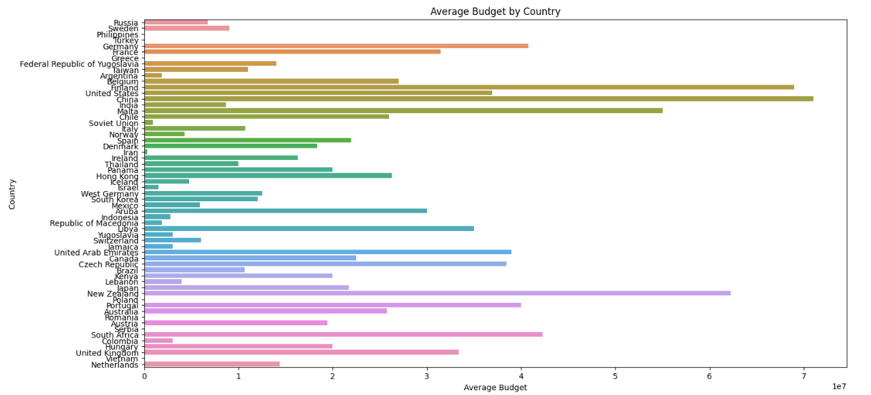
Graph model with explanation
Description
Graph
This graph gives us the bar graph of average budget by country
This graph tells us that China is highest investor closely followed by Finland.
This visual representation lets film makers choose the country they want to make the film if it is bigger film.

Slide 27
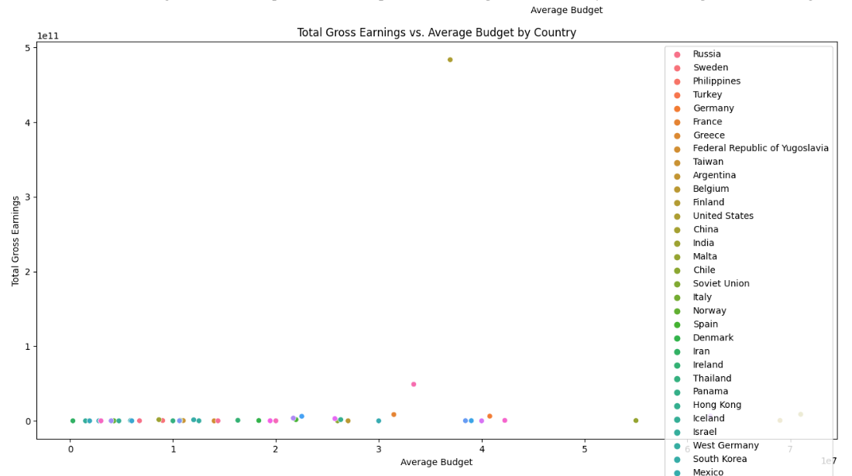
Graph model with explanation
Description
Graph
This graph gives us the scatter plot for total gross earnings Vs average budget by country
This gives an insight into each county’s level of involvement in the entertainment industry .

Slide 28
• Implementation
Algorithms – Step 1- Copy the dataset into hdfs
Step 2 -In spark, start the spark session with HiveContext
Step 3- Give hdfs path to read the dataset
Step 4- Create a data frame and load that data into it
Step 5- Perform data cleaning by dropping duplicate records
Step 6- Handle empty values by assigning default values
Step 7- Create a table and insert data from data frame
Step 8-Perform different type of data analysis
Step 9- Take the output of the data and perform data visualization

Slide 29
Integration is clearly performed, shown, and explained.
1)Starting Hadoop cluster – To start Hadoop cluster you must start namenode, datanode and resource node
2) Check the users and see permission cause that’s where we will copy our file

Slide 30
• Implementation
3) Creating a directory and copying the file from local to that directory and checking if the file exists

Slide 31
• Implementation
4)Double check in localhost just to be on the safe side.

Slide 32
• Implementation
5)Run your .py file using the command given. The command must be run from the path where the file exists

Slide 33
• Implementation
6)This is the .py file.
We are reading our data from hdfs and also starting the spark and including enableHivesupport to run Hive commands
We also started to clean the data

Slide 34
• Implementation
7) We are handling empty records so that it won’t be an issue in the later staged of our implementation

Slide 35
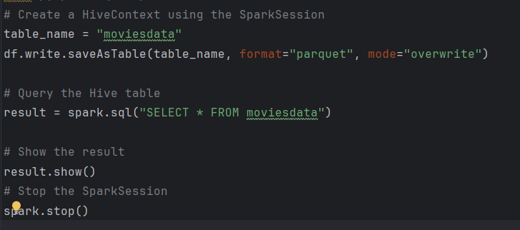
• Implementation
8)This is the .py file. We already integrated our hive with our spark. This shows us clearly now. Than previous snap shots. We have started to analyze the data

Slide 36
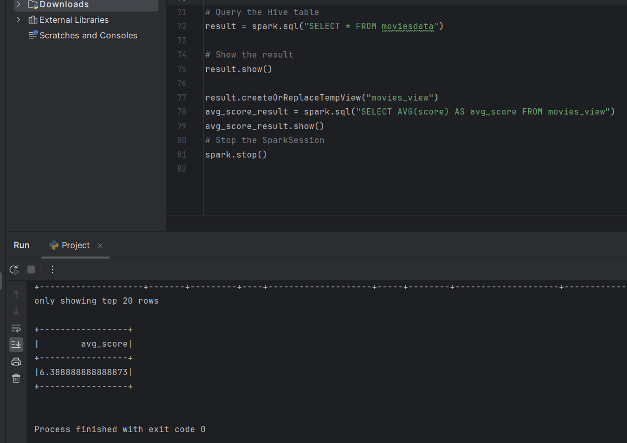
• Implementation
9)Simple analysis to give the average score

Slide 37
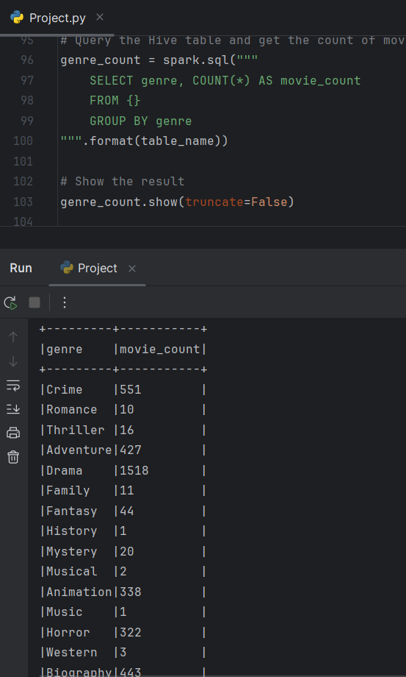
• Implementation
10)This gives us the count of movies made in each genre over the past four decades. Many such analysis has been done using Hadoop hive and spark

Slide 38
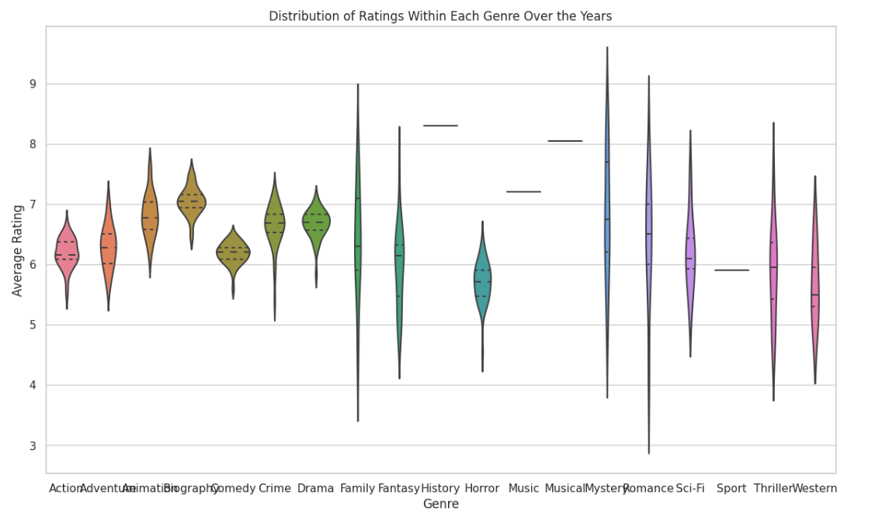
• Implementation
And Finally, Visualization using the dataset. This gives us how the ratings of a particular genre changed over the years .

Slide 39
Results
Output of DATA FRAME AFTER BEING READ
Empty Records BEFORE FIXING

Slide 40
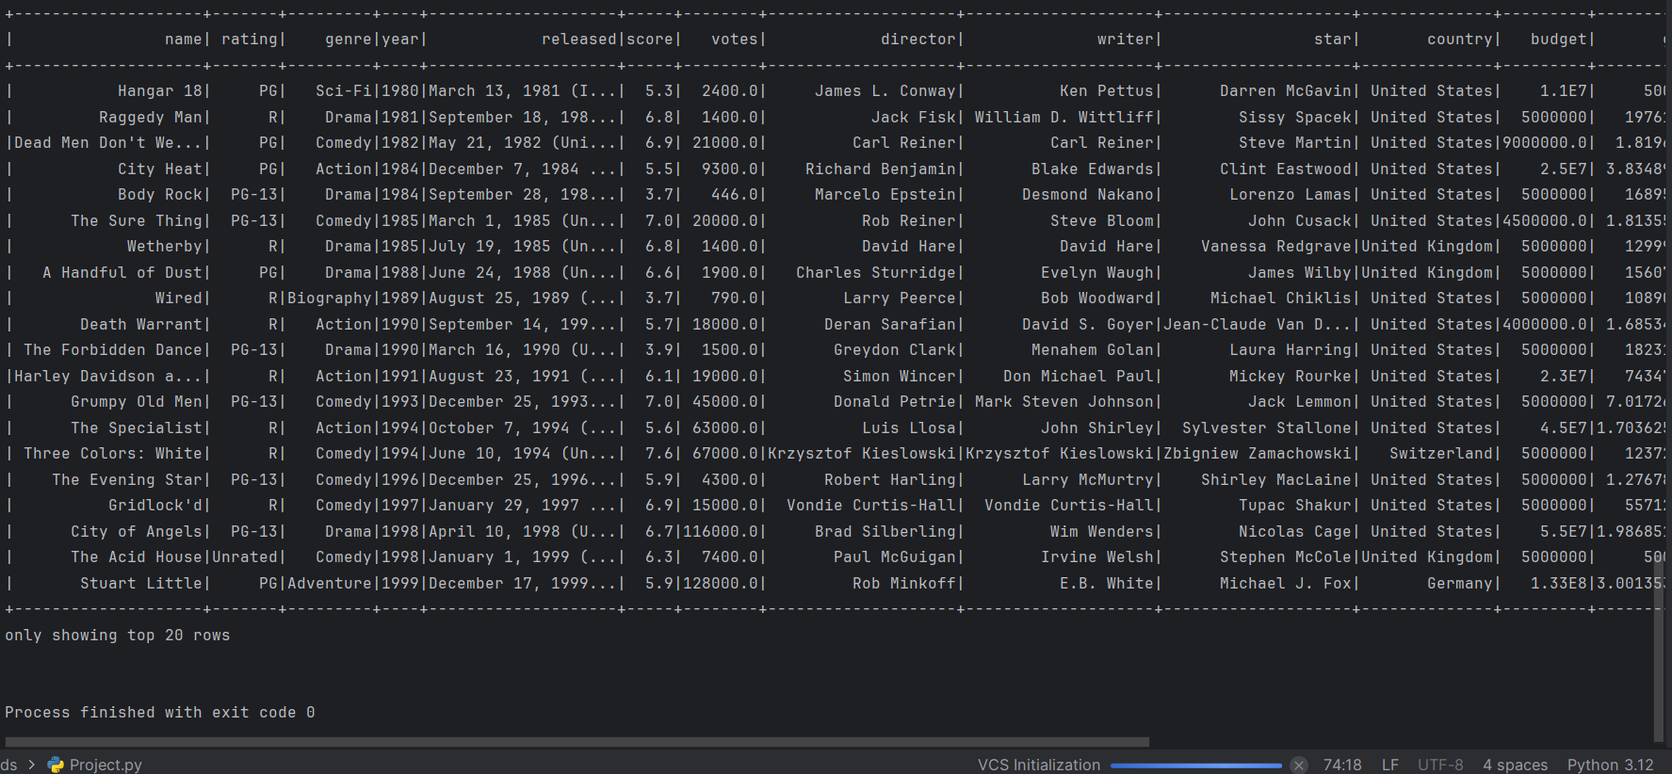
Results
Output of Data frame after handling empty records
Output of the created table

Slide 41
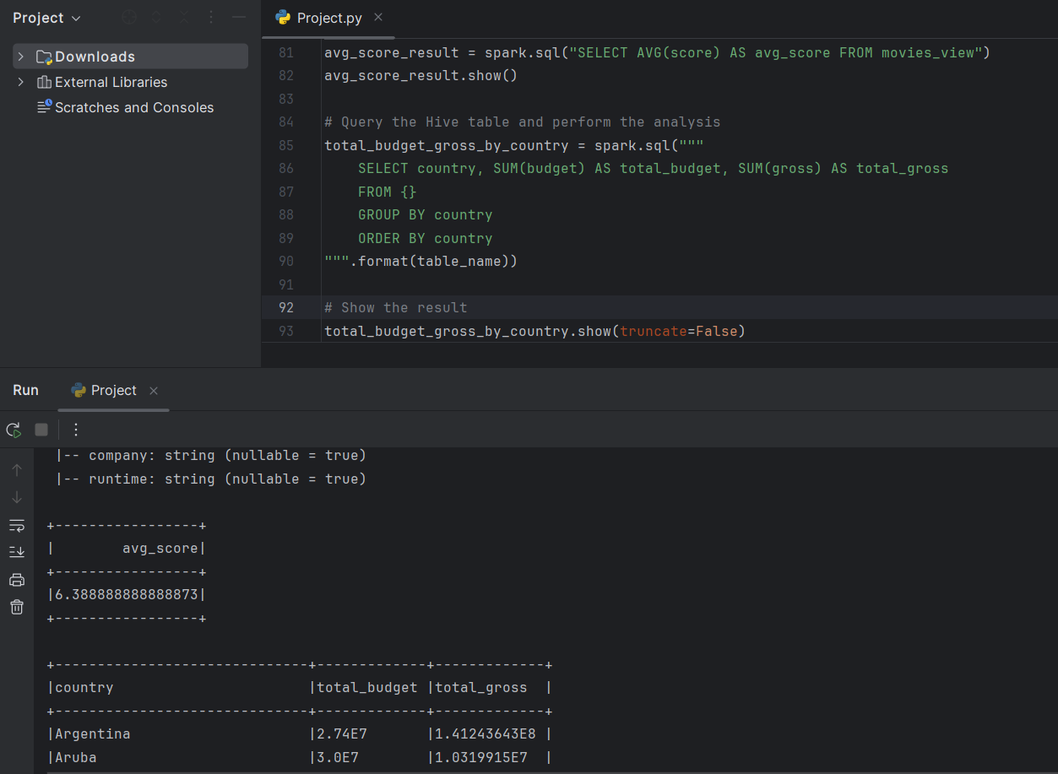
Results
Output of Average Score and total budget abd gross grouped by country
Output of the created table

Slide 42
Results
Output of Average Score and total budget abd gross grouped by country
Output of the created table

Slide 43
Implementation status report
Work completed- implemented the project successfully and performed the necessary analysis
• Description – All the below outcomes have been met
Outcome: Gain a comprehensive understanding of the dataset's characteristics and identify any data preprocessing needs.
Outcome: Clean and prepare the dataset for analysis to ensure accurate and reliable results.
Outcome: Showcase proficiency in using Hive for SQL-based data warehousing and analytics.
Outcome: Communicate insights effectively through visualizations, making complex information accessible.

Slide 44
Implementation status report
• Issues/Concerns- Found major issues while setting up the environment.
Had a lot of compatibility issues and other issues as Windows OS was used
Initially, we wanted to go with AWS. After trying to set the environment up for 4 days. We decided to go with the local
Environmental variables were not being read and we ended up uninstalling and installing the files so many times Some files were missing in some folders of the executable files
We were not able to do data visualization scripts in Python as a file was missing. We had to reinstall it again

Slide 45
Implementation status report
• References/Bibliograph- Installing Apache Hive on Windows 11 – Unboxing Big Data (wordpress.com)
Exploring Data Analytics in Project Management | Wrike
https://datauntold.com/predict-movie-success/#:~:text=Movie%20analytics%20can%20enable%20producers%20and%20directors%20to,success%20of%20movies%20by%20analyzing%20many%20data%20points.
Solved: Exception while connecting hive and sparkThe root ... - Cloudera Community – 296775
Apache Hadoop Architecture Explained (In-Depth Overview) (phoenixnap.com)
how to install python distutils – PythonHint
An Introduction To Graph, The Essential Data Analysis Tool (forbes.com)

Slide 46
Thank you

