Slide 1


Project : Advanced Encryption Standard (AES)
GA(EE4415/4415E): Saurabh Jain, Lin Longyang, Trinh Quang Kien, Su Hanyang
Lecturer(s): Prof. Massimo Alioto, Prof. Xu Yong Ping
National University of Singapore (NUS)
ECE Department
Green IC group

Slide 2
Coverage of Presentation
Introduction
Description
Implementation (RTL)
Interface with Testbench
Details at Testbench Level
Signal Timings
Synthesis Constraints
Marks distribution
Quick Start
Notes:
Many games and tricks can be played around the transistor threshold voltage (MOS, FinFET, TFET, …)

Slide 3
Coverage of Presentation
Introduction
Description
Implementation (RTL)
Interface with Testbench
Details at Testbench Level
Signal Timings
Synthesis Constraints
Marks distribution
Quick Start
Notes:
Many games and tricks can be played around the transistor threshold voltage (MOS, FinFET, TFET, …)

Slide 4
Introduction
Notes:
Many games and tricks can be played around the transistor threshold voltage (MOS, FinFET, TFET, …)

Slide 5
What is AES
AES: Advanced Encryption Standard
First introduced in 2001 for encrypting electronic data
Introduced by US. National Institute of Standard and Tech. (NIST)
Block length: 128 bits, key length: 128/192/256
Symmetric key algorithm (i.e. encryption and decryption uses same key)
First publically available cipher
AES also called “Rijndael”
Notes:
Many games and tricks can be played around the transistor threshold voltage (MOS, FinFET, TFET, …)

Slide 6
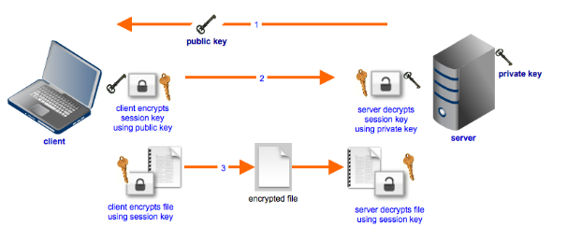
Where is AES Used
Secure file transfers protocols FTPS/ HTTPS/ SFTP etc.
Read more: https://en.wikipedia.org/wiki/Advanced_Encryption_Standard
Notes:
Many games and tricks can be played around the transistor threshold voltage (MOS, FinFET, TFET, …)

Slide 7
Coverage of Presentation
Introduction
Description
Implementation (RTL)
Interface with Testbench
Details at Testbench Level
Signal Timings
Synthesis Constraints
Marks distribution
Quick Start
Notes:
Many games and tricks can be played around the transistor threshold voltage (MOS, FinFET, TFET, …)

Slide 8
Description
Notes:
Many games and tricks can be played around the transistor threshold voltage (MOS, FinFET, TFET, …)

Slide 9
Overall Flow
http://poincare.matf.bg.ac.rs/~ezivkovm/nastava/rijndael_animacija.swf
Notes:
Many games and tricks can be played around the transistor threshold voltage (MOS, FinFET, TFET, …)

Slide 10
Coverage of Presentation
Introduction
Description
Implementation (RTL)
Interface with Testbench
Details at Testbench Level
Signal Timings
Synthesis Constraints
Marks distribution
Quick Start
Notes:
Many games and tricks can be played around the transistor threshold voltage (MOS, FinFET, TFET, …)

Slide 11
Implementation (RTL)
Notes:
Many games and tricks can be played around the transistor threshold voltage (MOS, FinFET, TFET, …)

Slide 12
Problem Statement
RTL implementation of AES with following specifications:
128 bit key
128 bit plain text
128 bit cipher text
Variants:
SISO: Single Input (key & plain text) Single Output (cipher text)
MIMO (N): Multiple Input (key & plain text) Multiple Output (cipher text)
N-slowing: N time multiplexed I/O streams
Notes:
Many games and tricks can be played around the transistor threshold voltage (MOS, FinFET, TFET, …)

Slide 13
Block Level Hierarchy
Mod: tb_aes
File: tb_aes.sv
# of instances: 1
Mod: AES_top
File: AES_top.v
# of instances: 1
Param: N (MIMO,N-slow)
Note: It is suggested NOT to modify the testbench (tb), however for debugging purposes if tb is required make your own tb
Mod: AEScntx
File: AEScntx.v
# of instances: 1
Param: N (MIMO,N-slow)
Mod: AESCore
File: AESCore.v
# of instances: 1
Param: N (MIMO,N-slow)
Mod: KeySchedule_top
File: KeySchedule_top.v
# of instances: ?
Param: -
Mod: MixCol_top
File: MixCol_top.v
# of instances: ?
Param: -
Mod: SubBytes_top
File: SubBytes_top.v
# of instances: ?
Param: -
Mod: ShiftRow_top
File: ShiftRow_top.v
# of instances: ?
Param: -
Mod: AddRndKey_top
File: AddRndKey.v
# of instances: ?
Param: -
Mod: matrix_mult
File: matrix_mult.v
# of instances: 4
Param: -
Mod: aes_sbox
File: aes_sbox.v
# of instances: 16
Param: -
Notes:
Many games and tricks can be played around the transistor threshold voltage (MOS, FinFET, TFET, …)

Slide 14
Provided Resources: Sub-Bytes
Verilog provided
Input:
16, 8-bit element
Element
Element
S-BOX
LUT
8-bit
8-bit
Notes:
Many games and tricks can be played around the transistor threshold voltage (MOS, FinFET, TFET, …)

Slide 15
Provided Resources: Mix Column
Galothian Multiplication
Input:
16, 8-bit element
Stored Matrix
Column 32 bit
Verilog provided
Column
32 bit
Notes:
Many games and tricks can be played around the transistor threshold voltage (MOS, FinFET, TFET, …)

Slide 16
Coverage of Presentation
Introduction
Description
Implementation (RTL)
Interface with Testbench
Details at Testbench Level
Signal Timings
Synthesis Constraints
Marks distribution
Quick Start
Notes:
Many games and tricks can be played around the transistor threshold voltage (MOS, FinFET, TFET, …)

Slide 17
Interface with Testbench
Notes:
Many games and tricks can be played around the transistor threshold voltage (MOS, FinFET, TFET, …)

Slide 18
Interface between Core, Controller & TB
Notes:
Many games and tricks can be played around the transistor threshold voltage (MOS, FinFET, TFET, …)

Slide 19
Coverage of Presentation
Introduction
Description
Implementation (RTL)
Interface with Testbench
Details at Testbench Level
Signal Timings
Synthesis Constraints
Marks distribution
Quick Start
Notes:
Many games and tricks can be played around the transistor threshold voltage (MOS, FinFET, TFET, …)

Slide 20
Details at Testbench Level
Notes:
Many games and tricks can be played around the transistor threshold voltage (MOS, FinFET, TFET, …)

Slide 21
SISO
Notes:
Many games and tricks can be played around the transistor threshold voltage (MOS, FinFET, TFET, …)

Slide 22
MIMO
Notes:
Many games and tricks can be played around the transistor threshold voltage (MOS, FinFET, TFET, …)

Slide 23
N-Slowing
Notes:
Many games and tricks can be played around the transistor threshold voltage (MOS, FinFET, TFET, …)

Slide 24
Coverage of Presentation
Introduction
Description
Implementation (RTL)
Interface with Testbench
Details at Testbench Level
Signal Timings
Synthesis Constraints
Marks distribution
Quick Start
Notes:
Many games and tricks can be played around the transistor threshold voltage (MOS, FinFET, TFET, …)

Slide 25
Signal Timings
Notes:
Many games and tricks can be played around the transistor threshold voltage (MOS, FinFET, TFET, …)

Slide 26
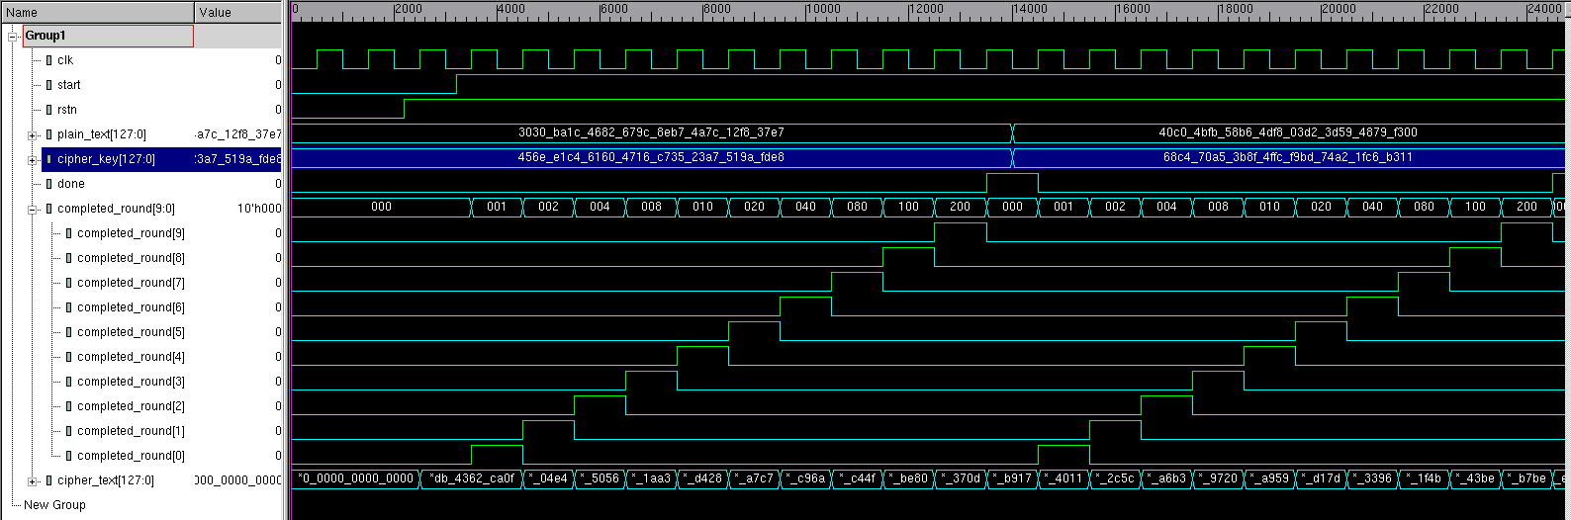
Timing of signals (SISO and MIMO)
Input 1
Input 2
rnd9 comp
Final rnd comp
rnd8 comp
rnd7 comp
rnd6 comp
rnd5 comp
rnd4 comp
rnd3 comp
output1
output2
rnd2 comp
rnd1 comp
Init rnd comp
Notes:
Many games and tricks can be played around the transistor threshold voltage (MOS, FinFET, TFET, …)

Slide 27
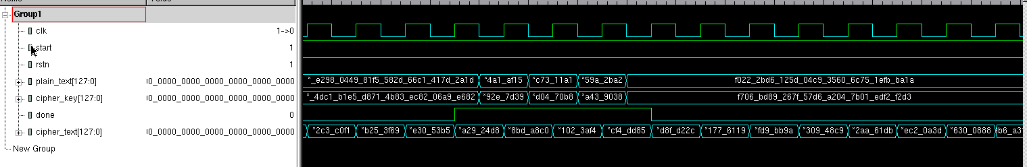
Timing of signals (N-Slowing)
N=4
Done asserted for 4 cycles
Notes:
Many games and tricks can be played around the transistor threshold voltage (MOS, FinFET, TFET, …)

Slide 28
Timing of signals (N-Slowing)
N=4
Ip2_{stream1}
Ip2_{stream2}
Ip2_{stream3}
Ip2_{stream4}
Notes:
Many games and tricks can be played around the transistor threshold voltage (MOS, FinFET, TFET, …)

Slide 29
Timing of signals (N-Slowing)
N=4
op1_{stream1}
op1_{stream2}
op1_{stream3}
op1_{stream4}
Notes:
Many games and tricks can be played around the transistor threshold voltage (MOS, FinFET, TFET, …)

Slide 30
Coverage of Presentation
Introduction
Description
Implementation (RTL)
Interface with Testbench
Details at Testbench Level
Signal Timings
Synthesis Constraints
Marks distribution
Quick Start
Notes:
Many games and tricks can be played around the transistor threshold voltage (MOS, FinFET, TFET, …)

Slide 31
Synthesis Constraints
SISO:
Clock period of 2 ns
Input delay (exclude clock) of 0.2 ns
Output delay of 0.2 ns
Load capacitance (all outputs) of 5fF
MIMO (N=4):
Clock period of 2 ns
Input delay (exclude clock) of 0.2 ns
Output delay of 0.2 ns
Load capacitance (all outputs) of 5fF
N-slowing (N=4):
Clock period of 0.5 ns
Input delay (exclude clock) of 0.1 ns
Output delay of 0.1 ns
Load capacitance (all outputs) of 5fF
Note: All constraint should be written in “constraint.tcl” file of respective parts
Notes:
Many games and tricks can be played around the transistor threshold voltage (MOS, FinFET, TFET, …)

Slide 32
Coverage of Presentation
Introduction
Description
Implementation (RTL)
Signal Timings
Interface with Testbench
Details at Testbench Level
Synthesis Constraints
Marks distribution
Quick Start
Notes:
Many games and tricks can be played around the transistor threshold voltage (MOS, FinFET, TFET, …)

Slide 33
Marks Distribution
Notes:
Many games and tricks can be played around the transistor threshold voltage (MOS, FinFET, TFET, …)

Slide 34
Submissions
SISO (Single Input Single Output) (10%)
MIMO (Multiple Input Multiple Output) (5%)
N-slowing (10%)
Report (total 5%)
Notes:
Many games and tricks can be played around the transistor threshold voltage (MOS, FinFET, TFET, …)

Slide 35
SISO (part I)
“src” directory:
Compiled *.v files (7.5%)
Comments in the code
“syn” directory:
“constraint.tcl” (else 2.5% won’t be awarded)
“synthesis.tcl” (2.5%):
Commands to analyze all *.v files in “src” folder (0.5%)
Command to elaborate “AES_top” (0.5%)
Command to source “constraint.tcl”
Command to compile (or synthesize) “AES_top” (0.5%)
Command to report timing (0.5%)
Command to report area (0.5%)
Notes:
Many games and tricks can be played around the transistor threshold voltage (MOS, FinFET, TFET, …)

Slide 36
MIMO (part II)
“src” directory:
Compiled *.v files (3.5%)
Comments in the code
“syn” directory:
“constraint.tcl” (else 1.5% won’t be awarded)
“synthesis.tcl” (1.5%):
Commands to analyze all *.v files in “src” folder (0.3%)
Command to elaborate “AES_top” (0.3%)
Command to source “constraint.tcl”
Command to compile (or synthesize) “AES_top” (0.3%)
Command to report timing (0.3%)
Command to report area (0.3%)
NOTE : Your code will be tested for arbitrary value of N
NOTE : N = 4 for synthesis
Notes:
Many games and tricks can be played around the transistor threshold voltage (MOS, FinFET, TFET, …)

Slide 37
N-Slowing (part III)
“src” directory:
Compiled *.v files (7%)
Comments in the code
“syn” directory:
“constraint.tcl” (else 3% won’t be awarded)
“synthesis.tcl” (3%):
Commands to analyze all *.v files in “src” folder (0.5%)
Command to elaborate “AES_top” (0.5%)
Command to source “constraint.tcl” file
Command to compile (or synthesize) “AES_top” (0.5%)
Command to retime the design (0.5%)
Command to report timing (0.5%)
Command to report area (0.5%)
NOTE : Your code will be tested for arbitrary value of N
NOTE : N = 4 for synthesis
Notes:
Many games and tricks can be played around the transistor threshold voltage (MOS, FinFET, TFET, …)

Slide 38
Report (part IV)
Architecture and indicate following (2%):
Interconnection between blocks (i.e. Subbytes, Shift-Rows, Mix-columns, Add-round-key and key-scheduling) (1%)
Registers in your design (1%)
Area (um²), critical path delay (ns) and calculated maximum throughput (MS/s) for following (2%):
SISO (0.5%)
MIMO, N=4 (0.5%)
4-slowing (1%)
Observation and discussion (1%)
Which (0.5%) strategy is best (for throughput) and why (0.5%)
Notes:
Many games and tricks can be played around the transistor threshold voltage (MOS, FinFET, TFET, …)

Slide 39

Throughput Calculation
X_{max} (MS/s) = Freq_{max} (MHz)x$\left(\frac{\# of valid samples}{\# of cycles}\right)$
Hints for completing project!!
Part 2: If part 1 completed part 2 doesn’t require any effort
Part 3: For N-slowing every register in your design has to be replaced by N cascaded registers
Notes:
Many games and tricks can be played around the transistor threshold voltage (MOS, FinFET, TFET, …)

Slide 40
Coverage of Presentation
Introduction
Description
Implementation (RTL)
Signal Timings
Interface with Testbench
Details at Testbench Level
Synthesis Constraints
Marks distribution
Quick Start
Notes:
Many games and tricks can be played around the transistor threshold voltage (MOS, FinFET, TFET, …)

Slide 41
Quick Start
Notes:
Many games and tricks can be played around the transistor threshold voltage (MOS, FinFET, TFET, …)

Slide 42
Quick Start
Make a new directory in your home
mkdir ~/<new_dir_name>
Copy src to your new directory
cp –r /app11/lab-session/ee4415_part2/* ~/<new_dir_name>/.
To Compile your source:
cd ~/<new_dir_name>/<part>/vcs
make compile
To run your code on terminal
make sim or ./simv
To run/debug your code in gui mode
./simv –gui
Before starting synthesis (in design compiler)
cd ~/<new_dir_name>/<part>/syn/
cp /app11/lab-session/ee4415_part1/.synopsys_dc.setup ~/<new_dir_name>/<part>/syn/.
Note: carry out synthesis of each part in “syn” folder of respective parts
Notes:
Many games and tricks can be played around the transistor threshold voltage (MOS, FinFET, TFET, …)

Slide 43
THANK YOU!
Questions?
Notes:
Many games and tricks can be played around the transistor threshold voltage (MOS, FinFET, TFET, …)

