Slide 1
Creating Self-Adapting Mobile System with dynamic software product line
Presented by :
Shweta Parihar (42)
Amulya PINDI (46)
Sri Chaitanya PatLURI (44)

Slide 2
objective
Mobile systems must cope with continuous context changes, making them an ideal fit with dynamic software product lines, which enable product adaptation at runtime. In this DSPL based process, devices upload only a small reconfiguration plan rather than the entire variability model, and mobile systems manage diversity without disrupting the base model

Slide 3
emerging Mobile
Operates in adverse conditions.
Should cope with context changes securing there reliability, durability & power awareness level.
Must be able to self adapt.
DSPL is highly suitable to self- adapting mobile system.

Slide 4
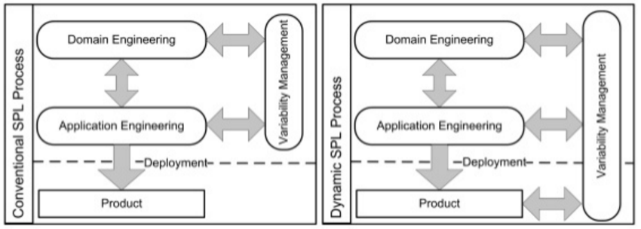
Dynamic Software product line “DSPL”
Product line: Paradigm shift from one kind of software development to usable reusable software architecture. Example( Pizza base + different toppings)
Dynamic features of a software-intensive systems sharing a common managed set of prospects that satisfy the specific need of a particular mission.
Picture credit : http://www.slideshare.net/odayibas/kutulu-a-domainspecific-language-for-featuredriven-product-derivation
Using Variability model at runtime

Slide 5
challenges in creating DSPL-based self-adaptation
Context Definition : Requirement of all actor should be considered.
Context change : Qos should be considered for each reconfiguration.
Reconfirmation constraint : Balance efficiency by preserving Qos & system property
Device Heterogeneity : Reconfiguration must adapt to each devices character & system must maintain its correct functionality after reconfiguration.
Language issue : Nonstandard languages are unfamiliar with most mobile application developer, so a simple standardize language is required

Slide 6
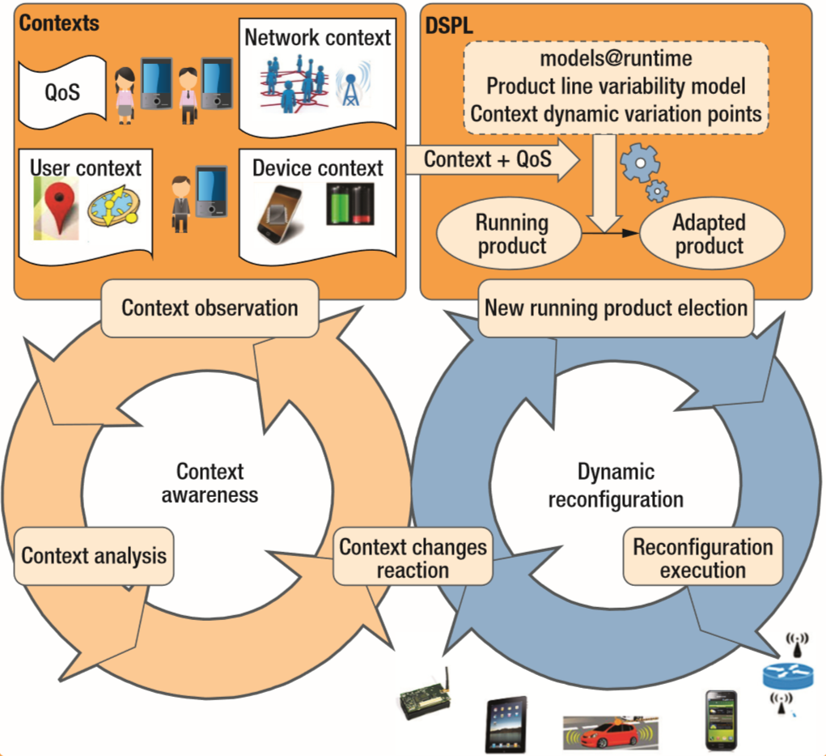
Proposed self adaptation process
CVL( common variability language) model is used to automatically generate initial configuration to become adapted product
Context of all the actor in a mobile system determine its overall context
Not all possible configurations meet a desired QoS. Ex: Reconfiguration process in a low-energy context could consume more energy than the reconfigured system would save.
1
4
2
5
3

Slide 7
IMPLEMENTATION IN FAMIWARE
What is FamiWare ?
FamiWare is a family of middleware for Ambient Intelligence specifically designed to be aware of contexts in sensor and smartphone devices. It provides both, several monitoring services to acquire contexts from devices and users, and a context-awareness service to analyze and detect context changes.
We use this, to implement our self-adaptation process and CVL’s role in modeling system variability and creating the model transformations that support dynamic reconfiguration.

Slide 8
Context observation and analysis
FamiWare provides services to monitor user, device and network contexts for both smartphones and sensors.
Even though services have same basic structures, providers model them as a part of variability model, thus varying them to each system’s needs.
Providers would use FamiWare’s SPL-based facilities to generate code automatically.
The context-awareness would check for any changes and the logic conditions serve criteria for context switch.

Slide 9
CONTEXT ADAPTATION AND SYSTEM RECONFIGURATION
Mobile system applications use the CVL tools to specify Vspec, FamiWare’s variability model and binding between Vspec and base model is written in UML.
Resolution models specified in CVL selects the variation points, that represents a particular product like android smart phone.
For each device, FamiWare clones the elements to represent the number of device types and each clone has unique configuration.
CVL modeling produces variable elements with more detail where as base-model designers need not be variability modeling experts.

Slide 10
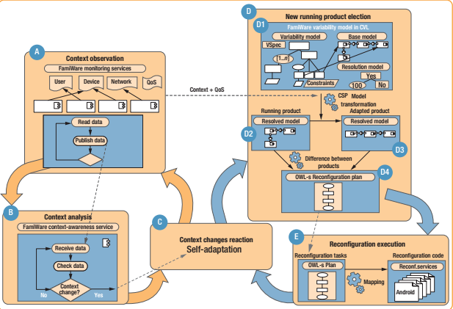

Slide 11
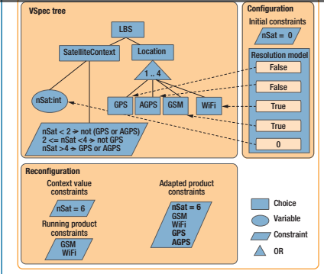
The Variability model also mentions the constraints between variation points and context conditions.
These constraints are essentially context-change conditions and required for reconfiguration for evert context change.
The CVL resolution would reflect the constraints and ensures that the system automatically selects other elements to represent different services/components.
The resolved model captures correspondence and is essentially a product architecture without variability that the system deploys in each device.

Slide 12
RECONFIGURATION
Specify new context values as new constraints.
Add new constraints
Create new resolution models.
Generate all resolution models compatible with new context.
Select the best resolution.
Execute the best resolution model in CVL.
Transform the running product into the adapted one at implementation level.
Generate reconfiguration plan.
Interpret the generated plans.

Slide 13
As the models at runtime are used, the product running at each device satisfies every context.
The plans generated would feature the constrains, ensuring the global system a valid state after reconfigurations.
Advantage of this is that the reconfiguration would load only 4 Kbytes in the devices.

Slide 14
Application to Dynamic Route Planning
The Process was applied to a dynamic route-planning service that runs in the highway control center of an intelligent transportation system.
This service is a part of the EU’s Interoperable Trust Assurance Infrastructure (Inter-Trust) Project.
The main objective of the INTER-TRUST project is to develop a dynamic and scalable framework to support trustworthy services and applications in heterogeneous networks and devices, based on the enforcement of interoperable and changing security policies, addressing the needs of developers, integrators and operators.

Slide 15
Working
It calculates fastest route given a vehicle’s current position and the desired destination.
The service considers user preferences(QoS) and contexts such as weather or rush-hour traffic estimates, selects an optimal route, and sends it to the vehicle’s onboard unit.
The unit’s location-based service resends the vehicle’s position to the control center to inquire if the route needs recalculating.
Events causing recalculation: Connectivity loss.
User Preferences(QoS Considerations): Reconfiguration Time, Communication Encryption Limits, Energy use versus accuracy and reconfiguration cost.

Slide 16
RECONFIGURATION TIME
Requirement: The system must detect at least 95% of all system faults and take no longer than 10 minutes (600 Seconds) to detect a full service failure.
When control center’s context awareness service stops receiving a vehicle’s position, it detects the vehicle’s onboard unit must be malfunctioning due usage of GSM/3G Network in a Heavy Traffic zone.
To continue providing position information, the system must reconfigure to use GPS or Wi-Fi to determine position and short-range communication, such as roadside units, Wi-Fi or geonetworking to send the position to control center.
The Reconfiguration Plan, P, consists of 4 tasks: Deactivate(GSM), Activate(Wi-Fi), GetPosition(Wi-Fi), Communication(Wi-Fi).
Result:
Time for context-awareness service to choose new resolution model according to QoS = 58 Sec
Average Configuration Time in an emergency situation = 75 Sec
Average Configuration Time in non-critical situation = 189 Sec
Total Time in emergency = 58 + 75 =133 Sec << 600 Sec
Total Time in non-emergency = 189 + 58 = 247 << 600 Sec

Slide 17
Secure Communication Latency:
Communication between control center and onboard unit and between roadside unit and onboard unit must be secure.
Encryption, Decryption and Any supplementary security functionality did not exceed 500 msec for each roundtrip message.
Energy-Accuracy Tradeoff
Managing battery life is crucial for mobile devices, since services such as GPS have a high energy expenditure. When the battery drops below a certain level, the location-based service can reconfigure to save energy.
One option is to read and send the GPS position less frequently.
Another option is to select a configuration that requires more than considering energy savings.
In emergency situations, the reported position must be accurate within 100 m using GPS regardless of energy expenditure. For non-critical situations, accuracy can be up to 200 m, this can be achieved by using GSM.
Reconfiguration Cost:
Each system adaptation implies a reconfiguration cost in both time and wasted energy. To consider reconfiguration cost, system simulates before runtime possible energy savings with new products, thereby choosing only those that save more energy than the reconfiguration process expends.

Slide 18
Conclusion
DSPL approach uses variability models to drive reconfiguration but is both nonintrusive, since variability is expressed outside the base model, and lightweight, since large models aren't loaded into the devices.
Various researchers have proposed elements of DSPL approach like CANDEL & MADAM.
CANDEL (Context As Dynamic Product Line) is a generic framework for representing context information as a dynamic product line of context primitives, but it has no model-driven reconfiguration process.
MADAM(Mobility and adaption enabling middleware) enables generic middleware components to carry out mobile system self-adaptation of mobile systems through Architectural models executed at runtime,. However, there's no language to describe variability outside the base models.

Slide 19
Thank you. Questions ?

