Slide 1
Builder Design Patterns
Vinutha Muthyala(36),
Amulya Pindi (46),
Naresh Pogakula(47),
Meghasai Reddy Bodamani(6),

Slide 2
Builder Design Patterns
It is a type of creational pattern that uses constructors in java to create objects, which have several parameters.
Two approaches are specified to maintain the parameter problems like mandatory and optional.
Telescopic Constructors
Java Beans

Slide 3
Another approach is discussed, which can create immutable objects. It is a form of Builder pattern, which allows objects to be constructed with desired number of variable attributes and characteristics. Few can be required and others optional.
We can construct objects in multi-step in a self-documenting type, JavaBeans model, but no possibility of leaving the object in inconsistent state.
Instead of making the desired object directly, the client would call the constructor with all the required parameters and gets the builder object. The client would then make calls methods on builder object to set each of the optional parameters.
Finally, client calls a build method and this would generate the instance of object which is immutable.

Slide 4
GUIDELINES
First, we should make static nested class called Builder inside class whose object would be a build by the Builder.
Builder class would have exactly the same set of the fields as the original class.
Builder class would then expose methods for adding the ingredients. Each of the method would then return same Builder object. Builder would be enriched with each method call.
Builder.build() is the method that would copy all builder field values into the actual class and then return object of the Item class.
Item class (created for builder) will have the private constructor so that they can create its object from the build() function and thus prevent outsider of being accessed by its constructor.

Slide 5
PRONS AND CORNS
Pros:
Code is maintainable if the number of fields required to create the object is more than 4 or 5.
Object creational code are less error-prone because user knows what they are passing as of explicit method call.
It increases the robustness, because only fully constructed object is be available to the client.
Cons:
This pattern is verbose and it also requires duplication of code because Builder has to copy all fields from the Original or the Item class.

Slide 6
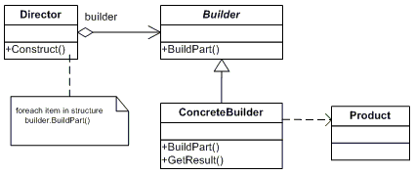
Uml class diagram

Slide 7
Sequence diagram

Slide 8
Example Code
RobotPlan.java
Robot.java
RobotBuilder.java
OldRobotBuilder.java
RobotEngineer.java
TestRobotBuilder.java

Slide 9
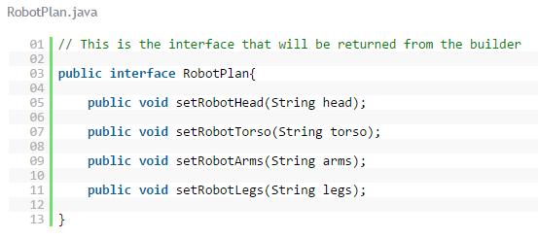
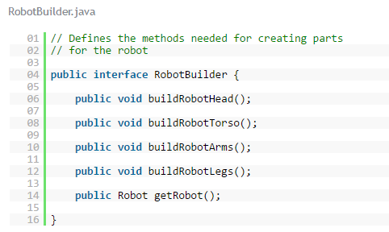
Example Code

Slide 10
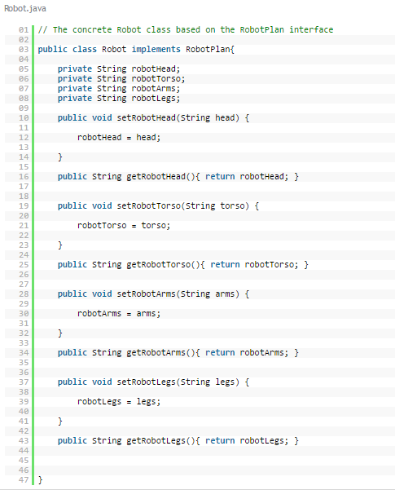
Example Code

Slide 11
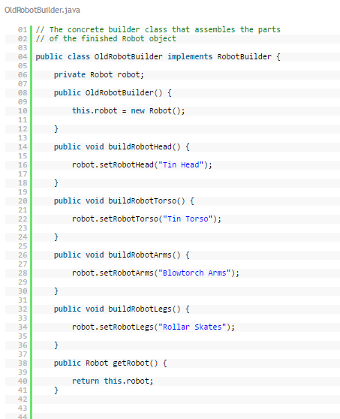
Example Code

Slide 12
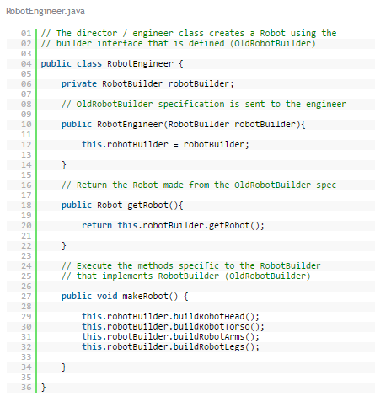
Example Code

Slide 13
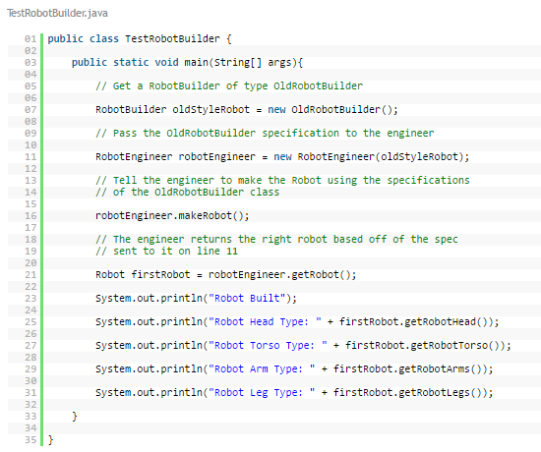
Example Code

Slide 14
REFERENCES:
https://javarevealed.wordpress.com/2013/08/12/builder-design-pattern/
http://javarevisited.blogspot.com/2012/06/builder-design-pattern-in-java-example.html
http://www.dofactory.com/net/builder-design-pattern
http://www.newthinktank.com/2012/09/builder-design-pattern-tutorial/

