Slide 1
IMPLEMENTATION IN FAMIWARE
What is FamiWare ?
FamiWare is a family of middleware for Ambient Intelligence specifically designed to be aware of contexts in sensor and smartphone devices. It provides both, several monitoring services to acquire contexts from devices and users, and a context-awareness service to analyze and detect context changes.
We use this, to implement our self-adaptation process and CVL’s role in modeling system variability and creating the model transformations that support dynamic reconfiguration.

Slide 2
Context observation and analysis
FamiWare provides services to monitor user, device and network contexts for both smartphones and sensors.
Even though services have same basic structures, providers model them as a part of variability model, thus varying them to each system’s needs.
Providers would use FamiWare’s SPL-based facilities to generate code automatically.
The context-awareness would check for any changes and the logic conditions serve criteria for context switch.

Slide 3
CONTEXT ADAPTATION AND SYSTEM RECONFIGURATION
Mobile system applications use the CVL tools to specify Vspec, FamiWare’s variability model and binding between Vspec and base model is written in UML.
Resolution models specified in CVL selects the variation points, that represents a particular product like android smart phone.
For each device, FamiWare clones the elements to represent the number of device types and each clone has unique configuration.
CVL modeling produces variable elements with more detail where as base-model designers need not be variability modeling experts.

Slide 4
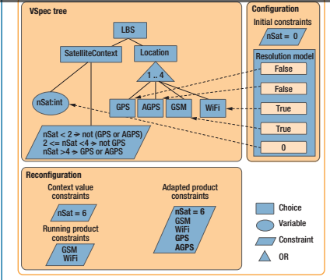
The Variability model also mentions the constraints between variation points and context conditions.
These constraints are essentially context-change conditions and required for reconfiguration for evert context change.
The CVL resolution would reflect the constraints and ensures that the system automatically selects other elements to represent different services/components.
The resolved model captures correspondence and is essentially a product architecture without variability that the system deploys in each device.

Slide 5
RECONFIGURATION
Specify new context values as new constraints.
Add new constraints
Create new resolution models.
Generate all resolution models compatible with new context.
Select the best resolution.
Execute the best resolution model in CVL.
Transform the running product into the adapted one at implementation level.
Generate reconfiguration plan.
Interpret the generated plans.

Slide 6
As the models at runtime are used, the product running at each device satisfies every context.
The plans generated would feature the constrains, ensuring the global system a valid state after reconfigurations.
Advantage of this is that the reconfiguration would load only 4 Kbytes in the devices.

