Slide 1
WAVES..!!!!
TASK: BUILDING A DOCUMENT ORGANIZER APPLICATION (DST USE CASE)
TEAM MEMBERS:
AMULYA PINDI
VINUTHA MUTHYALA
AISHWARYA POLAVARAPU
T

Slide 2
TASKS IMPLEMENTED:
Login into application using Facebook.
Uploading the files to the system and categorized them by extensions to specific containers.
Retrieving the main text from the files to help the reader to understand the purpose of the file.
Displaying all the existing folders in tree structure which helps us to easily traverse.

Slide 3
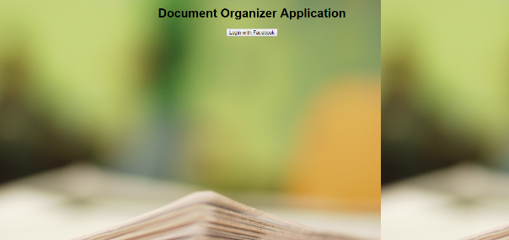
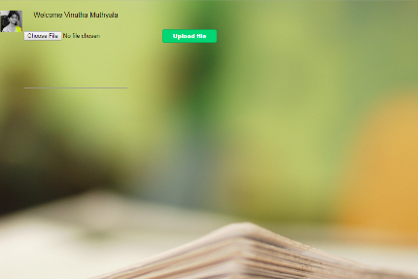
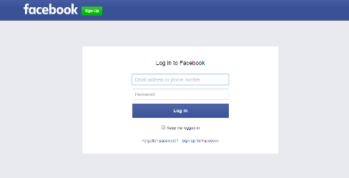
VISUALIZATIONS
Login Screen
Home Page

Slide 4
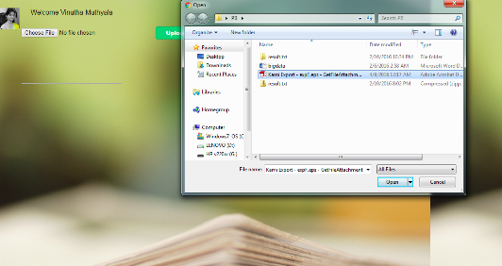
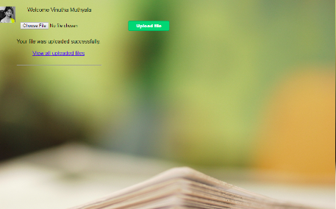
Uploading the documents
After the documents are uploaded.

Slide 5
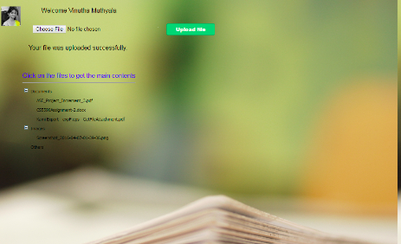
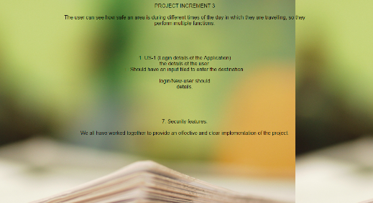
Thank You.
Documents
Text in the documents

