Slide 1

Association between Age, Gender, BMI, Bone Mineral Density, Alcohol Consumption, Smoking, and Incidence of Osteoporosis
GROUP – 7
Amulya Rangineni
Asmatahasin Mohammad
Manaswini Dasari
Prathyusha Vajinepally
Sri Rishitha Dammalapati

Slide 2
INTRODUCTION
Osteoporosis is a condition affecting the skeletal system that is characterized by a progressive reduction in bone mineral density (BMD), resulting in an increased risk of fractures. As the elderly population grows, healthcare systems will face increasing pressure, leading to elevated costs, morbidity, and mortality rates related to fractures. Hence, identifying the risk factors that lead to reduced BMD is critical to prevent, detect, and manage osteoporosis (Yao et al., 2019).
According to the National Osteoporosis Foundation (2021), osteoporosis is a significant public health issue, particularly among older adults, and is associated with a high rate of morbidity and mortality. BMD is a crucial factor in the diagnosis and management of osteoporosis, as it is used to estimate fracture risk by measuring the amount of bone minerals in each area of bone. Low BMD is linked to an increased risk of osteoporotic fractures. Therefore, early detection and monitoring of BMD are essential for preventing and managing osteoporosis (Cosman et al., 2014).
Smoking and excessive alcohol consumption are major risk factors for osteoporosis. According to Kanis et al. (2013), smoking is associated with decreased BMD and increased fracture risk. Similarly, heavy alcohol consumption is linked to decreased BMD and an increased risk of fractures (National Institute on Alcohol Abuse and Alcoholism, 2021). Excessive alcohol consumption can lead to a decline in BMD, particularly in postmenopausal women, by interfering with the bone remodeling process. Furthermore, it may cause malnutrition, impaired liver function, and hormonal imbalances, which can worsen osteoporosis (Akkawi & Zmerly, 2018).

Slide 3
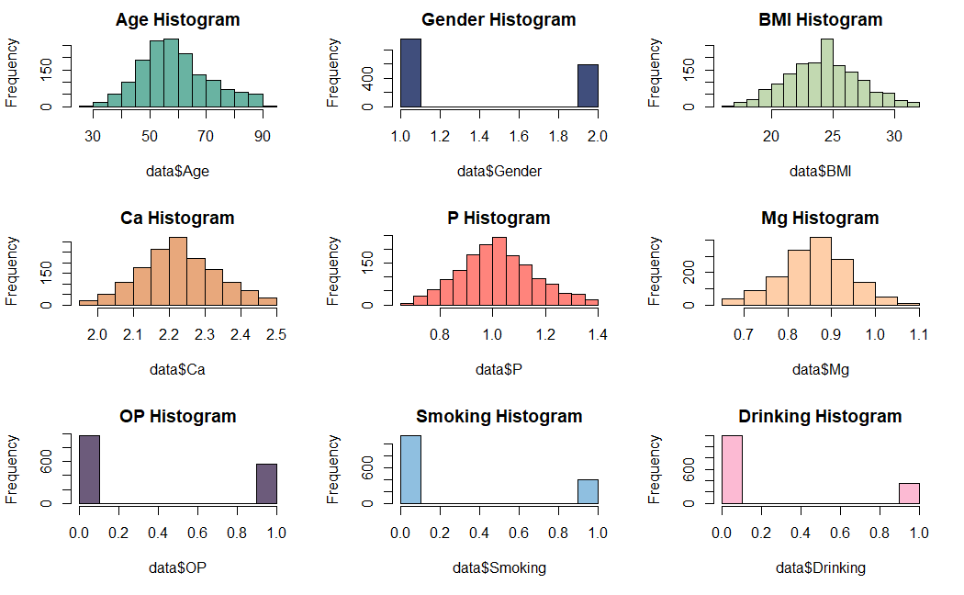
DATA DESCRIPTION
The dataset consists of 1538 observations (rows) and 40 variables (columns). The variables can be categorized as categorical and numerical variables. In the Kruskal-Wallis test, we divided the sample into male and female groups and age into four groups with osteoporosis to determine their significance. In the Mann-Whitney U test, we divided the sample into four age quartiles with osteoporosis to determine their significance.
Variable | Description
Age | In years (Numerical)
Gender | 1= male, 2=female (Categorical)
BMI | (Kg/m2 ) (Numerical)
Ca | (mmol/L) (Numerical)
P | (mmol/L) (Numerical)
Mg | (mmol/L) (Numerical)
OP | 0 = No, 1 = Yes (Categorical)
Smoking | 0 = No, 1 = Yes (Categorical)
Drinking | 0 = No, 1 = Yes (Categorical)
Data source: https://www.kaggle.com/datasets/jehanbhathena/bone-mineral-density

Slide 4
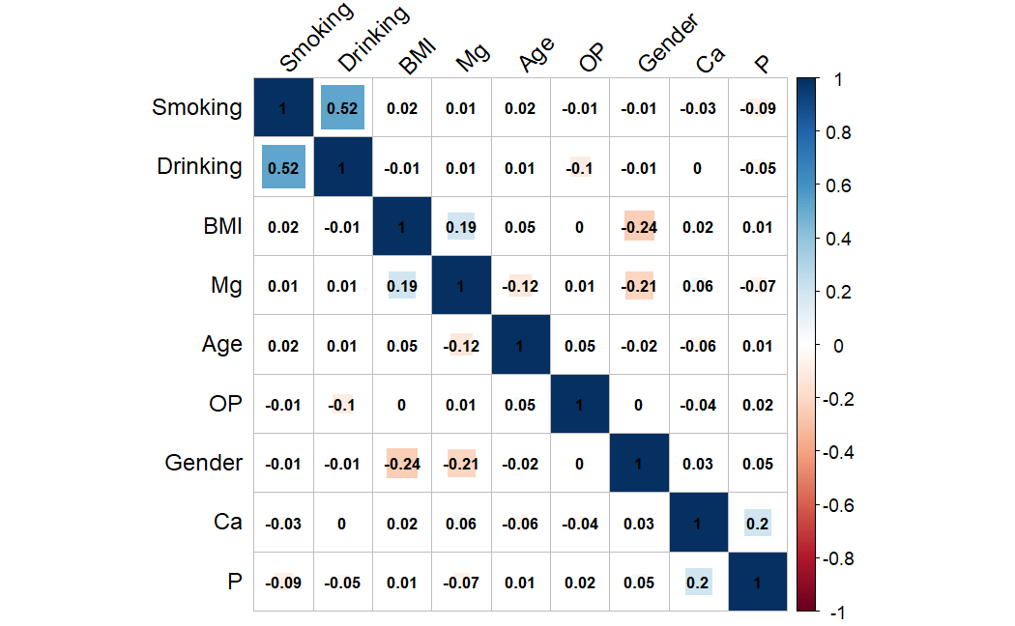
RESEARCH QUESTION
Is there any significant relationship between age, gender, BMI, Bone mineral density, alcohol consumption, smoking, and incidence of osteoporosis?
HYPOTHESIS
Null Hypothesis :
There is no significant relationship between age, gender, BMI, bone mineral density, alcohol consumption, smoking, and incidence of osteoporosis
Alternative Hypothesis :
There is a significant relationship between at least one of the variables (age, gender, BMI, bone mineral density, alcohol consumption, smoking) and the incidence of osteoporosis

Slide 5
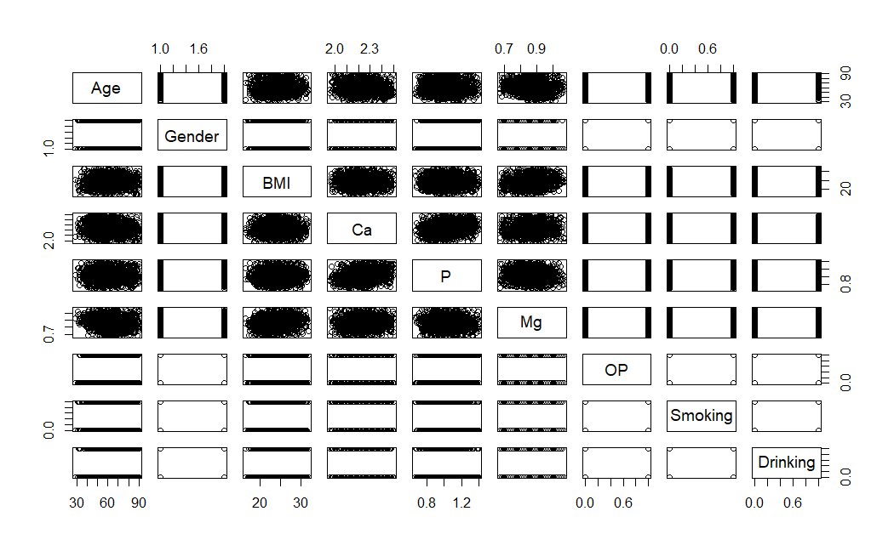
LIMITATIONS
The number of rows or observations in a dataset can have a significant impact on the accuracy and generalizability of statistical analyses. In this case, having a limited number of rows in the dataset can result in reduced statistics, making it difficult to detect significant effects or establish correlations between variables.
Additionally, normal distribution is an important assumption for many statistical methods. If the data does not follow a normal distribution, it can result in biased or inaccurate results. In this case, the lack of normal distribution for most of the data in the dataset means that many statistical methods may not be appropriate or may result in less accurate results.
As a result of these limitations, the analysis may be less accurate or may require additional data or alternative methods to overcome these limitations. It is important to carefully consider the limitations of the dataset when interpreting the results and drawing conclusions from the analysis.

Slide 6
STATISTICAL METHODS and FINDINGS
Statistical Tests performed | Variables used | Findings
Shapiro Wilk test | All variables | Not normally distributed
t-test | All variables | Null hypothesis rejected
Wilcoxon rank-sum test / Mann Whitney U test | Gender (Samples of male and female with osteoporosis) Age ( Age is divided in to 4 quartiles) | Since the p-value is 0.8942 p-value is 0.05544,
Kruskal- Walli's test | Gender (Samples of male and female with osteoporosis) | p-value is 0.8941, Chi-square value is 0.017706
Multiple regression model | OP ~ BMI + Smoking + Drinking | p-value: 0.0001127 (BMI: 0.927529, Smoking: 0.041181, Drinking: 5.51e-06)
Multiple regression model | OP ~ Ca, Mg, P | p-value: 0.3867 (Ca: 0.0995, Mg: 0.6303, P: 0.4157)
Multiple regression model | OP ~ Age +Gender | p-value: 0.09281 (Age: 0.02955, Gender: 0.85090)
Logistic regression model | OP ~ BMI +Gender | P-value: (BMI: 0.843, Gender: 0.859)
Logistic Regression | OP ~ BMI + Smoking +Drinking | p-value: (BMI: 0.9194, Smoking: 0.0392, Drinking: 6.83e-06)
Logistic Regression | OP ~ Ca + Mg + P | p-value: (Ca: 0.0994, Mg: 0.6302, P: 0.4148)

Slide 7
THANK YOU

