Slide 1
An Introduction to Graph Theory
Chapter 11

Slide 2

Chapter 11 An Introduction to Graph Theory
11.1 Definitions and Examples
Undirected graph
Directed graph
loop
G=(V,E)
isolated vertex
multiple
edges
adjacent
simple graph: an undirected graph without loop or multiple edges
degree of a vertex: number of edges connected
(indegree, outdegree)

Slide 3
Chapter 11 An Introduction to Graph Theory
11.1 Definitions and Examples
a
x
y
e
path: no vertex can be repeated
a-b-c-d-e
trail: no edge can be repeat
a-b-c-d-e-b-d
walk: no restriction
a-b-d-a-b-c
b
d
c
length: number of edges in
this (path,trail,walk)
closed if x=y
closed trail: circuit (a-b-c-d-b-e-d-a,
one draw without lifting pen)
closed path: cycle (a-b-c-d-a)

Slide 4
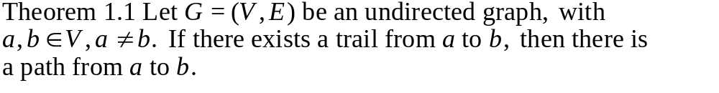
Chapter 11 An Introduction to Graph Theory
11.1 Definitions and Examples
remove any cycle on the repeated
vertices
a
x
b
Def 11.4 Let G=(V,E) be an undirected graph. We call G connected
if there is a path between any two distinct vertices of G.
a
e
a
e
b
b
disconnected with
two components
d
d
c
c

Slide 5
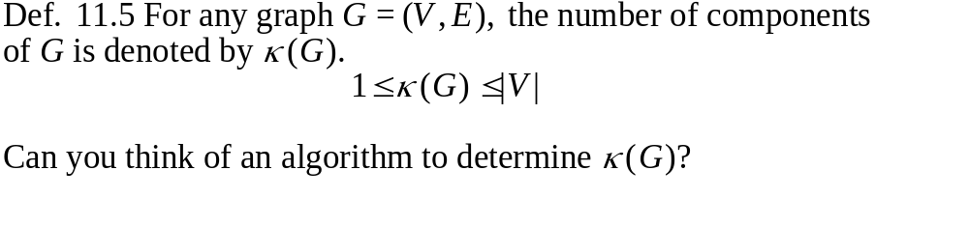
Chapter 11 An Introduction to Graph Theory
11.1 Definitions and Examples
Def. 11.6
multigraph of multiplicity 3
multigraphs

Slide 6
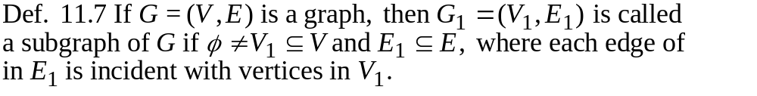
Chapter 11 An Introduction to Graph Theory
11.2 Subgraphs, Complements, and Graph Isomorphism
a
a
e
a
b
e
b
e
b
d
d
c
c
d
d
induced subgraph
include all edges
of E in V₁
c
c
spanning subgraph
V₁=V

Slide 7
Chapter 11 An Introduction to Graph Theory
11.2 Subgraphs, Complements, and Graph Isomorphism
a
Def. 11.11 complete graph: K_{n}
e
b
K₅
Def. 11.12 complement of a graph
a
d
G G
a
c
e
e
b
b
d
d
c
c

Slide 8
Chapter 11 An Introduction to Graph Theory
11.2 Subgraphs, Complements, and Graph Isomorphism
Theorem: Any graph of six vertices contains a K₃ or K₃.
(In a party of six, There exists 3 people who are either
mutually acquainted or mutually inacquainted.)
5 is not enough.
For 6 people, let's look from the point of
view of a:
a
From the pigeonhole principle, there are
3 who know a or 3 who does not know a.
e
b
a
a
d
b c d
b c d
c
K₃ or K₃.
K₃ or K₃.

Slide 9
Chapter 11 An Introduction to Graph Theory
11.2 Subgraphs, Complements, and Graph Isomorphism
Ex. 11.7 Instant Insanity, 4 cubes, each of the six faces on a
cube is painted with one of the colors, red (R), white (W),
blue (B), or Yellow (Y). The object is to place the cubes in a
column of four such that all four colors appear on each of the
four sides of the column.
Y
R
R
W
W R Y W
B B W Y
R B Y B
W R B Y
B
(1)
Y
(2)
W
(3)
W
(4)
There are (3)(24)(24)(24)=41472 possibilities to consider.
the bottom cube
6 faces with 4 rotations

Slide 10
Chapter 11 An Introduction to Graph Theory
11.2 Subgraphs, Complements, and Graph Isomorphism
Y
R
R
W
W R Y W
B B W Y
R B Y B
W R B Y
B
(1)
Y
(2)
W
(3)
W
(4)
R
W
Consider the subgraph of opposite column.
1
4
3
R
3
W
R
1
W
4
3
2
4
2
1
4
2
3
4
1
Y
B
3
1
2
Y
B
Y
B
2
Each edge corresponds
to a pair of opposite faces.
Y
B
W
R
W
R
Y
B
R
Y
B
W
B
W
R
Y
(1)
(2)
(3)
(4)

Slide 11
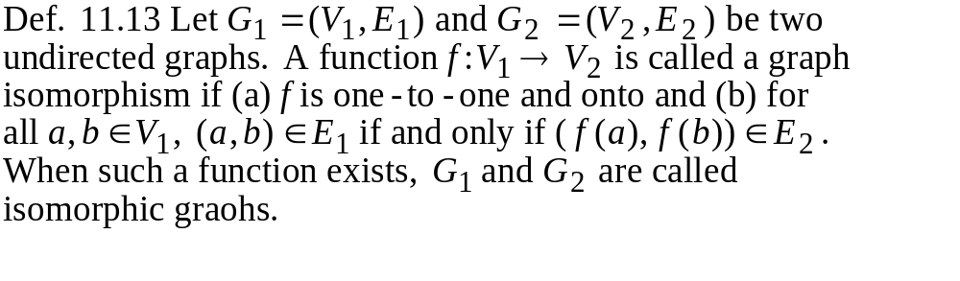
Chapter 11 An Introduction to Graph Theory
11.2 Subgraphs, Complements, and Graph Isomorphism
Graph Isomorphism
a
b
1
2
c
w x y z
3
4
d

Slide 12
Chapter 11 An Introduction to Graph Theory
11.2 Subgraphs, Complements, and Graph Isomorphism
Ex. 11.8
q
r
a
w
j
f
e
b
v
y
z
x
i
g
h
t
d
c
u
a-q c-u e-r g-x i-z b-v d-y f-w h-t j-s, isomorphic
Ex. 11.9
degree 2
vertices=3
degree 2 vertices=2
Can you think of an algorithm for testing isomorphism?

Slide 13
Chapter 11 An Introduction to Graph Theory
11.3 Vertex Degree: Euler Trails and Circuits
degree 1 vertex: pendant vertex
Theorem 11.2
Corollary 11.1 The number of vertices of odd degree must be even.
Ex. 11.11 a regular graph: each vertex has the same degree
Is it possible to have a 4-regular graph with 10 edges?
2|E|=4|V|=20, |V|=5 possible (K₅)
with 15 edges?
2|E|=4|V|=30 not possible

Slide 14
Chapter 11 An Introduction to Graph Theory
11.3 Vertex Degree: Euler Trails and Circuits
Ex. 11.12 The Seven Bridge of Konigsberg
area a
area b
area d
area c
a
Find a way to walk about the city so as to cross
each bridge exactly once and then return to the
starting point.
b
d
c

Slide 15
Chapter 11 An Introduction to Graph Theory
11.3 Vertex Degree: Euler Trails and Circuits
Def. 11.15 Let G=(V,E) be an undirected graph or multigraph
with no isolated vertices. Then G is said to have an Euler circuit
if there is a circuit in G that traverses every edge of the graph
exactly once. If there is an open trail from a to b in G and this
trail traverses each edge in G exactly once, the trail is called an
Euler trail.
Theorem 11.3 Let G=(V,E) be an undirected graph or multigraph
with no isolated vertices. Then G has an Euler circuit if and only
if G is connected and every vertex in G has even degree.
a
All degrees are odd. Hence no Euler circuit
for the Konigsberg bridges problem.
b
d
c

Slide 16
Chapter 11 An Introduction to Graph Theory
11.3 Vertex Degree: Euler Trails and Circuits
proof of Euler circuit theorem:
Euler circult connected and even degree
s
for starting vertex
obvious
v
for other vertices
connected and even degree Euler circuit
by induction on the number of edges.
e=1 or 2
e=n
find any circuit containing s
s

Slide 17
Chapter 11 An Introduction to Graph Theory
11.3 Vertex Degree: Euler Trails and Circuits
Can you think of an algorithm to construct an Euler circuit?
Corollary 11.2 An Euler trail exists in G if and only if G is
connected and has exactly two vertices of odd degree.
two odd degree vertices
add an edge
a b
Theorem 11.4 A directed Euler circuit exists in G if and only if
G is connected and in-degree(v)=out-degree(v) for all vertices v.
one in, one out

Slide 18

Chapter 11 An Introduction to Graph Theory
11.3 Vertex Degree: Euler Trails and Circuits
Ex. 11.13 Complete Cycles (DeBruijn Sequences)
If n is a positive integer and N=2^{n}, a cycle of length N of 0's and 1's
is called a complete cycle if all possible subsequences of 0's and 1's of
length n appear in this cycle.
n=1 01,
n=2 0011,
n=3 00010111,00011101
n=4 16 complete cycles
In general
For n=3:
a
00
b
h
f
vertex set={00,01,10,11}
a directed edge from x₁x₂ to x₂ x₃
01
10
g
Find an Euler circuit:
c
e
abcdefgh
00111010
d
abgfcdeh 00101110
11

Slide 19
Chapter 11 An Introduction to Graph Theory
11.4 Planar Graphs
Def. 11.17 A graph (or multigraph) G is called planar if G can be
drawn in the plane with its edges intersecting only at vertices of G.
Such a drawing of G is called an embedding of G in the plane.
Ex. 11.14,11.15 K₁,K₂,K₃,K₄ are planar, K_{n} for n>4 are nonplanar.
K₄
K₅
applications: VLSI routing, plumbing,...

Slide 20
Chapter 11 An Introduction to Graph Theory
11.4 Planar Graphs
Def. 11.18 bipartite graph and complete bipartite graphs (K_{m,n})
K_{4,4}
K_{3,3} is not planar.
Therefore, any graph containing K₅
or K_{4,4} is nonplanar.

Slide 21
Chapter 11 An Introduction to Graph Theory
11.4 Planar Graphs
Def. 11.19 elementary subdivision (homeomorphic operation)
u
w
u
v
w
G₁ and G₂ are called homeomorphic if they are isomorphic
or if they can both be obtained from the same loop-free
undirected graph H by a sequence of elementary subdivisions.
a
b
a
b
a
b
a
b
c
c
c
c
e
d
e
d
e
d
e
d
Two homeomorphic graphs are simultaneously planar or nonplanar.

Slide 22
Chapter 11 An Introduction to Graph Theory
11.4 Planar Graphs
Theorem 11.5 (Kuratowski's Theorem) A graph is planar if
and only if it contains a subgraph that is homeomorphic to
either K₅ or K_{3,3}.
Ex. 11.17 Petersen graph
a subgraph homeomorphic to K_{3,3}
a
a
j
f
d
e
j
b
c
g
i
i
b
e
f
h
c
h
d
g
Petersen graph is nonplanar.

Slide 23
Chapter 11 An Introduction to Graph Theory
11.4 Planar Graphs
A planar graph divides the plane
into several regions (faces), one
of them is the infinite region.
R1
K₄
R4
R2
v=4,e=6,r=4, v-e+r=2
R3
Theorem 11.6 (Euler's planar graph theorem)
For a connected planar graph or multigraph:
v-e+r=2
number
of vertices
number
of regions
number
of edges

Slide 24

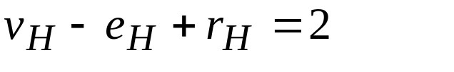
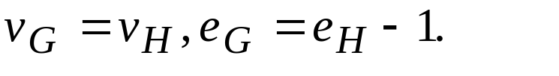
Chapter 11 An Introduction to Graph Theory
11.4 Planar Graphs
proof: The proof is by induction on e.
e=0 or 1
v=1
r=1
e=0
v=1
r=2
e=1
v=2
r=1
e=1
v-e+r=2
Assume that the result is true for any connected planar graph or
multigraph with e edges, where
Now for G=(V,E) with |E|=k+1 edges, let H=G-(a,b) for a,b in V.
Since H has k edges,
And,
Now consider the situation about regions.

Slide 25
Chapter 11 An Introduction to Graph Theory
11.4 Planar Graphs
case 1: H is connected
b
b
a
a(=b)
a(=b)
a

Slide 26
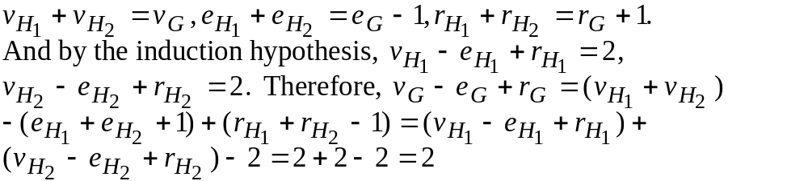
Chapter 11 An Introduction to Graph Theory
11.4 Planar Graphs
case 2: H is disconnected
H₁
a
a
H₂
b
b
b
H₁
a
b
H₂
a

Slide 27
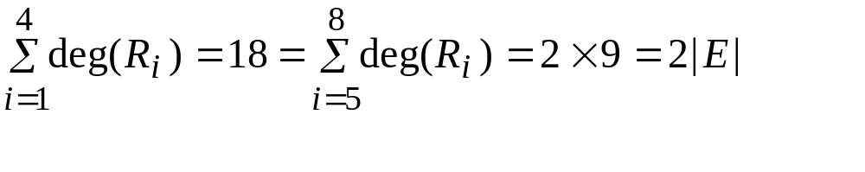
Chapter 11 An Introduction to Graph Theory
11.4 Planar Graphs
degree of a region (deg(R)): the number of edges traversed in
a shortest closed walk about the boundary of R.
two different embeddings
R₆
a
b
R₈
R₂
R₄
c
R₃
R₅
R₇
R₁
g
h
d
f
deg(R₁)=5,deg(R₂)=3
deg(R₃)=3,deg(R₄)=7
deg(R₅)=4,deg(R₆)=3
deg(R₇)=5,deg(R₈)=6
abghgfda

Slide 28
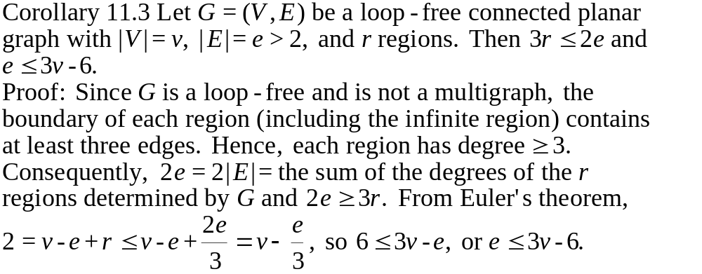
Chapter 11 An Introduction to Graph Theory
11.4 Planar Graphs
Only a necessary condition, not sufficient.

Slide 29

Chapter 11 An Introduction to Graph Theory
11.4 Planar Graphs
Ex. 11.18 For K₅, e=10,v=5, 3v-6=9<10=e. Therefore,
by Corollary 11.3, K₅ is nonplanar.
Ex. 11.19 For K_{3,3}, each region has at least 4 edges, hence
4r 2e. If K_{3,3} is planar, r=e-v+2=9-6+2=5. So 20=4r 2e=18,
a contradiction.

Slide 30
Chapter 11 An Introduction to Graph Theory
11.4 Planar Graphs
A dual graph of a planar graph
1
1
2
a
b
2
c
3
3
4
d
5
6
4
f
e
6
5
g
An edge in G corresponds with an edge in G^{d}.
It is possible to have isomorphic graphs with respective duals that
are not isomorphic.

Slide 31
Chapter 11 An Introduction to Graph Theory
11.4 Planar Graphs
Def. 11.20 cut-set: a subset of edges whose removal increase
the number of components
Ex. 11.21
b
e
cut-sets: {(a,b),(a,c)},
{(b,d),(c,d)},{(d,f)},...
d
f
a
h
c
g
a bridge
For planar graphs, cycles in one graph correspond to cut-sets
in a dual graphs and vice versa.

Slide 32
Chapter 11 An Introduction to Graph Theory
11.5 Hamilton Paths and Cycles
a path or cycle that contain every vertex
Unlike Euler circuit, there is no known
necessary and sufficient condition for a
graph to be Hamiltonian.
an NP-complete problem
Ex. 11.24
a
b
c
There is a Hamilton path, but no
Hamilton cycle.
d
e
f
g
h
i

Slide 33
Chapter 11 An Introduction to Graph Theory
11.5 Hamilton Paths and Cycles
Ex. 11.25
x
start labeling from here
4x's and 6y's, since x and y must
interleave in a Hamilton path (or cycle),
the graph is not Hamiltonian
y
y
y
x
y
y
x
x
y
The method works only for bipartite graphs.
The Hamilton path problem is still NP-complete when restricted
to bipartite graphs.

Slide 34
Chapter 11 An Introduction to Graph Theory
11.5 Hamilton Paths and Cycles
Ex. 11.26 17 students sit at a circular table, how many sittings are
there such that one has two different neighbors each time?
Consider K₁₇, a Hamilton cycle in K₁₇ corresponds to a seating
arrangements. Each cycle has 17 edges, so we can have
(1/17)17(17-1)/2=8 different sittings.
5
5
5
3
15
3
15
3
15
2
1
17
2
1
17
2
1
17
4
16
4
16
4
16
14
6
6
6
1,2,3,4,5,6,...,17,1
1,3,5,2,7,4,...,17,14,16,1
1,5,7,3,9,2,...,16,12,14,1

Slide 35
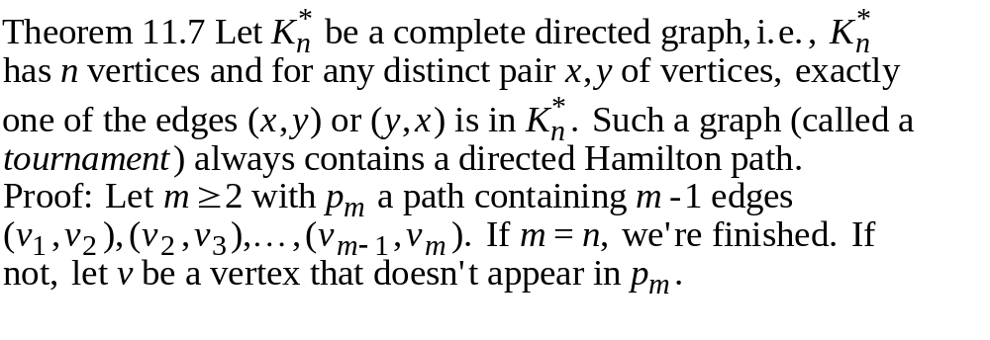
Chapter 11 An Introduction to Graph Theory
11.5 Hamilton Paths and Cycles
case 1.
v v₁ v₂ ...v_{m}
case 2. v₁ v₂ ...v_{k} v v_{k+1} ...v_{m}
case 3. v₁ v₂ ...v_{m} v

Slide 36
Chapter 11 An Introduction to Graph Theory
11.5 Hamilton Paths and Cycles
Ex. 11.27 In a round-robin tournament each player plays every
other player exactly once. We want to somehow rank the players
according to the result of the tournament.
not always possible to have a ranking where a player in a certain
position has beaten all of the opponents in later positions
a b c
but by Theorem 11.7, it is possible to list the players such that
each has beaten the next player on the list

Slide 37
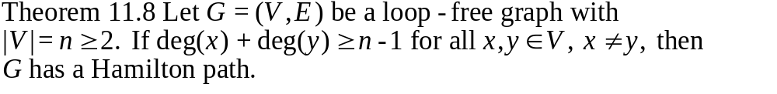
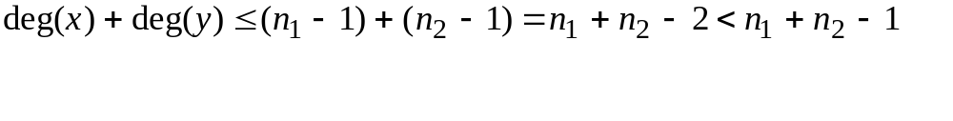
Chapter 11 An Introduction to Graph Theory
11.5 Hamilton Paths and Cycles
Proof: First prove that G is connected. If not,
x
y
n₁ vertices
n₂ vertices
a contradiction

Slide 38
Chapter 11 An Introduction to Graph Theory
11.5 Hamilton Paths and Cycles
Assume a path p_{m} with m vertices
v₁ v₂ v₃ ... v_{m}
case 1. either v v₁ or v_{m} v
case 2. v₁,v₂,...,v_{m} construct a cycle
either v₁ v₂ v₃ ... v_{m}
or v₁ v₂ v₃ ...v_{t-1} v_{t} ... v_{m}
otherwise assume deg(v₁)=k, then deg(v_{m})<m-k.
deg(v₁)+deg(v_{m})<m<n-1, a contradiction
Therefore, v can be added to the cycle.
v

Slide 39
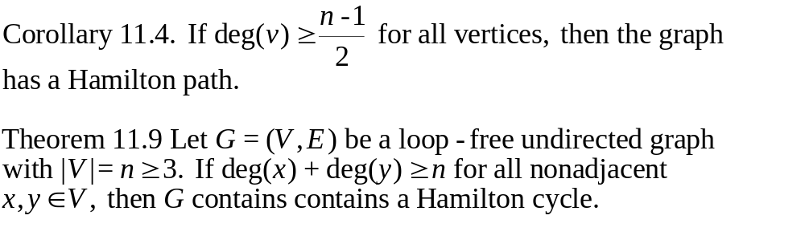
Chapter 11 An Introduction to Graph Theory
11.5 Hamilton Paths and Cycles
Proof: Assume G does not contain a Hamilton cycle. We add edges
to G until we arrive a subgraph H of K_{n} where H has no Hamilton
cycle, but for any edge e not in H, H+e has a Hamilton cycle.
For vertices a,b wher (a,b) is not an edge of H. H+(a,b) has a
Hamilton cycle and (a,b) is part of it.

Slide 40
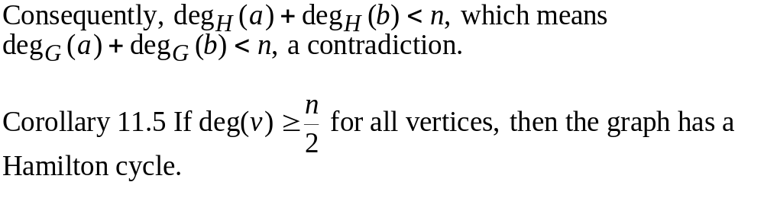
Chapter 11 An Introduction to Graph Theory
11.5 Hamilton Paths and Cycles
a(=v₁) b(=v₂) v₃ ... v_{n}
If (b,v_{i}) is in H, then (a,v_{i-1}) cannot be in H. Otherwise,
b v_{i} v_{n} a v_{i-1} v_{i-2} v₃ is a Hamilton cycle in H.

Slide 41
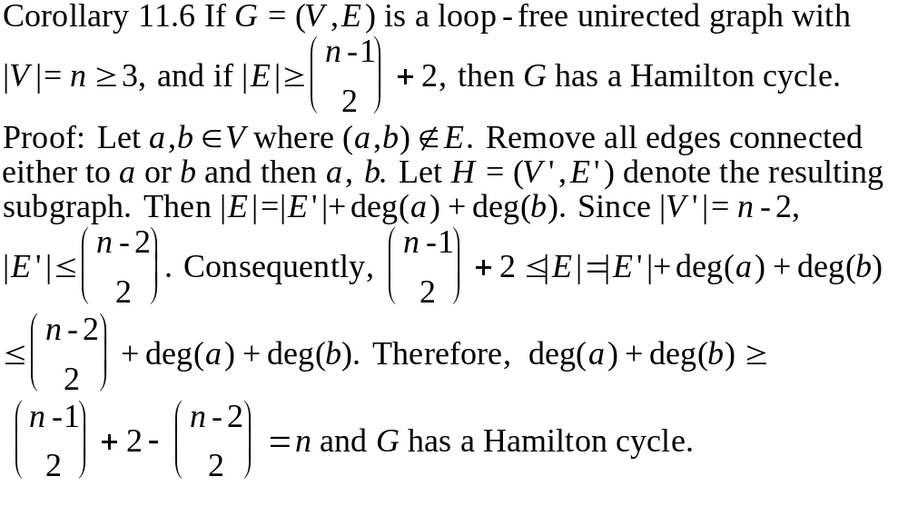
Chapter 11 An Introduction to Graph Theory
11.5 Hamilton Paths and Cycles

Slide 42
Chapter 11 An Introduction to Graph Theory
11.5 Hamilton Paths and Cycles
A related problem: the traveling salesman problem
a
3
e
Find a Hamilton cycle of shortest total distance.
1
b
3
2
For example, a-b-e-c-d-a with total cost=
1+3+4+2+2=12.
4
3
d
5
4
2
c
graph problem vs. Euclidean plane problem
(computational geometry)
Certain geometry properties (for example, the triangle
inequality) sometimes (but not always) make it simpler.

Slide 43
Chapter 11 An Introduction to Graph Theory
11.5 Hamilton Paths and Cycles
Two famous computational geometry problems.
1. closest pair problem: which two points are nearest
2. convex hull problem
the convex hull

Slide 44
Chapter 11 An Introduction to Graph Theory
11.6 Graph Coloring and Chromatic Polynomials
Def. 11.22 If G=(V,E) is an undirected graph, a proper coloring
of G occurs when we color the vertices of G so that if (a,b) is an
edge in G, then a and b are colored with different colors. The
minimum number of colors needed to properly color G is called
the chromatic number of G and is written χ(G).
a
3 colors are needed.
a: Red
b: Green
c: Red
d: Blue
e: Red
e
χ(K_{n})=n
b
χ(bipartite graph)=2
d
c
In general, it's a very difficult problem (NP-complete).

Slide 45
Chapter 11 An Introduction to Graph Theory
11.6 Graph Coloring and Chromatic Polynomials
A related problem: color the map where two regions are
colored with different colors if they have same boundaries.
Four colors are enough for any map. Remain
a mystery for a century. Proved with the aid
of computer analysis in 1976.
a
b
B
G
c
Y
R e
f
a
d
B
R
f
b
e
c
d

Slide 46
Chapter 11 An Introduction to Graph Theory
11.6 Graph Coloring and Chromatic Polynomials
P(G,λ): the chromatic polynomial of G=the number of ways
to color G with λ colors.
Ex. 11.31 (a) G=n isolated points, P(G,λ)=λ^{n}.
(b) G=K_{n}, P(G,λ)=λ(λ-1)(λ-2)...(λ-n+1)=λ^{(n)}
(c) G=a path of n vertices, P(G,λ)=λ(λ-1)^{n-1}.
(d) If G is made up of components G₁, G₂, ..., G_{k},
then P(G,λ)=P(G₁,λ)P(G₂,λ)...P(G_{k},λ).
Ex. 11.32
e
coalescing the vertices
G
G
G'
e
e

Slide 47
Chapter 11 An Introduction to Graph Theory
11.6 Graph Coloring and Chromatic Polynomials
Theorem 11.10 Decomposition Theorem for Chromatic Polynomials.
If G=(V,E) is a connected graph and e is an edge, then
P(G_{e},λ)=P(G,λ)+P(G'_{e},λ).
a
e
coalescing the vertices
G
b
G
G'
e
e
In a proper coloring of G_{e}:
case 1. a and b have the same color: a proper coloring of G'_{e}
case 2. a and b have different colors: a proper coloring of G.
Hence, P(G_{e},λ)=P(G,λ)+P(G'_{e},λ).

Slide 48
Chapter 11 An Introduction to Graph Theory
11.6 Graph Coloring and Chromatic Polynomials
Ex. 11.33
e
=
-
P(G,λ)
P(G_{e},λ)
P(G'_{e},λ)
P(G,λ)=λ(λ-1)³-λ(λ-1)(λ-2)=λ⁴-4λ³+6λ²-3λ
Since P(G,1)=0 while P(G,2)=2>0, we know that χ(G)=2.
Ex. 11.34
e
e
=
-
=
-2
P(G,λ)=λλ⁽⁴⁾-2λ⁽⁴⁾= λ(λ-1)(λ-2)²(λ-3)
χ(G)=4

