Slide 1
Week 9 Notes
By: Ethan Chriswell, Kyle McManus, Ryan Hildebrandt

Slide 2
Tuesday October 22, 2019
Fair Prediction with Disparate Impact

Slide 3
Introduction
Recidivism prediction instruments (RPI’s) provide decision makers with an assessment of the likelihood that a criminal defendant will reoffend at a future point in time
COMPAS
Developed by Northpointe Inc.
Risk Assessment used to determine recidivism likelihood
With such heavy impact we need to know if systems are bias
ProPublica Analysis to see if COMPAS is bias

Slide 4
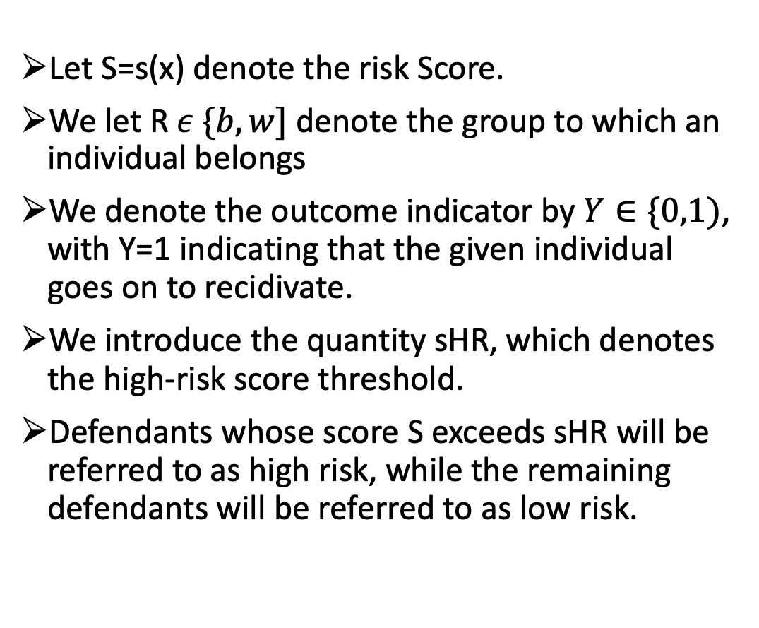
Notation
Let S=s(x) denote the risk Score.
We let R $ε \{b,w]$ denote the group to which an individual belongs
We denote the outcome indicator by $Y∈\{0,1)$, with Y=1 indicating that the given individual goes on to recidivate.
We introduce the quantity sHR, which denotes the high-risk score threshold.
Defendants whose score S exceeds sHR will be referred to as high risk, while the remaining defendants will be referred to as low risk.

Slide 5
Four Different Fairness Criteria
Calibration
Predictive Parity
Error Rate Balance
Statistical (Demographic) Parity

Slide 6
Collaboration
A score S=S(x) is said to be well-calibrated if it reflects the same likelihood of recidivism irrespective of the individuals’ group membership
In their response to the ProPublica investigation, Flores et al. [6] verify that COMPAS is well-calibrated using logistic regression modeling

Slide 7
Predictive Parity
A score s = S(x) satisfies predictive parity at a threshold sHR if the likelihood of recidivism among high-risk offenders is the same regardless of group membership. ℙ(Y=1 ∣∣ S>sHR, R=b) = ℙ(Y=1 ∣∣ S>sHR, R=w).
Predictive parity at a given threshold sHR amounts to requiring that the positive predictive value (PPV) of the classifier Y^ = 1S>sHR be the same across groups
Northpointe’s refutation of the ProPublica analysis shows that COMPAS satisfies predictive parity for threshold choices of interest.

Slide 8
Error Rate Balance
A score S = s(x) satisfies error rate balance at a threshold sHR if the false positive and false negative error rates are equal across groups ℙ (S>sHR ,∣∣Y=0 , R=b)= ℙ(S>sHR ,Y=0, R=w) ℙ (S<sHR ,∣∣Y=1 , R=b)= ℙ(S<sHR ,Y=1, R=w)
ProPublica analysis considered a threshold or sHR=4, which they showed leads to considerable imbalance in both false positive and false negative rates.
Error rate balance is also closely connected to the notions of equalized odds and equal opportunity

Slide 9
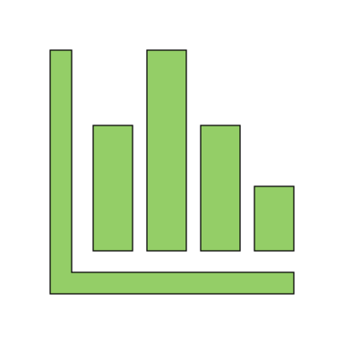
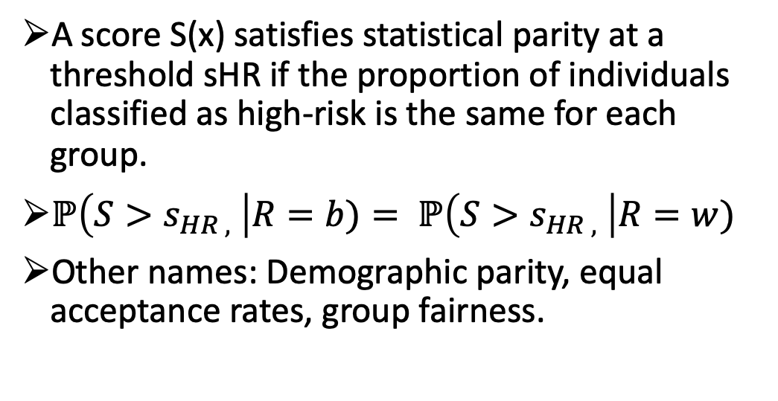
Statistical (Demographic) Parity
A score S(x) satisfies statistical parity at a threshold sHR if the proportion of individuals classified as high-risk is the same for each group.
$ℙ\left(S>s_{HR ,} \right|R=b)= ℙ\left(S>s_{HR ,} \right|R=w)$
Other names: Demographic parity, equal acceptance rates, group fairness.

Slide 10
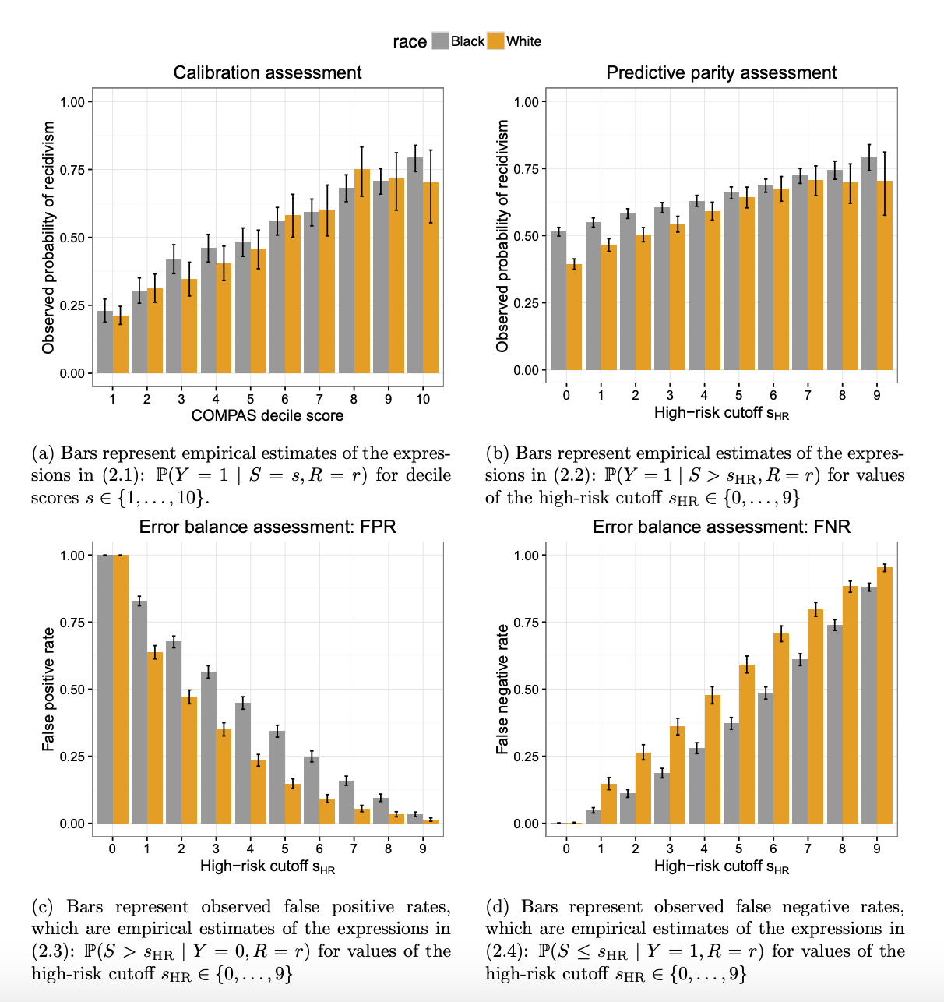
Does Compas Satisfy
Calibration Assessment
Yes
95% Confidence Intervals Intercept for Black and White groups
Predictive Parity
Yes
95% Confidence Intervals Intercept for Black and White groups
Error Balance
No
Higher False Positive Rates for Black Groups is Higher
Statistical Parity
No
Higher False Negative Rates for White Groups is Higher

Slide 11

Conclusion
The error rate imbalance exhibited by COMPAS is not a coincidence, nor can it be remedied in the present context
Impossibility Result
When the recidivism prevalence i.e., the base rate P (Y=1 | R =r) differs across groups, any instrument that satisfies predictive parity (PPR) at a given threshold sHR must have imbalanced false positive or false negative rates at that threshold.

Slide 12
Thursday October 24, 2019
Equality of opportunity in supervised learning

Slide 13
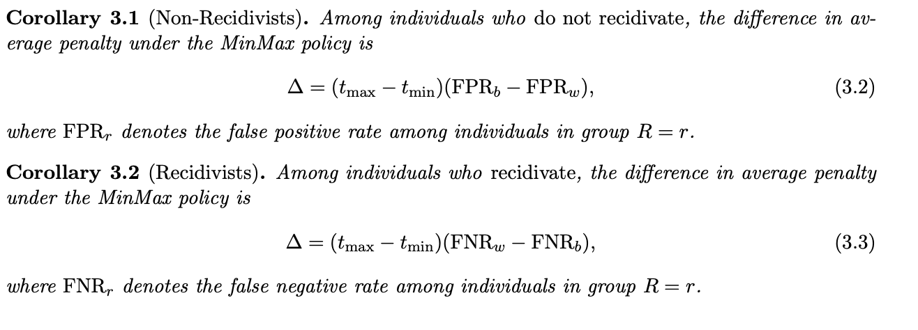
Does this lead to disparate impact?
What is disparate impact?
Definition could be context specific
In COMPAS context, let’s say that defendant receives higher penalty if he/she is adjudged high-risk and lesser penalty if he/she is adjudged low-risk- Penalty = Amount at which bail is set
If penalties suffered by different groups are different, then there is disparate impact

Slide 14
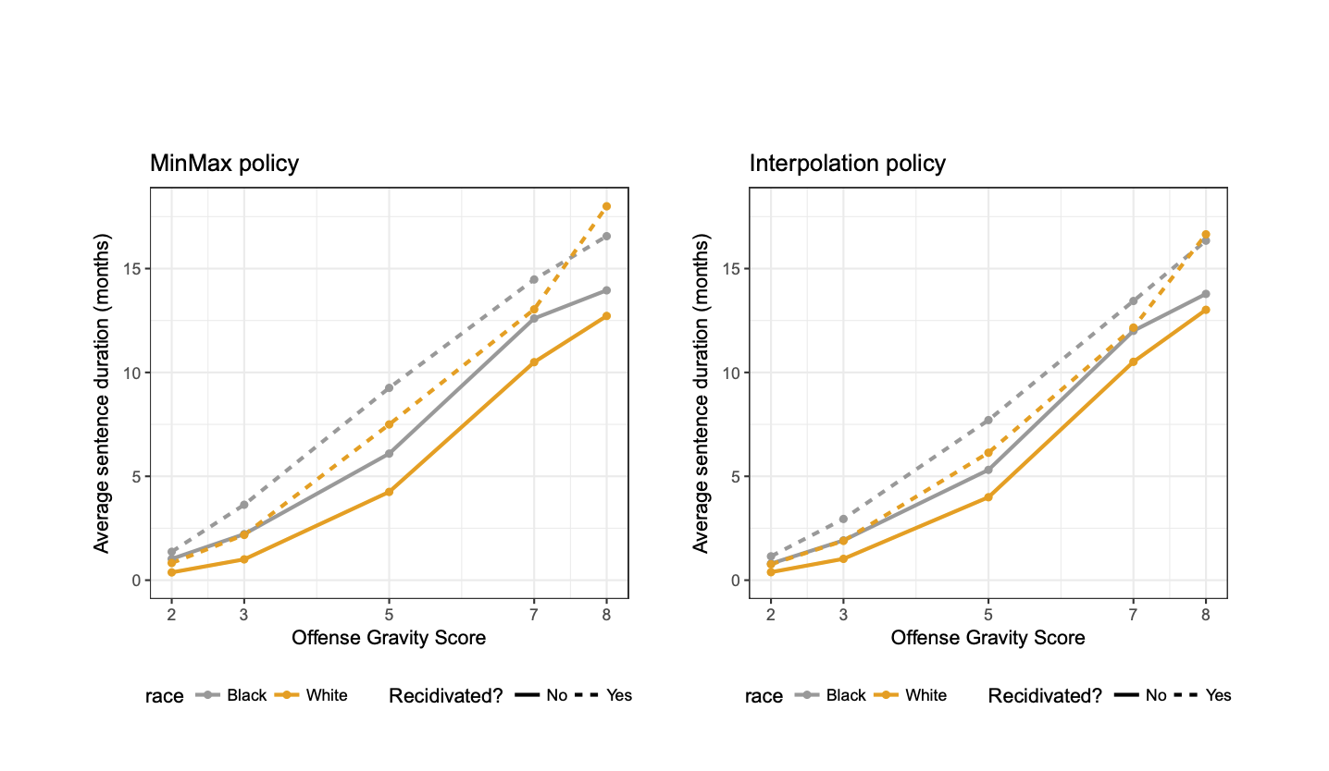
Important to see the Distinction
Unfairness in ML relates more to predictions made by ML model
Disparate impact deals more with what you do with the predictions
Might be the case that unfair ML does not lead to disparate impact if it is not actually used to make decisions - Just using your ML model to understand how your features are correlated with you target variable

Slide 15
Three Ways of Fixing Biases
Preprocess Data
Postprocessing Data
Modify ML Algorithm

Slide 16
What is their high-level approach?
Don’t change anything in the ML training pipeline
Train models like you usually do
Do some post-processing on the outputs of the ML model
Make it fairer
Make this process oblivious to the training set

Slide 17

2 Fairness criteria that they try to establish
Equalized odds - Across your two categories: FPR should be equal, TPR should be equal
Equal opportunity
We say that a binary predictor Yb satisfies equal opportunity with respect to A and Y if only satisfied for the positive class
Equal opportunity is a weaker, though still interesting, notion of non-discrimination, and thus typically

Slide 18
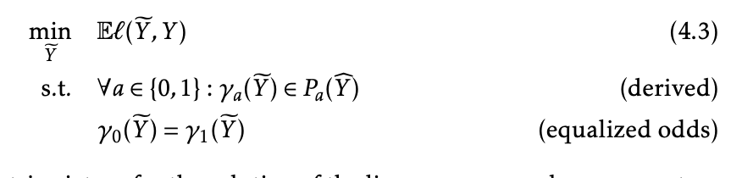
Deriving from Binary Predictor

Slide 19
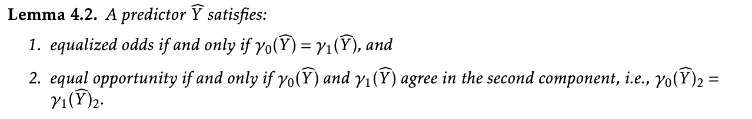
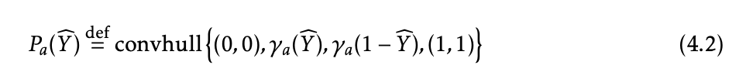
Deriving from Binary Predictor pt.2

Slide 20
Another Approach: Pre-Processing
Remove the sensitive attribute
Remove all features with sensitive attribute
Brute Force Method?
For all the features that are somewhat correlated with the sensitive attribute
What is a more sophisticated method?
X,A
C=c(z)
Z
Max I(X;Z)
MinI(A;Z)

Slide 21

That's it!
Questions?

