Slide 1
Week 3 Notes
By Allen Ge, Meishuai Li, Zeyang Zhu

Slide 2
Big Data

Slide 3
Introduction
Every object generates data
Why is this trend emerging now? Because now we have the technology to digitize all existing knowledge, whereas this thing did not exist earlier
Information is coming from all different kinds of sources, which did not exist before
A byproduct of our increasing use of technology
2020, data volume would be 40 zetabytes
40 zetabyes = grains of sand on earth * 75
Data processing in last two years = data proc in last 3000 years

Slide 4
Analogies
Copernicus collected astronomical data – data for the visible world
Microscope opened up the invisible world
Atomic world was opened up by electron microscope
Supervisible world - Big data is a microscope
We collect lots of data and we use powerful algorithms to parse through this data

Slide 5
Emerging Big Data
Before
We thought of things
Wrote them down = knowledge
Now
Bunch of information- not knowledge
Play around with it until it becomes knowledge
Every action that we do creates data – that data is mostly meaningless in the raw form until someone contextualizes it and gives meaning to it

Slide 6
Why is Big Data Happening Now?
Development of internet
Rapidly increasing the amount of data available
Ubiquity of small scale devices that can act as crowdsourced sensors
Accelerating data storage capacity and computing power at low cost
Moore’s law
Development of cloud computing, e.g., AWS
Development of distributed platforms e.g., Hadoop, Apache Spark
Development of ML algorithms to process this data
One has led to the other Big data spurred ML, which in turn led to need for more data

Slide 7
Data Case: Social Media
What data could be collected?
Interests
Likes/posts/messages/friends
Photographs
Relationship status
Birthday
Work and educational history, etc.
Who could use this data?
Finding potential matches – new feature coming up
Advertisements
Cambridge Analytica – Political parties around the world to spread targeted political campaigns
American and Indian voters, etc.

Slide 8
Data Case: Vending Machine
What data could be collected?
What products sell the most
Payment information about people (if they use electronic payment)
Time/days when purchases peak or fade
Locations of vending machines where people buy these products
Locations of products inside the machines which were picked up
Who could use this data?
Could help them decide where to place physical stores/distribution centers, etc. so as to maximize their profits
Could also help in the design of better vending machines

Slide 9
Case Study: Flu Prediction
Old method – Accumulating info submitted by doctors about patient visits
2 weeks to reach CDC
Google uses search results of “flu” to predict outbreak in real-time
Issues:
Flu mentioned several times in the news…ppl interested in this..drove up Google Search

Slide 10
Unique Case Studies
Big data has allowed us to uncover fairness issues
Big data has been used for disaster response
Earthquake in Haiti
Big data for uprisings in Tunisia
Target example…Our buying patterns can tell more about our pregnancies than our actual families

Slide 11
Concerns with Big Data
Anything that’s going to change the world, by definition should have the ability to change it for the worse
Data revolution also leading to issues
Somebody is listening in
Big brother
My device knowing me
Huge implications for how we interact with machines

Slide 12
Deep Learning

Slide 13
Deep Learning
Classification:
1.Classification Problems
2.Decision Trees
3.Random Forest
4.GRT
5.Neural Network
-Lots of temporary data
-Lots of computer power
Diff adjust (1920-2010)
1960-1970

Slide 14
Initial Problems
x1 + -
- x
x2 XOR Example
Newsal networks
-Multiple layer perceptron (MLR) NN
-Building block

Slide 15
Activation Functions
w1x1+w2x2+w3x3+w4x4 >=b
w1x1+w2x2+w3x3+w4x4 <b
Non-Linear Activation Functions
1.Sigmoid Function
2. ReLU ( Rectified Linear Unit)
3. Leaky ReLU
4.Tan H
1
H * e ^-(w1x1+w2x2+w3x3+w4x4+b)

Slide 16
Perceptron
X1
X2
X3
x4
W1
W2
W3
w4
Activation Function
perceptron
b
Y 1or 0

Slide 17
Bias variance trade off
Under Fitting
Over Fitting
Test Accuracy
Error
Training Accuracy
No. of NN

Slide 18
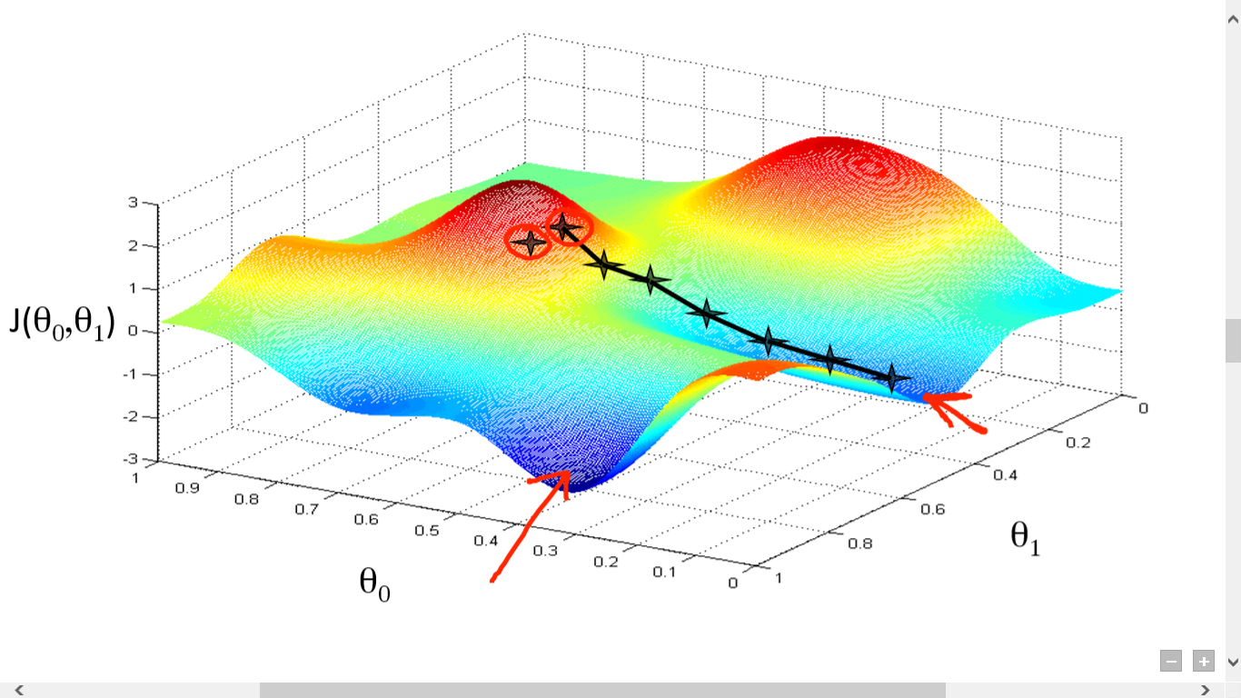
Gradient Descent
Deep network are trained using gradient descent
Back propagation is often how you do gradient descent with neural networks

