Slide 1
Week 4 Notes: Deep Learning Architecture
By: Rachael Girardey, Lauren Clarke, Alex Jones

Slide 2
Difference between DL & ML
Deep Learning
A Representation Learning Method: people have traditionally collected data from various sources but these features aren’t powerful to predict information from this data
A learning alternative and more useful visual representations of data
Many layers instead of feature extractor (form useful representations for the problem) = automated the task = Representation Learning Methods
Anybody can be a data scientist as long as they have good data
Machine Learning
Looks at the features and to determine best possible outcome
Ex: Determining the price of a house based on specific features
Does not have enough power to look at multiple features
Works well with raw data by:
Building a feature extractor from domain experts (humans)
Get complicated unintelligible features
Feed into a standard ML model (such as SVM)
Get outcome

Slide 3
Four Models of Deep Learning
Use of these models depends on the task
There is no rule on which one to use
The size and depth of neural networks are increasing
Standard Vanilla
Convolutional Neural Networks (CNN)
Recurrent Neural Networks (RNN)
Generative Adversarial Network (GAN)

Slide 4
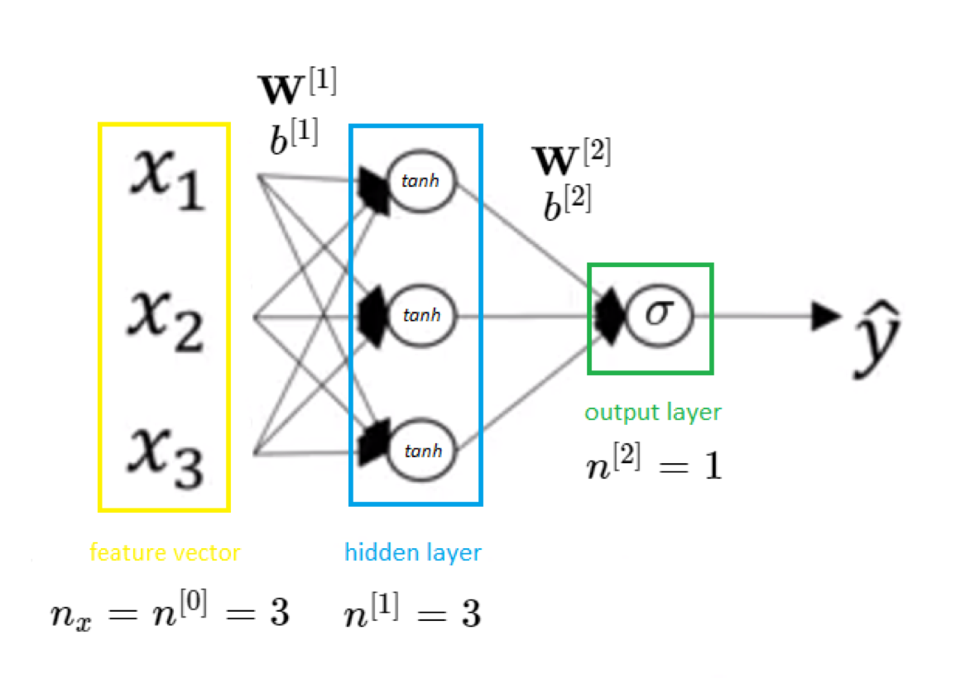
Standard ‘Vanilla’ Deep Learning
Use when data has no particular structure
Gradient descent
Each neuron is deciding its output
Contains a set of numeric features
Typically remains in tabular form

Slide 5
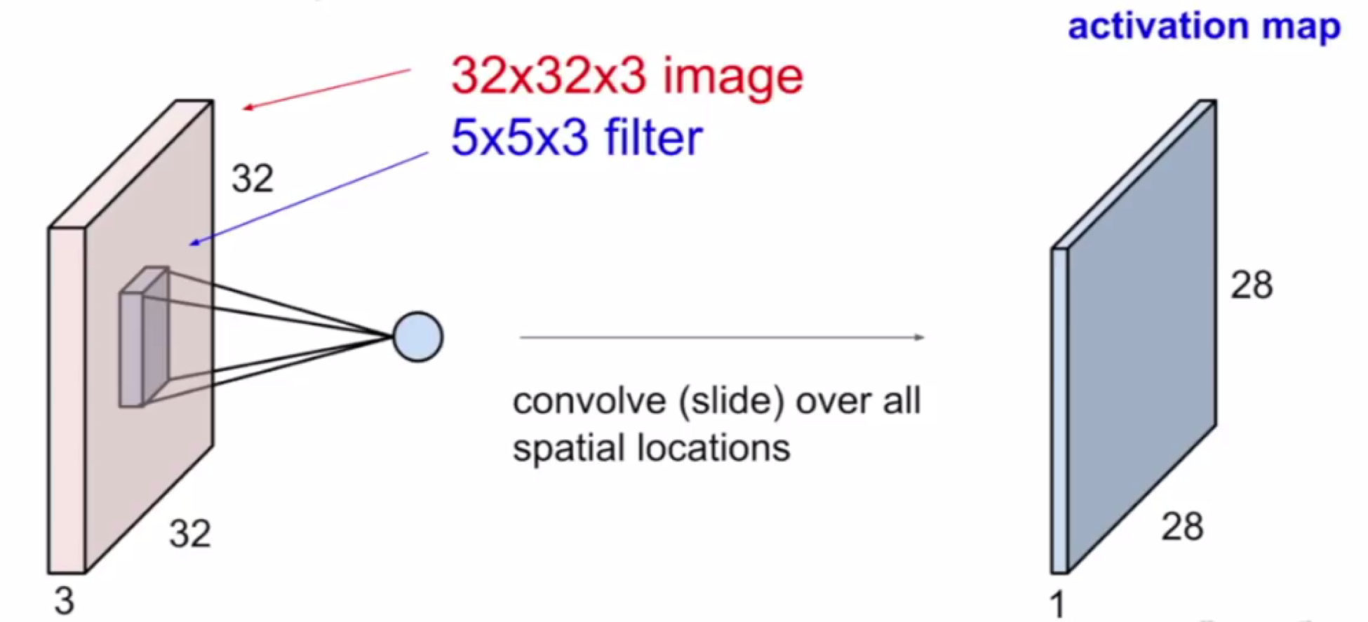
Convolution Neural Networks (CNN)
Spatial dependence
Ex: Images, heat maps, CT scans
Exploits objects in images and allows for exploration of confidence scale once completed
D, W, H : preserve the natural spatial structure in which each pixel becomes a feature
Convolutional layer
1. Convolve the filter with the image (slide over the image spatial computing dot products)
2. Place filter over original image giving the next level of features to see the correspondence amongst the two

Slide 6
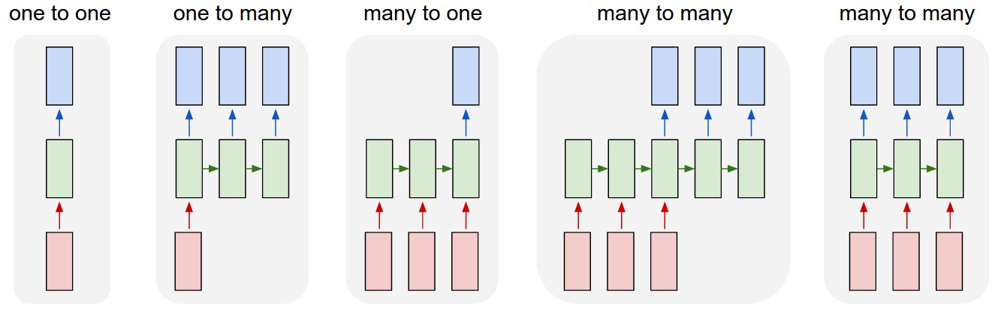
Recurrent Neural Networks (RNN)
Used when data has sequential structure and dependence on past
Recursively feeds the output into its vector
Output is a vector of things, such as, an entire sentence, a frame from a video, etc.
Focuses its attention at a different spatial location when generating each word and it’s sentiment classification
Process sequences: one-to-one networks, one-to-many networks, and many-to-many networks
Inputs are passed into these unit network models and undergoes feedback loops
New state = the function of parameters W = (old state, input vector)
Examples: LSTM (Long Short Term model) & GRU (ways for connecting networks)
Examples: videos, textraised data, image captioning, and translation of languages
I am feeling= 3 different features- RNN tries to predict the next word

Slide 7
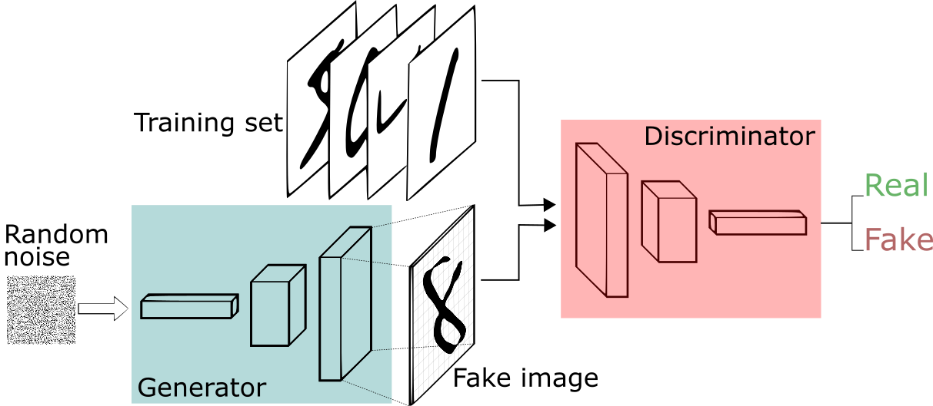
Generative Adversarial Networks (GAN)
Used to generate new data that mimics properties of original data (Deep Fakes)
Contains 2 parts:
Generator Network: responsible for generating new data (leads to new videos, images, data points, etc.)
Discriminator Network: takes the new input that is being constructed and distinguishes what data belongs to each set.
If the discriminator makes a mistake, it’s reframed so it doesn’t make the same mistake again

Slide 8
References
“Gradient Descent for Neural Networks.” Master Data Science,
2 Aug. 2019, http://datahacker.rs/gradient-descent-for-neural-networks/.
Karpathy, Andrej.“Recurrent Neural Networks.” The Unreasonable Effectiveness of Recurrent Neural
Networks, May 2015, http://karpathy.github.io/2015/05/21/rnn-effectiveness/.
Silva, Thalles. “A Beginner's Guide to Generative Adversarial Networks (GANs).” Skymind, https://skymind.ai/wiki/generative-adversarial-network-gan.
Udofia, Udeme. “Basic Overview of Convolutional Neural Network (CNN).” DataSeries, DataSeries, 20 Sept. 2019, https://medium.com/@udemeudofia01/basic-overview-of-convolutional-neural-network-cnn-4fcc7dbb4f17.

