Slide 1
Week 6 Notes
By Eric Sullivan and Nina Scolieri

Slide 2
What is Interpretability?
Interpretability is the degree to which a human can understand the cause of a decision
Why is interpretability needed?
When problems or objectives are not completely specified
It allows humans to figure out if the ML model is meeting a specific set of criteria with its predictions
When there is an incompleteness in problem formalization

Slide 3
Why is Interpretability Desirable?
Trust
Causality
Transferability
Informativeness
Fair and Ethical Decision Making

Slide 4
Trust
People desire more than just good performance on standard metrics
Being able to understand a model makes users feel more comfortable using certain systems
People want a system that won’t discriminate based on race, gender sexual orientation, etc

Slide 5
Causality
Most ML models are based off of correlations not causations
People can draw from these correlations and try to interpret a causal relationship
Correlations wouldn’t be understandable if you didn't have a interpretable model

Slide 6
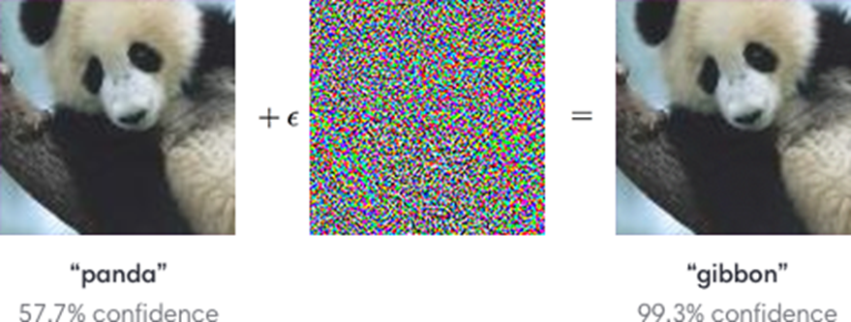
Transferability
ML models need to be able to do well on tasks it has already learned from and also transfer its knowledge to slightly different tasks
A model trained to recognize pictures of a panda, noise is added to the model and it predicts that the next image it’s fed is a “gibbon” not a panda
Without interpretability, we wouldn’t be able to understand how this prediction was made

Slide 7
Informativeness
When you don’t intend to utilize the model for decision making
Accuracy is not a factor because the model isn’t being used for decision making
Without interpretability, you can’t have informativeness

Slide 8
Fair and Ethical Decision Making
People want their models to be non-discriminatory
An example would be the recidivism prediction: A model could be used to determine whether someone with a criminal record should be granted bail or sent back to prison
Model should not make decisions solely based on race, sex, age, etc
If this was a problem, we wouldn’t be able to understand why without interpretability

Slide 9
Arguments for Interpretability
Important for instances where you might have causal associations
Good for providing clarity in situations where completeness is lacking
Pneumonia example
Predicted that people with asthma have a lower chance of getting pneumonia which isn't true
With interpretability, we'd be able to see people with asthma take more preventative measures so they don't contract pneumonia which is why their risk is lower
Positive correlation between “time to care” and “risk of dying from pneumonia”
Causal Relationships
Deep learning models only look at correlations, not causations
Collecting the right data would not give the insight needed to uncover causal associations

Slide 10
Arguments Against Interpretability
Don’t need to know the inner workings of everything
Example: Netflix movie recommendations
The recommendations these algorithms produce have very low impact on our lives
We may not fully understand why or how a system like Netflix recommends certain options for its users, but we have confidence that the system has been tested numerous times and makes accurate predictions most of the time

