Slide 1
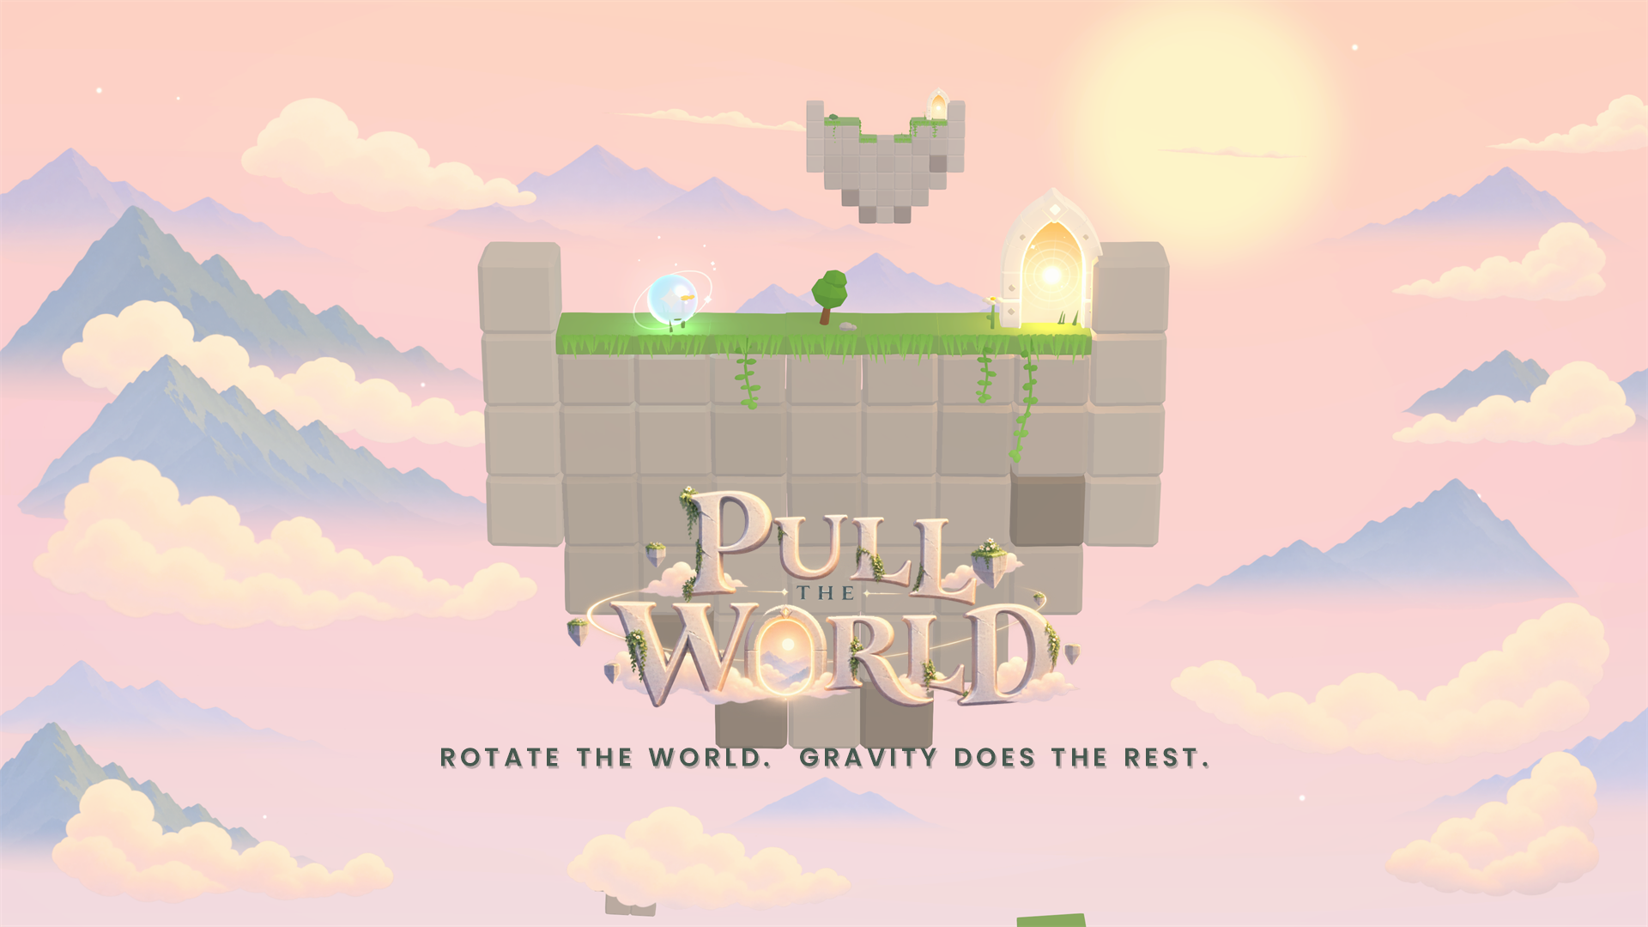
Notes:
Pull the World - a calm physics puzzle where you never move the character: you rotate the whole island and gravity carries a glowing orb home.

Slide 2
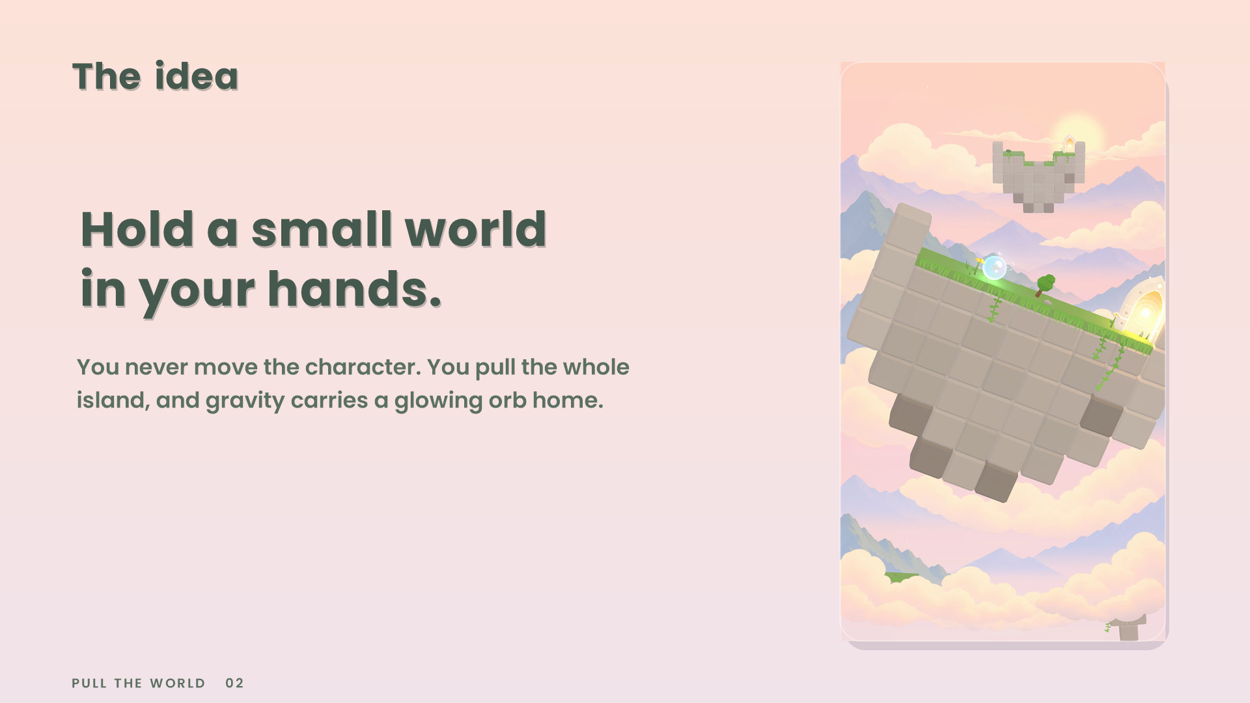
Notes:
The idea in one sentence. The fantasy: holding a small painted world in your hands and tipping it.

Slide 3
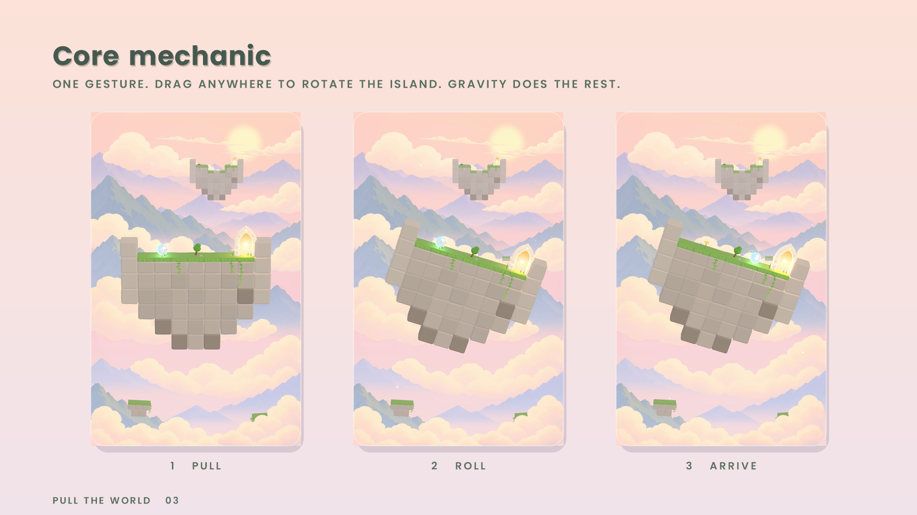
Notes:
The core mechanic: one gesture. Drag anywhere to rotate the island; the orb rolls with gravity; the portal is the goal.

Slide 4
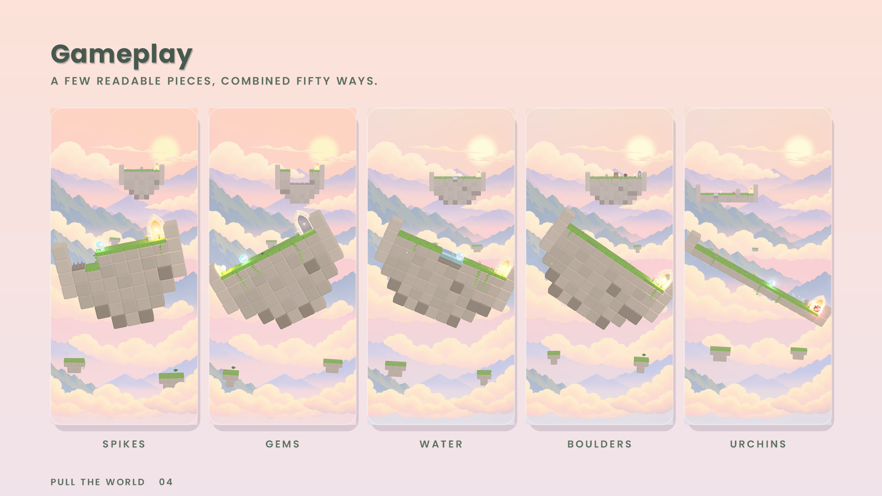
Notes:
Situations built from a few readable pieces: spikes, gems, water, boulders that break crates, spring pads, urchins.

Slide 5
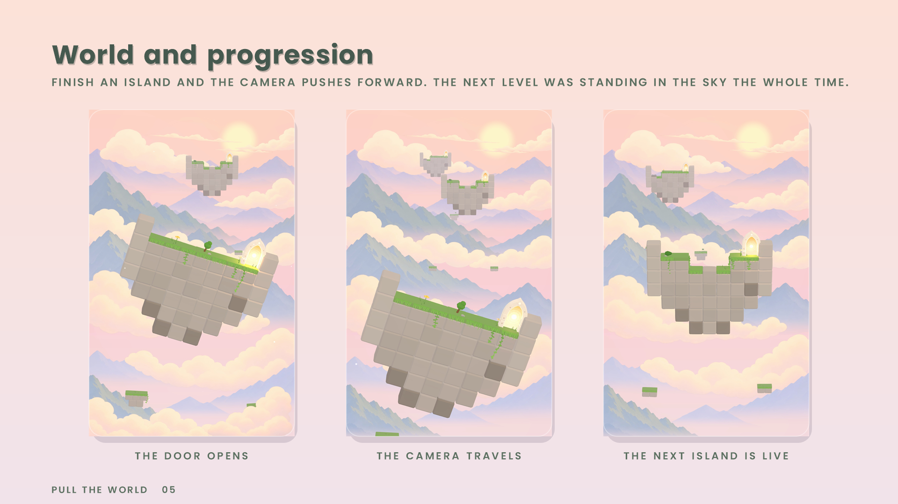
Notes:
Progression: levels stand in one continuous world. Finish an island and the camera pushes forward to the next, which was already visible in the sky.

Slide 6
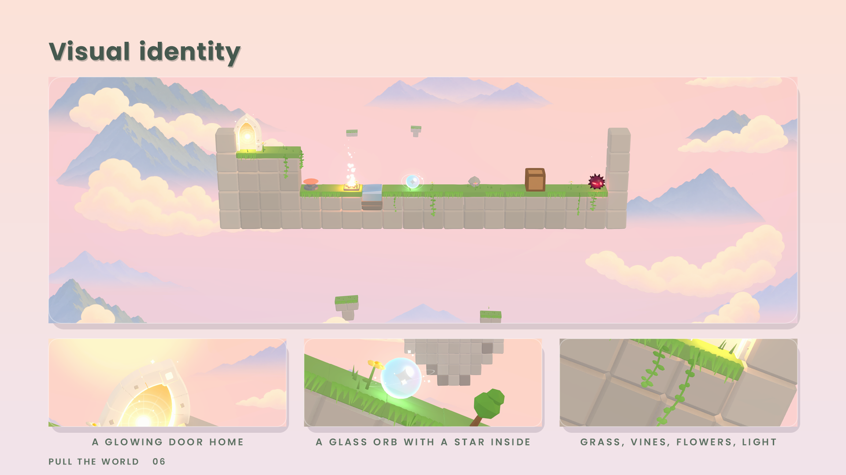
Notes:
Visual identity: pastel dawn, painted parallax layers, glass orb, glowing portal, grass, vines, flowers, particles.

Slide 7
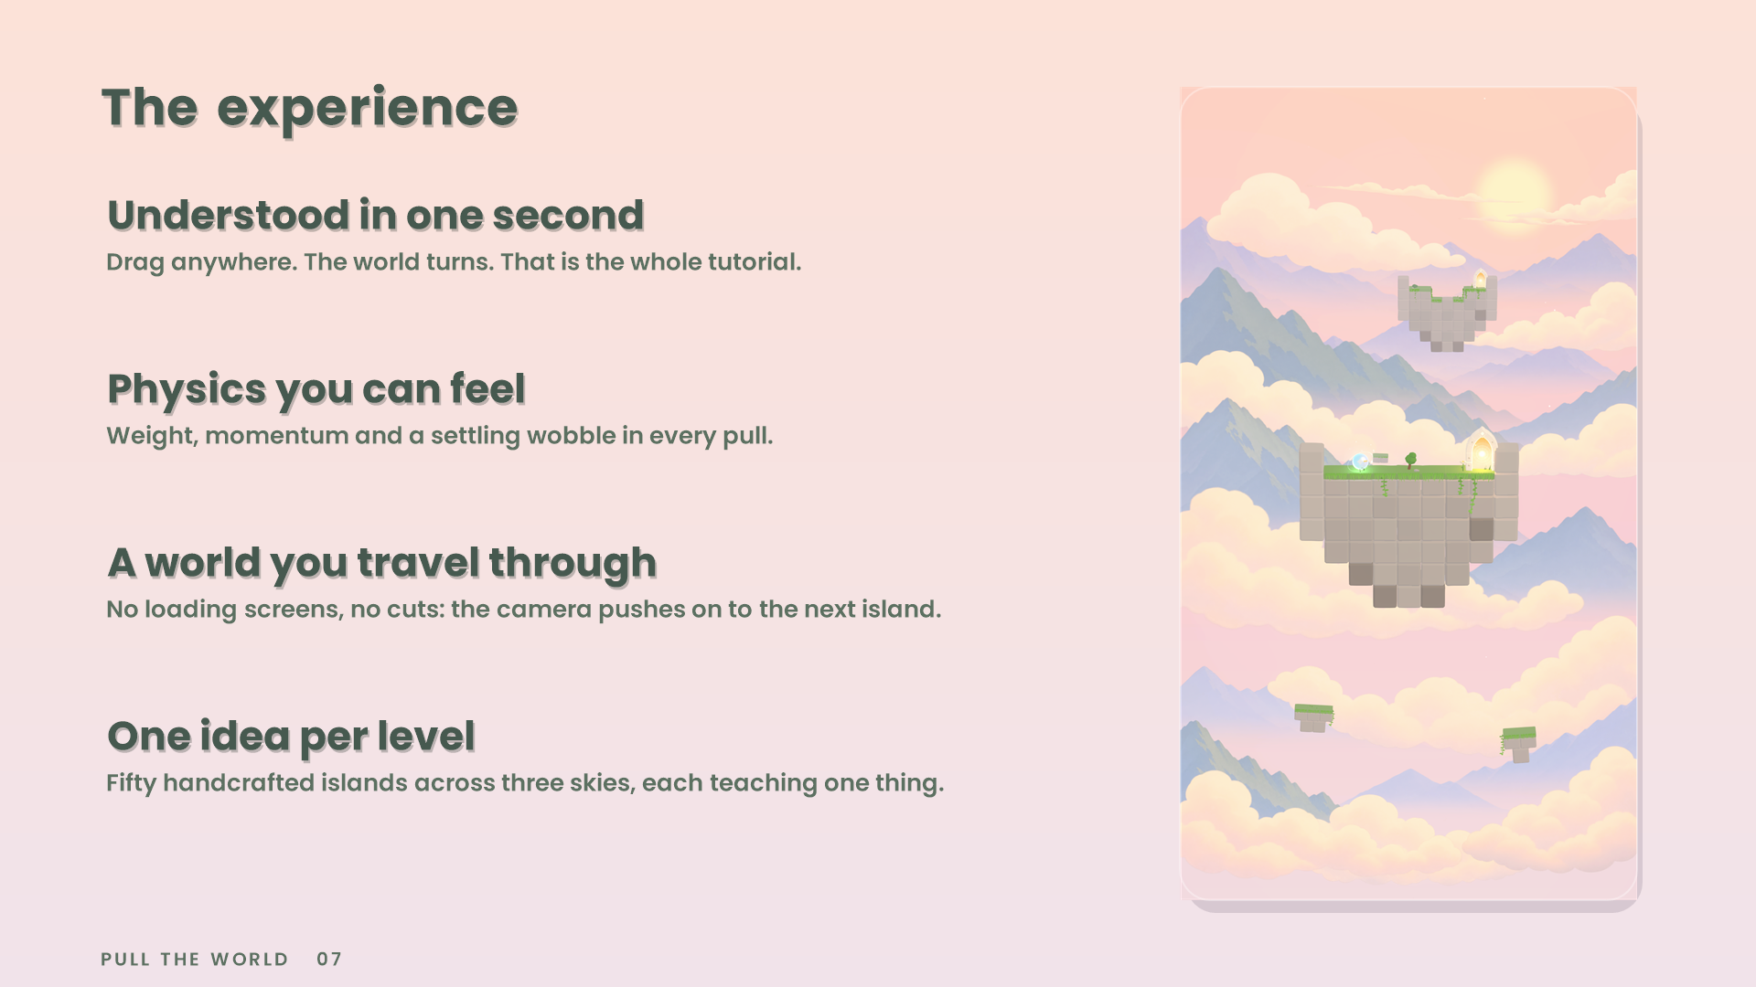
Notes:
Why it feels good: understood in a second, physics you can feel, a world that never cuts, one idea per level.

Slide 8
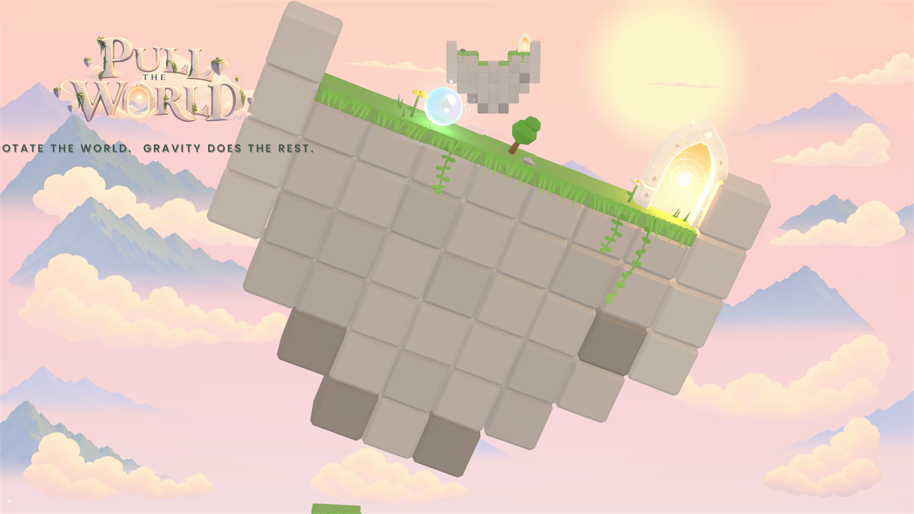
Notes:
Pull the World.

