Slide 1
SwiftLog Logistics Supply Chain Analytics
12.22%
on time
Executive presentation | Week 5, Data Analytics track
Olabisi Amusan | AnalystLab Africa Experience Lab
Notes:
Introduce the project: a five-page Power BI solution for SwiftLog Logistics Limited. The headline number is the on-time delivery rate of 12.22%.

Slide 2
SwiftLog at a glance
15
4
5,000
₦14.44M
warehouses (Lagos 8, Abuja 4, Kano 3)
customer cities: Ibadan, Kano, Lagos, Abuja
orders from 1 Jan to 8 Sep 2026
revenue from non-cancelled orders
The challenge
Rapid growth has brought delayed deliveries and inventory imbalances
Supplier performance is inconsistent and returns are rising
Management has limited visibility into key metrics
Our answer: a five-page Power BI solution that turns 11 raw files into one executive view.
Notes:
SwiftLog runs 15 warehouses and serves four cities. The data covers January to 8 September 2026.

Slide 3
Project objectives
1
Monitor business performance
2
Improve delivery efficiency
3
Reduce operational costs
4
Improve inventory management
5
Evaluate supplier performance
6
Improve warehouse operations
7
Reduce product returns
8
Support executive decisions
Notes:
The eight business objectives from the brief. Each one maps to at least one dashboard page.

Slide 4
How the data was prepared
1
Import
2
Clean
3
Model
4
Measure
11 CSV files loaded into Power BI
Types set, dates parsed, text trimmed, Month, Quarter and Year added, 3 duplicate inventory rows removed, repeated stock rows summed
Star-style relationships across Customers, Orders, Order_Items, Products, Shipments, Delivery_Performance, Warehouses, Inventory, Employees and Returns
25+ DAX measures for revenue, delivery, inventory, returns and retention
Key decisions: Revenue = Quantity × UnitPrice, excluding cancelled orders. A shipment is On Time only when DelayDays is 0, because the source Status column contradicts DelayDays on 1,203 shipments.
Notes:
Walk through the four stages. Stress the two decisions: how revenue is calculated and how on-time is defined.

Slide 5
KPI summary
₦14.44M
5,000
991
₦4.28K
95.96%
Total revenue
Total orders
Customers
Average order value
Repeat customers
12.22%
3.57 days
9.46%
1,006,935
0.08
On-time delivery
Average delay
Return rate
Units in stock
Inventory turnover
Notes:
Green is healthy, red needs attention. The three red KPIs are on-time delivery, return rate and inventory turnover.

Slide 6
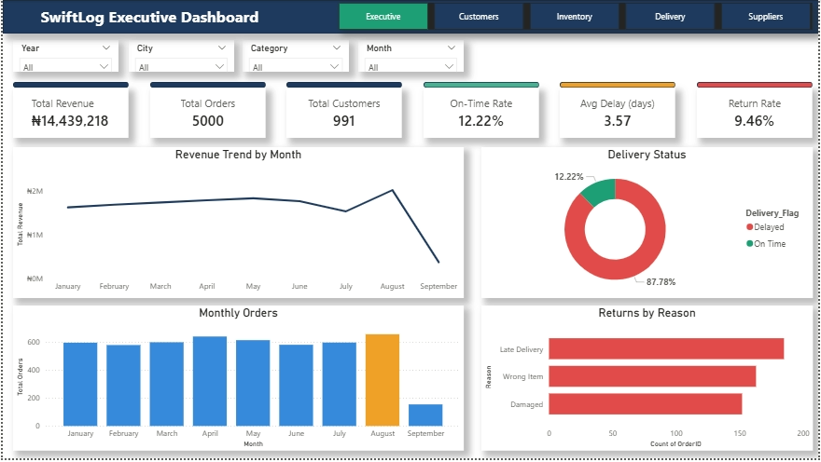
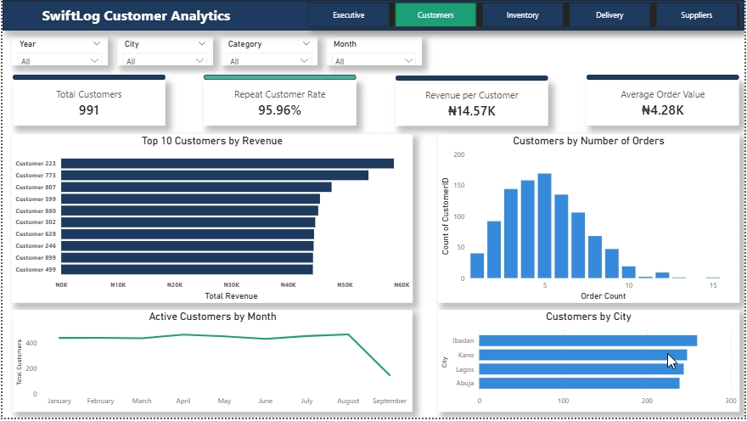
Executive and customer dashboards
Executive: revenue peaks in August, only 12% of shipments arrive on time
Slicers for year, month, city and category filter every visual
Customers: 96% order more than once, and revenue is not concentrated
Top 10 customers earn only 3.3% of revenue
Notes:
Demo the executive page first, then click a month to show cross-filtering. Then move to the customers page.

Slide 7
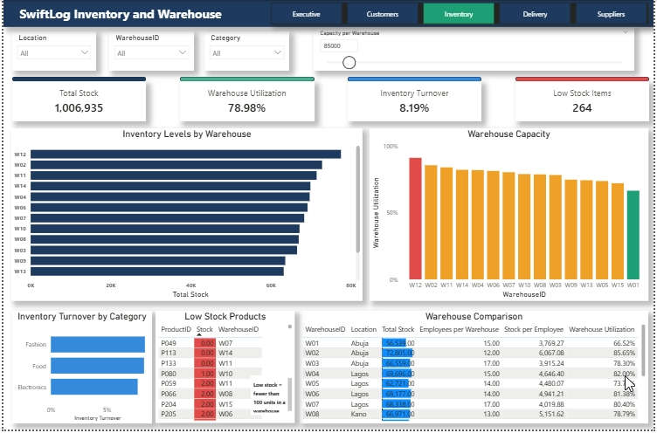
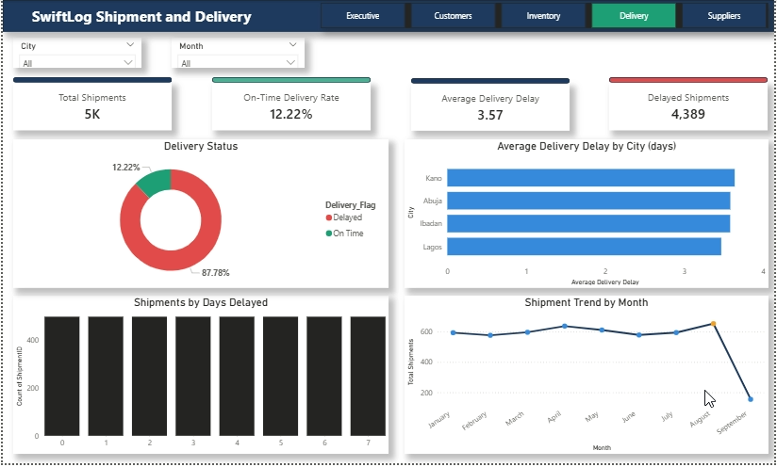
Inventory and delivery dashboards
Inventory: 264 product lines hold fewer than 100 units, turnover is 0.08
Warehouse capacity uses a What-If slider because capacity is not in the data
Delivery: 4,389 of 5,000 shipments arrive late, in every city
Average delay is 3.47 to 3.64 days across the four cities
Notes:
On the inventory page, move the capacity slider to show utilisation changing. On the delivery page, point out that delay is similar in every city.

Slide 8
Supplier and product view
Products
Fashion leads with 37.5% of revenue
Top products: P085 (₦143K), P040 (₦131K), P025 (₦123K)
Top 10 products make up only 8.4% of revenue
Suppliers: performance cannot be scored. Products and Shipments have no SupplierID, so no supplier can be linked to a delay. The 150 suppliers are listed and the gap is a recommendation.
Notes:
Be upfront about the supplier gap. Inventing a score would risk wrong decisions about real suppliers.

Slide 9
Revenue is steady and peaks in August
654
orders in August, the peak month (₦2.03M revenue)
37.5%
of revenue comes from Fashion
96%
of customers order more than once
* September covers 1 to 8 Sep only
Notes:
Demand is healthy and spread widely. August is the peak. September is low only because the data stops on 8 September.

Slide 10
One in three orders is cancelled
₦7.23M
of order value cancelled (1,626 orders)
₦7.33M
still pending (1,716 orders)
₦7.11M
of reported revenue is from delivered orders
161 returns are linked to cancelled orders, which should not be possible.
Notes:
Only about a third of orders are delivered. Total revenue includes pending orders, so about half of it is not yet delivered.

Slide 11
Late delivery is the top reason for returns
Only 12.22% of shipments arrive with no delay, and 39% are 5 or more days late
Delay is network-wide: every city averages 3.47 to 3.64 days
Best warehouses: W02, W11 and W01. Weakest: W05, W09 and W03
Return rate is 9.46% of orders, and is similar across all three categories
Return rates by product are estimates: the Returns data has no ProductID.
Notes:
Late Delivery is the most common return reason at 37%, so fixing delivery should also reduce returns.

Slide 12
Priority recommendations
1
Set a delivery SLA
2
Cut cancellations
3
Clear the pending backlog
On-time is 12.22%. Review carriers and report weekly.
32.5% of orders cancelled. Capture reasons, target under 20%.
1,716 orders pending. Add an ageing report and escalation rule.
4
Restock low lines
5
Fix return causes
6
Link suppliers to data
264 lines under 100 units. Set reorder points.
Late delivery, wrong item and damage are near-equal. Add pick checks and better packaging.
Add SupplierID to Products and Shipments, then build a scorecard.
Six of twelve recommendations shown. The full list is in the executive report.
Notes:
The full twelve cover delivery, warehouse efficiency, cancellations, backlog, inventory, stock balance, staffing, returns, data quality, suppliers, retention and growth.

Slide 13
Expected business impact
Delivery and returns
Revenue realisation
Inventory and cost
Better on-time delivery should cut late-delivery returns, the largest return reason at 37%.
Fewer cancellations and a shorter backlog move more of the ₦14.44M towards delivered. Recovering 25% of cancelled value would add about ₦1.8M (illustrative).
Reorder points reduce stock-outs, and rebalancing stock and staff reduces holding and handling cost.
Next steps
Add SupplierID, shipment dates and warehouse capacity to the data
Review this dashboard weekly and set targets for the red KPIs
Notes:
Impact figures are proposals for management to set targets against, not forecasts.

Slide 14
Conclusion
SwiftLog has strong, loyal demand.
The biggest gains are operational: on-time delivery, order completion and stock control.
Closing four data gaps will make the next analysis far more precise.
12.22%
on time
Notes:
Close by returning to the headline number, then take questions.

