Slide 1

CoVID 19 CasE Study in NYC
BY VISHAL KHARAT.

Slide 2
[ INDEX ]
1. INTRODUCTION.
2. BUSINESS PROBLEM
3. ANALYSIS
CONCLUSION.
REFERENCES

Slide 3
1. INTRODUCTION
COVID 19
1.By Corona Virus
2. Infectectious Diseases
3. First pandemic were in Wuhan (china)
4. Millions of suffered
5.NYC have highest pandemic

Slide 4
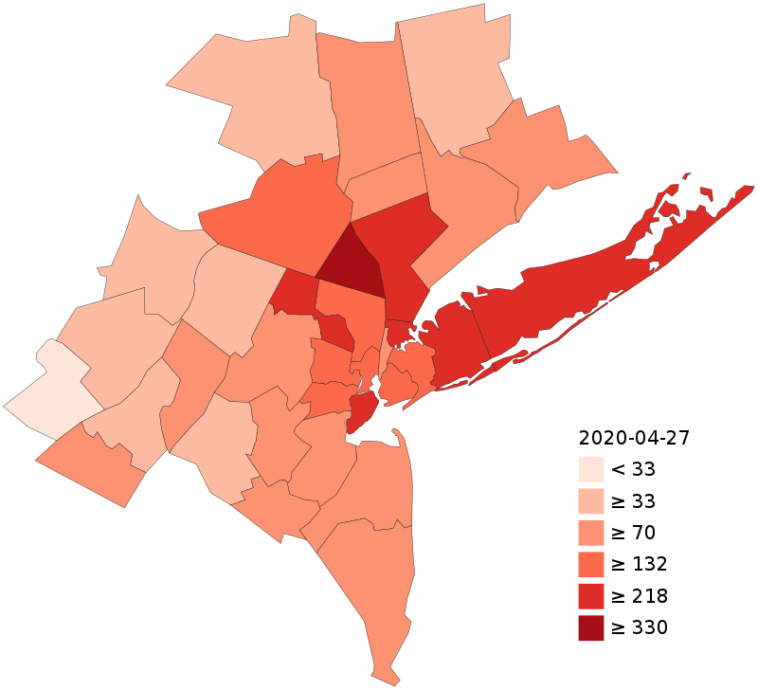
2. Analysis
AS we Seen CORONA PANDEMIC
SEVERE EFFECT IN NEW YORKCITY

Slide 5
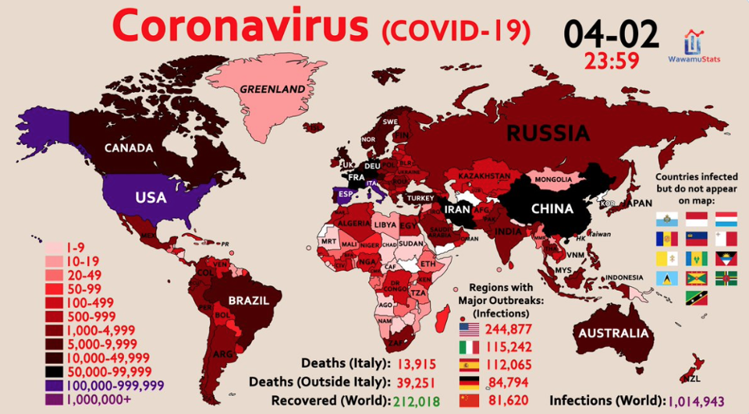
World COVID 19 DATA

Slide 6
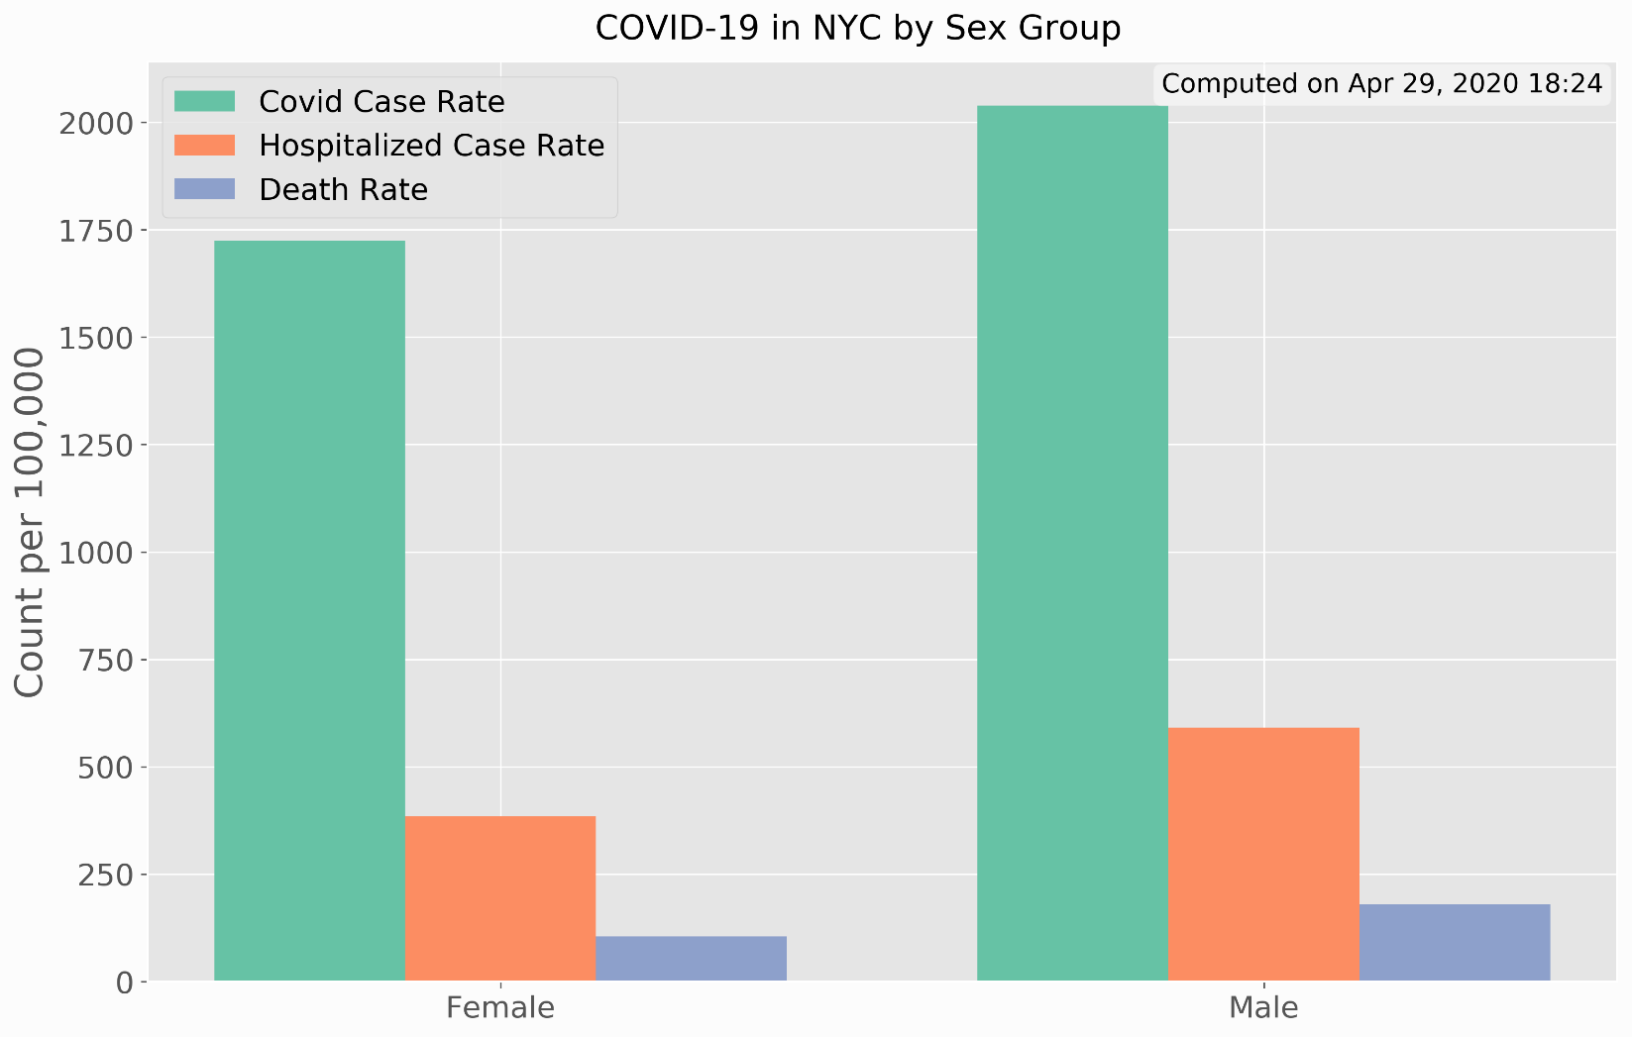
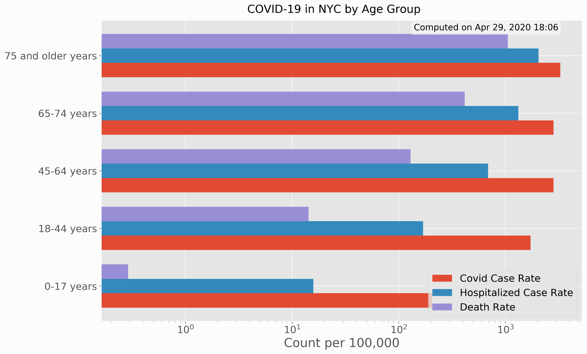
Covid 19 By SEX GROUP & BY AGE GROUP

Slide 7
[ REFERENCES ]
https://en.wikipedia.org/wiki/2020_coronavirus_pandemic_in_New_York_City
www.google.com/data
www.nyc.gov
Foursquare.com

Slide 8


