Slide 1

Exploratory Data Analysis
G2M insight for Cab Investment firm
July 21, 2024

Slide 2

Agenda
Executive Summary
Problem Statement
Approach
EDA
EDA Summary
Recommendations

Slide 3
Background
Due to remarkable growth in the Cab Industry in last few years and multiple key players in the market, our company is planning for an investment in Cab industry and as per our Go-to-Market(G2M) strategy we want to understand the market before taking final decision.
The objective of this presentation is to provide actionable insights to identify the right company for making investment.
Conclusion:
Investment in Yellow Cab is recommended.

Slide 4
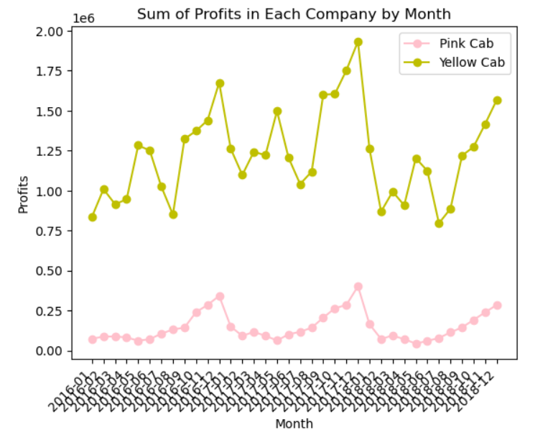
Profits by Time
Comparing the profits of the two companies by month, we can see that Yellow Cab is always making more profits than Pink Cab
Profits of both companies show seasonality with most usage towards the end of the year, while the trend is smoother with Pink Cab.

Slide 5
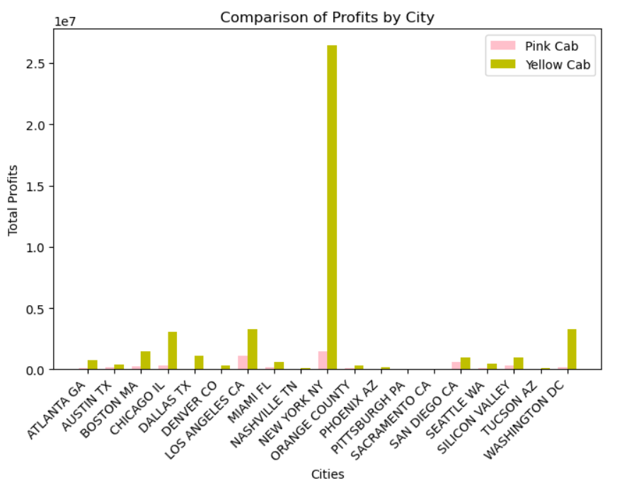
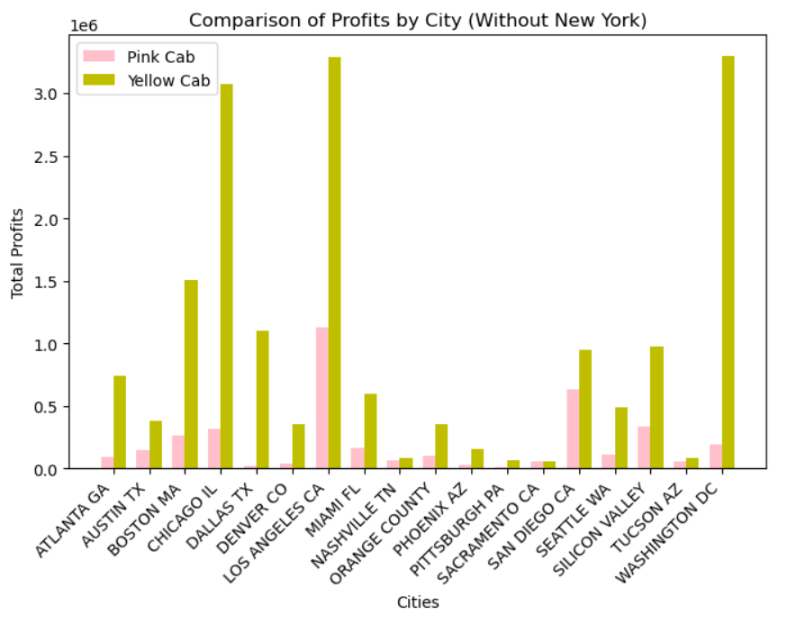
Profits by City
Since New York has too high a profit and making other cities hard to see, we make an additional graph removing it to check the details of other cities.
Yellow Cab makes more profits in almost all cities as obviously shown in both graphs.

Slide 6
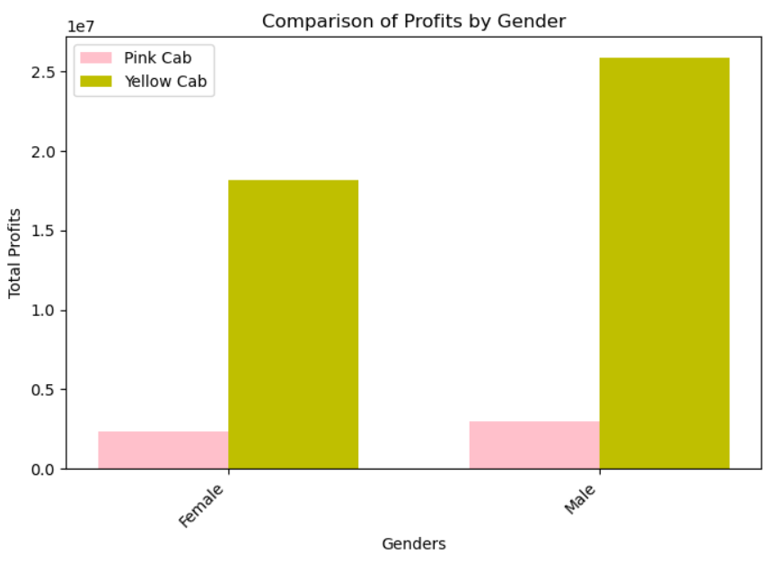
Profits by Gender
In general, the cab companies make less profits from female users.
Yellow Cab makes more profits from both genders

Slide 7
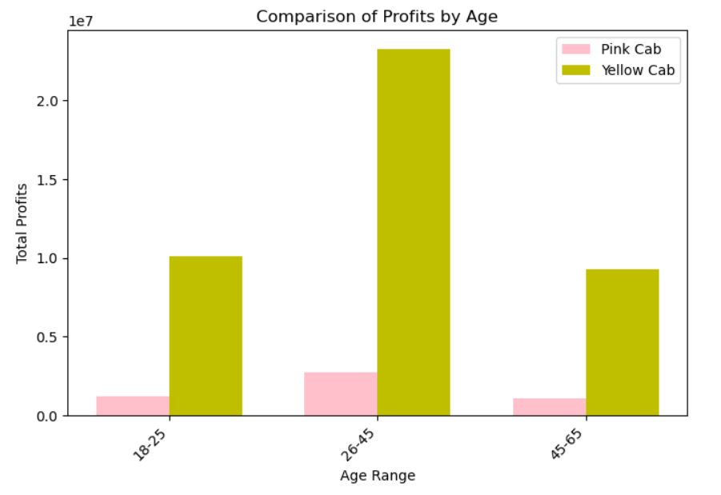
Profits by Age
In general, the cab companies make most profits from middle-aged people.
Yellow Cab makes more profits from all age groups.

Slide 8
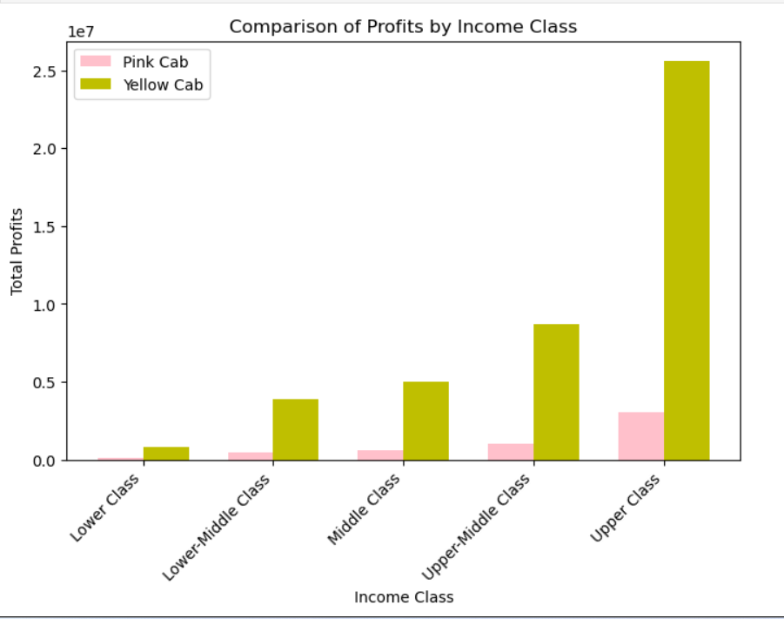
Profits by Income
In general, the cab companies make most profits from higher-income people.
Yellow Cab makes more profits from all income groups.
Income cutouts referencing (yearly income divide by 12 and round to hundreds): https://finance.yahoo.com/news/income-fall-americas-lower-middle-122100515.html?guccounter=1&guce_referrer=aHR0cHM6Ly93d3cuZ29vZ2xlLmNvbS8&guce_referrer_sig=AQAAACpNeVSLCa8ycoLlPcb9HucFFjWCZmofdvs-A_ScxsRdS2MHOUCzCJwgc-1U9MbJkWRHjCOJUHNRxvPfj2vUtAYFkjhIQHc4AU94Y5oJsyMCevf1WLmnwyO2K2KFIjaU29i5ybkKgmqzbkKy6GZaxi2pTLUNLxKybVVBmV1wbseN

Slide 9
Conclusion
In conclusion, Yellow Cab makes more profits not only in general, but also in different cities, and among costumers from different gender, ages groups, and income groups.
The only downside of Yellow Cab compared to Pink Cab is that the profit oscillates more with seasonality
However, the downside is not overweighting the upsides, so we should invest in Yellow Cab.

Slide 10
Thank You

