Slide 1
Analysis of Road Accident in Rural and Urban Area from 2021-2022
Evelyn A. Imaezue

Slide 3
Monthly Sum of Casualties in 2021 & 2022
The highest number of Casualties on road accident occurred in November, 2021 with the sum of 20,975.
In October 2021, there was 20,109 casualties on road accident.
In July, 2021 there was 19,682 casualties on road accident.
However, there were more casualties on road accident in 2021 than 2022.

Slide 4
Monthly Sum of Vehicles Casualty in 2021 & 2022
In November 2021, the highest number of affected vehicles on road accident is 28,491,
In October, 2021 there is a total of 27,057 Vehicles casualty.
In July, 2021 there is a total of 26,263 Vehicles casualty.
However, there are more Vehicles casualty in 2021 than 2022.

Slide 5
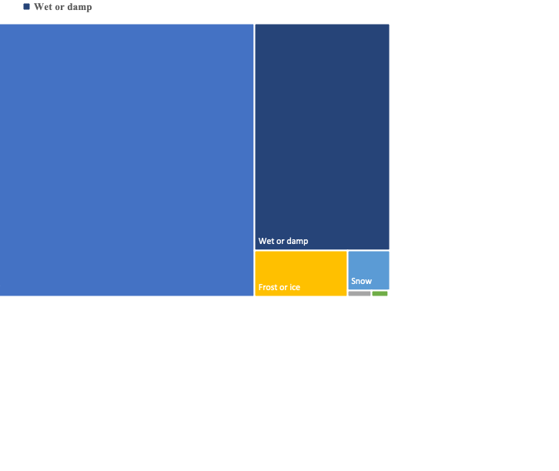
Sum of Casualties by Road Surface
Dry road surface had the most casualties on road accident with 278,468
While wet or damp road surface had 115,714 casualties.
The least road accident occurred during flood with 39 casualties and flood over 3cm. Deep with 564 casualties.

Slide 6
Light Condition by Sum of Vehicles and sum of Casualties
There are higher number of affected vehicles in road accident than the number of casualties.
“Daylight” has the highest number of affected Vehicles with 423,257 and total casualties of 304,962.
While, “darkness lighting unknown” has the least number of casualties in road accident with 3,829 and affected vehicles with 5,085.

Slide 7
Sum of Severity by Location

