Slide 1
Analysis of Road Accident in Rural and Urban Area from 2021-2022
Evelyn A. Imaezue

Slide 2
Monthly Sum of Casualties in 2021 & 2022
Most road casualties occurred in November

Slide 3
Monthly Distribution of Damaged Vehicles following Road Accidents
Most vehicles damaged following road accidents occurred in November as well

Slide 4
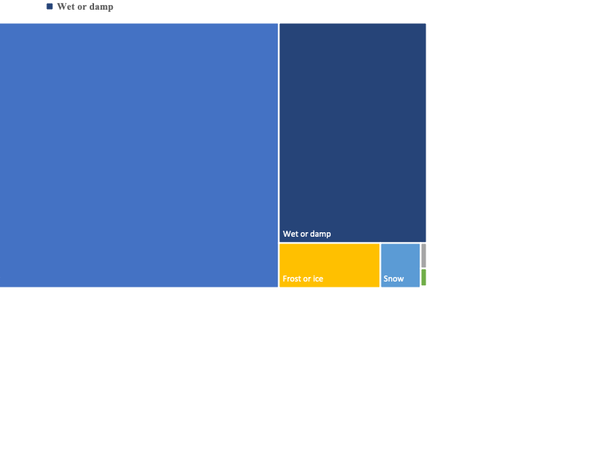
Sum of Casualties by Road Surface
The least road casualties occurred on flooded road surface.

Slide 5
Sum of Vehicles affected and sum of Casualties by Light Condition
There are higher number of affected vehicles than casualties.
“Daylight” has the highest number of affected Vehicles and total casualties.
Darkness lighting unknown has the least f casualties and affected vehicles

Slide 6
Sum of Severity by Location
From the data, urban areas have more casualties than rural areas and slight accident occurred most in both locations.

Slide 7
Percentage of Casualty by Road Type
Single carriage-way has the highest % of casualty accident than dual carriage ways which have the least.
Dual carriage-way has the least casualties by road type.

Slide 8
Percentage of Casualty by Road Severity
Most casualties occurred in slight accident.
Least casualties occurred in fatal accident

