Slide 1
Case Study 2
Amy Adyanthaya
2022-12-11
Notes:
Hello, I am Amy Adyanthaya and I will be discussing my findings for Case study 2, which will be looking at the factors that impact employee attrition.

Slide 2
General Demographics
Number of Employees: 870
Number of Departments: 9
Median Employee Age: 35 years
Median Years Employed: 10
Overall Attrition Rate: 16%
Notes:
Some general demographics about the employees:
Currently there are 870 employees at the company
There are nine departments reporting attrition data
The median age of the employees is 35 years
The median number of years employed is 10
And the overall attrition rate is 16%.

Slide 3
Top Three Attrition Factors
Measured the Impact on Employee Attrition
Total Working Years
Monthly Income
Job Involvement
Notes:
The top three factors identified to impact employee attrition at the company are
The total number of employee working years
The employee monthly income
And The employee job involvement
Want r shiny to show combos of top three factors

Slide 4
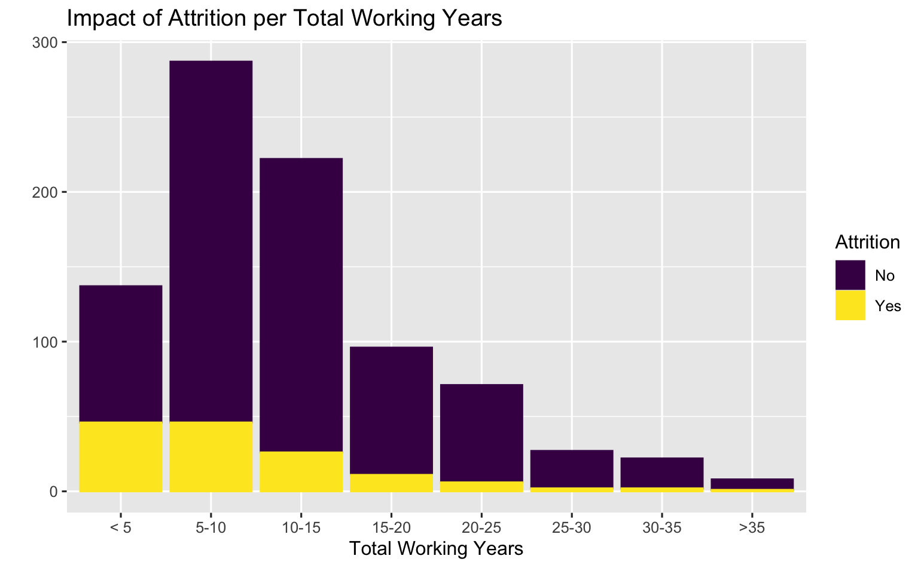
Total Working Years
Has an overwhelming impact on Attrition
P-value < 4.038x10⁻⁹
Timing of Attrition
33.6% occur within the first five years of employment
49.6% occur within the first 10 years of employment
Notes:
The total number of working years had an overwhelming impact on employee attrition, with a significant p-value for a Kruskal-Wallis chi-squared test.
33.6 percent of employee attrition occurred within the first five years of employment and by ten years the attrition rate occurred for nearly half of the employees.
After the 10 years of working the rate of attrition decreases, reflecting a non-normal distribution, skewing to the right.

Slide 5
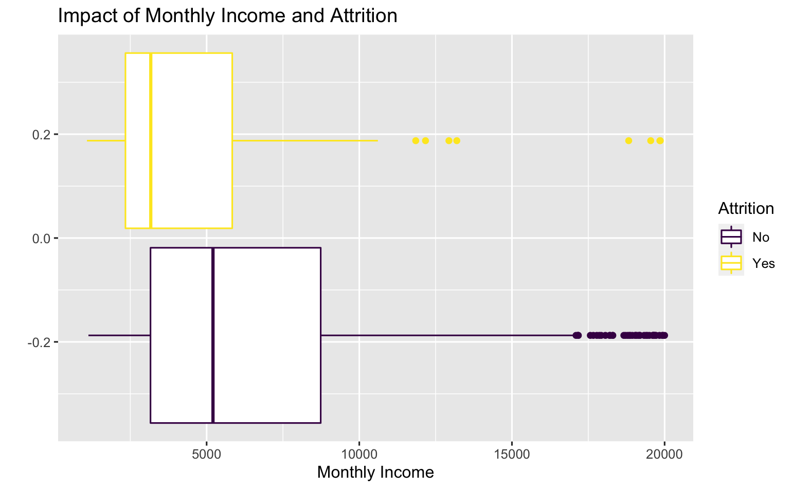
Monthly Income
Has an overwhelming impact on Attrition
P-value < 4.69x10⁻⁹
Median monthly income
Attrition = $3171
Non-Attrition = $5209
The median monthly income does not reflect being normally distributed
Variation in the standard deviations
Notes:
The employee monthly income had an overwhelming impact on employee attrition, with a significant p-value for a Kruskal-Wallis chi-squared test.
The reported median monthly income is 24% lower for employees with attrition as compared to non-attrition
The median Monthly income does not reflect a normal distribution, as variation in the standard deviations occurs

Slide 6
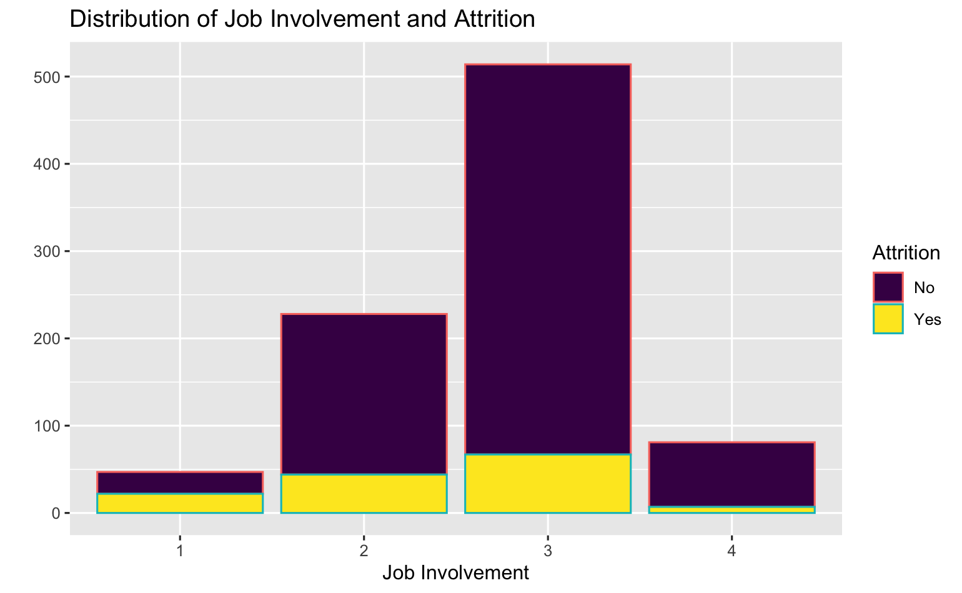
Job Involvement
Has an overwhelming impact on Attrition
P-value < 5.211x10⁻⁹
Grading of Job Involvement provided in data without explanation
Grade 1 attrition rate is 46.8%
Grade 2 attrition rate is 19.3%
Grade 3 attrition rate is 13%
Grade 4 attrition rate is 8.6%
Notes:
Job Involvement also had an overwhelming impact on the employee attrition rate, with a significant p-value for the Pearson's Chi-squared test
The data did not explain the grading level of the job involvement however, it may be assumed, that as the grade level increases, so does the employee job involvement.
Employees with a grade level 1 represent nearly half of the employee attrition, however grade level 1 reflects the least number of employees in the company
Job Involvement reflects a non-normal distribution, with skewing to the left

Slide 7
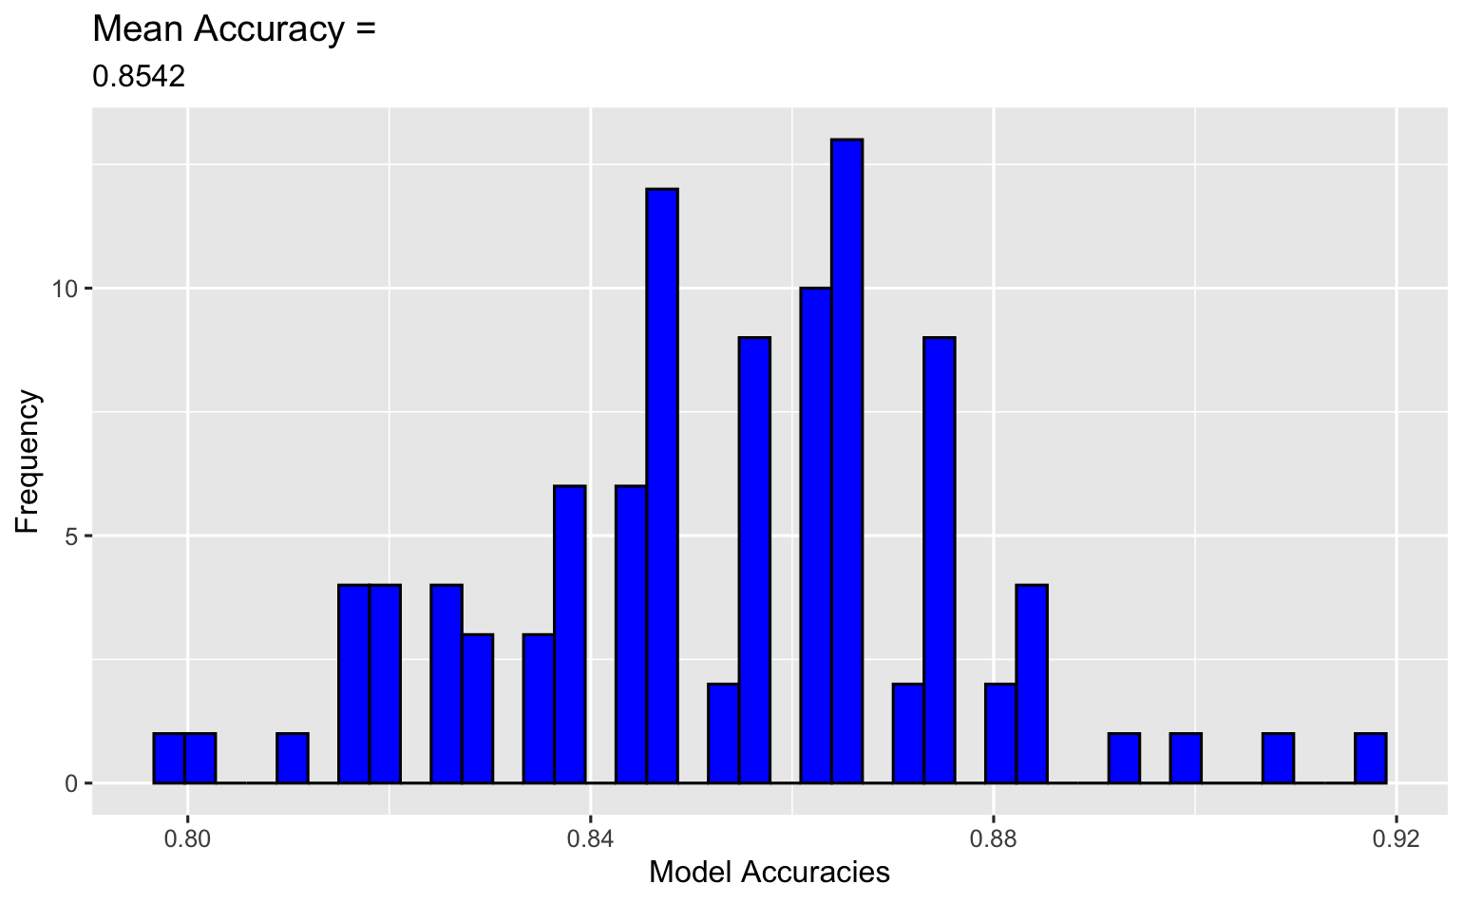
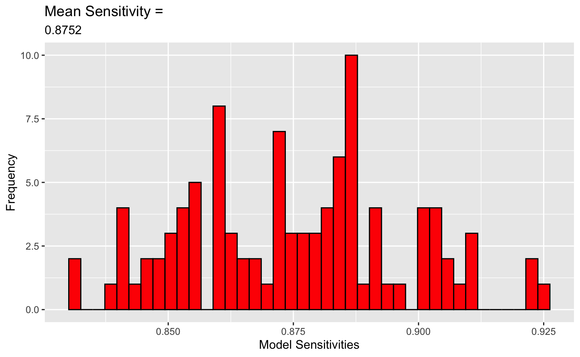
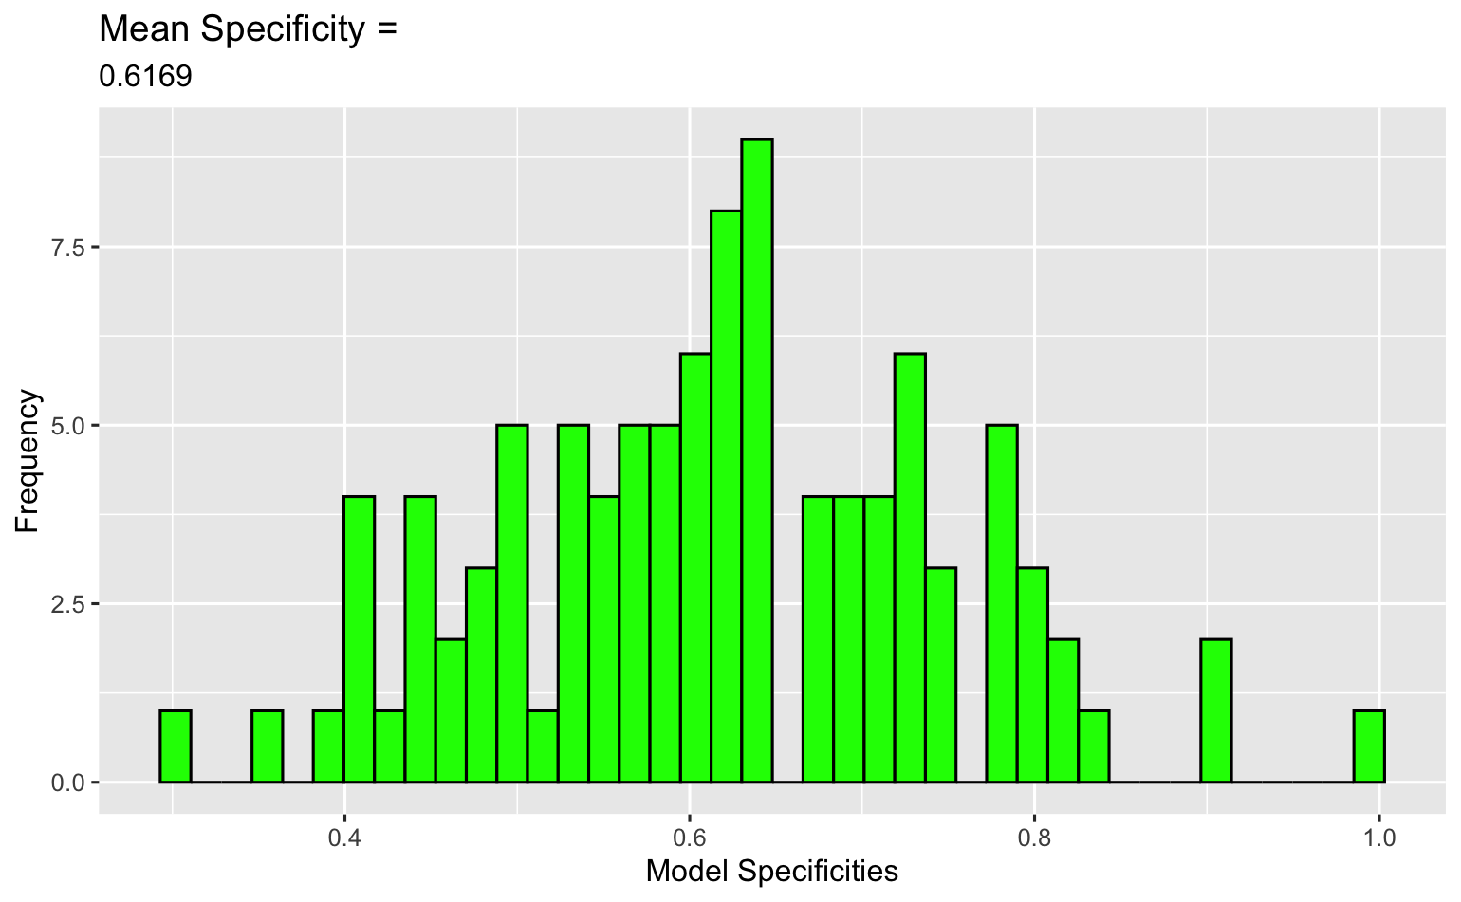
Naïve Bayes Prediction Model of Attrition
Variables used in final model to predict Attrition
Total Working Years | Monthly Income | Job Involvement
Performance Rating | Age | Overtime
Relationship Satisfaction | Years Since Last Promotion | Business Travel
Model Iterations = 100
Train/Test Sets = 75%/25%
Notes:
Naive Bayes was used in modeling to predict employee attrition.
Nine variables were identified to have an impact on the prediction of attrition, including “Total Working Years”, “Monthly Income” and “ Job Involvement”.
The modeling was performed 100 times with a training set of 75% defined.
The mean accuracy of the model was calculated to be 85.4%. This reflects the number of correctly classified observations.
The mean sensitivity of the model was calculated to be 87,5%. This reflects the number of correctly identified attritions that are truly employee attritions.
The mean specificity of the model was calculated to be 61.7%. This reflects the number of correctly identified non-attritions that are truly employee non-attritions.

Slide 8
Trends in Job Roles
Employee Factors
Attrition
Age
Total Working Years
Education
Notes:
Some of the employee factors were examined to determine if there was a trend on job roles. These were Attrition, Age, Total Working Yeas and Education.

Slide 9
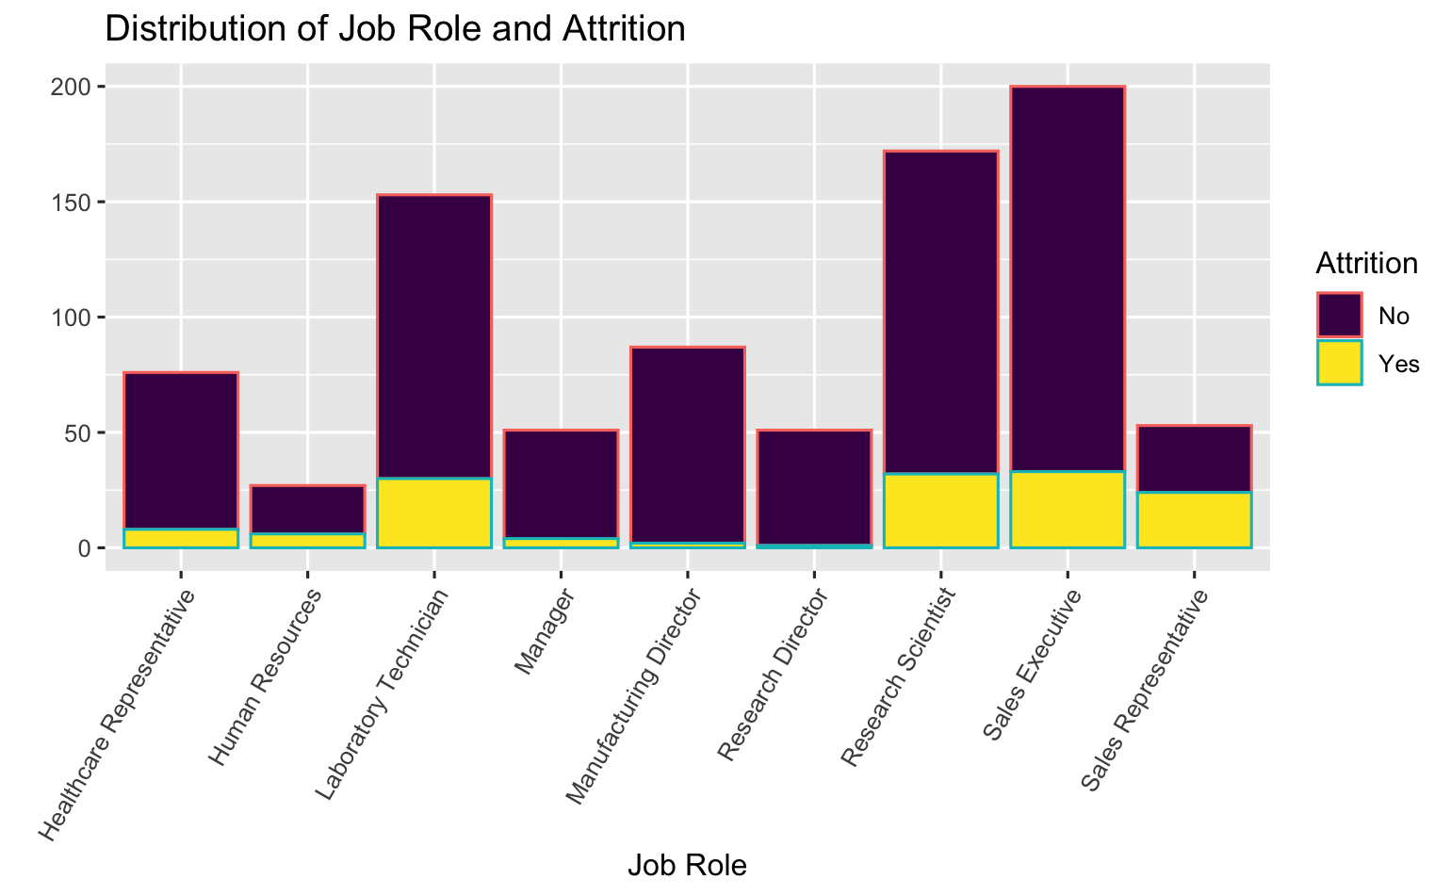
Job Role & Attrition
Overwhelming impact on Attrition
P-value < 3.647x10⁻⁹
Top job roles with Attrition
Sales Representative: 45.3%
Human Resources: 22.2%
Laboratory Technician: 19.6%
Notes:
It was identified that the employee job role had an overwhelming impact on the employee attrition rate, with a significant p-value for the Pearson's Chi-squared test
It should be noted that although the Job role had an individual impact on employee attrition, it was determined that the job role was not affective for the overall attrition model.
The job roles with high attrition rates were sales representatives, human resources and then lab technicians.

Slide 10
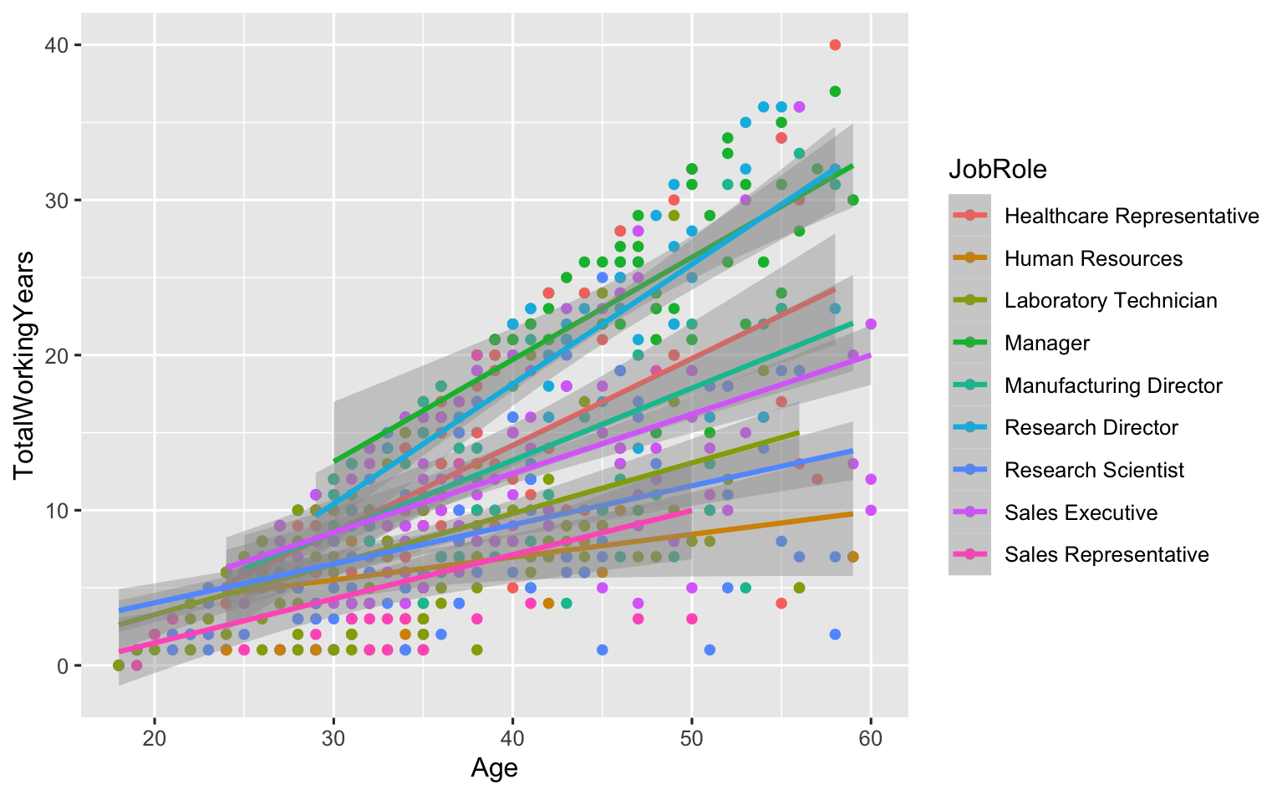
Job Role, Age & Total Working Years
Direct relationship between Age and Total Working Years on Job Role
Leadership Job Roles tend to have
Employees older in Age
Employees with higher Total Working Years
Individually there is overwhelming evidence that each variable is associated with Job Role
Age p-value = 2.2x10⁻¹⁶
Total Working Years p-value = 2.2x10⁻¹⁶
Notes:
Looking at Age and Total Working years combined, there appears to be a direct relationship on Job Role.
Leadership roles, such as Sales Executives & Research Directors, tend to have older employees with higher total working years. Lower-level job roles, such as HR or Sales representatives tend to have younger employees with fewer working years.
Individually, Age and Total Working Years, showed overwhelming evidence that they were associated with Job Roles.

Slide 11
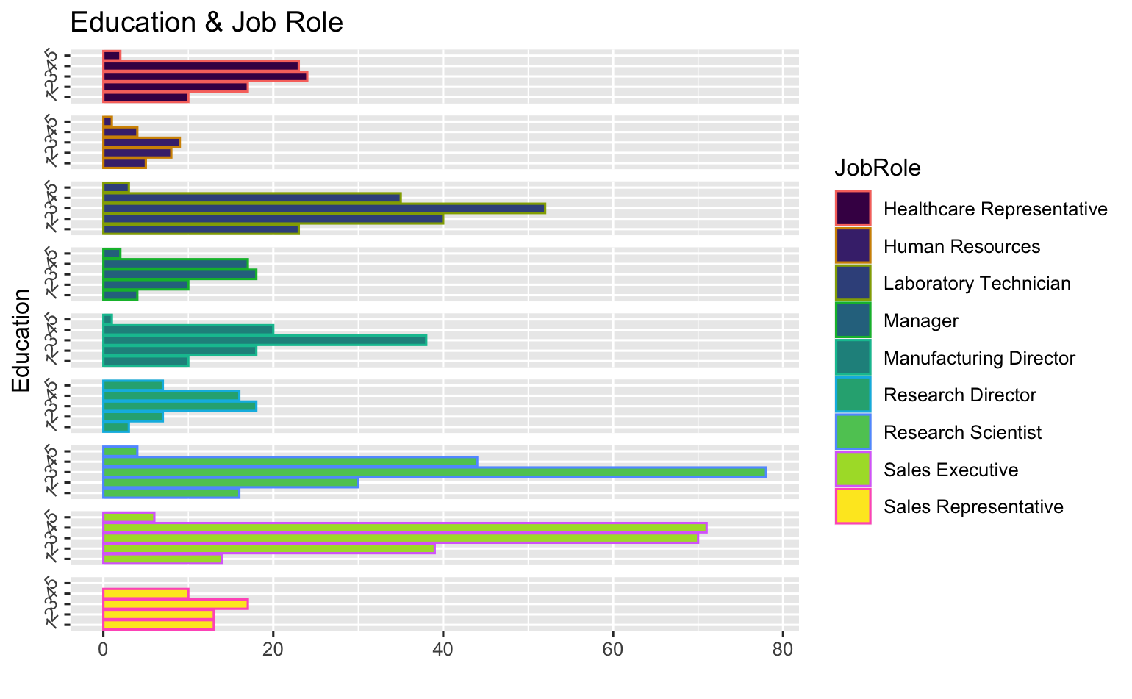
Job Role & Education
Strong evidence Education has an impact on Job Role
P-value = 0.000804
Education levels provided without explanation
Assumed grades 1- 5 implies lowest Education level to highest
Job Roles with higher Education levels
Sales Executive
Research Scientist
Laboratory Technician
Notes:
The impact of Education on Job Roles was the last relationship examined. There was strong evidence that Education had an impact on the Job Role, with a significant p-value for the Pearson's Chi-squared test
Details on the grading of the Education levels were not explained in the data however it be assumed that the grades 1 through 5 implies lowest to highest education levels.
The job roles with the higher education levels were Sales Executives, Research Scientists and Lab Technicians.

Slide 12
Conclusion
Attrition
The top three factors identified were each found to be significantly associated with employee attrition
Total Working Years
Monthly Income
Job Involvement
The Naïve Bayes model was able to predict an attrition model with 85% accuracy, 88% sensitivity and 62% specificity
Job Role
A combination of Age and Total Working Years were associated with the employee job roles
Individually, both were significantly associated with employee job roles
Employee Attrition and Education were each found to be significantly associated with employee job roles
Notes:
In conclusion,
The top three factors identified were found to be significantly associated with employee attrition.
Using nine employee variables in the data, the Naïve Bayes model was able to predict employee attrition with 85% accuracy, 88% sensitivity and 62% specificity.
The variables age, total working years, attrition and education were each found to be significantly associated with employee job roles.

Slide 13
Any Questions?
Thank you
Amy Adyanthaya: aadyanthaya@mail.smu.edu
Notes:
That concludes the presentation.
Thank you for your time. Please let me know if you have any questions.

