Slide 1

Top mba colleges in india
a comparative analitycal study…
By Ameesha Mittal

Slide 2
Objectives
Collecting data and rankingfor top MBA courses in India
Evaluating the accuracy of given rankings.
Creating predictive models to suggest quality of course and value for money
Creating clusters of colleges.

Slide 3
Top 20 MBA collges in India:
Indian Institute of Management, IIM A
Indian Institute of Management, Calcutta
Xavier Labour Relations Institute
Faculty of Management Studies (FMS)
S.P. Jain Institute of Management and Research
Management Development Institute, Gurgaon
Indian Institute of Management, Kozhikode
Indian Institute of Management, Indore
International Management Institute, Delhi
Indian Institute of Foreign Trade
NMIMS, mumabi
National Institute of Industrial Engineering
Xavier Institute of Management, Bhubaneswar
Symbiosis Institute of Business Management
Department of Management Studies, IITD
Jamnalal Bajaj Institute of Management Studies
Vinod Gupta School of Management (IIT Kharagpur)
T. A. Pai Management Institute
Shailesh J. Mehta School of Management
Birla Institute of Management Technology

Slide 4
Accuracy of given rankings.
Accuracy of given rankings has been evealuated using multiple regression
Parameters used for evaluating:
Ranking: our dependent variable
Cat cutoff: since most of these colleges take admissions through CAT, CAT Cutoff seems o be a relevant parameters to judge the college’s reputation in the society
Avg Salary: An important parameter since final aim of the student taking admission is to earn a decent package at the end to the course
Fees: Inverse relation to the ranking. Low fees (with good facilities) makes a room for more people belonging to financially weaker section of the society
No. of permanent faculty: More the faculty, more the guidance and diversity.
No. of MDPs: Good colleges shall provide more number of courses
Sex ratio: Since the admission procedure for all colleges is same sex ratio will help us determine which colleges are preferred for girls i.e. which college maintains the best co-ed atmosphere
No. of international faculty and no. of guest speakers: These parameters project the reputation of the colleges amongst other scholars of the world.
No. of student exchange programs: Shows the amount of exposure given to students
No. of companies: More companies shall visit the college that produces better qualified students
Placement percentage: Students take admission with a purpose of getting placed in a good company at the end of the course. Thus this parameters shows how much that purpose is fulfilled.
Note: number of students is not used because more number of students allowed in a batch does not imply better teaching facilities. Good college wont be the one who takes more admissions. It will be the one who train those it takes well.

Slide 5
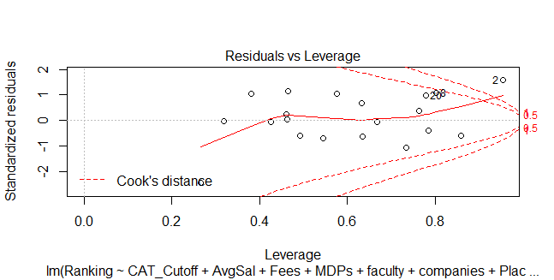
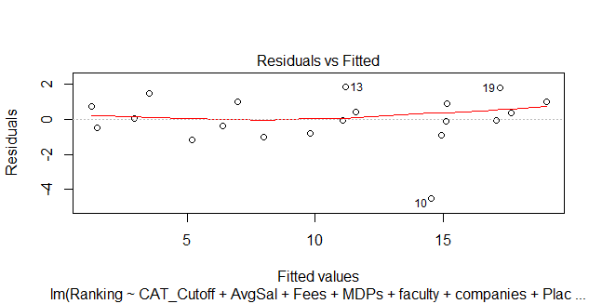
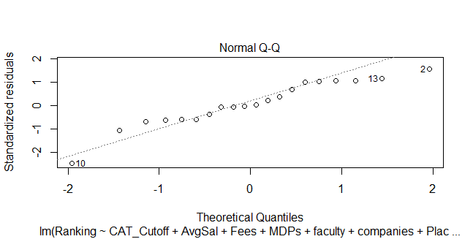
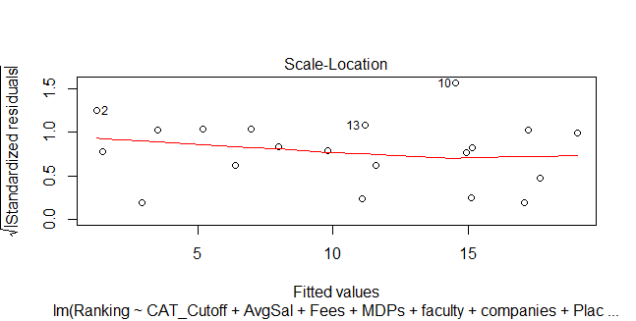
Graphs obtained by regression analysis
A p-value of 0.0007528 was obtained suggesting that the given rankings is fairly accurate

Slide 6
Quality Evaluation and Value for money
Quality has been evaluated by categorizing the parameters under following headings and adding them up:
Placements and salary
Personality Development
International Exposure
Academics
N additonal parameter added to the evaluated quality provides with value for money
Thus,
VFM=Fees/Quality

Slide 7
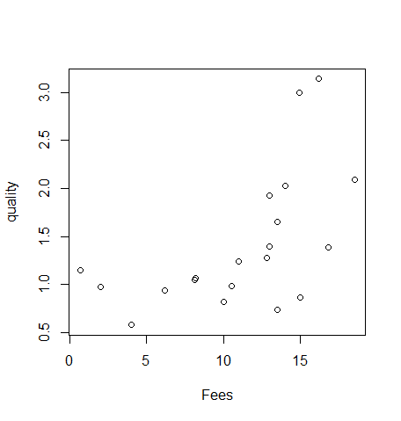
Observations:
It has been observer that Indian Institute of management, Calcutta (ranked 2) provide best quality of education while Indian Institute of management (ranked 1) stands third in terms of quality that has been evaluated here. Whole result can be seen in the files attached
We observe that Faculty of management, Delhi provides best value for money in spite of being 11th in terms of quality due to its low fees.

Slide 8
Cluster Analysis
Much of the history of cluster analysis is concerned with developing algorithms that were not too computer intensive, since early computers were not nearly as powerful as they are today. Accordingly, computational shortcuts have traditionally been used in many cluster analysis algorithms. These algorithms have proven to be very useful, and can be found in most computer software.
Here two clustering techniques are applied:
Hierarchical clustering: For the hierarchial clustering methods, the dendogram is the main graphical tool for getting insight into a cluster solution.
PAM: Partitioning Around Medoids : Unlike the hierarchical clustering methods, techniques like k-means cluster analysis (available through the kmeans function) or partitioning around mediods (avaiable through the pam function in the clusterlibrary) require that we specify the number of clusters that will be formed in advance. pam offers some additional diagnostic information about a clustering solution, and provides a nice example of an alternative technique to hierarchical clustering.

Slide 9
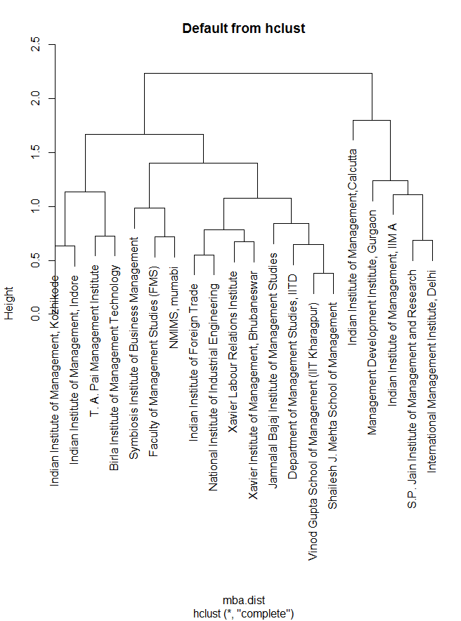
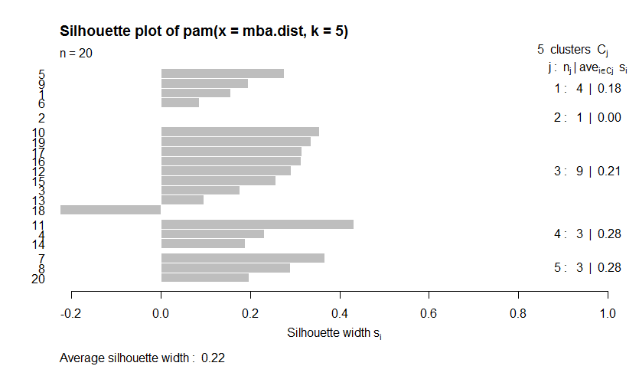
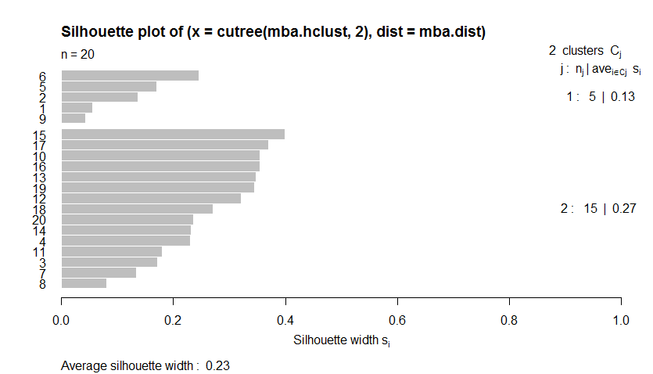
Graphs Obtained
Hierarchical clustering
PAM

Slide 10
CONCLUSIONS
MBA is one of the most prestigious courses in India. Various management colleges have been setup in the country to provide this course. Thus it is important for the candidates to know which one is better than others. According to the statistical study presented, various conclusions can be drawn.
Ranking of colleges is highly dependent on various parameters like number of faculty, number of courses offered, average salary offered during placements and many more. As per the results of regression analysis the given rankings of colleges is quite accurate with IIM Ahmadabad as the best MBA college in the state followed by IIM Calcutta and Xaviers Labour Institute.
Approach of normalization, categorization and weighted mean for predictive modelling suggests that the ranking of courses is closely related to quality calculated with few differences. Indian Institute of management, Calcutta (ranked 2) provide best quality of education while Indian Institute of management (ranked 1) stands third in terms of quality that has been evaluated here.
Value for money calculation represents the almost direct relationship between fees and quality of program with few exceptions. Faculty of management, Delhi takes extremely low fees which take it up the ladder to the top of “value for money” queue in spite of it being 11th in terms of quality due to its low fees.
For clustering, two techniques were adopted both suggesting that the colleges can be clustered mainly in two groups first one comprising of IIM A, S.P. Jain Institute of Management and Research, Management Development Institute, Gurgaon and International Management Institute, Delhi and IIM Calcutta and the second containing all others. This clusters can further be divided with nest suitable clustering coming up at 5 clusters. As we increase the the number of clusters our graphs become more and more structurally diversified.
There is no certified solution to the problem statement. The more we play with our variables and draw careful conclusions the more we tend towards better analytical models.

Slide 11


