Slide 1
WomenTechWomenYes Annual Gala
Let’s gather signatures!

Slide 2
Goal
High volume: busiest stations for a given day/time
High density of people with potential interests: areas with higher income or more tech companies/universities

Slide 3
Hottest when and where

Slide 4
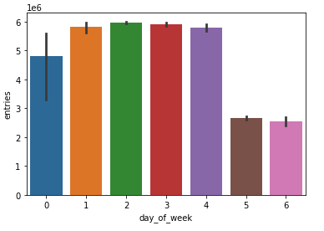
MTA traffic every day
Weekdays > weekends
Rain plot (weekly commute for 8 weeks:
May-June 2018, 2019)

Slide 5
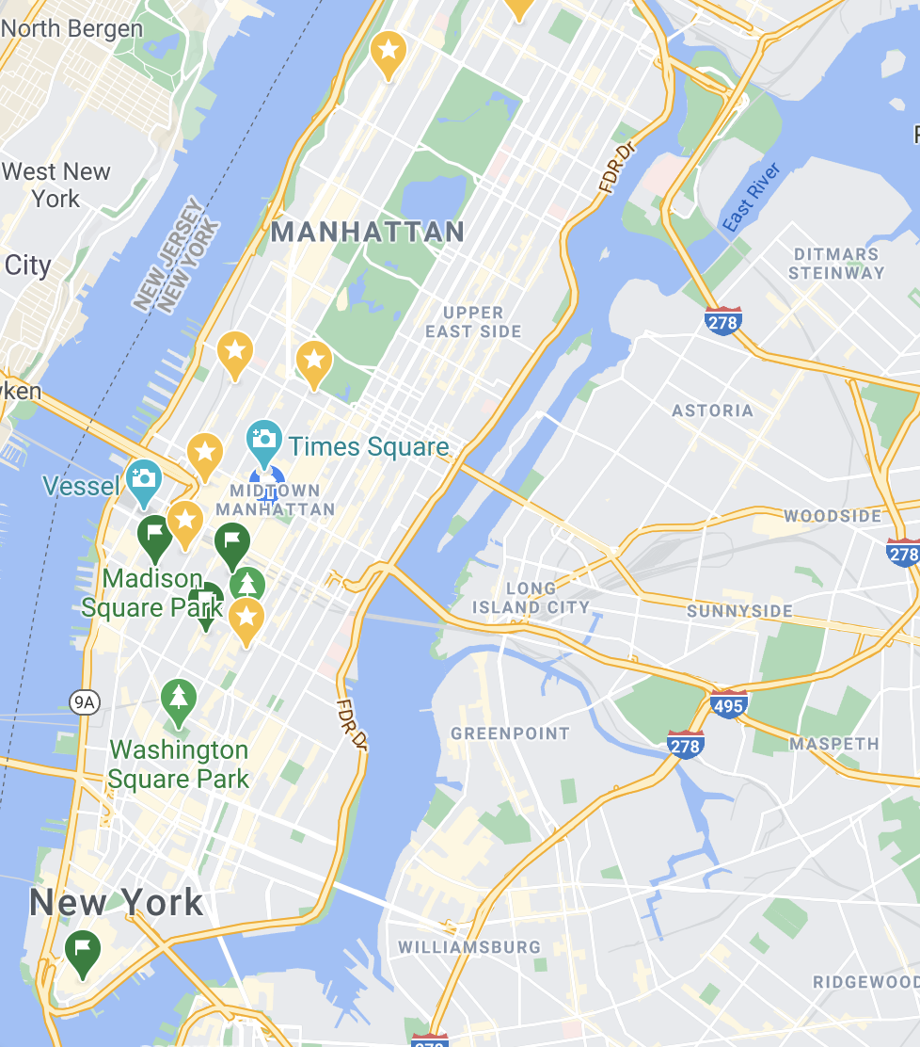
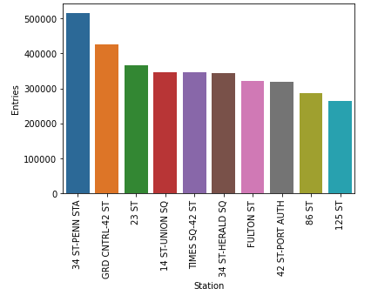
Top 10 busiest stations
(x=STATION, y=daily traffic)
Map of NYC + 10 busy stations

Slide 6
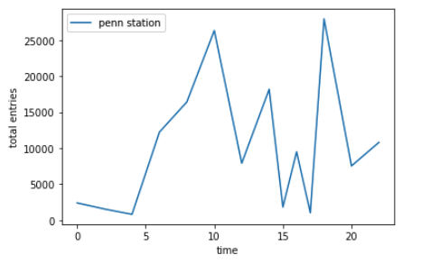
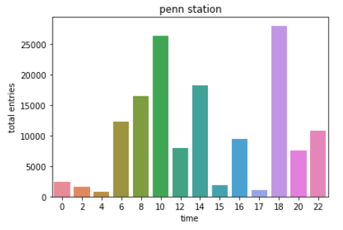
Busiest hours
Line plot of (x=hour, y=hourly (or block of hours) traffic) for top 10 stations:
Specify the peak hours

Slide 7
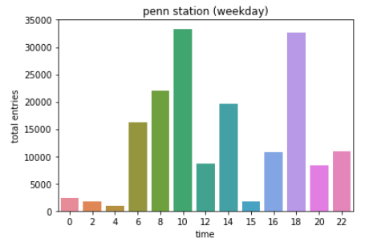
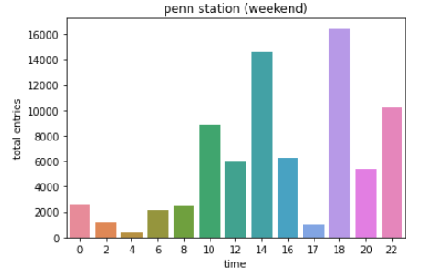
Weekdays vs weekends
Compare plots (or combined into plot) of weekday/weekend peak hours

Slide 8
Passionate crowd

Slide 9
Who loves galas!
Cost of living in NYC
Bar chart of (zip code, count of income>75k)
Map of NYC + highest income areas

Slide 10
Who loves tech?
Map of NYC + tech companies/universities

Slide 11
Our Target
Map of NYC + 10 busy stations
Overlap with high income (transparent shadow)
Overlap with tech locations

Slide 12
Street Team Execution
Weekdays – time – locations
Weekends – time – locations

