Slide 1
WomenTechWomenYes Annual Gala
Let’s gather signatures!

Slide 2
Goal
High volume: busiest stations for a given day/time
High density of people with potential interests: areas with higher income or more tech companies/universities
Scenario: 20 people from street team

Slide 3
Data sources
2018-2019 May/June mta turnstile data (mta.info)
mta station info
IRS by zip code
locations of 5 large tech companies and universities

Slide 4
Busiest places

Slide 5
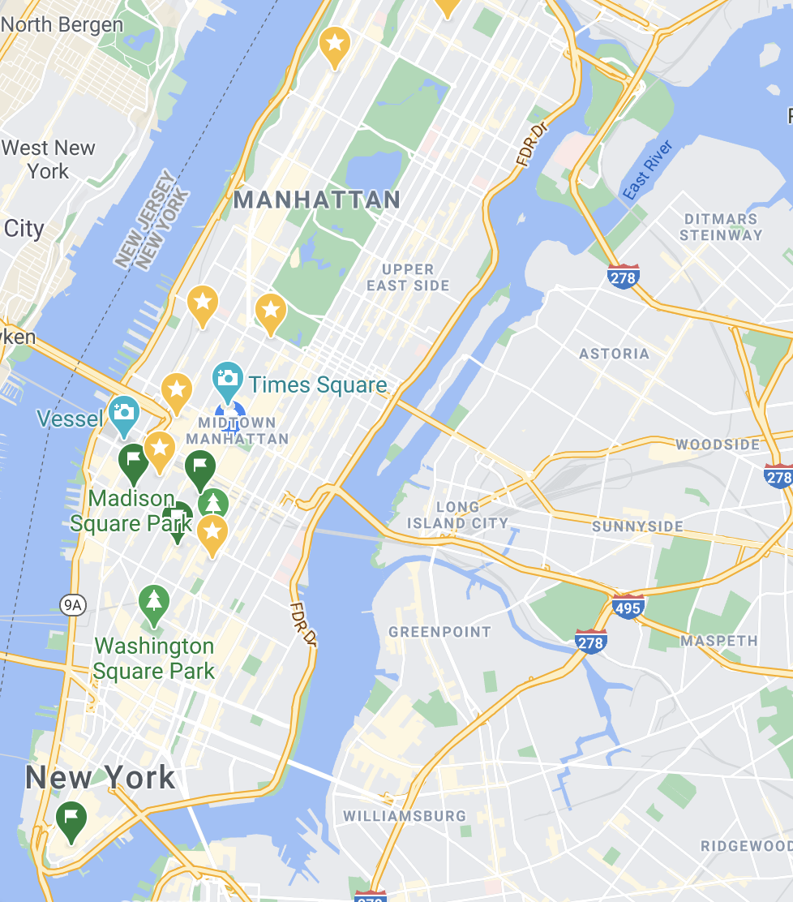
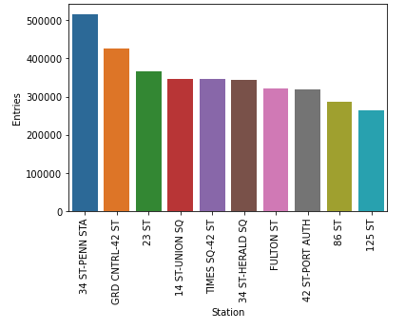
Top 10 busiest stations
(x=STATION, y=daily traffic)
Map of NYC + 10 busy stations
Traffic = entries + exits

Slide 6
Passionate crowd

Slide 7
Who loves galas!
Cost of living in NYC
Bar chart of (zip code, count of income>75k)
Map of NYC + highest income areas

Slide 8
Who loves tech?
Map of NYC + tech companies/universities

Slide 9












Who loves tech?

Slide 10
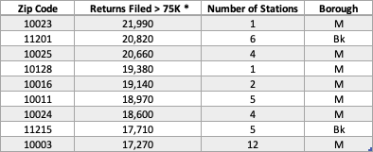
Who loves galas!
Considered income brackets of residents near MTA station stops
Extra income for a night out and to make a voluntary monetary contribution
*Data Source: https://www.irs.gov/statistics/soi-tax-stats-individual-income-tax-statistics-2018-zip-code-data-soi

Slide 11
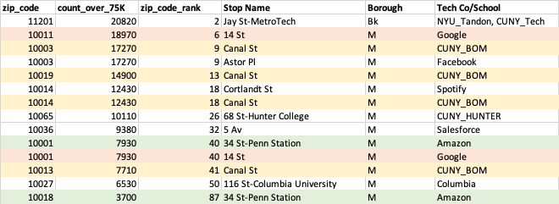
rough table of the biz/edu and income perspectives combined - AB
Note – stations listed more than once have multiple entry/exit points that those addresses are in different zip codes

Slide 12
Our Target
Map of NYC + 10 busy stations
Overlap with high income (transparent shadow)
Overlap with tech locations

Slide 13
Street Team Execution
Weekdays – time – locations
Weekends – time – locations

Slide 14
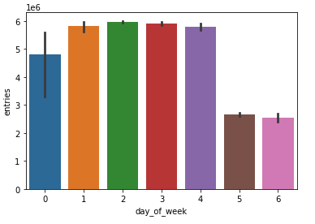
MTA traffic every day
Weekdays > weekends
Rain plot (weekly commute for 8 weeks:
May-June 2018, 2019)

Slide 15
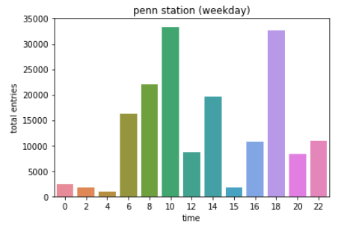
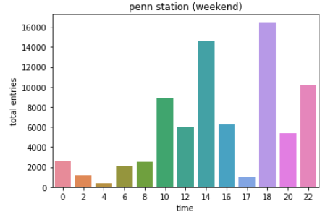
Weekdays vs weekends
Compare plots (or combined into plot) of weekday/weekend peak hours

Slide 16
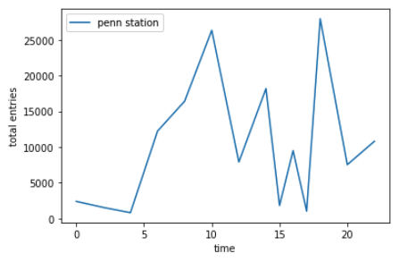
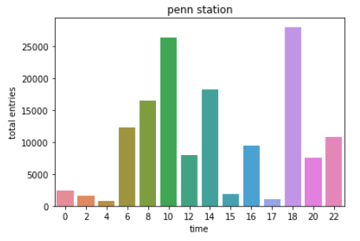
Busiest hours
Line plot of (x=hour, y=hourly (or block of hours) traffic) for top 10 stations:
Specify the peak hours

