Slide 1
Zoo animal classification
Comparing classification methods

Slide 2
Zoo Animals Classification
Data from 101 Animals
7 Class Types – Mammal, bird, reptile, fish, amphibian, bug, and invertebrate
16 Columns consisting of characteristics such as hair, feathers, toothed, ect.

Slide 3

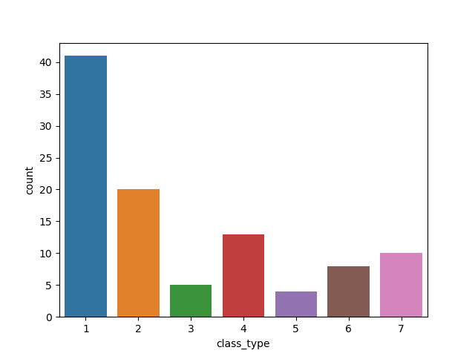
Sum of Animals Per Class Type
The groups are not balanced
which may have an effect.
1- Mammals
2 – Bird
3 - Reptile
4 – fish
5 - Amphibian
6 - Bug
7- Invertebrate

Slide 4
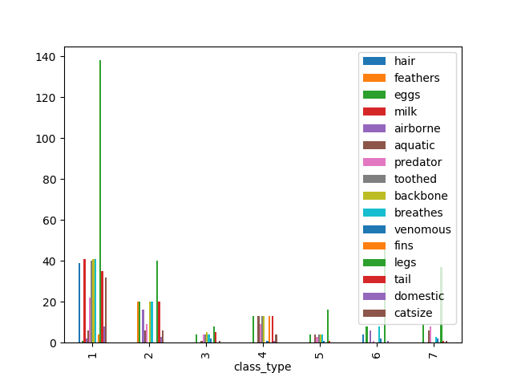
Sum of Characteristics per class type
1- Mammals
2 - Bird
3 - Reptile
4 - Fish
5 - Amphibian
6 - Bug
7- Invertebrate

Slide 5
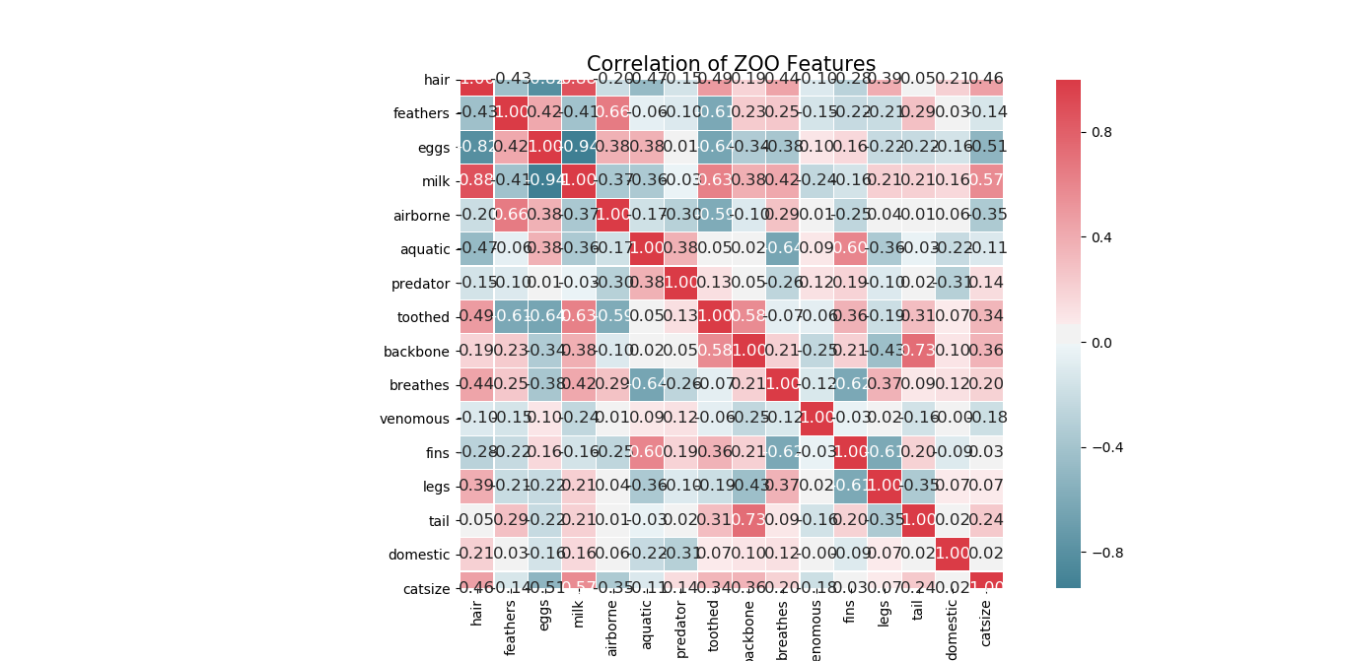
Correlation of characteristics

Slide 6
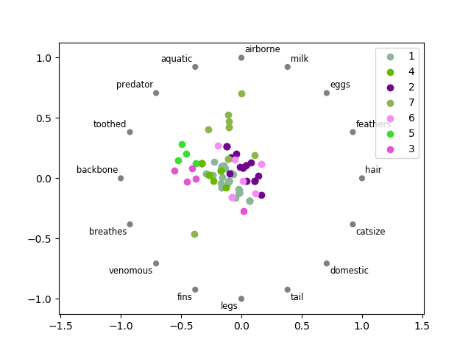
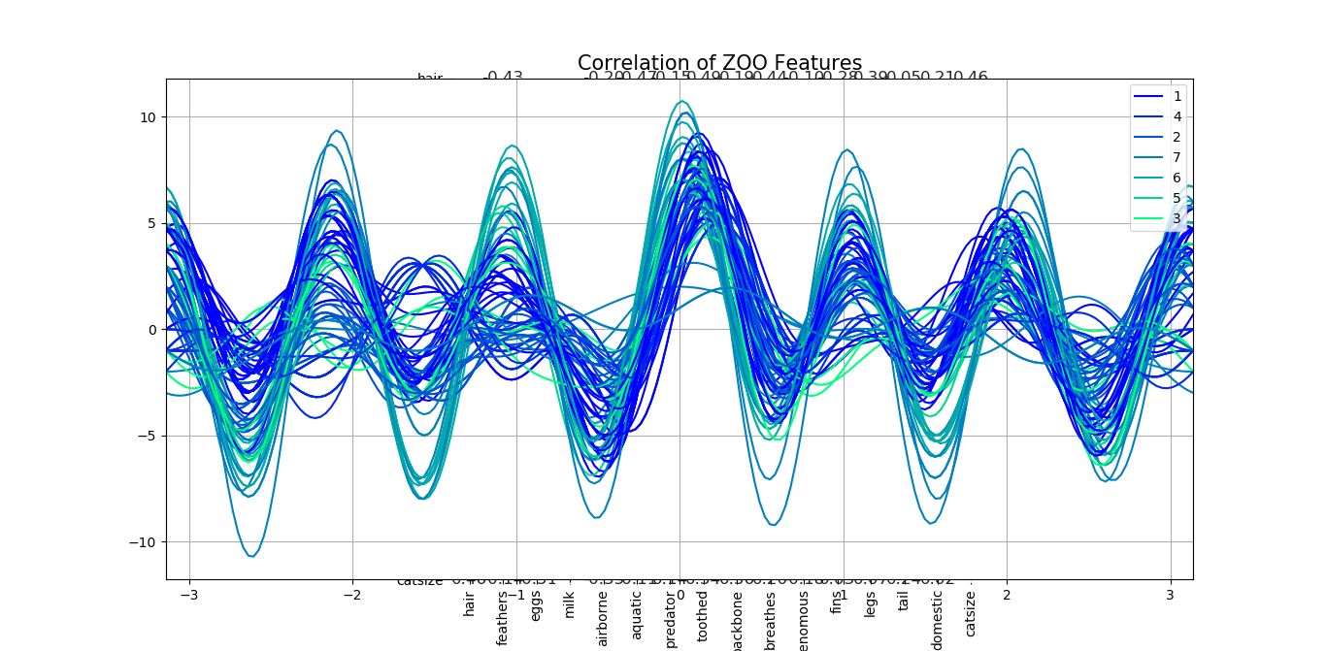
Visualizing multivariate data
Radviz
Andrew curves

Slide 7
Testing classifiers
Want to classify the class type of the animal based on the other 16 columns
Split the data – 70% train, 30% test
Tested 4 different classifiers
Gaussian Naïve Bayes
K Nearest Neighbors
Support Vector Machine
Logistic Regression

Slide 8
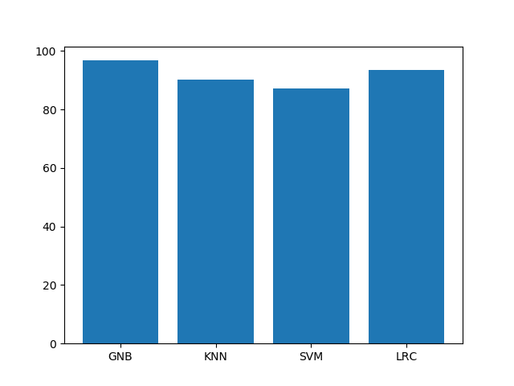
How they did
Gaussian Naïve Bayes
Accuracy of 96.77%
K Nearest Neighbors
Accuracy of 90.32%
Support Vector Machine
Accuracy of 87.10%
Logistic Regression
Accuracy of 93.55%

Slide 9
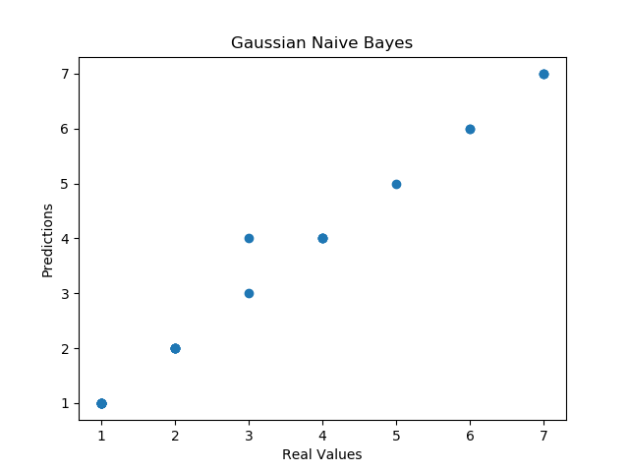
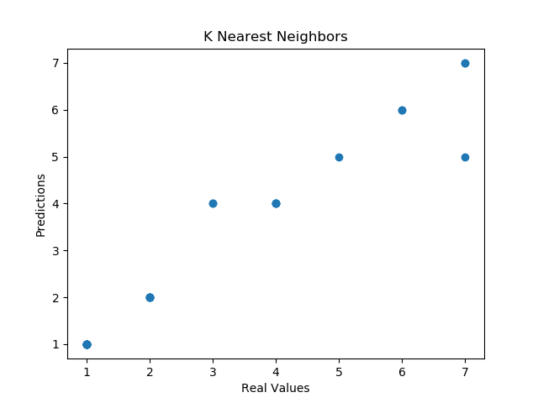
Graphing the scores

Slide 10
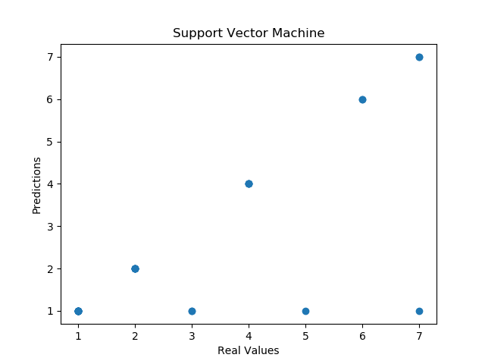
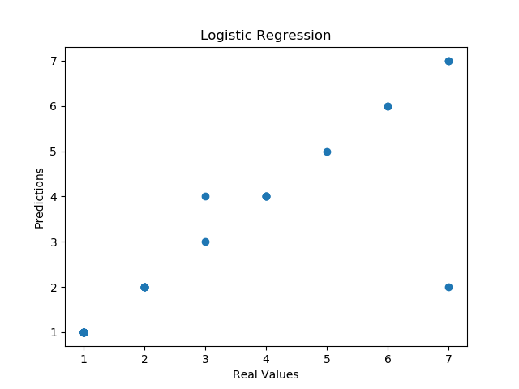
Graphing the scores

Slide 11
Summary
Gaussian Naïve Bayes had the highest accuracy score at 96.77%
¾ of the classifiers had an accuracy score above 90%
Support Vector Machine scored the worst at 87.10%

