Slide 1
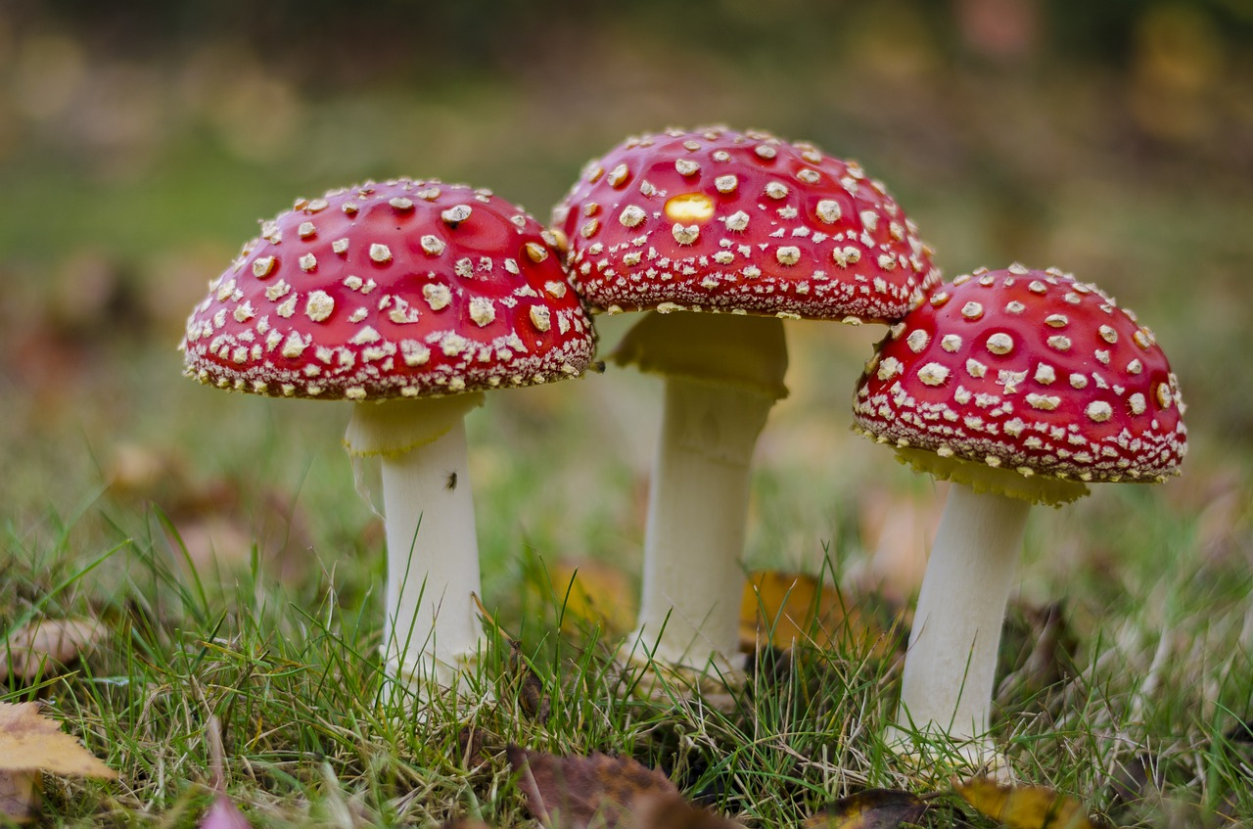

Mushroom Classification
CS 7265 Big Data Analysis
Jiaxin Chen
Notes:
The goal we need to do is classify between edible (e) to poisonous (p) mushrooms.

Slide 2
Motivation
Introduction of dataset
Data Preprocessing
Decision Tree Classifier
Gaussian Naïve Bayes Classifier
Conclusion
Future Plan

Slide 3
Motivation
How can we classify a mushroom is edible or poisonous?
Classification methods:
Decision Trees classifier
Linear regression for classification
Naïve Bayes classifier
Linear Discriminant Analysis
Compare the performance of this two Machine Learning models.

Slide 4
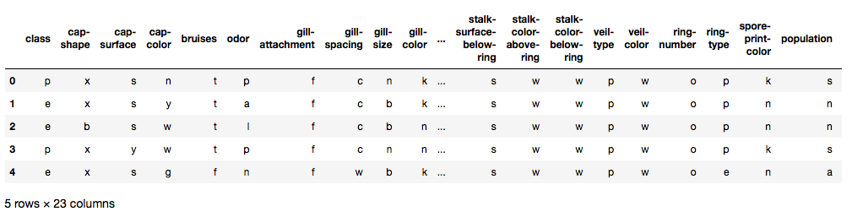
Introduction of the Dataset
Number of Samples: 8124
Number of Attributes: 22
Number of Classes: edible=e, poisonous=p
Notes:
Although this dataset was originally contributed to the UCI Machine Learning repository nearly 30 years ago, it is still a good dataset for us to understand classification.

Slide 5
cap-shape: bell=b, conical=c, convex=x, flat=f, knobbed=k, sunken=s
cap-surface: fibrous=f, grooves=g, scaly=y, smooth=s
cap-color: brown=n, buff=b, cinnamon=c, gray=g, green=r, pink=p, purple=u, red=e, white=w, yellow=y
bruises: bruises=t, no=f
odor: almond=a, anise=l, creosote=c, fishy=y, foul=f, musty=m, none=n, pungent=p, spicy=s
gill-attachment: attached=a, descending=d, free=f, notched=n
gill-spacing: close=c, crowded=w, distant=d
gill-size: broad=b, narrow=n
gill-color: black=k, brown=n, buff=b, chocolate=h, gray=g, green=r, orange=o, pink=p, purple=u, red=e, white=w, yellow=y
stalk-shape: enlarging=e, tapering=t
stalk-root: bulbous=b, club=c, cup=u, equal=e, rhizomorphs=z, rooted=r, missing=?
stalk-surface-above-ring: fibrous=f, scaly=y, silky=k, smooth=s
stalk-surface-below-ring: fibrous=f, scaly=y, silky=k, smooth=s
stalk-color-above-ring: brown=n, buff=b, cinnamon=c, gray=g, orange=o, pink=p, red=e, white=w, yellow=y
stalk-color-below-ring: brown=n, buff=b, cinnamon=c, gray=g, orange=o, pink=p, red=e, white=w, yellow=y
veil-type: partial=p, universal=u
veil-color: brown=n, orange=o, white=w, yellow=y
ring-number: none=n, one=o, two=t
ring-type: cobwebby=c, evanescent=e, flaring=f, large=l, none=n, pendant=p, sheathing=s, zone=z
spore-print-color: black=k, brown=n, buff=b, chocolate=h, green=r, orange=o, purple=u, white=w, yellow=y
population: abundant=a, clustered=c, numerous=n, scattered=s, several=v, solitary=y
habitat: grasses=g, leaves=l, meadows=m, paths=p, urban=u, waste=w, woods=d
Notes:
Here is the details of each attribute. Each letter represents a type of the attributes. For example:
the decision tree is used to learn the data set so “?” is just a special value of at tribute 11 and there is no need to eliminate the instance that contain missing value.

Slide 6
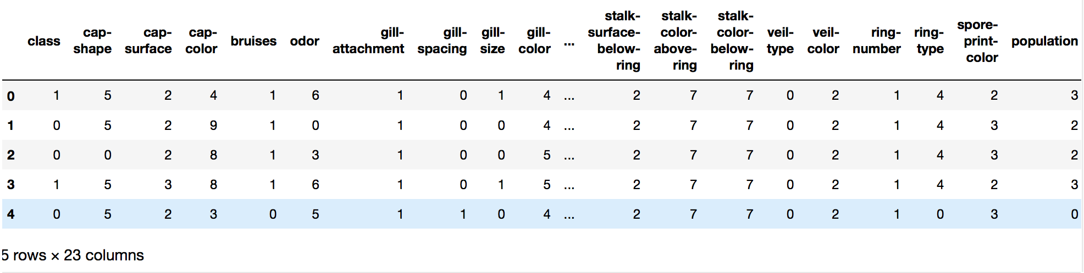
Data Preprocessing
Convert strings to integers with LabelEncoder
Separate features and labels
Notes:
First step, We can see that the dataset has all values in strings. We need to convert them to integers. Thus we perform label encoding on the data.
Second step, Separate features and labels. First column ”class” is the labels, and other 22 columns are attrubutes.

Slide 7
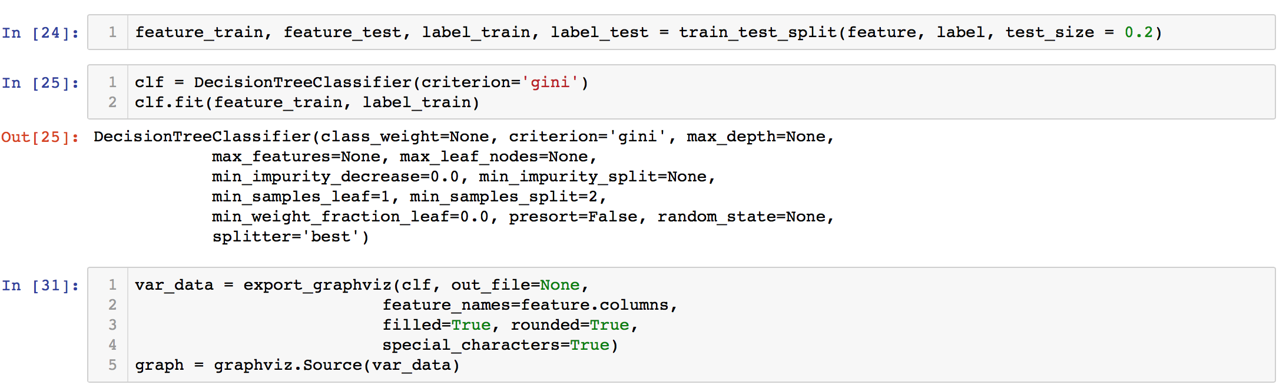
Decision Tree Classifier
80% of data for training, 20% of data for test
Notes:
GINI = all data belong to one class only

Slide 8
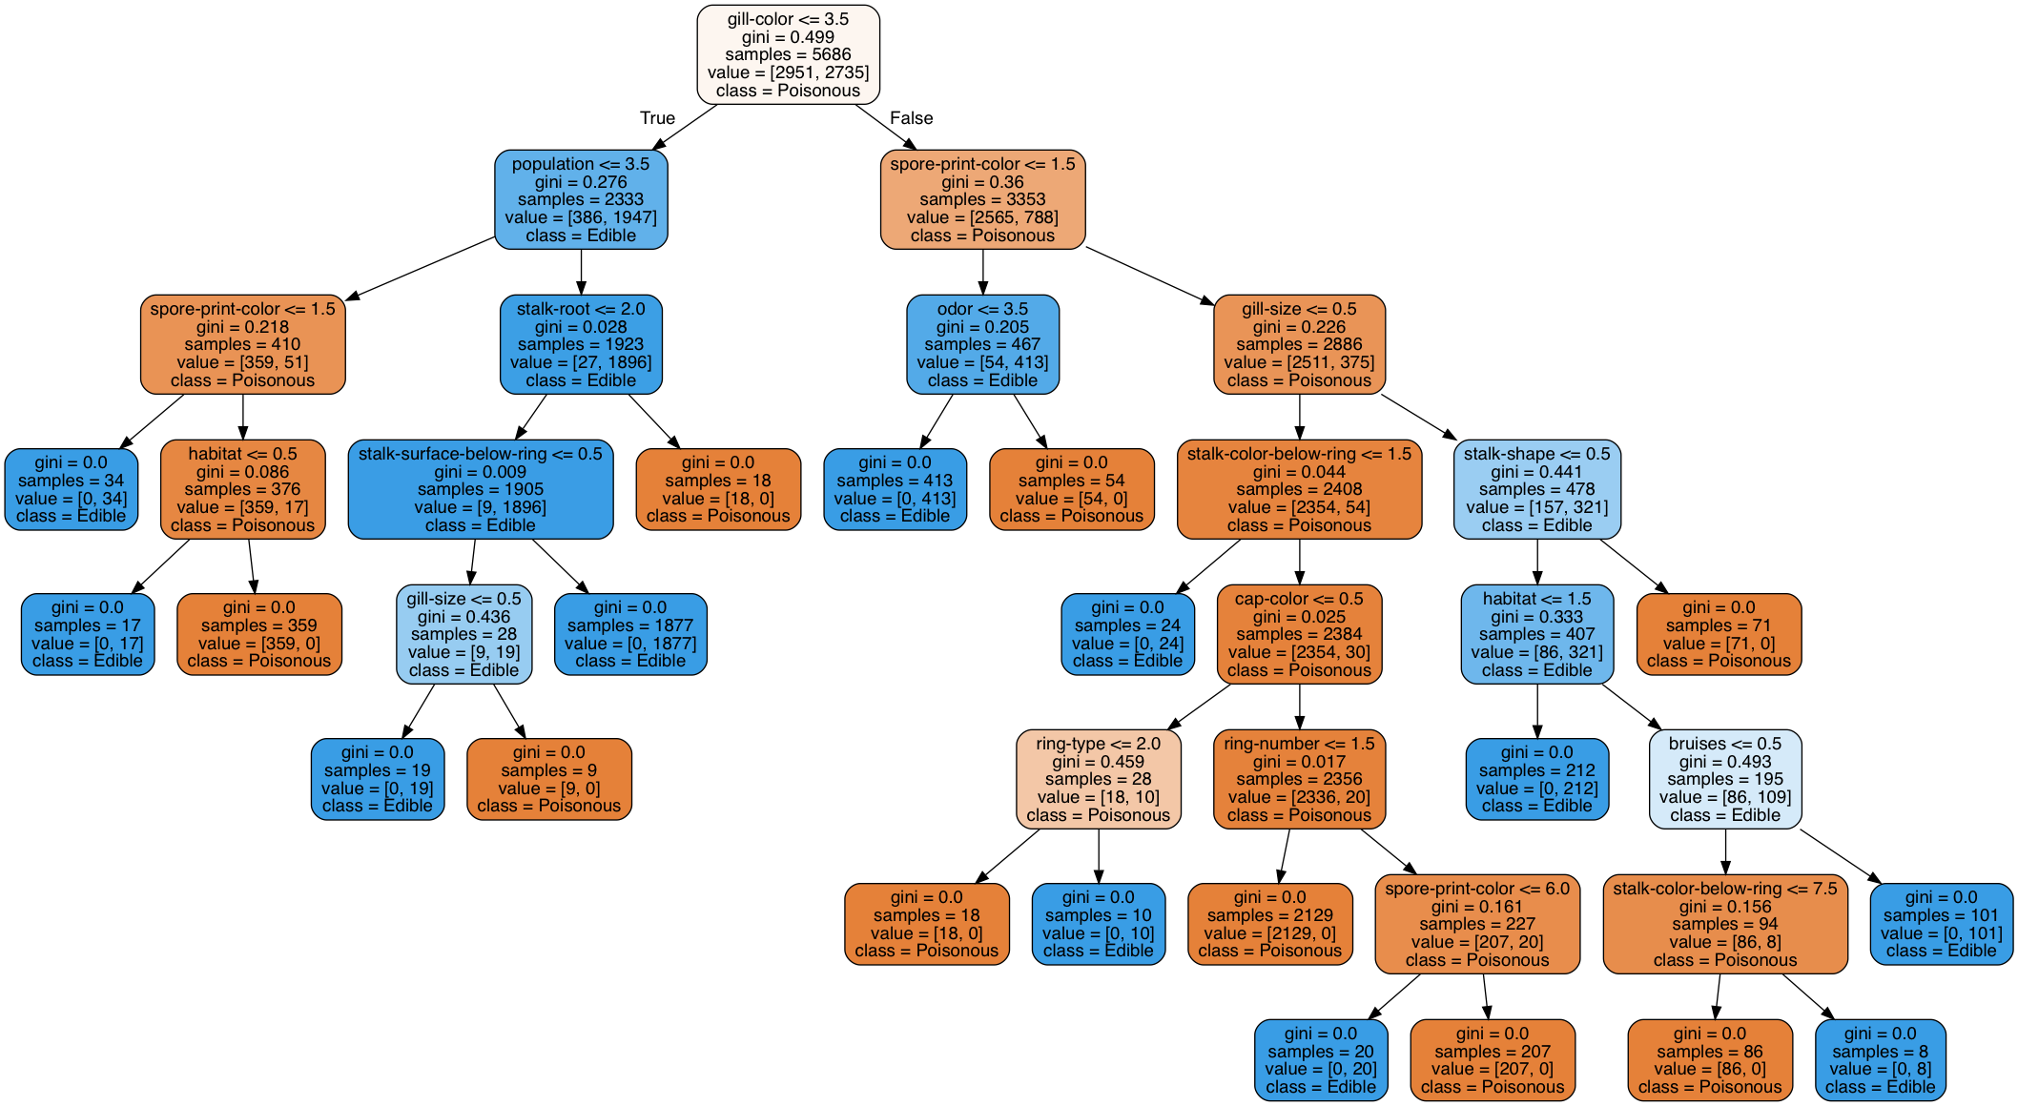
Notes:
When GINI index = 0, all data belong to one class only

Slide 9
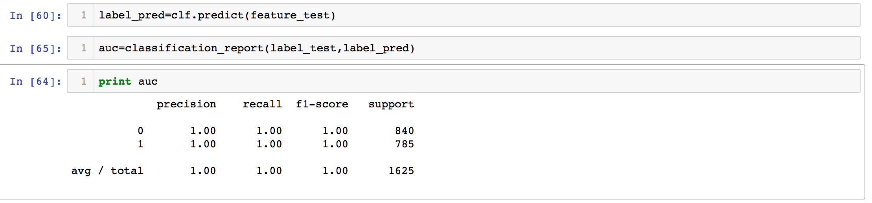
Accuracy
Overfitting?
Very impressive accuracy!!
Notes:
and achieved very impressive accuracy .

Slide 10
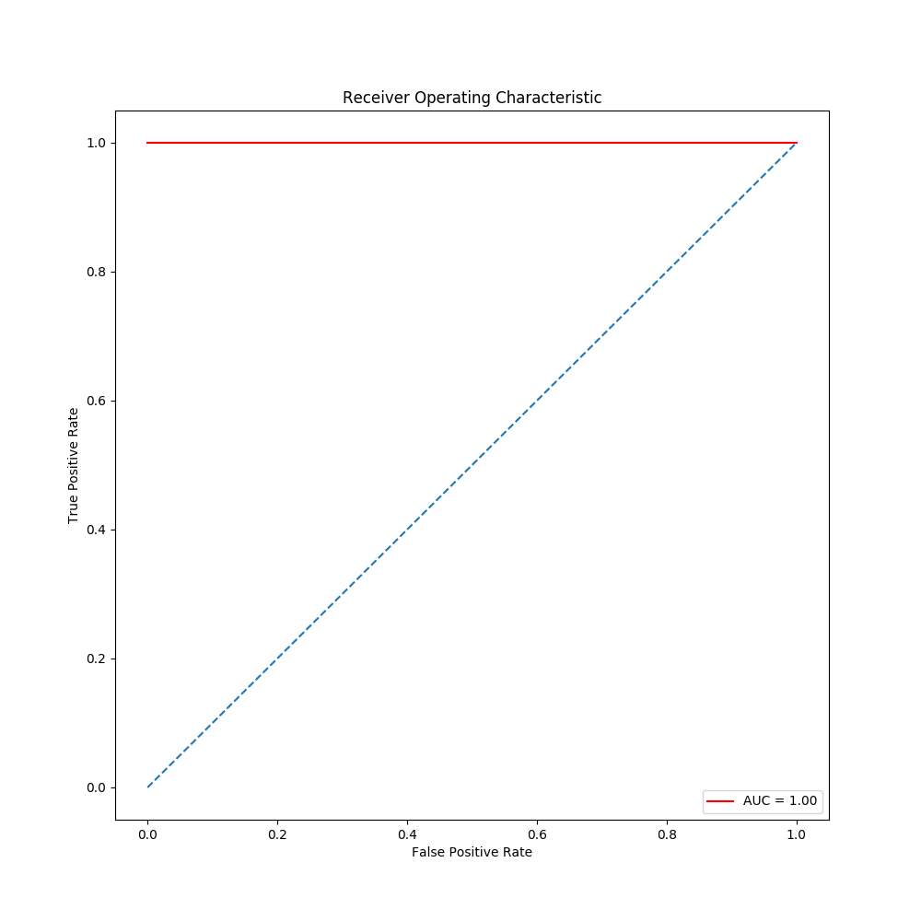
Receiver Operating Characteristic (ROC) Curve

Slide 11
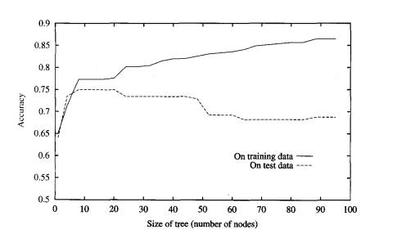
What is Overfitting?
In statistics, overfitting is “the production of an analysis that corresponds too closely or exactly to a particular set of data, and may therefore fail to fit additional data or predict future observations reliably”.------From Wikipedia
In Machine Learning, overfitting refers to a model that models the training data too well. That means, a model got a good training accuracy but bad test accuracy.
Notes:
For the realistic datasets, we want our models to get a higher accuracy. If the accuracy is too high, we need to consider does this models cause overfitting problem?

Slide 12
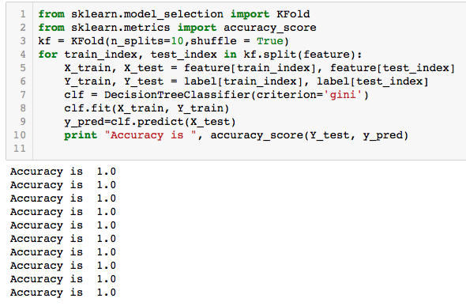
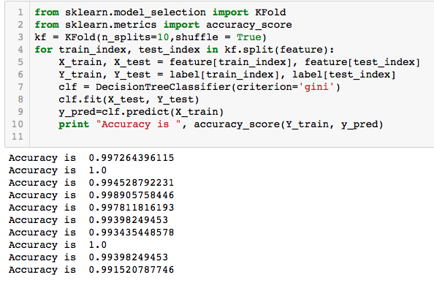
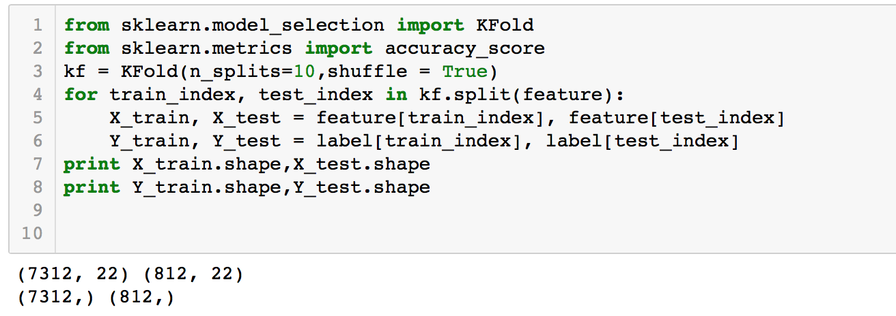
10-Fold Cross Validation
Notes:
Still impressive !! Based on the results of 10-Fold Cross Validation, I cannot say there is a overfitting problem, but I do think there are some prefect separator, when the samples have the prefect separator, it doesn’t need others attributes, the decision tree have already predicted the class of the samples.

Slide 13
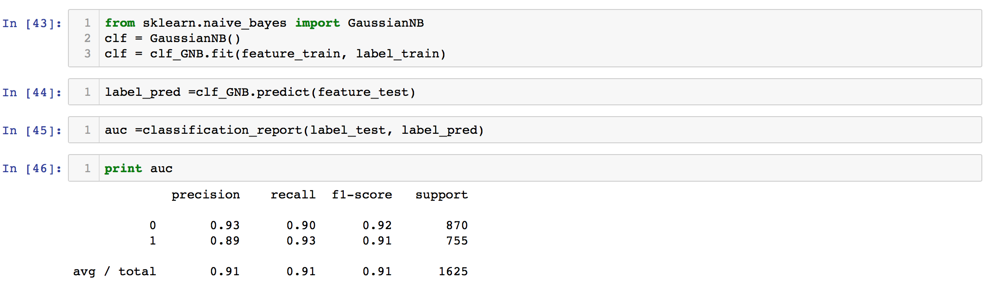
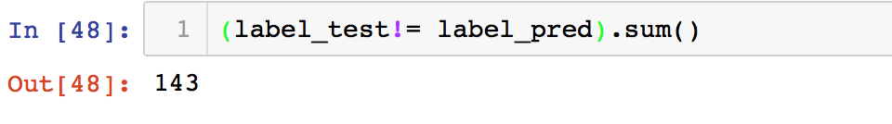
Gaussian Naïve Bayes Classifier
The number of mismatched labels is:

Slide 14
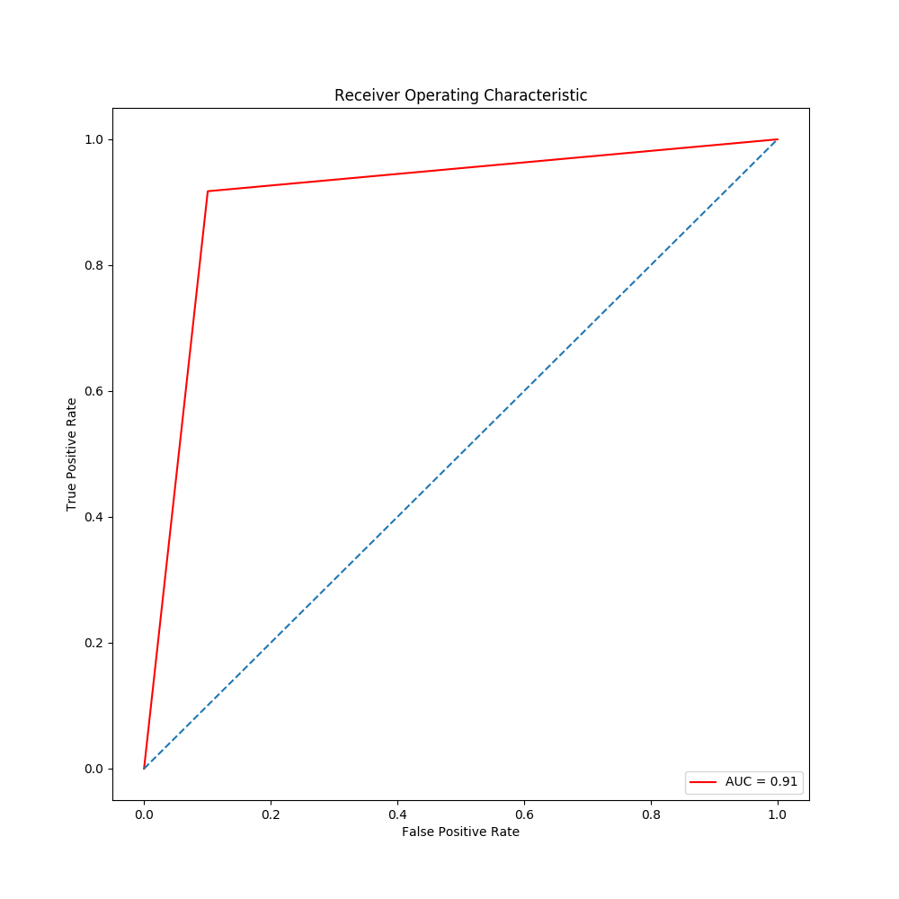
Receiver Operating Characteristic (ROC) Curve

Slide 15
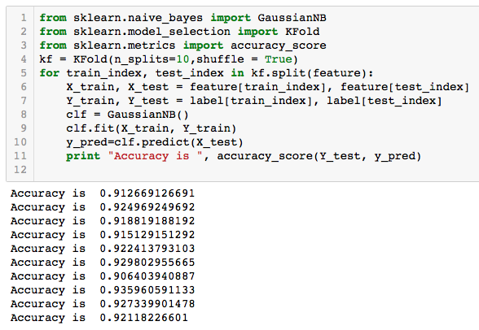
10-Fold Cross Validation
Notes:
The 10-Fold Cross Validation accuracy are all around 92%.

Slide 16
Conclusions
For this mushrooms dataset, based on the results of accuracy and ROC curve, Decision tree is a better classifier than Gaussian Naïve Bayes.
Future Plan
1. Feature selection:
Find out what are the important features of this mushroom dataset, and test the accuracy of Decision Tree again.
2. Compare the performance with other classification methods.
Notes:
Decision tree is just fit the dataset very well.

Slide 17
Reference
Dataset source: Mushroom records drawn from The Audubon Society Field Guide to North American Mushrooms (1981). G. H. Lincoff (Pres.), New York: Alfred A. Knopf
https://machinelearningmastery.com/overfitting-and-underfitting-with-machine-learning-algorithms/
https://www.r-bloggers.com/practical-machine-learning-with-r-and-python-part-5/
https://dzone.com/articles/is-your-decision-tree-accurate-enough
https://www.kaggle.com/nirajvermafcb/comparing-various-ml-models-roc-curve-comparison

Slide 18
Thank you
Questions?

