Slide 1
Introduction dynamical system modelling
Pierre Nouvellet
pierre.nouvellet@sussex.ac.uk
Modelling infectious disease epidemics, analysis and response
Short course. Bogota. 11-15th December 2017

Slide 2
Understanding the dynamics of ID
Being prepared and responding promptly require understanding the dynamics of the disease
Karesh et al. (2012) Lancet

Slide 3
Understanding the dynamics of ID
Being prepared and responding promptly require understanding the dynamics of the disease
Karesh et al. (2012) Lancet

Slide 4
Objectives
Introduction to concepts in quantitative epidemiology of infectious diseases
Understand the dynamics of epidemics
Understanding key parameters
Modelling control
Application to Ebola

Slide 5
Objectives, details
Exponential growth
Epidemic curve
Flow diagrams – dynamical system
Contact rate
Model SEI
Reproduction number
Models for Ebola

Slide 6

Exponential growth
One dog is infected.
He will infect other.
Who will infect more.
We obtain a chain reaction:
an epidemic
8
7
6
5
I
4
3
2
1
0
1
2
t
3
4

Slide 7
Exponential growth
t=0, I₀= 1
t=1, I₁= 2
t=2, I₂= 4
8
7
6
5
I
4
3
2
1
0
1
2
3
4
t

Slide 8
Exponential growth
t=0, I₀= 1
t=1, I₁= 2 = I₀ x 2
t=2, I₂= 4 = I₁ x 2
8
7
6
5
I
4
3
2
1
0
1
2
3
4
t

Slide 9
Exponential growth
t=0, I₀= 1
t=1, I₁= 2 = I₀ x 2
t=2, I₂= 4 = I₁ x 2
Exponential growth: I_{t}= I₀ x 2^{t} = I₀ x e^{r t}
8
7
6
5
I
4
3
2
1
0
1
2
3
4
t

Slide 10
Epidemic curve
Healthy
Infected
Dead or recovered
t=0
t=1

Slide 11
Epidemic curve
Healthy
Infected
Dead or recovered
t=0
t=1
t=2
t=3
t=4

Slide 12
Epidemic curve
Healthy
Infected
Dead or recovered
t=0
t=1
t=2
t=3
t=4

Slide 13
Epidemic curve
Healthy
Infected
Dead or recovered
t=0
t=1
t=2
t=3
t=4

Slide 14
Epidemic curve
Healthy
Infected
Dead or recovered
t=0
t=1
t=2
t=3
t=4
Less susceptible
Exponential phase
Epidemic tailing off

Slide 15
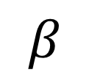
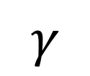
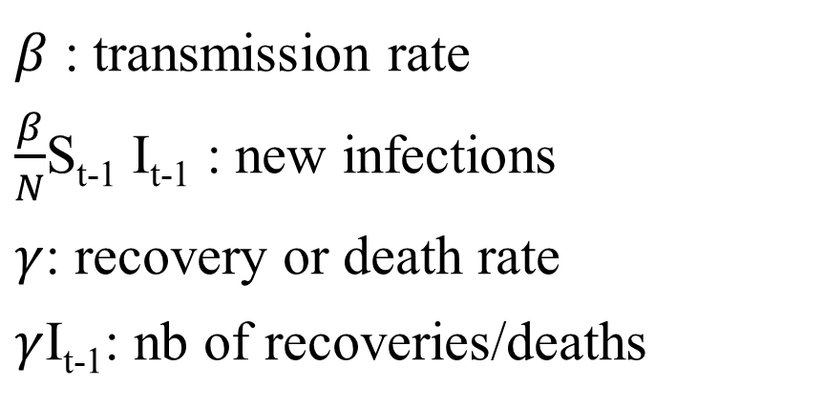
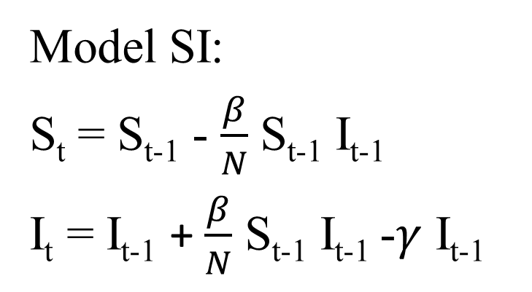
Flow diagram
Healthy
Infected
Dead or recovered
$$β$$
$$γ$$
S
I
Model SI:
S_{t} = S_{t-1} - $\frac{β}{N}$ S_{t-1} I_{t-1}
I_{t} = I_{t-1} + $\frac{β}{N}$ S_{t-1} I_{t-1} -$γ$ I_{t-1}
$β$ : transmission rate
$\frac{β}{N}$S_{t-1} I_{t-1} : new infections
$γ$: recovery or death rate
$γ$I_{t-1}: nb of recoveries/deaths

Slide 16
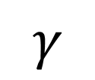

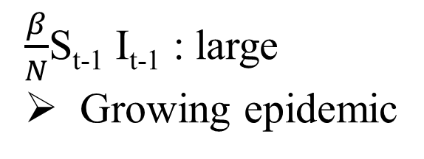
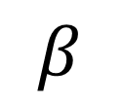
Flow diagram
$$β$$
$$γ$$
S
I
$\frac{β}{N}$S_{t-1} I_{t-1} : large
Growing epidemic
$\frac{β}{N}$S_{t-1} I_{t-1} : small
Decreasing epidemic

Slide 17
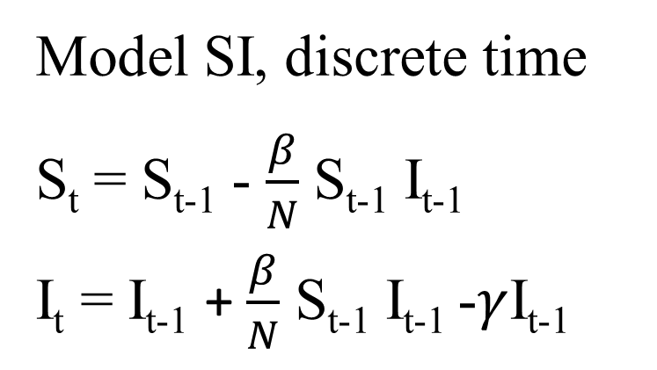
Flow diagram
$$β$$
$$γ$$
S
I
Model SI, discrete time
S_{t} = S_{t-1} - $\frac{β}{N}$ S_{t-1} I_{t-1}
I_{t} = I_{t-1} + $\frac{β}{N}$ S_{t-1} I_{t-1} -$γ$I_{t-1}

Slide 18
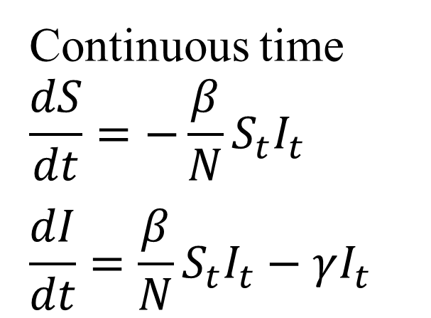
Flow diagram
$$β$$
$$γ$$
S
I
Model SI, discrete time
S_{t} = S_{t-1} - $\frac{β}{N}$ S_{t-1} I_{t-1}
I_{t} = I_{t-1} + $\frac{β}{N}$ S_{t-1} I_{t-1} -$γ$I_{t-1}
Continuous time
$$\frac{dS}{dt}=−\frac{β}{N}S_{t}I_{t}$$
$$\frac{dI}{dt}=\frac{β}{N}S_{t}I_{t}−γI_{t}$$

Slide 19
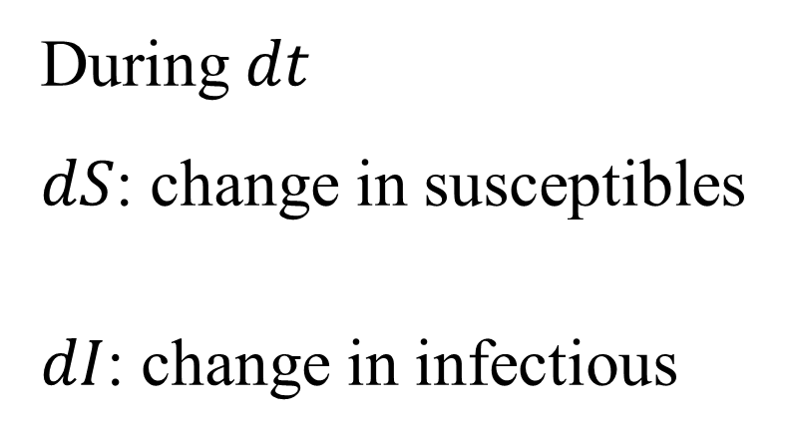
Flow diagram
$$β$$
$$γ$$
S
I
During $dt$
$dS$: change in susceptibles
$dI$: change in infectious
Continuous time
$$\frac{dS}{dt}=−\frac{β}{N}S_{t}I_{t}$$
$$\frac{dI}{dt}=\frac{β}{N}S_{t}I_{t}−γI_{t}$$

Slide 20
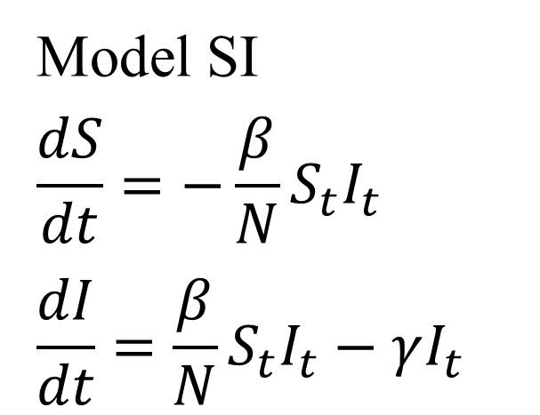
Flow diagram
$$β$$
$$γ$$
S
I
Model SI
$$\frac{dS}{dt}=−\frac{β}{N}S_{t}I_{t}$$
$$\frac{dI}{dt}=\frac{β}{N}S_{t}I_{t}−γI_{t}$$

Slide 21
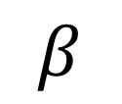
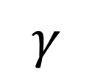
Characterise contacts
$$β$$
$$γ$$
S
I
The number of contact is fixed, regardless of density
Frequency dependent contacts
The number of contact increase with density
Density dependent contact
‘Frequency dependent’
‘Density dependent’

Slide 22
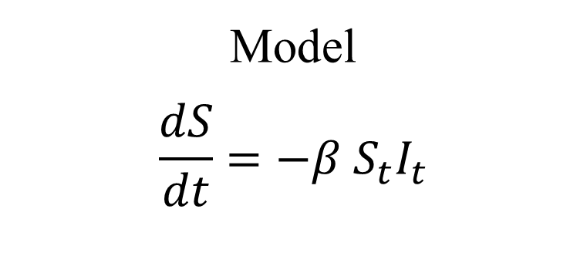
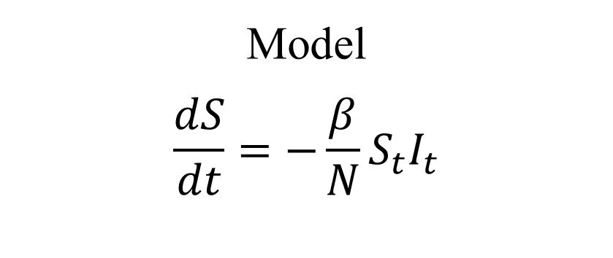
Characterise contacts
$$β$$
$$γ$$
S
I
‘Frequency dependent’
‘Density dependent’
Model
$$\frac{dS}{dt}=−\frac{β}{N}S_{t}I_{t}$$
Model
$$\frac{dS}{dt}=−β{ S}_{t}I_{t}$$

Slide 23
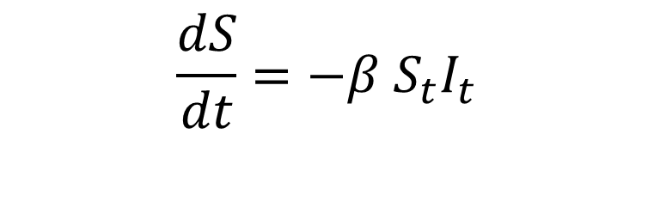

Characterise contacts
Implications for the epidemic curve
‘Frequency dependent’
‘Density dependent’
$$\frac{dS}{dt}=−\frac{β}{N}S_{t}I_{t}$$
$$\frac{dS}{dt}=−β{ S}_{t}I_{t}$$

Slide 24
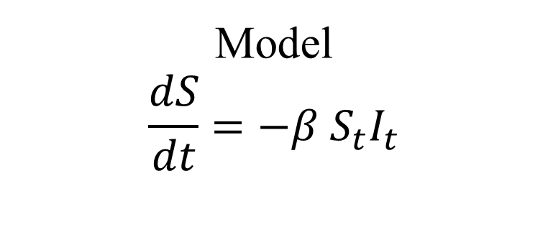
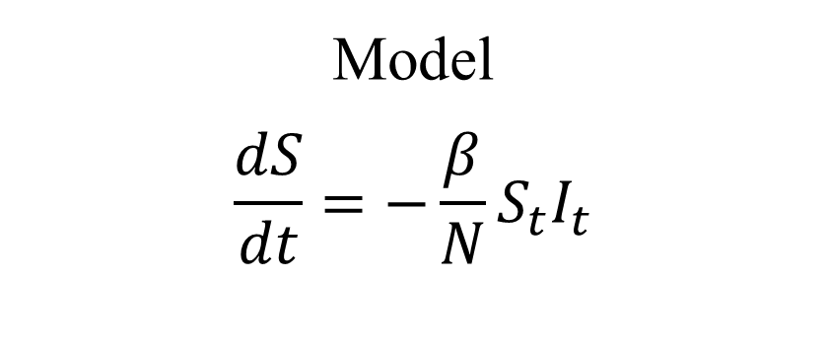
Characterise contacts
$$β$$
$$γ$$
S
I
‘Frequency dependent’
‘Density dependent’
Ebola
Model
$$\frac{dS}{dt}=−\frac{β}{N}S_{t}I_{t}$$
Model
$$\frac{dS}{dt}=−β{ S}_{t}I_{t}$$

Slide 25
Reproduction number
Definition:
Average number of secondary cases generated by an index case in a large entirely susceptible population

Slide 26
Reproduction number
Duration of infectiousness: context dependent
Time from onset to recovery (or death)
Time from onset to isolation (SARS)

Slide 27
Reproduction number
Transmission rate: very difficult to estimate

Slide 28
Reproduction number
Contact rate: needs clear definition of infectious contact

Slide 29
Reproduction number
Deriving R0 from compartmental models

Slide 30
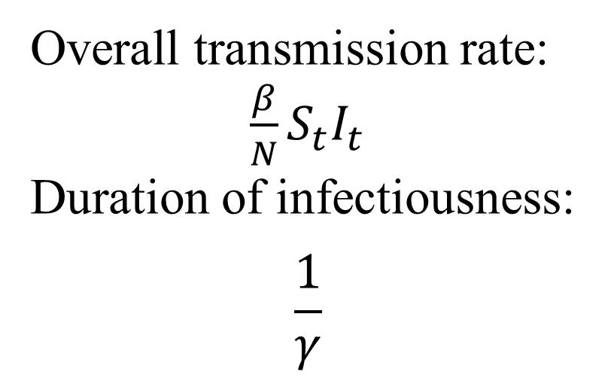
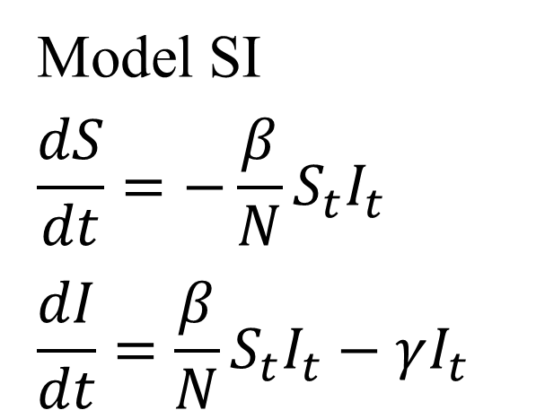
Reproduction number
Deriving R0 from compartmental models
Model SI
$$\frac{dS}{dt}=−\frac{β}{N}S_{t}I_{t}$$
$$\frac{dI}{dt}=\frac{β}{N}S_{t}I_{t}−γI_{t}$$
Overall transmission rate:
$\frac{β}{N}S_{t}I_{t}$
Duration of infectiousness:
$$\frac{1}{γ}$$

Slide 31
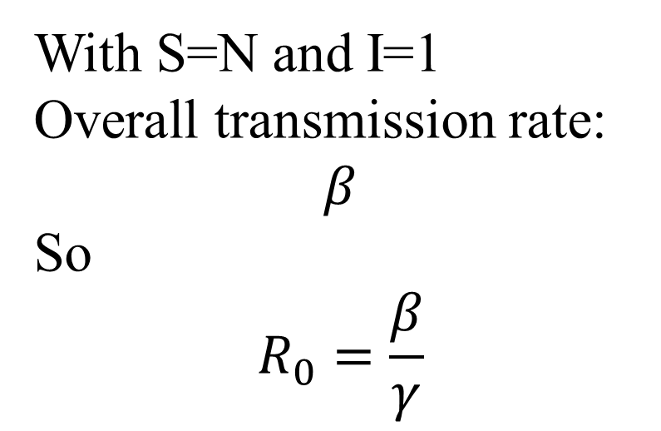
Reproduction number
Deriving R0 from compartmental models
Model SI
$$\frac{dS}{dt}=−\frac{β}{N}S_{t}I_{t}$$
$$\frac{dI}{dt}=\frac{β}{N}S_{t}I_{t}−γI_{t}$$
With S=N and I=1
Overall transmission rate:
$$β$$
So
$$R_{0}=\frac{β}{γ}$$

Slide 32
Reproduction number
Deriving R0 from compartmental models
! If we change the model, we (usually) change the formula for R0!
Model SI
$$\frac{dS}{dt}=−\frac{β}{N}S_{t}I_{t}$$
$$\frac{dI}{dt}=\frac{β}{N}S_{t}I_{t}−γI_{t}$$
With S=N and I=1
Overall transmission rate:
$$β$$
So
$$R_{0}=\frac{β}{γ}$$

Slide 34
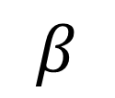

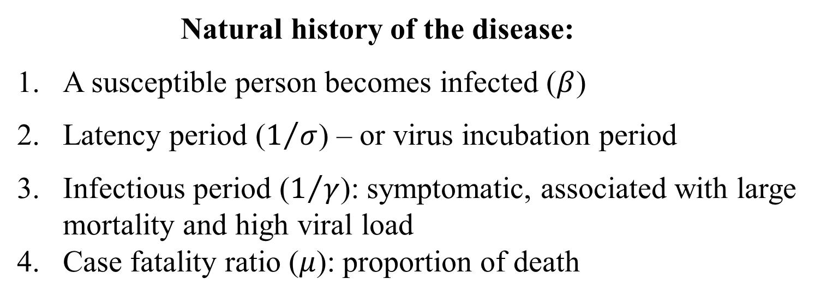
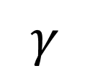
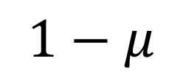
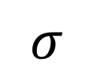
Ebola model
Natural history of the disease:
A susceptible person becomes infected ($β$)
Latency period ($1/σ$) – or virus incubation period
Infectious period ($1/γ$): symptomatic, associated with large mortality and high viral load
Case fatality ratio ($μ$): proportion of death
$$1−μ$$
$$β$$
$$σ$$
$$γ$$
R
S
E
I
$$μ$$
D

Slide 35
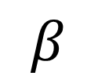

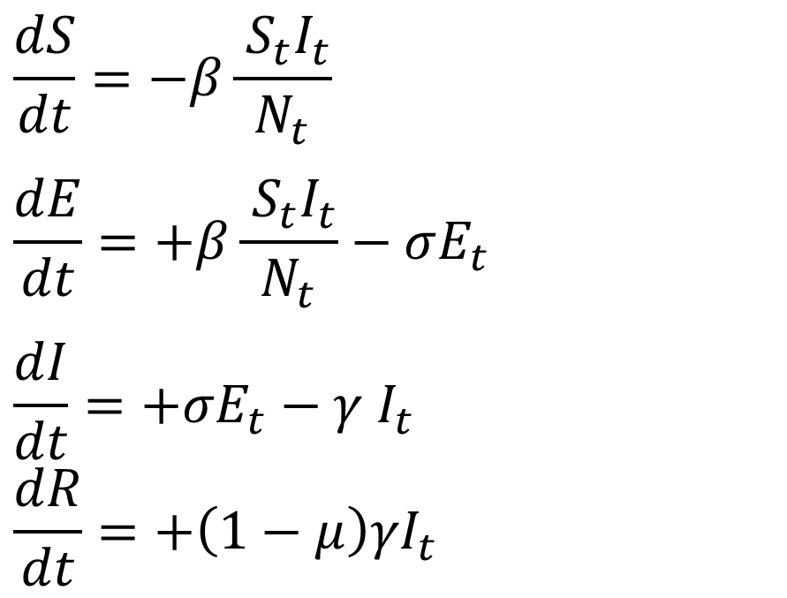
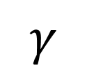
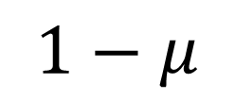
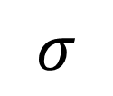
Ebola model
$$1−μ$$
$$β$$
$$σ$$
$$γ$$
R
S
E
I
$$μ$$
D
$$\frac{dS}{dt}=−β\frac{{ S}_{t}I_{t}}{N_{t}}$$
$$\frac{dE}{dt}=+β\frac{{ S}_{t}I_{t}}{N_{t}}−σE_{t}$$
$$\frac{dI}{dt}=+σE_{t}−γ I_{t}$$
$$\frac{dR}{dt}=+\left(1−μ\right)γI_{t}$$
Model for contacts: ‘frequency dependent’

Slide 36
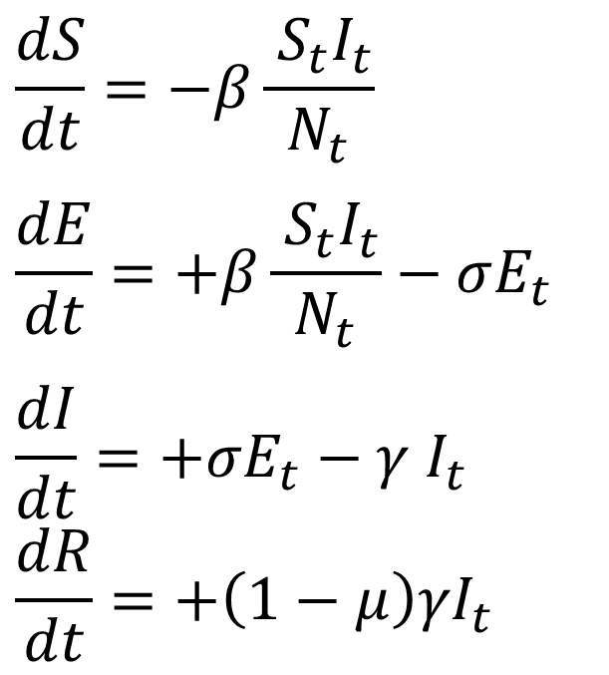
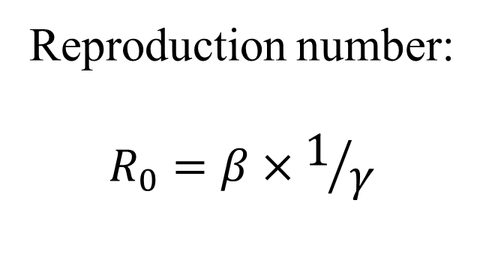
Ebola model
$$1−μ$$
$$β$$
$$σ$$
$$γ$$
R
S
E
I
$$μ$$
D
$$\frac{dS}{dt}=−β\frac{{ S}_{t}I_{t}}{N_{t}}$$
$$\frac{dE}{dt}=+β\frac{{ S}_{t}I_{t}}{N_{t}}−σE_{t}$$
$$\frac{dI}{dt}=+σE_{t}−γ I_{t}$$
$$\frac{dR}{dt}=+\left(1−μ\right)γI_{t}$$
Reproduction number:
$$R_{0}=β×1/γ$$

Slide 37
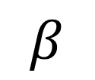
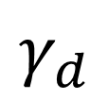
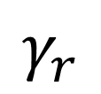

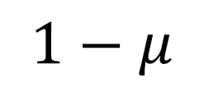
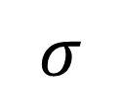
Ebola model
Increasing model complexity:
delay onset/death ≠ delay onset/recovery
$$1−μ$$
$$γ_{r}$$
I_{r}
R
$$β$$
$$σ$$
S
E
$$γ_{d}$$
$$μ$$
I_{d}
D

Slide 38
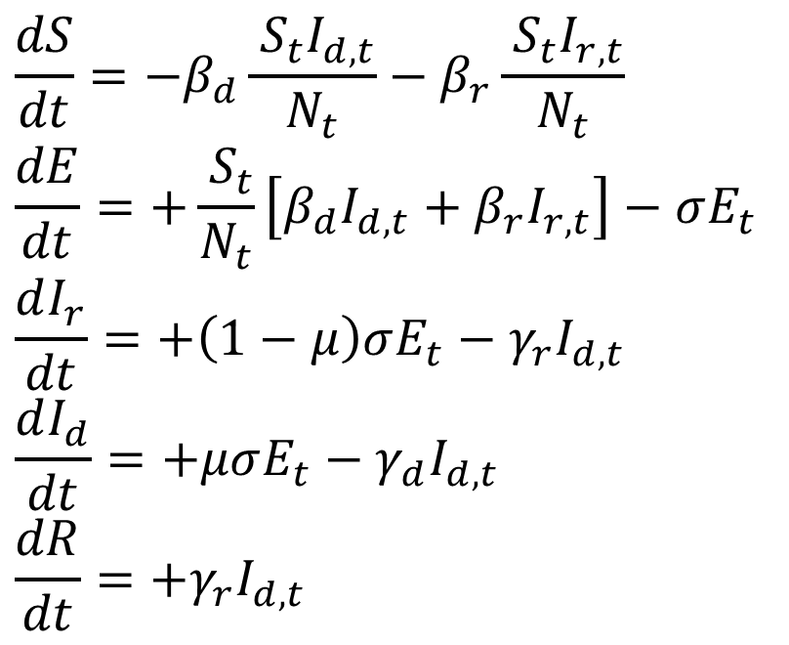
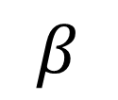
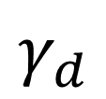
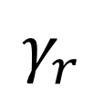

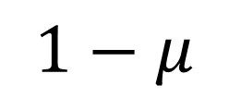
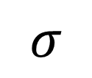
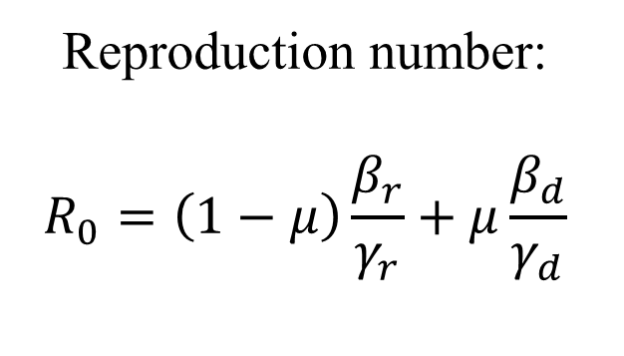
Ebola model
$$1−μ$$
$$γ_{r}$$
I_{r}
R
$$β$$
$$σ$$
S
E
$$γ_{d}$$
$$μ$$
I_{d}
D
$$\frac{dS}{dt}=−β_{d}\frac{{ S}_{t}I_{d,t}}{N_{t}}−β_{r}\frac{{ S}_{t}I_{r,t}}{N_{t}}$$
$$\frac{dE}{dt}=+\frac{{ S}_{t}}{N_{t}}\left[β_{d}I_{d,t}+β_{r}I_{r,t}\right]−σE_{t}$$
$$\frac{dI_{r}}{dt}=+\left(1−μ\right)σE_{t}−γ_{r}I_{d,t}$$
$$\frac{dI_{d}}{dt}=+μσE_{t}−γ_{d}I_{d,t}$$
$$\frac{dR}{dt}=+γ_{r}I_{d,t}$$
Reproduction number:
$$R_{0}=\left(1−μ\right)\frac{β_{r}}{γ_{r}}+μ\frac{β_{d}}{γ_{d}}$$

Slide 39
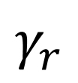
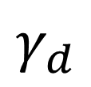
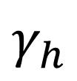
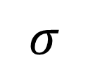













Ebola model
Increasing model complexity:
delay onset/death ≠ delay onset/recovery
once hospitalised/isolated, no further transmission
$$γ_{r}$$
$$1−π$$
$$I_{r}^{c}$$
R^{c}
$$1−μ$$
$$γ_{d}$$
$$β$$
$$I_{r}^{}$$
$$I_{d}^{c}$$
D^{c}
$$σ$$
S
E
$$γ_{h}$$
$$I_{d}^{}$$
$$γ_{r}$$
$$μ$$
$$I_{r}^{h}$$
R^{h}
$$γ_{d}$$
$$π$$
$$I_{d}^{h}$$
D^{h}

Slide 40



Ebola model
Pre-hospital
$$\frac{dS}{dt}=−λ_{t}{ S}_{t}$$
$$\frac{dE}{dt}=λ_{t}{ S}_{t}−σE_{t}$$
$$\frac{dI_{r}}{dt}=\left(1−μ\right)σE_{t}−γ_{h}I_{r,t}$$
$$\frac{dI_{d}}{dt}=μσE_{t}−γ_{h}I_{d,t}$$
with
$$λ_{t}=β_{d}\frac{\left(I_{d,t}+I_{d,t}^{c}\right)}{N_{t}}+β_{r}\frac{\left(I_{r,t}+I_{r,t}^{c}\right)}{N_{t}}$$
Stay in community
$$\frac{dI_{r}^{c}}{dt}=\left(1−π\right)γ_{h}I_{r,t}−γ_{r}I_{r,t}^{c}$$
$$\frac{dI_{d}^{c}}{dt}=\left(1−π\right)γ_{h}I_{d,t}−γ_{d}I_{d,t}^{c}$$
$$\frac{dR^{c}}{dt}=γ_{r}I_{r,t}^{c}$$
In hospital
$$\frac{dI_{r}^{h}}{dt}=πγ_{h}I_{r,t}−γ_{r}I_{r,t}^{h}$$
$$\frac{dI_{d}^{h}}{dt}=πγ_{h}I_{d,t}−γ_{d}I_{d,t}^{h}$$
$$\frac{dR^{h}}{dt}=γ_{r}I_{r,t}^{h}$$

Slide 41

Ebola model
Reproduction number:
Someone who will die in community: $β_{d}×\left[\frac{1}{γ_{h}}+\frac{1}{γ_{d}}\right]$
Someone who will recover in community: $β_{r}×\left[\frac{1}{γ_{h}}+\frac{1}{γ_{r}}\right]$
Someone who will die in hospital: $β_{d}×\left[\frac{1}{γ_{h}}\right]$
Someone who will recover in hospital: $β_{h}×\left[\frac{1}{γ_{h}}\right]$
Weighting to obtain reproduction number:
$R_{0}=μ\left(1−π\right)β_{d}\left[\frac{1}{γ_{h}}+\frac{1}{γ_{d}}\right]+\left(1−μ\right)\left(1−π\right)β_{r}\left[\frac{1}{γ_{h}}+\frac{1}{γ_{r}}\right]$+$μπβ_{d}\left[\frac{1}{γ_{h}}\right]$+$\left(1−μ\right)πβ_{r}\left[\frac{1}{γ_{h}}\right]$
$=μ β_{d}\left[\frac{1}{γ_{h}}+\left(1−π\right)\frac{1}{γ_{d}}\right]+\left(1−μ\right)β_{r}\left[\frac{1}{γ_{h}}+\left(1−π\right)\frac{1}{γ_{r}}\right]$

Slide 43
Increase complexity
Impact of unsafe funeral - vaccination
Stochastic Model
Spatial Model
Individual based Model
Warning:
‘To explain a complex and poorly understood reality with a complex poorly understood model is
not progress’
John Maynard Smith

Slide 45










Ebola model
practical
$1−$P_{cfr}
$$γ$$
$$σ$$
R
$$β$$
S
E
I
$$\text{P}\text{cfr}$$
D
$1−$P_{cfr}
$$β$$
$$γ$$
$$σ_{h}$$
R
$$σ$$
S
E
I
I_{h}
D
$$\text{P}\text{cfr}$$

