Slide 1
Be Confident! Confidence Intervals

Slide 2
What is a Confidence Interval?
A range of numbers that you’re reasonably certain contains the mean
Abbreviated CI

Slide 3
Confidence Interval Percentages
Typical ones are:
99% CI
95% CI
90% CI
But theoretically it could be any percentage
The larger the number, the more certain you are

Slide 4
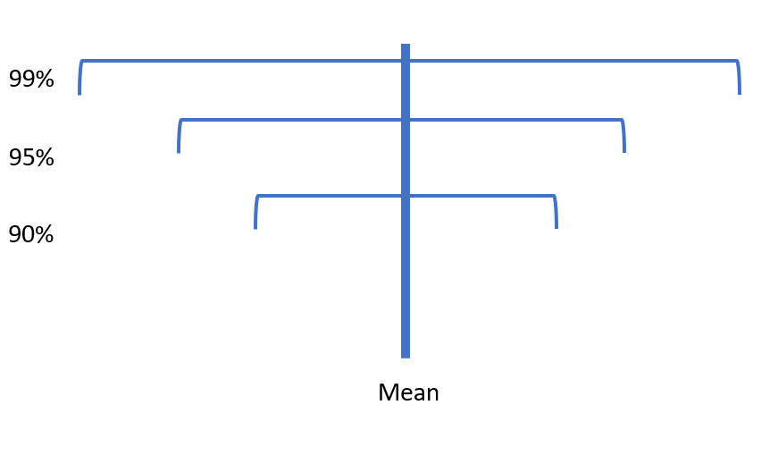
The Larger the Number, the More Certainty!

Slide 5
Margin of Error
No one and nothing is perfect!
How much you might be wrong by
Abbreviated MOE

Slide 6
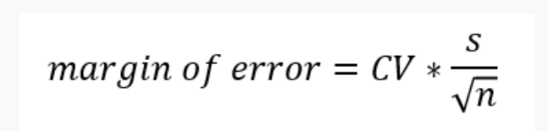
Calculating Margin of Error
CV = critical value
s = standard deviation
n = sample size

Slide 7
Critical Values
Confidence Level | Critical Value
90% | 1.645
95% | 1.96
99% | 2.575

Slide 8
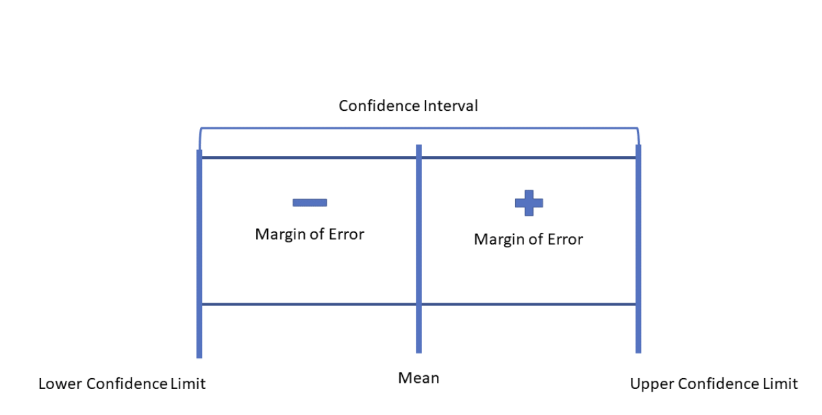
Calculating Confidence Intervals
Place the margin of error on either side of the mean to create the confidence interval

Slide 9
An Example

Slide 10
What is the 95% CI for….
Distribution with…
Mean of 7
Standard deviation of 1
Sample size of 200

Slide 11
Steps
1) Find the CV from the table: 1.96
2) Plug ‘n play!
MOE = 1.96 x (1/ √200)
MOE = 1.96 x (1/14.14)
MOE = 1.96 x .07
MOE = .139

Slide 12
Steps
3) Get the lower confidence limit
Mean – MOE
7-.14 = 6.86
4) Get the upper confidence limit
Mean + MOE
7 + .14 = 7.14
The 95% CI is: 6.86-7.14

Slide 13
Questions?

