Slide 1
Wine Price Analysis Pascale Chamberland Amy Chamberlain Ian Coyer
Template from https://www.free-power-point-templates.com/free-wines-powerpoint-template/
Notes:
Slide 1: Pascale
Slide 2-5: Amy
Slide 6-11: Ian
Slide 12-14: Pascale
Slice 15: Pascale

Slide 2
We have a problem…we need wine
Correlation between the price of a bottle of wine and its characteristics
What might impact the price of a bottle of wine?

Slide 3
Data Source
WineEnthusiast: data was scraped from reviews during the week of June 15, 2017
https://www.kaggle.com/zynicide/wine-reviews

Slide 4
Key Questions
Are the ratings on Wine Enthusiast a good predictor of the price of a bottle of wine?
Can you expect to pay more for a bottle of wine from a certain region?
Are we paying more for wines with long (code: hoity-toity) names?

Slide 5
Data Wrangling
Limit analysis to key markets on the West Coast:
Napa Valley, Wash. State, Oreg. State
Removed unwanted variables (reviewer name, etc.)
Computed additional variables
Value (points/price), Name Length
Normalized feature variables for modeling

Slide 6
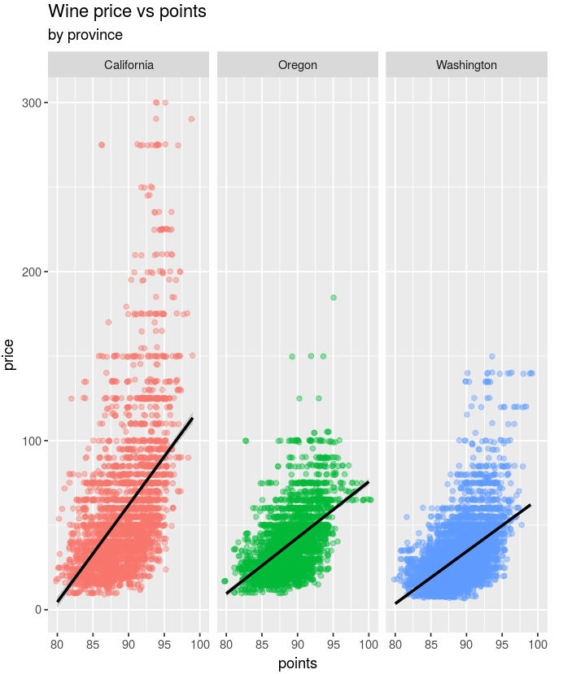
Wine Price vs. Points by Province

Slide 7
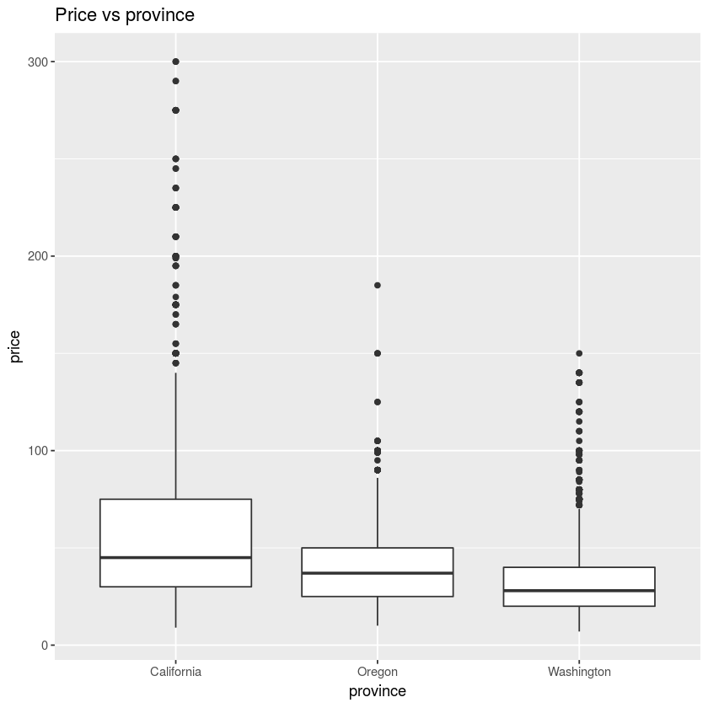
Price vs Province

Slide 8
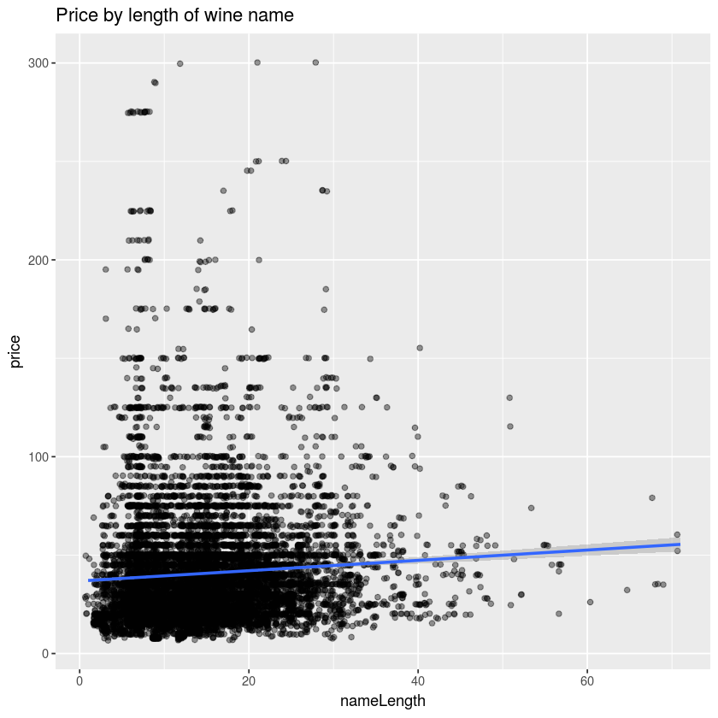
Price by Length of Wine Name

Slide 9
T-test Analysis
Price by Points
More highly rated wine would cost more: Yes
Price by Region
Cost differs by region: Yes
Price by Name length
Cost differs by name length:
Surprisingly, Yes
Notes:
Points split at median: low points < 90, high points >= 90
-comfortable doing one-sided
Name length split at median: short name < 15, long name >= 15
-did two-sided for others as unsure of outcome

Slide 10
Regression Models
Model 1:
Price predicted by:
Points, province, name length
Model 2:
Price predicted by:
Points, province, name length, value
Notes:
Points split at median: low points < 90, high points >= 90
-comfortable doing one-sided
Name length split at median: short name < 15, long name >= 15
-did two-sided for others as unsure of outcome

Slide 11
Models Summary
Model 1:
Adjusted R-squared: 0.3408
All coeff’s sig. at < .001
Model 2:
Adjusted R-squared: 0.554
All coeff’s sig.
Name length only at .05 level and had negative coeff.
others at < .001
Notes:
Points split at median: low points < 90, high points >= 90
-comfortable doing one-sided
Name length split at median: short name < 15, long name >= 15
-did two-sided for others as unsure of outcome

Slide 12
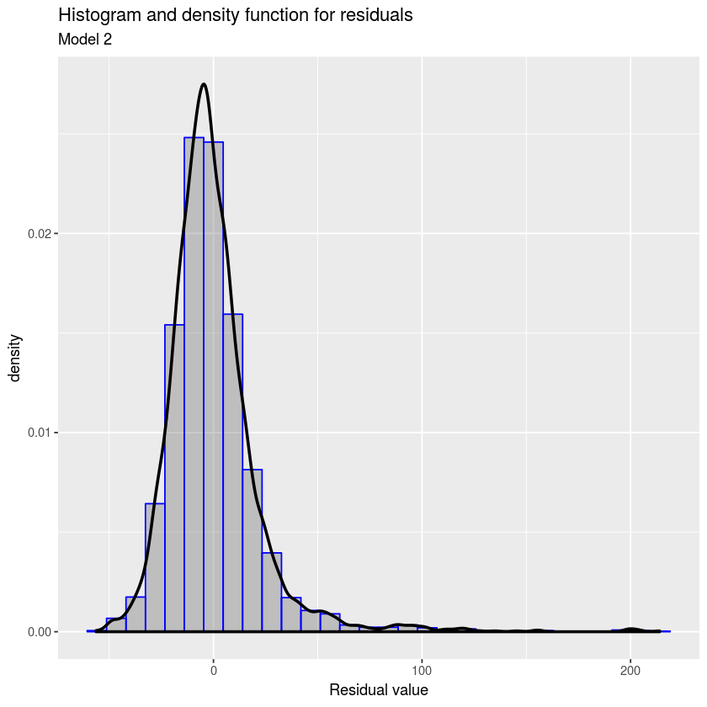
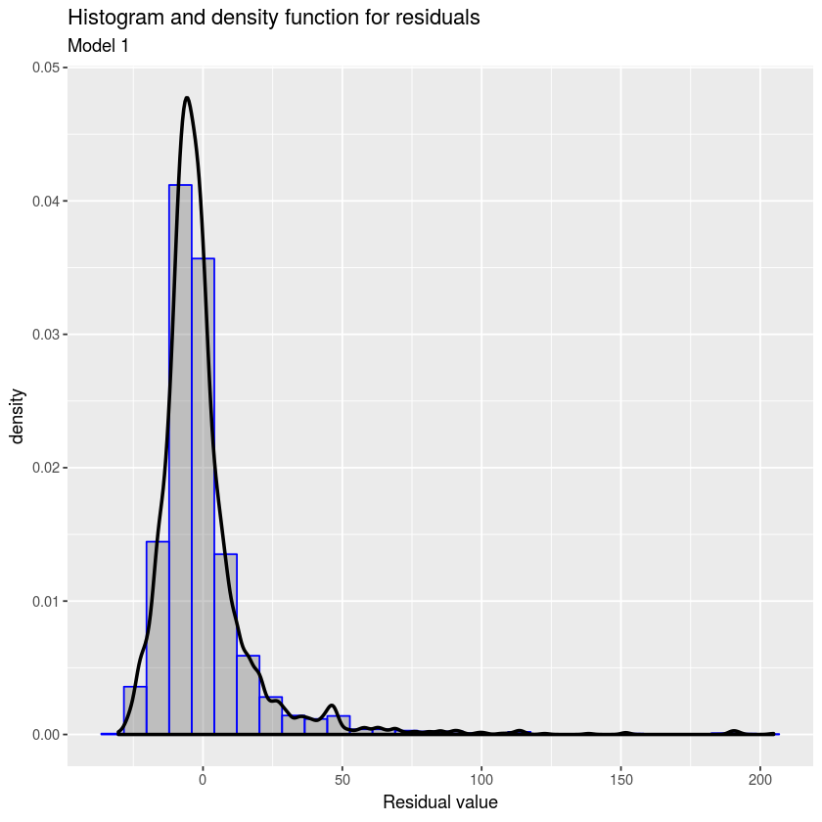
Histograms of Residuals
Model 1
Model 2

Slide 13
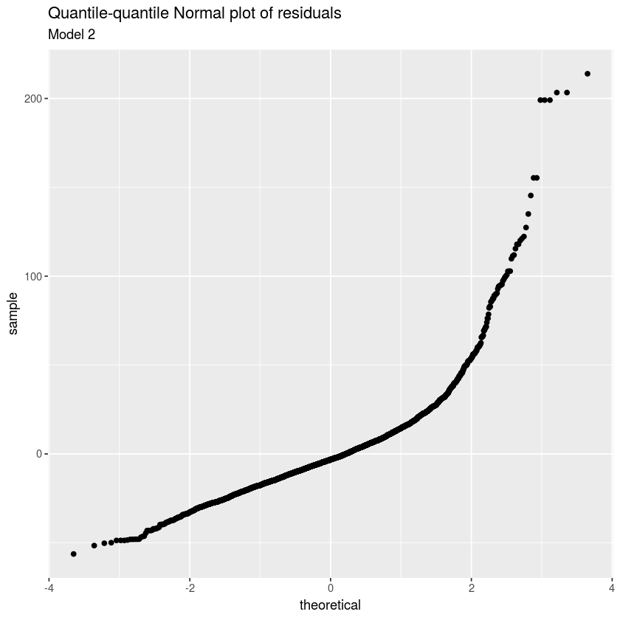
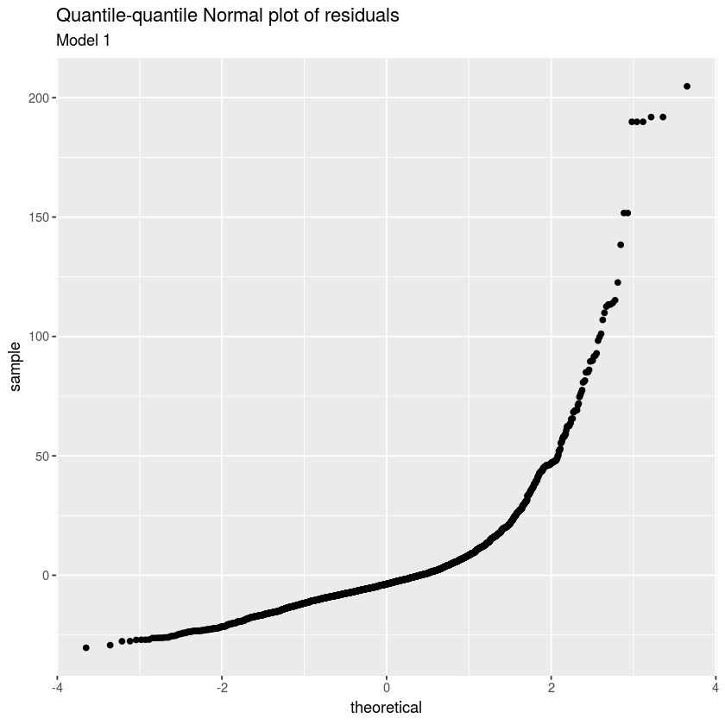
QQ-plots of Residuals
Model 1
Model 2

Slide 14
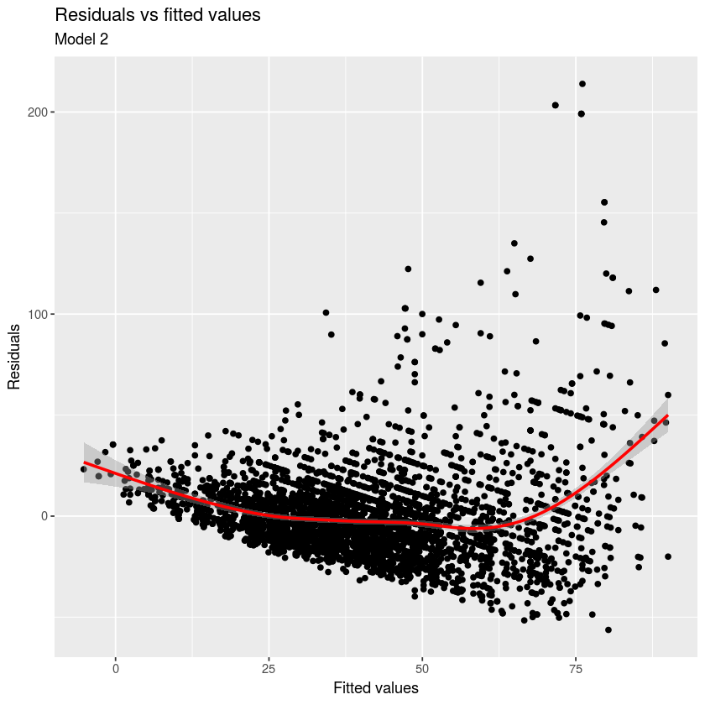
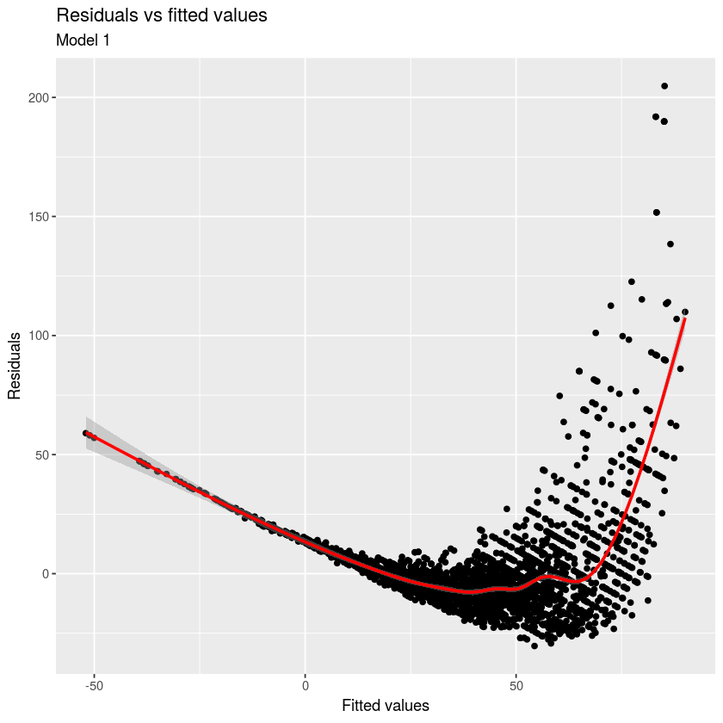
Scatterplots of Residuals vs Fitted Values
Model 1
Model 2

Slide 15
Conclusions
Features examined are statistically significant:
Province does help explain price
Paying premium for CA wines; WA least $$
You pay more for a higher wine rating
You pay more for a longer wine name, generally
However, the models do not explain all of variation in wine price, especially for most expensive wines
Notes:
-wine name length in Model 2 had negative coeff. – Model 2 may be overfit
-Model 1 had reasonable fit

Slide 16

So…Buy WA! ☺
Questions?
https://drinks.seriouseats.com/2012/12/best-budget-wine-washington-columbia-crest-chardonnay-chateau-ste-michelle-merlot.html
Template from https://www.free-power-point-templates.com/free-wines-powerpoint-template/

