Slide 1


Session 1
11th January 2024
Notes:
Keep the presentation short, PSP
Before next time to present it, update the new data for measles case and death, read all the text below the slides

Slide 2

Objectives of the session
Introduction (15 min)
R markdown (1 hours and 15 minutes)
Understand the R markdown language as tool to make routine report
Convert a basic script into a R markdown report
=> Presentation, live demo, and practice
Package sitrep (20 min)
Install of the package from Github
Explore the templates available for data analysis
=> Live demo and practice
Discussions & wrap up (15 min)
Creating a community of R users
How to improve the R sessions?
Topic for the next session

Slide 3
R markdown

Slide 4

Epidemiology and routine report
In Epidemiology we love work our “automated reports”
Weekly epi sitrep
Weekly surveillance report
Outbreak investigation report
Population estimate report
…

Slide 5
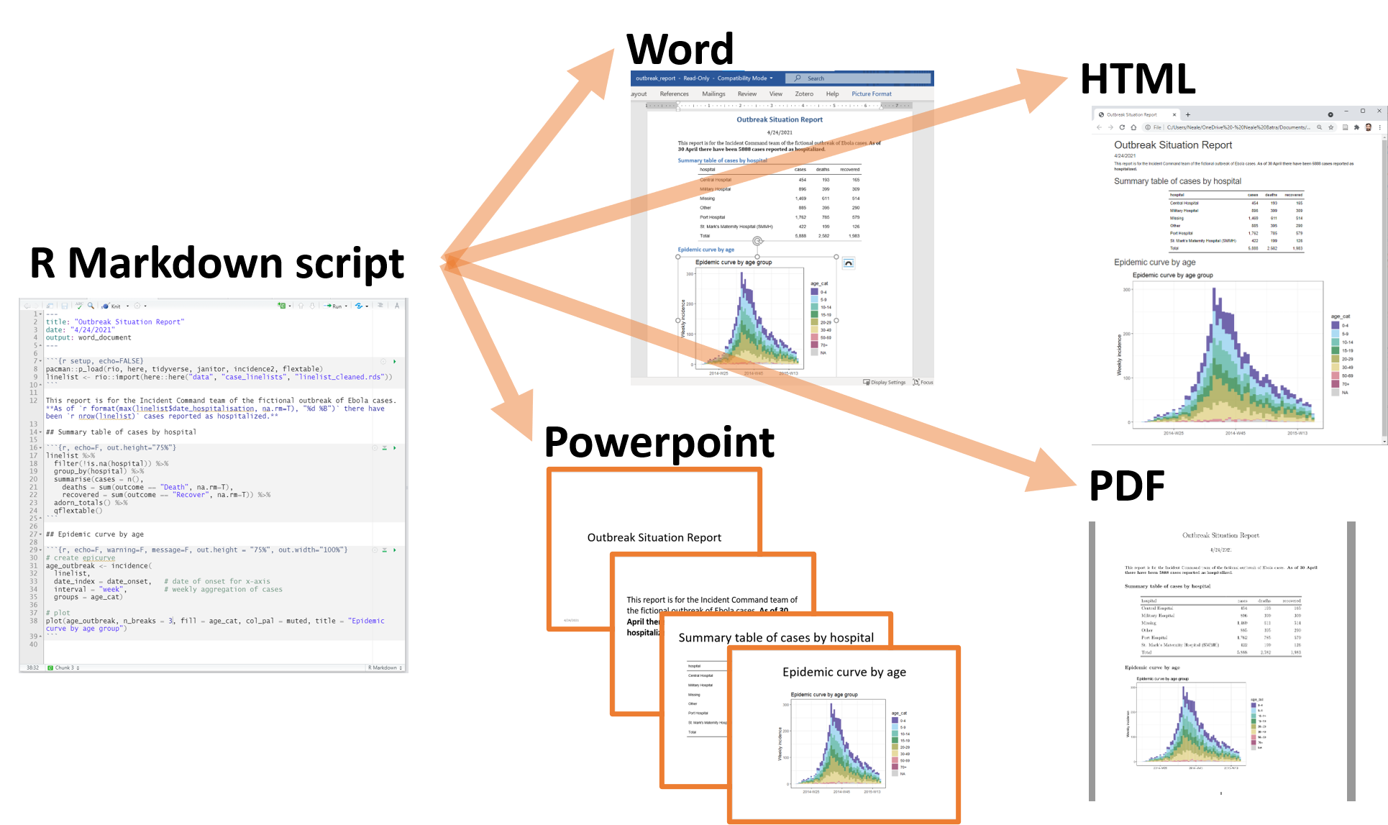

Various formats

Slide 6
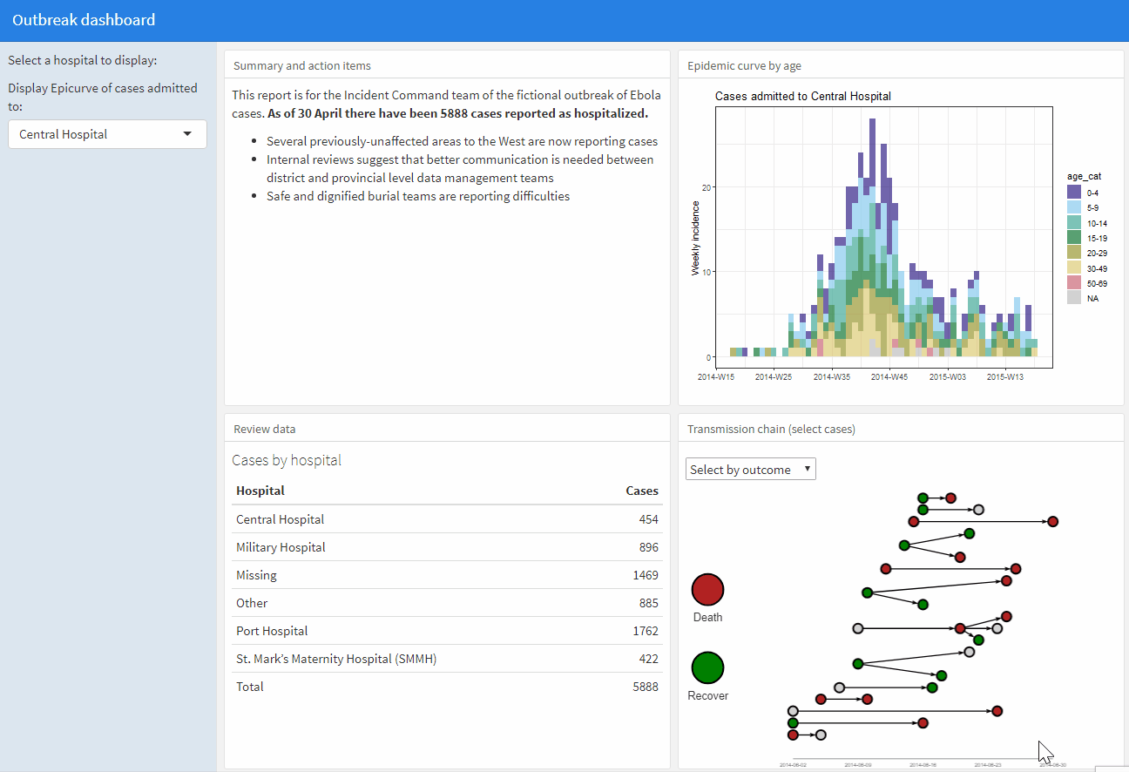
Dashboard

Slide 7

Vocabulary
Markdown: a language not specific to R that allows you to write a document using plain text, that can be converted to html and other formats
R Markdown: a variation on markdown that is specific to R (.Rmd)
{rmarkdown}: an R package to render the .Rmd file into the desired output
{knitr}: an R package that reads the code chunks and ‘knit’ them into the document
Pandoc: a software separate from R but is installed automatically with RStudio that converts the output into word/pdf/powerpoint etc.

Slide 8
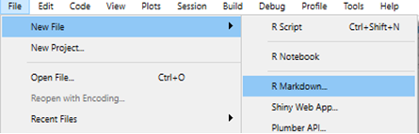
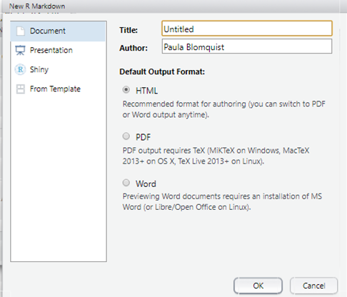
Starting a new Rmd file

Slide 9
Overview
Important things to realize
The entire script is now a document (extension is .rmd or .Rmd)
R code is placed inside code “chunks”
Between chunks, you can write as in a normal text document
But you can get bonus features
You can embed code within normal text

Slide 10
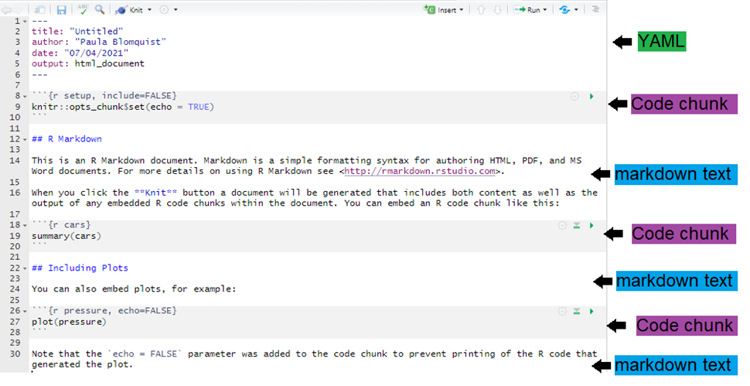
Example

Slide 11
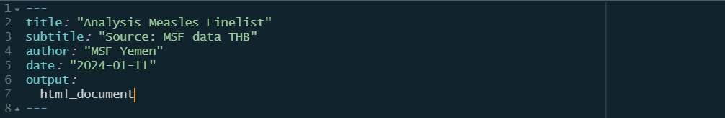
YAML Meta data
This section at the top of the documents specifies core setting for the production

Slide 12
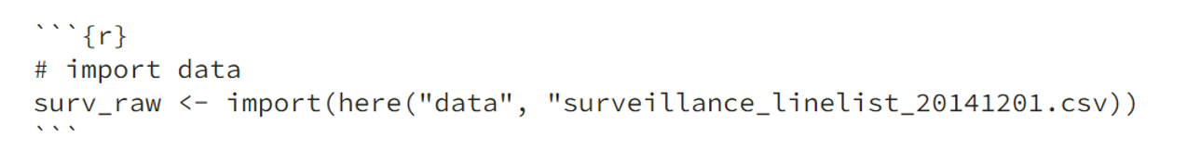
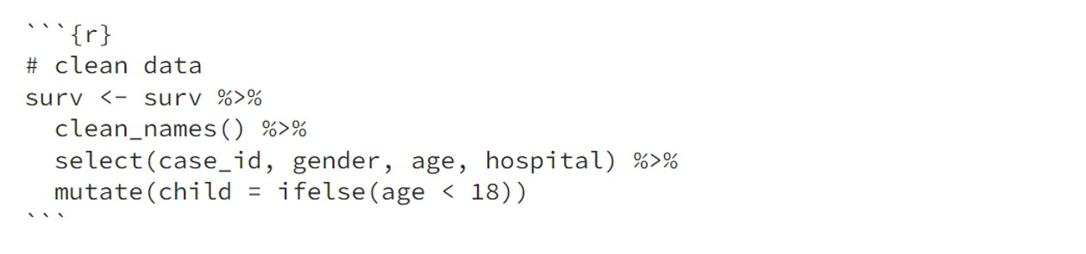
R code chunk
Sections of the script that dedicated to running R code are called “chunks”.
This is where you load packages, import data, and do the data management and create visualisations.
There may be many code chunks, so they can help you organize your R code into parts
Each chunk begins and ends with 3 back-ticks ` ` `
Here, I can write text between code chunks

Slide 13
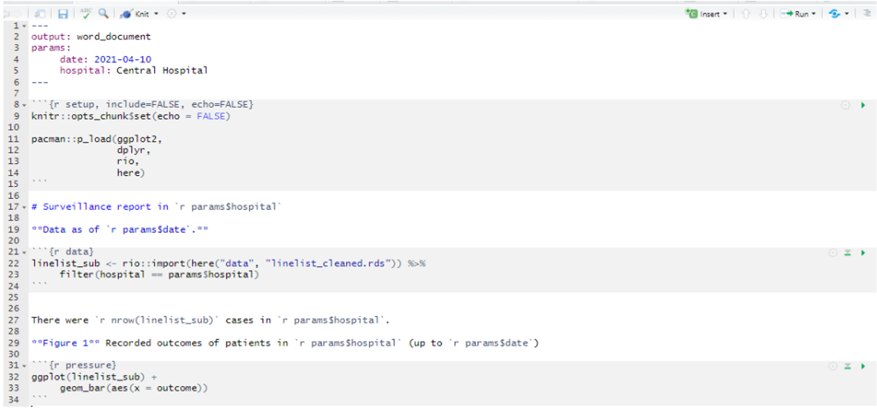
R code chunk
Sections of the script that are dedicated to running R code are called “chunks”.

Slide 14
R code chunk
At the top of each chunk, with curly brackets {}, is
The letter “r” (signifying R code)
A chunk name: optional, no space allowed, all chunk names must be different
Other options:
eval = TRUE => run the code or ignore it
echo = TRUE => display the code in the document
warning = TRUE => print R code warnings to the document
message = TRUE => print any R code messages to the document
include = TRUE => print R outputs (e.g. plots) in the document
Many other options are possible!

Slide 15
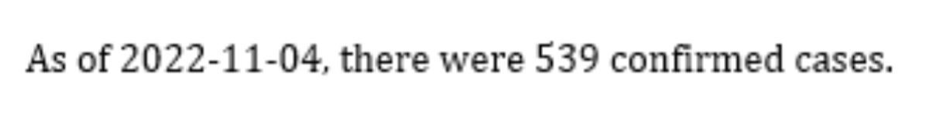
R inline
R code can be incorporated in the mardown text (outside of the chunk) within 2 back-ticks ` ` and starting with the letter r
As of `r Sys.Date()`, there were `r nrow(surv)`confirmed cases.
Produces this:

Slide 16
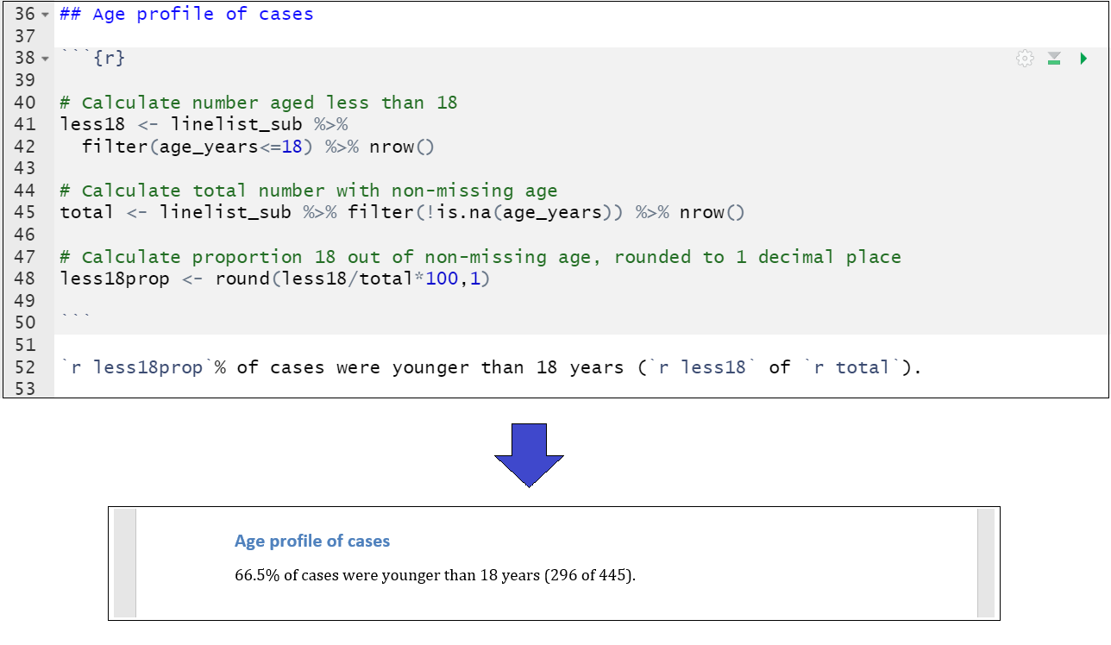
R inline

Slide 17
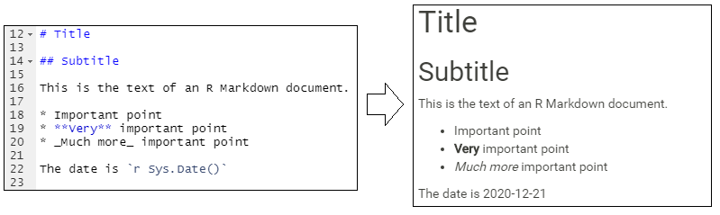
Heading and bullet
Heading are controlled with hash symbols #, ##, ###, etc
Bullet are controlled with star symbol *

Slide 18

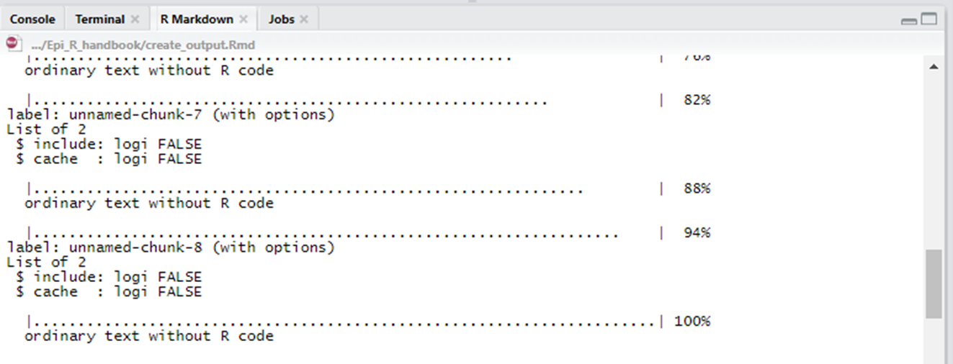
Producing the document
Press the “knit” button at the top. Use the dropdown for options
Progress will show in the “R markdown” pane (next to the R Console)

Slide 19
R markdown - Live demo
9-1_demo_script_to_rmd.R
Convert this in an automated report
demo_rmarkdown.Rmd

Slide 20
R markdown - Practice
9-1_demo_script_to_rmd.R
Convert this in an automated report
demo_rmarkdown.Rmd

Slide 21
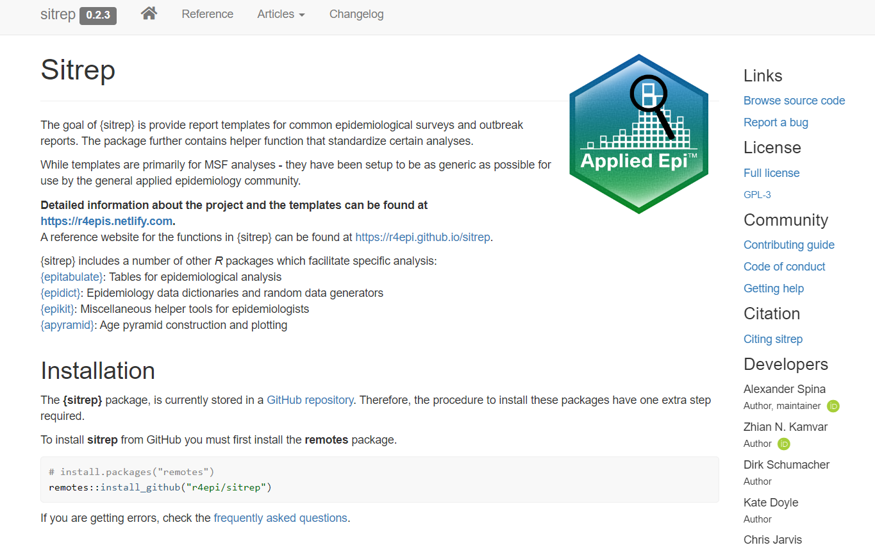
Library sitrep
Functions for epidemiological analysis
Templates
=> https://r4epi.github.io/sitrep/
install.packages("remotes")
library(remotes)
remotes::install_github("r4epi/sitrep")

Slide 22
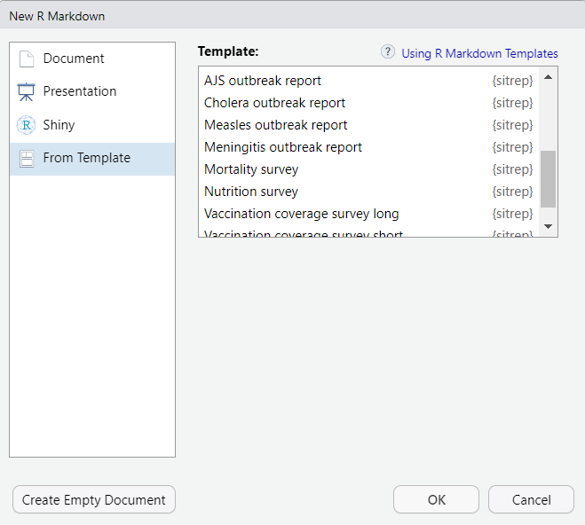
Templates
Outbreak report
Measles
Cholera
Meningitis
Survey
Mortality
Nutrition
Vaccination coverage

Slide 23

Additionnal ressources
R Markdown in the Epi R handbook
https://epirhandbook.com/en/reports-with-r-markdown.html
R Markdown Cheat Sheet
https://www.rstudio.com/wp-content/uploads/2015/02/rmarkdown-cheatsheet.pdf
Rstudio:
https://rmarkdown.rstudio.com/lesson-1.html

Slide 24
Discussion & wrap up
Creating a community of R users
How to improve the R sessions?
Topic for the next session

Slide 25


Notes:
side information:
Control focuses on humans only
The virus remains infectious in the air (or on infected surfaces) for up to 2 hours
Replication in nasopharynx and regional lymph nodes, then dissemination the whole body
Basic reproductive numbers to give an idea
Measles: 12-18
Pertussis 12-17
Smallpox 5-7 (also why eradication was possible, smaller R0= as measles)
Ebola 1.5-2.5.
Isolation for measles (p 81 in the msf book “infection control … same recommendation in “UpToDate”): Type of isolation = Airborn (aérosols) ->cohorting in the same room, no specific precaution (no gloves, no mask and no gown), duration of the illness as isolation duration, only staff health and immune person allowed in the room

