Slide 1


- Session 2 Data visualization for public health
8th February 2024
Notes:
Keep the presentation short, PSP
Before next time to present it, update the new data for measles case and death, read all the text below the slides

Slide 2

Agenda of the session
Introduction (15 min)
A few reminders data visualization with {ggplot2} (15 minutes)
Grammar of graphic
Questions/clarification from the R training?
Managing dates (20 min)
Live demo
Practice
Making epicurve (60 min)
Live demo
Practice
Session wrap-up (10 min)

Slide 3

A few reminders about the basics of data visualization with {ggplot2}

Slide 4
{ggplot2} Grammar of Graphics
Build a plot object by “adding” commands on top of one another that specify plot layers and design elements
The order of layers will usually look like this:
ggplot() => Open the plot
data => specify the dataset
mapping = aes() => select variables to plot
geom_graphic() => add geometry, the type of graphic
Modify "scales", such as a color scale or y-axis breaks
Add "theme" plot design elements such as axis labels, title, caption, fonts, text sizes, background themes, or axes rotation
Use of “+” to connect functions

Slide 5
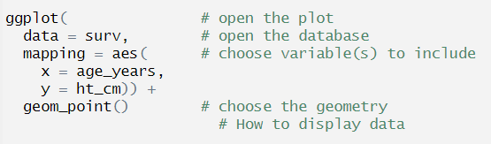
Grammar of Graphics

Slide 6
Which geometry for these graphics?
Scatter plot
Histogram
Lines plot
Bar plot
geom_point()
geom_histogram()
geom_line()
geom_bar() for linelist data
geom_col() for aggregated data

Slide 7
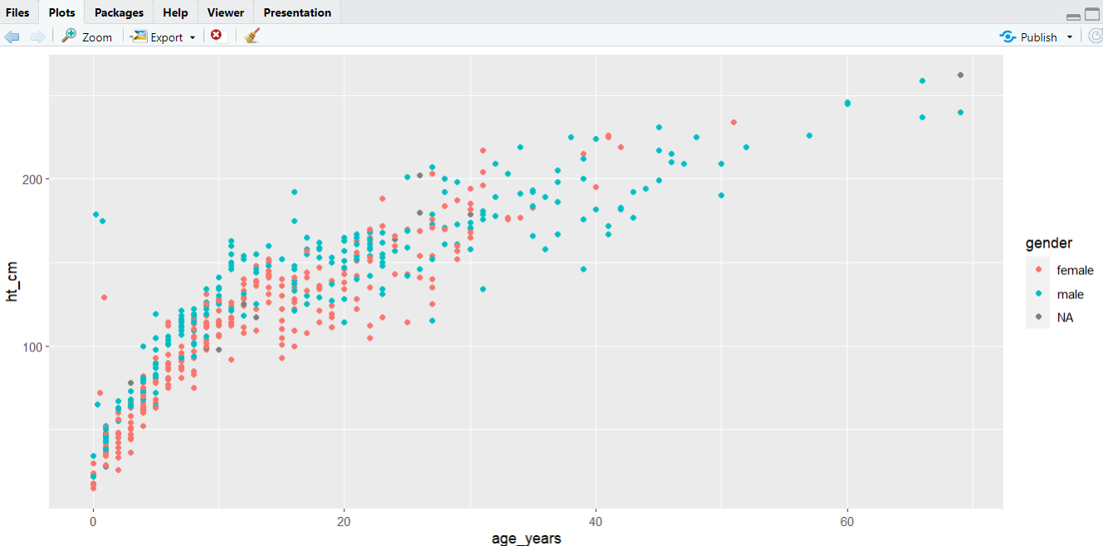
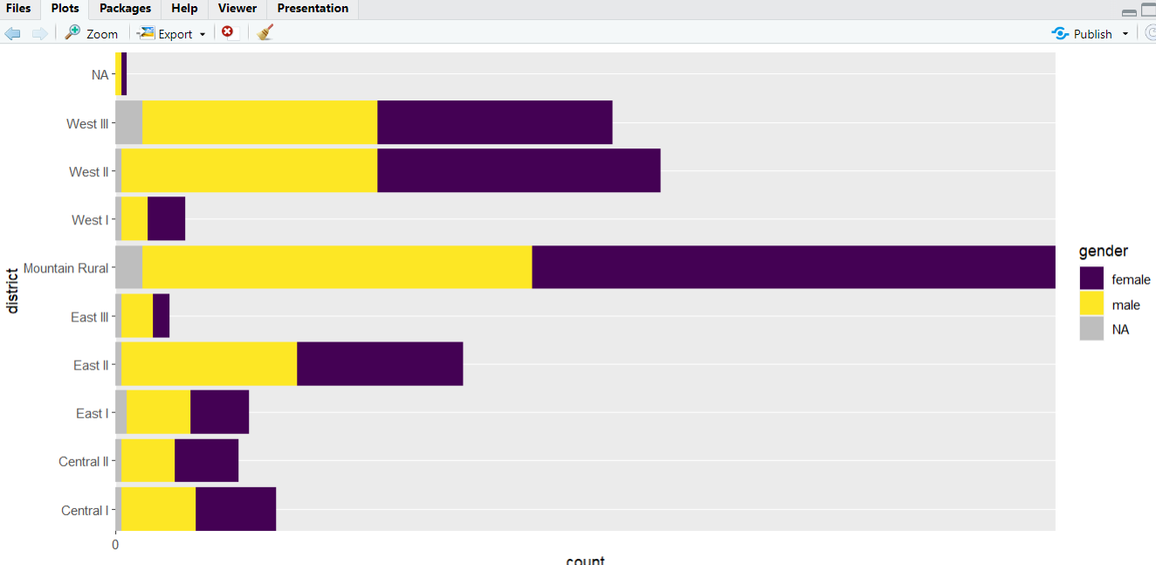

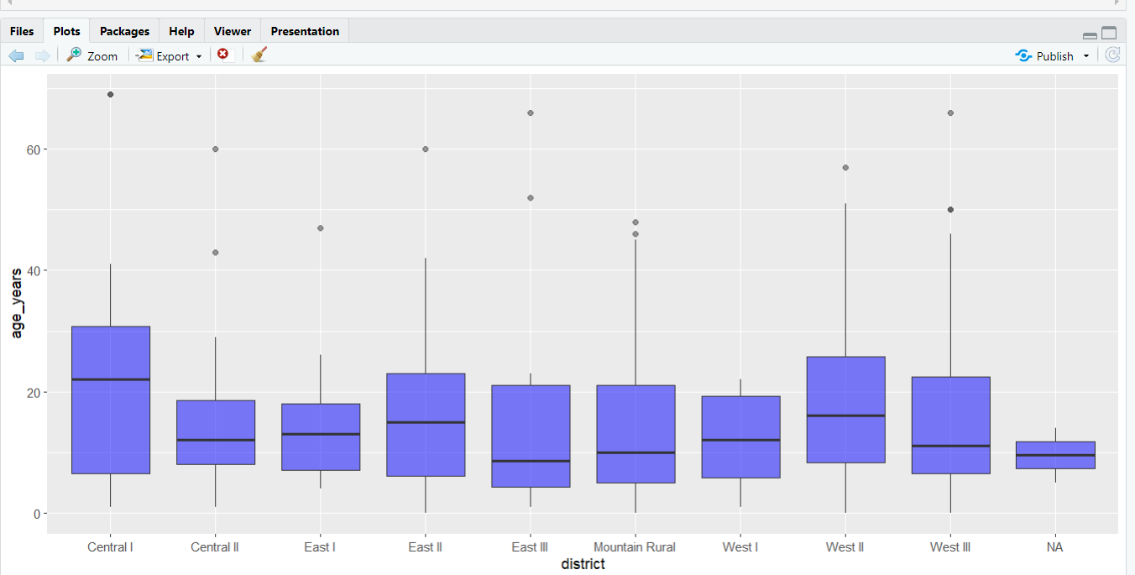
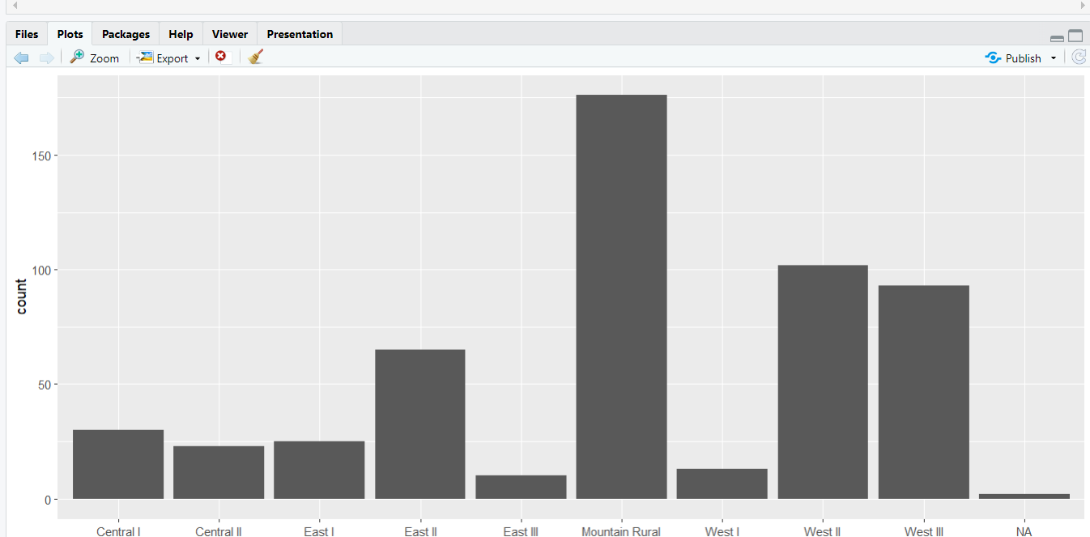
The basics of {ggplot2} - Live Demo

Slide 8
Questions?

Slide 9
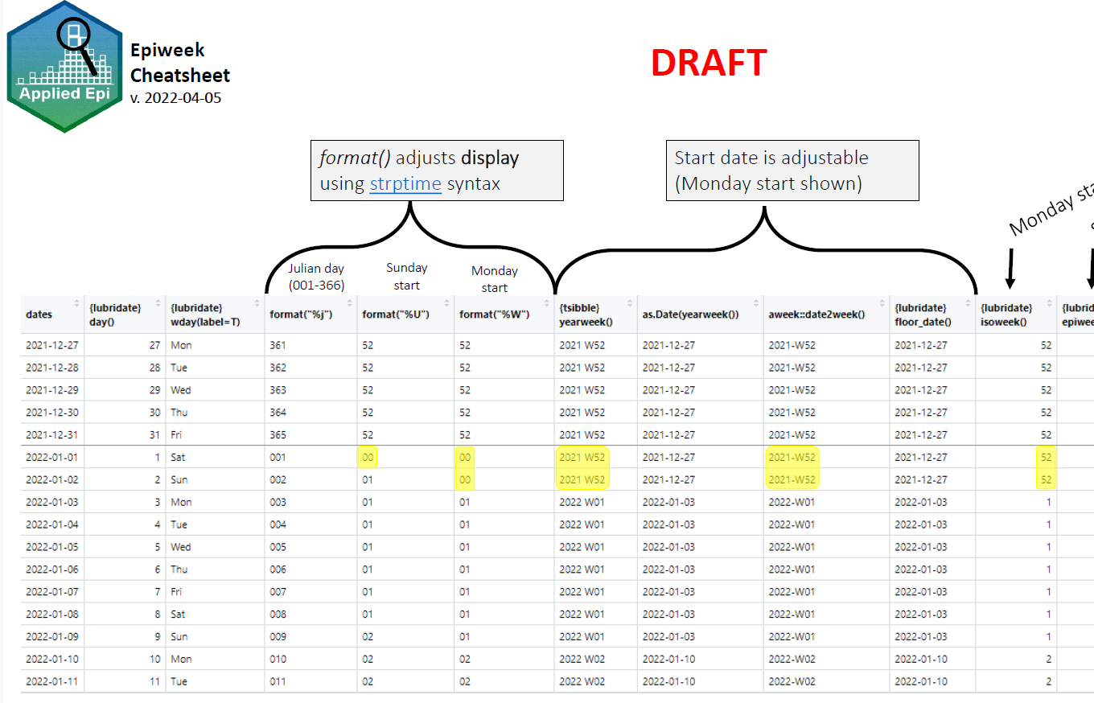
Managing dates - Live Demo

Slide 10
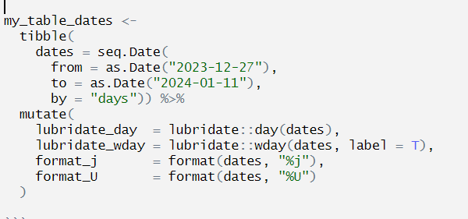
Managing dates - Practice
Exercice
Continue the table adding these functions:
format(“%W”)
tsibble::yearweek
as.Date(yearweek())
aweek::date2week
lubridate::floor_date()
lubridate::isoweek()
lubridate::epiweek()
See in the teams chat the script:
R_SESSION_2_managing_dates.R

Slide 11
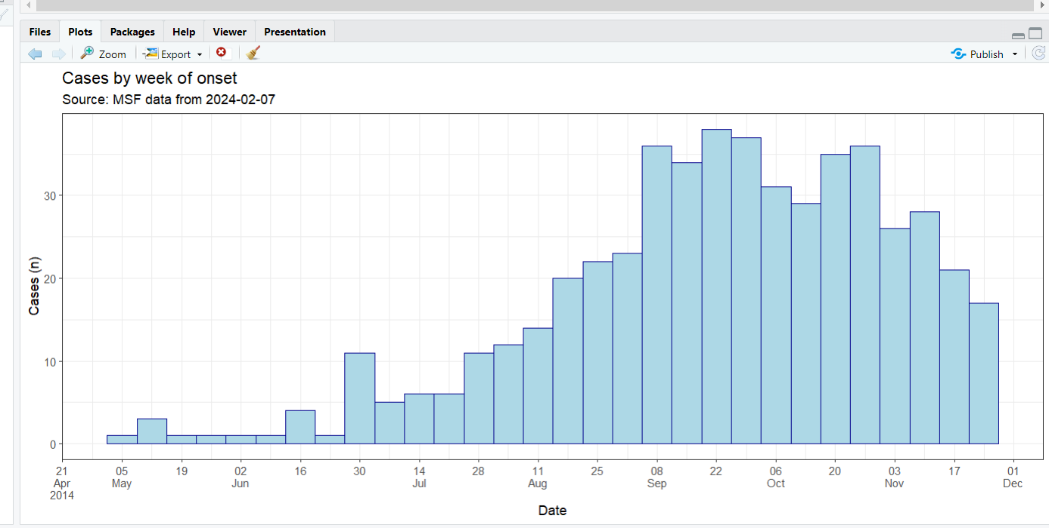
Making an Epicurve - Live Demo

Slide 12
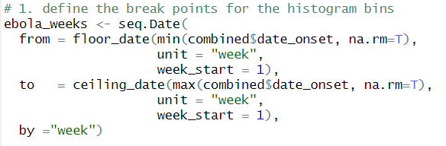
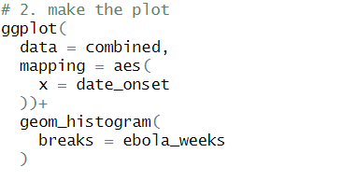
Making an Epicurve - Practice
Define the break points for the histogram bins (ebola_weeks)
seq.Date()
floor_date()
ceiling_date()
Make the basic epicurve using
ggplot()
geom_histogram()
2.1 Change the x-axis
scale_x_date()
label_date_short()
2.2 Add titles and a theme
labs()
theme_bw()
Open the script (back up folder) and create the dataset combined
7-2_ebola_after_pivoting.R

Slide 13
Discussion & wrap up
Creating a community of R users
How to improve the R sessions?
Topic for the next session

Slide 14


Notes:
side information:
Control focuses on humans only
The virus remains infectious in the air (or on infected surfaces) for up to 2 hours
Replication in nasopharynx and regional lymph nodes, then dissemination the whole body
Basic reproductive numbers to give an idea
Measles: 12-18
Pertussis 12-17
Smallpox 5-7 (also why eradication was possible, smaller R0= as measles)
Ebola 1.5-2.5.
Isolation for measles (p 81 in the msf book “infection control … same recommendation in “UpToDate”): Type of isolation = Airborn (aérosols) ->cohorting in the same room, no specific precaution (no gloves, no mask and no gown), duration of the illness as isolation duration, only staff health and immune person allowed in the room

